Slide 1
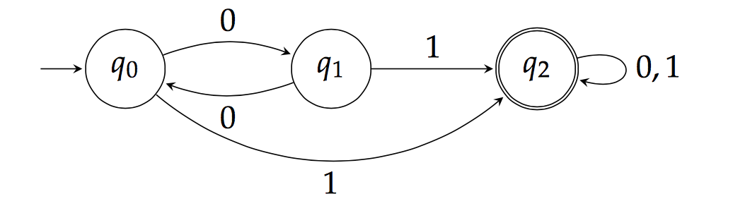
Theory of Computation Lesson 1
Deterministic Finite State Automata
Notes:
It’s the first lesson of Theory of Computation. We’re gonna say hello with Deterministic Finite State Automata. Let’s start to lesson.

Slide 2
Notes:
The transition system in this animation is called tollgate. Nowadays, instead of cash, we are opening this kind of gates with active or passive radio waves. But in our example, we're going to consider using cash. Thus, we'll learn how the cash-based tollgates worked.

Slide 3

Imagine opening the gate with 25 cents.
Each coin will now represent the letters that make up a word for us.
5 + 5 + 5 + 5 + 5 ----> AAAAA
5 + 10 + 10 ----> ABB
5 + 5 + 5 + 10 ----> AAAB
…
10 + 10 + 5 ----> BBA
25 ----> C
Now we must figure out which words should be accepted.
Notes:
Let's imagine you opened your gate with 25 cents.
In this lesson, we will learn to turn every problem into a language problem.
So every coin will now represent the letters that make up a word for us.
For example, 5 10 and 25 cent coins will turn into letters A B and C.
Now let's think mathematically about how we can open the gate.
First you can throw five times 5 cents to open the gate.
This solution is perceived by the automaton as a string with five 'A’s.
Another solution is 5 + 10 + 10. It is perceived as A B B
And so on.
Thus our problem has been transformed into a language problem. Now we must figure out which words should be accepted.

Slide 4

But we have a problem
Automaton systems have no memory!
When the user puts to machine a new coin, the system cannot remember how much coin has been thrown in total until that moment.
Therefore, the system cannot calculate how much more coins needs to be thrown to open the gate.
Notes:
But... Wait! We have a problem. You cannot use traditional programming methods here. Because automaton systems have no memory! So you cannot use variables.
When the user puts to machine a new coin, the system cannot remember how much coin has been thrown in total until that moment.
Therefore the system cannot calculate how much more coins needs to be thrown to open the gate.

Slide 5
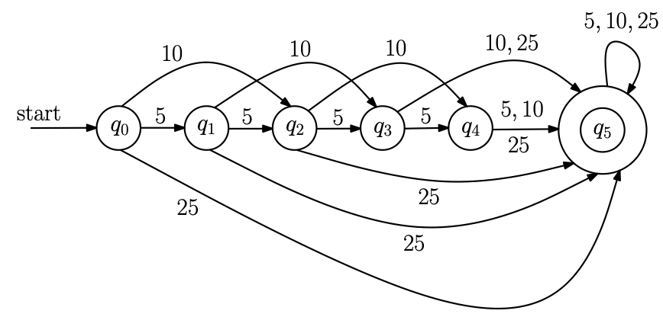
Instead of Variables
Finite State Automata use states to remember situations.
Notes:
Finite State Automata use states to remember situations instead of variables.
Here we have six circles and each circle represents a state.

Slide 6
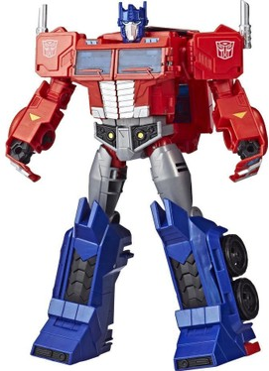
To save the world We need Transformers
If we want to solve the toll-gate problem with finite state automata, we should see the coins thrown to open the gate as letters on the keyboard.
Notes:
If we want to solve the toll-gate problem with finite state automata, we should see the coins thrown to open the gate as letters on the keyboard.

Slide 7
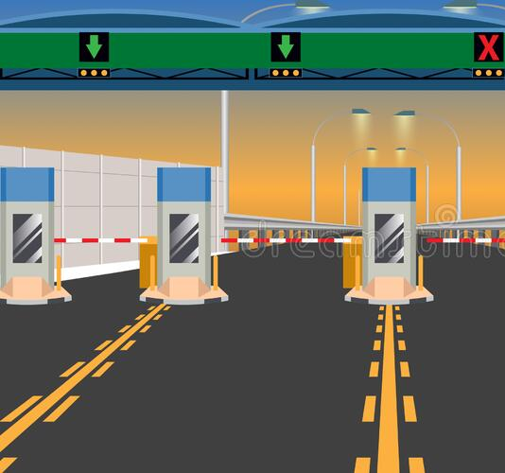
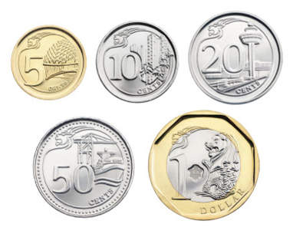

We need a Transformation
Notes:
We will design a automaton to solve toll-gate problem by transforming coins to letters.

Slide 8
States
q₀ : there is no money at the automaton yet
q₁ : we have 5 cents only
q₂ : 10 cents
q₃ : 15 cents
q₄ : 20 cents
q₅ : 25 cents
Notes:
First, we need a set of states. Each state is used to remember something.
For example in the solution of toll-gate opening with 25 cents problem Q-zero is the initial state. So we use it to remember that there is no money at the automaton yet.
Q-one shows we have 5 cents only, likewise Q-two is 10 cents. Thus you can comment Q-three and Q-four. Finally the Q-five represents 25 cents which is our target. Now we have defined the tasks of the states to use in our solution.

Slide 9






Alphabet
Since each coin the user throws will correspond to a letter, we must first define an alphabet and map which symbol each coin corresponds to.
Notes:
Second, we need an Alphabet.
Since each coin the user throws will correspond to a letter we must first define an alphabet and map which symbol each coin corresponds to.

Slide 10
Transitions
We have to represent each symbol in our alphabet as an arrow going out of each state. Like the others, there should be three edges that come out of q₀: 5, 10, and 25 cents (because of our alphabet)
Notes:
Third, we need to describe transitions among the defined states.
In fact it's easier to plan transitions once you've identified the tasks of the states. Since we're gonna write a deterministic program anyway, we have to represent each symbol in our alphabet as an arrow going out of each state. Note that we call the arrows as edges in graph theory. Like the others there should be three edges that come out of Q-zero: 5 cents 10 cents and 25 cents. We said that in our problem there are three exiting edges from each state in accordance with the alphabet but it is up to the programmer to determine which states they will lead to.

Slide 11
Start State
One of the states defined to solve the problem must be identified as Start (or initial) state.
Notes:
Fourth, we have to define where the system will start.
One of the states defined to solve the problem must be identified as Start state or in other words initial state.

Slide 12
Accept State
The states which should open the gate must be described as Accept (or final) states.
Notes:
Fifth, we need to define where the system will stop.
The states which should open the gate must be described as Accept state or in other words final state.

Slide 13
Formal Definition
We now come to the formal definition of a finite automaton.
Definition: A finite automaton is a 5-tuple M = (Q, Σ, δ, q, F) where
1. Q is a finite set, whose elements are called states, 2. Σ is a finite set, called the alphabet; the elements of Σ are called symbols,
3. δ : Q x Σ → Q, called the transition function,
4. q is an element of Q; it is called the start state, 5. F is a subset of Q; the elements of F are called accept states.
Notes:
We now come to the formal definition of a finite automaton:
Definition. A finite automaton is a 5-tuple M = Capital Q Capital sigma delta lowercase q capital F
where Capital Q is a finite set, whose elements are called states, Capital sigma is a finite set called the alphabet; the elements of sigma are called symbols,
Delta is a function defined as cartesian product of Capital Q and Capital sigma goes Capital Q called the transition function,
Lowercase q is an element of Q; it is called the start state, Capital F is a subset of Capital Q, the elements of Capital F are called accept states.
You can think of the transition function delta as being the program of the finite automaton.

Slide 14
It is your turn
Let there be a system that works with 1€ and 2€ coins. Let's represent these two coins with a (1€) and b (2€). Draw the transition diagram of the finite state automaton that does not open the door without giving at least two €2.
Notes:
It is your turn
Solve this if you can

Slide 15
A first example
A = {w : w is a binary string containing an odd number of 1s}.
Σ = {0, 1}
0000 1 0000000 1 000000 1 0000000 1 000000 1 00000
odd even odd even odd
Notes:
It’s our first example. Capital A is defined with w words so that w is a binary string containing an odd number of 1s.
Here because of the question, our alphabet will be binary. So Capital sigma includes 0 and 1 only.
Then we should find the states.
Since the question does not deal with the letter zero, we can focus on only letter one.
Each letter 1 entered by the user will change the even-odd status of the number of 1's in the typed string.

Slide 16
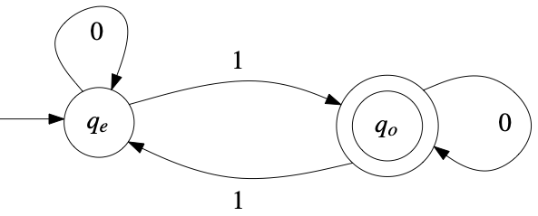
A first example
q_{e} : even number of 1s
q_{o} : odd number of 1s
Notes:
Because of the logic requested in the question, it is sufficient to define two states: q-odd and q-even. Due to the nature of the problem q-even should be defined as the initial state. As the user begins to enter symbols into the system from outside there may be a transition between states but this will depend on the problem. Here any 0 symbol entered by the user does not require any state change. But the symbol 1 causes the states to change every time. When we admit this solution to ourselves the transition diagram on the screen appears.

Slide 17
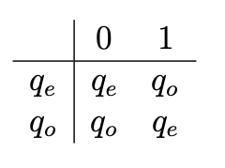
A first example
Table Method
Notes:
Just as we can use tools such as chopsticks other than forks while eating we can also design finite state automata with different tools. For now we will proceed with two tools: transition diagram and table method. In simple terms, a transition diagram is a graphical representation of the table method. In this example when the system starts up, it boots up in the q-even state and for example if the user enters a 0 symbol at that time the system understands that it must remain in the q-even state.

Slide 18
A second example
A = {w : w is a binary string containing 101 as a substring}.
Here, when we reach a “101” sequence, we accept it. This substring can be at beginning, end or middle of the string.
q : Start state, we have nothing
q₁ : The first symbol (“1”) made an alarm
q₁₀ : The second symbol (“0”) increase the alarm level
q₁₀₁ : The third symbol (“1”) accepts the string
Notes:
A second example
A = {w so that w is a binary string containing 1-0-1 as a substring}.
Here when we reach a 1-0-1 sequence we accept it. This substring can be at beginning end or middle of the string. We said that there is no memory in automata. Then we must design states that enable the system to remember these three consecutive symbols. Examine the situations below.
q is the Start state. It means we have nothing
q₁ means the first symbol letter 1 came, it made an alarm
Q ₁₋₀ means the second symbol letter 0 came. It increases the alarm level
Q₁₋₀₋₁ means the third symbol letter 1 came. The automaton must accept the string

Slide 19
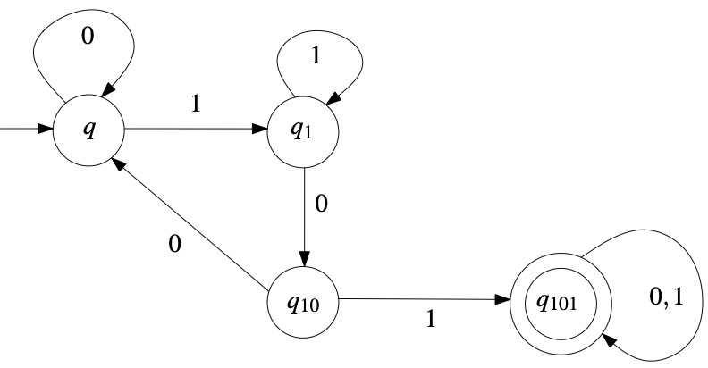
A second example
Notes:
Now it's time to plan the initial state. The first question is, what state should the initial state be? Could it be one of the situations that belong to the solution we have in mind or should we add a new situation?
After finding the answer to this question we will ask the following question. Have we planned an out-going edge labeled with each letter in the alphabet for each states of the solution we have in mind?
Where should it go if the symbol 0 appears? If symbol 1 comes up where should it go?
And the last question: In what states do we meet the conditions required by the problem? We will make the states where all conditions are met the accept state and indicate this with a double-lined circle.

Slide 20
A third example
A = {w ∈ {0,1}∗ : w has a 1 in the third position from the LEFT}
This problem is easier than the previous one. Because the first and the second letters are not important, we can think at first the third letter from the start.
{0,1} {0,1} 1 {0,1}∗
If the third one is 1, then go an accept stay and stay there, else, go a reject state and stay there.
Notes:
A third example
A = {w is element of 0-1 star so that w has a 1 in the third position from the LEFT}
This problem is easier than the previous one. Because the first and the second letters are not important, we can think at first the third letter from the start.
The first symbol can be 0 or 1. Also, the second symbol can be 0 or 1. But the the third one must be 1 only.
Then we will say this to the automaton we will design:
If a symbol 1 comes as the third letter then go an accept stay and stay there, otherwise go a reject state and stay there.

Slide 21
A third example
Here, we should think the solution directly. Thus, we draw the first four states. Then we add a last state for rejecting. So, using five states is enough.
0,1
q₁
0,1
q₂
0,1
q₃
1
q₄
0
0,1
q₅
Notes:
Here we need to remember the sequence number of the letters up to the third letter. Thus, we use at least four states to check the third symbol. Then we add a last state for rejecting. That’s all. We need five states.

Slide 22
It is your turn
A = {w ∈ {0,1}∗ : w contains an even number of 0s and 1s}
Here, we can assume that there are even numbers of 0s and 1s in the start state. Now we need four states as:
q_{ee}: even number of 0s and even numbers of 1s
q_{oe}: odd number of 0s and even numbers of 1s
q_{eo}: even number of 0s and odd numbers of 1s
q_{oo}: odd number of 0s and odd numbers of 1s
Notes:
It is your turn
A = {w is element of 0-1 star so that w contains an even number of 0s and 1s
Here we can assume that there are even numbers of 0s and 1s in the start state. Now we need four states as:
Q_{e-e}: means even number of 0s and even numbers of 1s
Q_{o-e}: means odd number of 0s and even numbers of 1s
Q_{e-o}: means even number of 0s and odd numbers of 1s
Q_{o-o}: means odd number of 0s and odd numbers of 1s
Now you can go on this solution

Slide 23
A fourth example
A = {w ∈ {0,1}∗ : w has a 1 in the third position from the right}
Here, the last three letters are important, and we need remember them all. Therefore, we need 8 different states:
Since each new symbol from the user is added to the right of the string, the state in the design may have to change
q₀₀₀ q₀₀₁ q₀₁₀ q₀₁₁ | q₁₀₀ q₁₀₁ q₁₁₀ q₁₁₁
Notes:
A fourth example
A = {w ∈ {0,1} star so that w has a 1 in the third position from the right}
Here the last three letters are important, and we need remember them all. Therefore, we need 8 different states. 8 states starting with q zero zero zero and going up to q one one.
Since each new symbol from the user is added to the right of the string, the last three letters of the string we have will change and therefore the state in the design may have to change to another state.

Slide 24
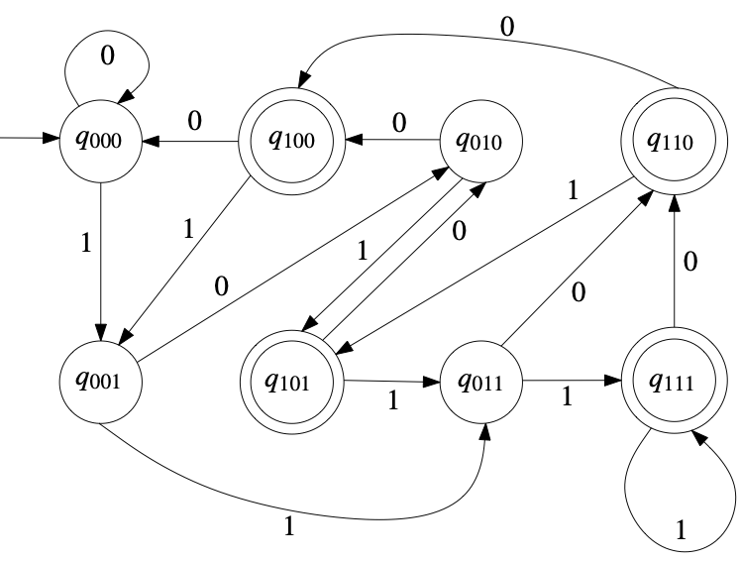
A fourth example
After determination of the states, designing the transitions will be easier.
☺
Notes:
After determination of the states, designing the transitions will be easier.
Of course for someone new to the subject this question may seem difficult at first glance. Please try to understand the transitions by checking them one by one. If you do not understand why the transitions are defined this way or if the transition diagram still seems complicated to you go back to the previous step. You can review our solution on how we determine the total number of states.

Slide 25
It is your turn
Draw the transition diagram of the finite state automaton of the regular language where both 0's and 1's are odd.
A={01, 10, 0001, 0111, 1110, 1000, 111000,…}
Notes:
It is your turn
Solve this if you can

Slide 26
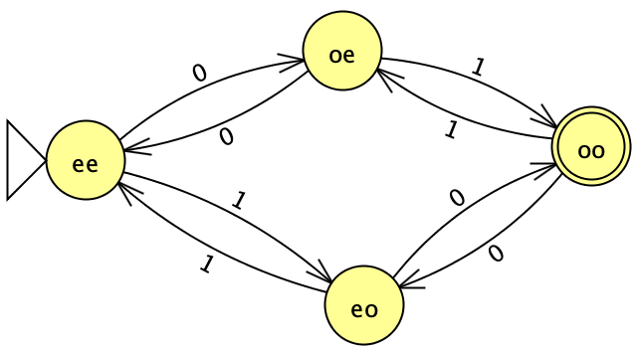

Solution

Slide 27
That’s all.
Thanks for listening.
Notes:
That’s all.
Thanks for listening.

