Slide 1
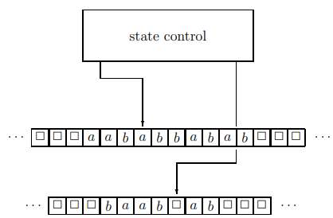
Theory of Computation Lesson 10
Turing Machines
Notes:
This is lesson ten in Theory of Computation. We start to the new chapter called as Turing Machines. In this lesson, we will learn Turing Machines.

Slide 2
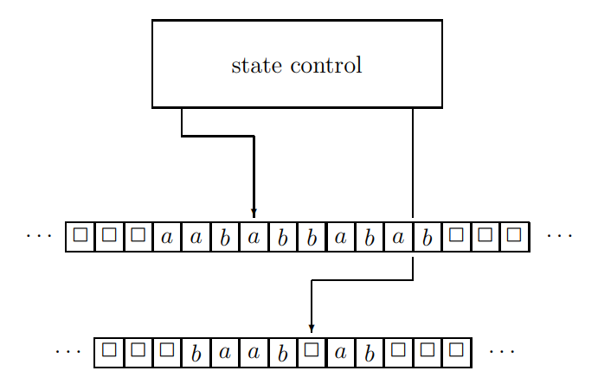
Turing Machines
Notes:
Turing machines were invented by Alan Turing in 1936. He proved that any mathematical problem imaginable can be solved using such a machine, if it can be represented by an algorithm.

Slide 3
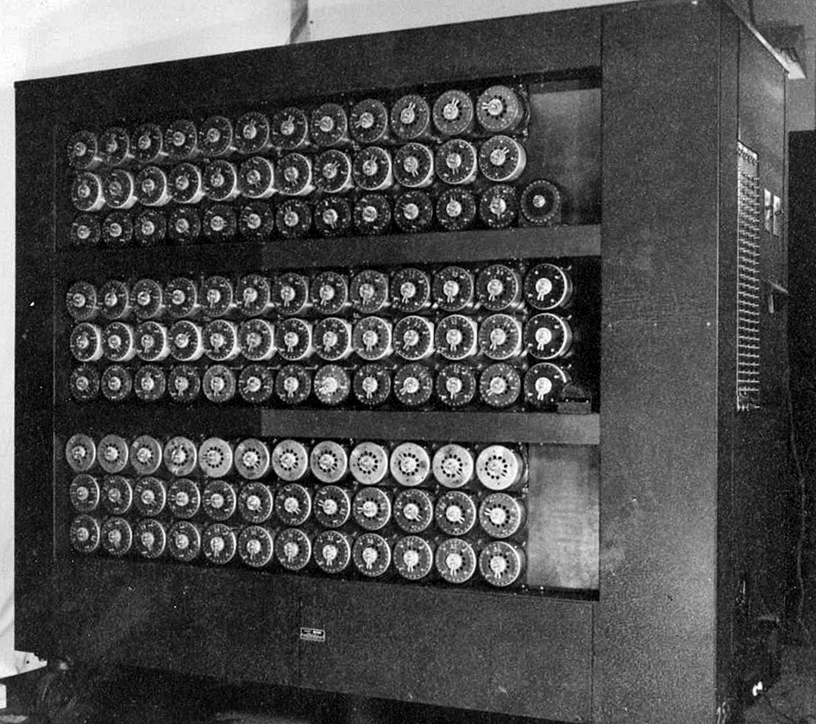
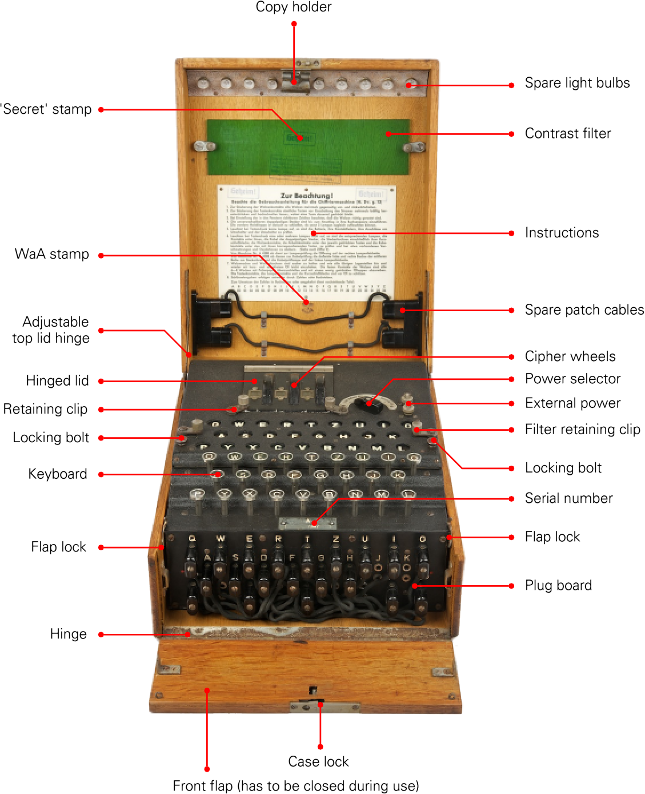
Turing Machines
ENIGMA
Turing Bombe, 1940
Notes:
The whole world then got to know Alan Turing better with the Bombe machine in 1940 that cracked the Enigma codes.

Slide 4
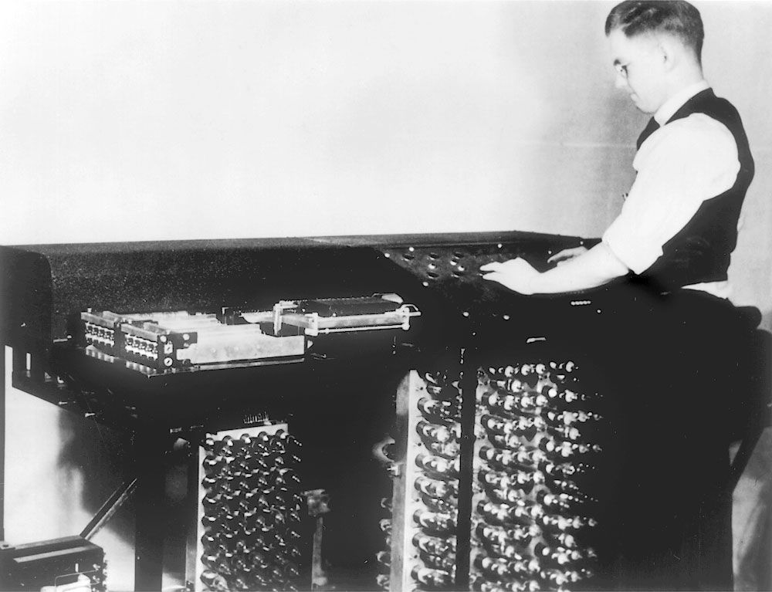
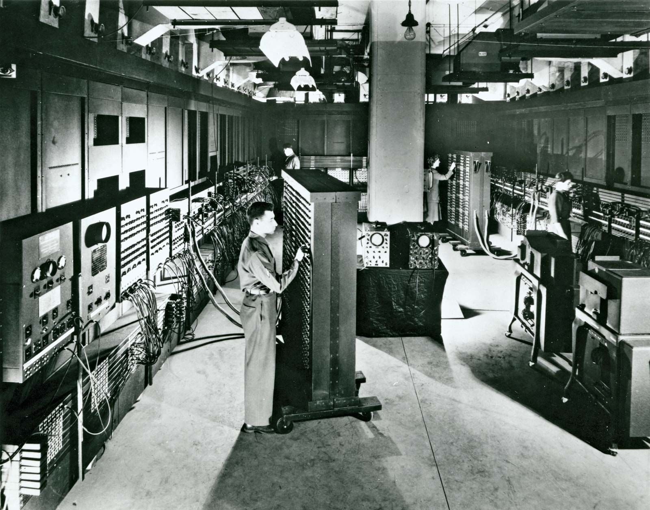
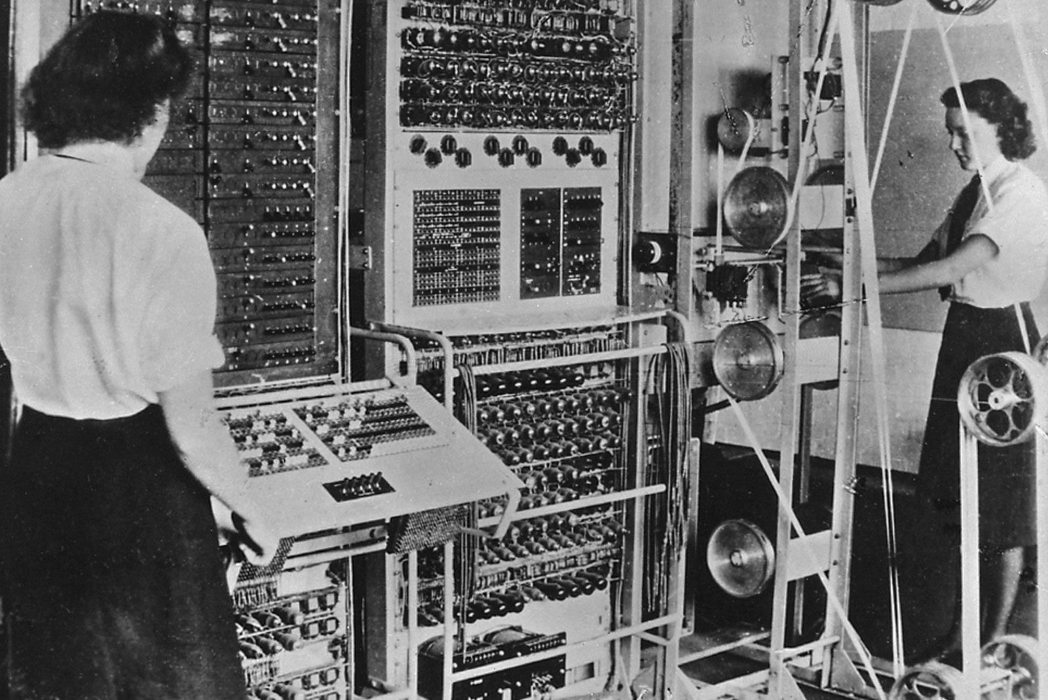
Turing Machines
ABC computer, 1942
ENIAC, 1946
COLOSSUS computer, 1943
Notes:
Thanks to this experience, programmable electrical machines began to appear. While devices such as the ABC in 1942 and the Colossus in 1943 were exciting, the ENIAC completed in 1946 is considered the first digital computer. Therefore, we can say that the idea of Turing Machines actually played the most important role in the theoretical formation of today's computers.

Slide 5
Turing Machines
Although Turing machines are similar to finite automata, because of infinite length writable tape, have the advantage of unlimited memory.
Notes:
Let's start by getting to know the Turing Machines, which form the basis of the computers we use today.
A Turing machine is an abstract computational model that performs computations by reading and writing to an infinite tape. It provides a powerful computational model for solving problems in computer science and testing the limits of computation.
Although Turing machines are similar to finite automata, because of infinite length writable tape, have the advantage of unlimited memory.

Slide 6
Turing Machines
1. There are k tapes, k ≥ 1. Each tape has infinite cells. Each cell stores a symbol belonging to a finite set Γ. If a cell contains #, then this means that the cell is actually empty.
Notes:
Just like Pushdown Automata, Turing Machines have some parts. Let's start by getting to know them. First, we should talk about infinite-length tapes. We have k tapes. Here k is greater than or equal to 1.
Each tape is divided into cells, and is infinite both to the left and to the right. Each cell stores a symbol belonging to a finite set gamma, which is called the tape alphabet. The tape alphabet contains the blank symbol. If a cell contains blank symbol, then this means that the cell is actually empty.

Slide 7
Turing Machines
2. Each tape has a tape head which can move along the tape, one cell per move. It can also read the cell it currently scans and replace the symbol in this cell by another symbol.
Notes:
The second, Each tape has a tape head which can move along the tape, one cell per move. It can also read the cell it currently scans and replace the symbol in this cell by another symbol.

Slide 8
Turing Machines
3. There is a state control, which can be in any one of a finite number of states. The finite set of states is denoted by Q. The set Q contains three special states: a start state, an accept state, and a reject state.
Notes:
The third, There is a state control, which can be in any one of a finite number of states. The finite set of states is denoted by capital Q. The set capital Q contains three special states: a start state, an accept state, and a reject state.

Slide 9
Formal Definition
A deterministic Turing machine is a 7-tuple
M = (Σ, Γ, Q, δ, q, q_{accept}, q_{reject}), where
Σ is a finite set, called the input alphabet; the blank symbol # is not contained in Σ,
Γ is a finite set, called the tape alphabet; this alphabet contains the blank symbol #,
Q is a finite set, whose elements are called states,
q, q_{accept}, q_{reject} are the start, accept, reject states.
δ is called the transition function, which is a function
Q × Γ^{k} → Q × Γ^{k} × {L, N, R} ^{k}
Notes:
Formal Definition of Turing Machine
A deterministic Turing Machine is a 7-tuple, capital M = sigma, gamma, capital Q, delta, lowercase q, lowercase q accept, and lowercase q reject), where
sigma is a finite set, called the input alphabet; the blank symbol is not contained in sigma,
Gamma is a finite set, called the tape alphabet; this alphabet contains the blank symbol,
Capital Q is a finite set, whose elements are called states,
Lowercase q is an element of capital Q; it is called the start state,
Lowercase q accept is an element of capital Q; it is called the accept state,
Lowercase q reject is an element of capital Q; it is called the reject state,
Delta is called the transition function, which is a function
Capital Q Cartesian product, gamma to the k goes to, capital Q Cartesian product, Gamma to the k Cartesian product, L, N, or R to the k

Slide 10
A Sample Delta Rule
qa → q#R
When we focus on the states here, we will see that the state has not changed. Thus, we can read it as 'stay in the same state'.
states
Notes:
For easy understanding, we will first give an example delta rule.
When we focus on the states here, we will see that the state has not changed. Thus, we can read it as 'stay in the same state'.

Slide 11
A Sample Delta Rule
qa → q#R
When the tape head reads a symbol ‘a’ from the tape, the tape head must delete it.
tape
Notes:
Then, we can focus at the second letters on the rule. The second letter is a symbol-a on the left. It means that if the tape head read this symbol.
The second letter on the right is a blank-symbol. This means, 'delete symbol-a by writing a blank symbol on it'. Now we can read the rule as
when the tape head reads a symbol-a from the tape in the state q, the tape head must delete it by staying in the same state.

Slide 12
A Sample Delta Rule
qa → q#R
On the right hand-side, there is a capital R symbol. We can understand that 'tape head must move to the right'.
tape head action
Notes:
And last, the third part of the rule is read. On the right hand-side, there is a capital R symbol. We can understand that 'tape head must move to the right'.

Slide 13
A Sample Delta Rule
qab → q#bRN
When the state controller is in the state q, if the first tape head reads a symbol a and the second tape head shows a symbol b,
Notes:
If the system uses two tapes, one sample can seen like this rule. When the state controller is in the state q, if the first tape head reads a symbol a and the second tape head shows a symbol b,

Slide 14
A Sample Delta Rule
qab → q#bRN
Then stay in the same state,
In the first tape, delete the symbol by moving right,
In the second tape, do not change tape symbol and not move.
Notes:
then stay in the same state,
in the first tape, delete the symbol by moving right,
in the second tape, do not change tape symbol and not move.

Slide 15

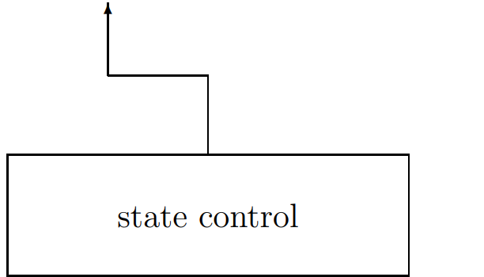
Start Configuration of TM
The input is a string over the input alphabet Σ. Initially, this input string is stored on the first tape, and the head of this tape is on the leftmost symbol of the input string. Initially, all other k − 1 tapes are empty, i.e., only contain blank symbols, and the Turing machine is in the start state q.
Notes:
The input is a string over the input alphabet sigma. Initially, this input string is stored on the first tape, and the head of this tape is on the leftmost symbol of the input string. Initially, all other k − 1 tapes are empty, i.e., only contain blank symbols, and the Turing machine is in the start state q.

Slide 16
Execution of TM
Starting in the start configuration, the Turing machine performs a sequence of computation steps as described before. The computation terminates at the moment when the Turing machine enters q_{accept} or q_{reject}.
Notes:
Starting in the start configuration, the Turing machine performs a sequence of computation steps as described before. The computation terminates at the moment when the Turing machine enters the accept state q-accept or the reject state q-reject. Hence, if the Turing machine never enters these two states, the computation does not terminate.

Slide 17
Acceptance of TM
If the computation on the input string terminates in q_{accept}, the Turing machine M accepts this input. If the computation on this input terminates in q_{reject}, then M rejects the input string.
Notes:
If the computation on the input string terminates in the accept state, the Turing machine M accepts this input. If the computation on this input terminates in the reject state, then M rejects the input string.

Slide 18
Example 1: Palindromes using one tape
Notes:
In this example, we will show how to construct a Turing machine with one tape, that decides whether or not any input string is a palindrome. Recall that a string is called a palindrome, if reading it from left to right gives the same result as reading it from right to left. The tape contains the input string, the tape head is on the leftmost symbol of the string, and the Turing machine is in the start state q0. The main algorithm is that, the first, the tape head reads the leftmost symbol of the string, deletes this symbol and “remembers” it by means of a state, let say q prime a. Then the tape head moves to the rightmost symbol and tests whether it is equal to the leftmost symbol using the remembered state. If they are not equal, the Turing machine enters the reject state, and the computation terminates. If they are equal, then the rightmost symbol is deleted, the tape head moves to the new leftmost symbol, and the whole process is repeated. The Turing machine enters the accept state as soon as the string currently stored on the tape is empty.

Slide 19
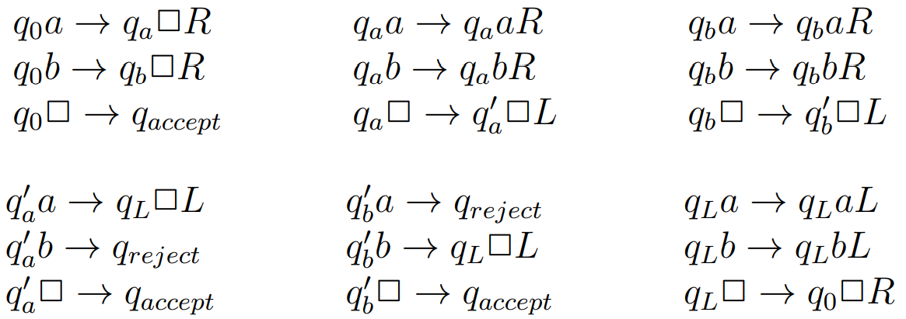
Example 1: Palindromes using one tape
Notes:
In the animation, a four-letter palindrome given as a-b-b-a is studied. Since we have only one tape on which the string is also given, we also have to use the tape as a memory. In this way, problems that need to be solved with one tape have more states and therefore longer code than multi-tape solutions. Soon we will solve the same problem with two tapes.

Slide 20
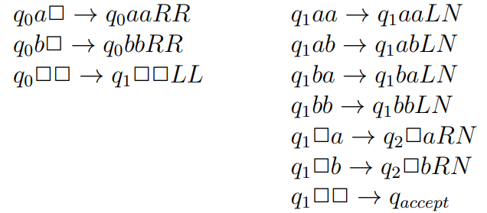
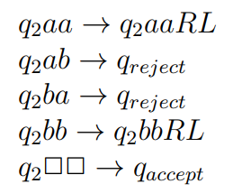
Example 2: Palindromes using two tapes
Notes:
We again consider the palindrome problem, but now we use a Turing machine with two tapes.
The first tape contains the input string and the head of the first tape is on the leftmost symbol. The second tape is empty and its tape head is at an arbitrary position. The Turing machine is in the start state.
First, the input string is copied to the second tape. Then the head of the first tape moves back to the leftmost symbol of w, while the head of the second tape stays at the rightmost symbol. Finally, the actual test starts. The head of the first tape moves to the right and, at the same time, the head of the second tape moves to the left. While moving, the Turing machine tests whether the two tape heads read the same symbol in each step.

Slide 21
That’s all.
Thanks for listening.
Notes:
That’s all.
Thanks for listening.

