Slide 1
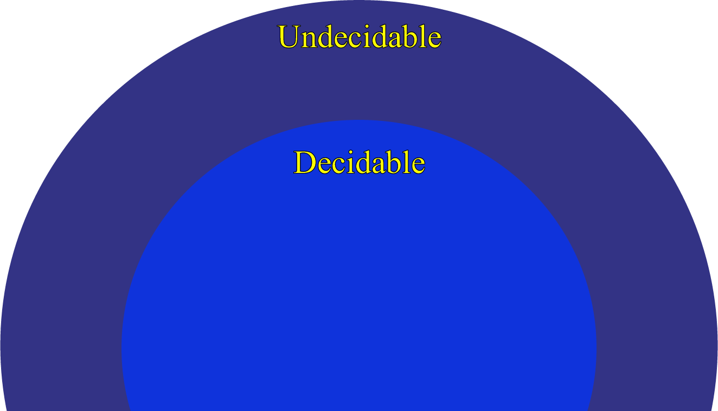
Theory of Computation Lesson 11
Decidable & Undecidable Languages
Notes:
This is the lesson eleven in Theory of Computation. We start to the new chapter. In this lesson, we will learn Decidable & Un-decidable Languages.

Slide 2
Decidability
The main titles you will hear within the scope of this chapter are as follows:
Decidable Languages
Enumerable Languages
Undecidable Languages
In some sources, the terms Recursively Enumerable or Turing Recognizable is used instead of Enumerable. Don't be confused, they all represent the same thing.
Notes:
The main titles you will hear within the scope of this chapter are as follows:
The first, Decidable Languages
The second, E-numerable Languages
The third, Un-decidable Languages
In some resources, the terms Recursively E-numerable or Turing Recognizable is used instead of E-numerable. Don't be confused, they all represent the same thing.

Slide 3
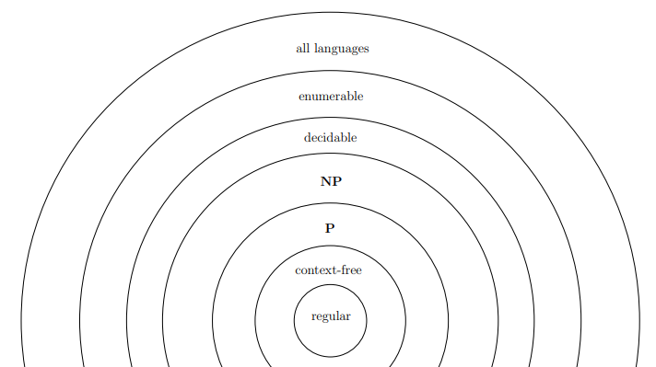
Decidability
Undecidable Languages
Decidable Languages
Notes:
The representation of the tools we learned in this course in terms of decidability is shown in the figure. In short, all problems that are not decidable are called un-decidable. But some of the un-decidable languages are treated as recursively e-numerable. This is conceptually important.

Slide 4
Decidable Languages
On a word entered for testing L-language, a Turing Machine (TM) can do one of following:
stops and accepts,
stops and rejects,
or cannot stop.
If a TM prepared for an L-language guarantees to stop by making a decision of accept or reject on every word entered by a user, then the L-language is called Decidable Language.
Notes:
On a word entered for testing L-language, a Turing Machine can do one of following:
it stops and accepts,
it stops and rejects,
or it cannot stop.
Although we are not dealing with a machine that does not stop in the chapter of Turing machines, you have experienced this in the Pushdown Automata examples. So you can predict that any Turing Machine can also go into an infinite loop. Now we will talk about the formal definitions of the term Decidability on machines which can stop or not stop.
If a Turing Machine prepared for an L-language guarantees to stop by making a decision of accept or reject on every word entered by a user, then the L-language is called Decidable Language.

Slide 5
Enumerable (Recognizable) Languages
L-language is called recursively enumerable or Turing recognizable, if a Turing Machine prepared for L
stops by accepting words that are elements of L-language,
but cannot guarantee stopping on words that are not elements (sometimes rejecting but sometimes not terminating)
Notes:
Recursively e-numerable or Turing recognizable languages are a bit different from decidable ones.
L-language is called recursively e-numerable or Turing recognizable, if a Turing Machine prepared for L
stops by accepting words that are elements of L-language,
but cannot guarantee stopping on words that are not elements (sometimes rejecting but sometimes not terminating)

Slide 6
Undecidable Languages
If a Turing Machine cannot terminate on L-language, in other words neither
If any TM cannot guarantee terminate in words that are elements of the language,
If any TM cannot guarantee stopping on words that are not elements of the language,
That L-language is called as Undecidable.
Notes:
If a Turing Machine cannot terminate on L-language, in other words neither
If any Turing Machine cannot guarantee terminate in words that are elements of the language,
or, If any Turing Machine cannot guarantee stopping on words that are not elements of the language,
that L-language is called as Un-decidable.

Slide 7
A_{DFA} Language with TM
We can implement any DFA language on JFLAP, and the code can decide a word is element of that language or not. We can be sure that our code will terminate absolutely. Because we know that, there is no loop-forever in DFA. It has states and each state means accept or reject.
DFA language is decidable.
Notes:
Remember, we started this lesson by learning Deterministic Finite State Automata, namely DFA. We will now interpret the state of the DFA in the Turing Machine.
We can implement any DFA language on JFLAP to represent the Turing Machine, and the code can decide a word is element of that language or not. We can be sure that our code will terminate absolutely. Because we know that, there is no loop-forever in DFA. It has states and each state means accept or reject.
For this reason we can say DFA language is decidable.

Slide 8
A_{NFA} Language with TM
We learned that DFA and NFA are equivalent to each other. With this information alone, you can interpret that, if DFA is decidable, then NFA must be decidable too. Because every NFA can be transformed into a DFA, we can prove this theoretically.
NFA language is decidable.
Notes:
We learned that DFA and NFA are equivalent to each other. With this information alone, you can interpret that, if DFA is decidable, then NFA must be decidable too.
You are right. Because every NFA can be transformed into a DFA, we can prove this theoretically.
As a result, NFA language is decidable.

Slide 9
A_{CFG} Language with TM
In order to find out if it is decidable, we can consider Chomsky normal form. If we transform a CFG into Chomsky normal form, for a word with n length, it is guaranteed that it terminates in 2n-1 steps. Thus, we have proved the following result:
CFG language is decidable.
Notes:
Now, we can look at Context Free Grammar language. Remember, there can be some loop-forever structures in this language. But Chomsky normal form could prevent this situation.
In order to find out if it is decidable, we can consider Chomsky normal form. If we transform a Context Free Grammar into Chomsky normal form, for a word with n length, it is guaranteed that it terminates in 2 n minus 1 steps.
Thus, we have proved the following result: Context Free Grammar language is decidable.

Slide 10
A_{TM} Language with TM
We can start by considering the JFLAP implementation again. When a code written with a TM is loaded into JFLAP,
Can JFLAP detect that the code has an infinite-loop?
Can JFLAP guarantee terminating on every TM code?
Notes:
Now we're starting to look at really hard problems. We can start by considering the JFLAP implementation again. When a code written with a Turing Machine is loaded into JFLAP, can JFLAP detect that the code has an infinite-loop?
Or we can ask the question as follows. Can JFLAP guarantee terminating on every Turing Machine code?

Slide 11
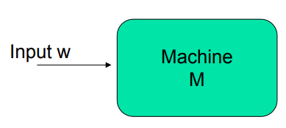
A_{TM} Language with TM
We assume that A_{TM} is decidable. Then there exists a Turing machine H that has the following property. For every input string <M, w> for H:
If <M, w> ∈ A_{TM} (i.e., M accepts w), then H terminates in its accept state.
If <M, w> ∉ A_{TM} (i.e., M rejects w or M does not terminate on input w), then H terminates in its reject state.
H .
Notes:
Now, We assume that A-TM is decidable. With this assumption, there exists a Turing machine H that has the following property. For every input string M comma w for H:
If M comma w is element of A-TM, then H terminates in its accept state.
If M comma w is not element of A-TM, then H terminates in its reject state.
Here, You can think of H as JFLAP and M is just another Turing machine code to run on a word. If M can terminate on w word with accept, H will also accept, otherwise H will reject.

Slide 12
A_{TM} Language with TM
We create a new Turing machine D to run on <M>. You can think of D as a compiler and M is just another TM code to run on D. The D compiler is executed as follows:
Run the Turing machine H on the input <M,<M>>.
If H terminates in its accept state, then D terminates in its reject state.
If H terminates in its reject state, then D terminates in its accept state.
Notes:
We create a new Turing machine D to run on M. You can think of D as a compiler and M is just another Turing machine code to run on D. The D compiler is executed as follows:
Run the Turing machine H on the input M comma M. Here we are sure that H terminates. For this reason, we don't write any situation about H not stopping in D codes.
Then D decides by considering the result of H.
If H terminates in its accept state, then D terminates in its reject state.
If H terminates in its reject state, then D terminates in its accept state.

Slide 13
A_{TM} Language with TM
Assume that we load D itself as code into the D compiler again. The D compiler was already testing the loaded code by sending its own codes as strings via H. So there is a contradiction here.
If D accepts <D>, then H terminates in its accept state, thus D rejects <D>.
If D rejects <D> or does not terminate, then H terminates in its reject state, thus D accepts <D>.
Notes:
Now we can test it. Imagine that we load D itself as code into the D compiler again. Already the D compiler was testing the loaded code by sending its own codes as strings via H. So there is a conflict here. This is the part you will struggle to understand.
If program D could accept its own codes as strings and stop, then program H would still accept D codes on the D string. But this time, the D compiler, which indirectly refers to the H compiler, will say that the D program rejects the D string, relying on H's decision when making a decision. There seems to be something wrong. Now let's consider the opposite.
If program D rejected its own codes as strings or could not stop, program H would still reject D codes on the D string. The D compiler, relying on the H compiler, will also say, "The D program accepts the D string". Again, there is a contradiction. Therefore, it would not be correct to say that the A-TM language is decidable.

Slide 14
A_{TM} Language with TM
D .
H .
D .
<D>
<D>
If D accepts <D>, then H terminates in its accept state, thus D rejects <D>.
If D rejects <D> or does not terminate, then H terminates in its reject state, thus D accepts <D>.
Notes:
We create a new Turing machine D to run on M. You can think of D as a compiler and M is just another Turing machine code to run on D. The D compiler is executed as follows:
Run the Turing machine H on the input M comma M. Here we are sure that H terminates. For this reason, we don't write any situation about H not stopping in D codes.
Then D decides by considering the result of H.
If H terminates in its accept state, then D terminates in its reject state.
If H terminates in its reject state, then D terminates in its accept state.

Slide 15
Halting Problem
Based on the Church-Turing thesis, we can say that the same problem can occur in a Java program. We define the following language:
Halt = {<P, w>: P is a Java program that terminates on the input string w}.
Notes:
Based on the Church-Turing thesis, we can say that the same problem can occur in a Java programs. We define the following language:
Halt = P comma w so that P is a Java program that terminates on the input string w.

Slide 16

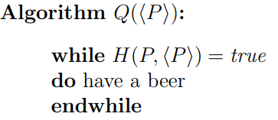
Halting Problem
Let the H and Q programs below be prepared with the same logic as in the previous example.

Slide 17
A_{TM} and Halting are Enumerable
A_{TM}
Halting
x
x
Notes:
Both of the languages we mentioned fall under E-numerability. But we will also talk about a language which is not e-numerable.

Slide 18
Decidability vs. Enumerability
If you are in doubt about a problem, you can comment using the rules below.
1. P is Decidable, if and only if ~P is Decidable.
(P ∈ D) ↔ (~P ∈ D)
2. P is Decidable, if and only if P and ~P are Enumerable.
(P ∈ D) ↔ (~P ∈ E) and (P ∈ E)
3. If P is Decidable, then P is Enumerable.
(P ∈ D) → (P ∈ E)
Notes:
There are some relationships between Decidability and E-numerability. If you are in doubt about a problem, you can comment using the rules below.
The first, the P program is Decidable, if and only if inverse of P is Decidable.
The second, the P program is Decidable, if and only if both P and inverse of P are Enumerable.
The third, If the P program is Decidable, then P is Enumerable.

Slide 19
That’s all.
Thanks for listening.
Notes:
That’s all.
Thanks for listening.

