Slide 1
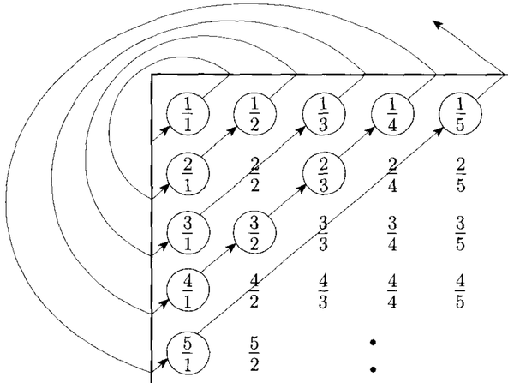
Theory of Computation
Countable & Uncountable Languages
Notes:
This is the lesson twelve in Theory of Computation. We go on to the decidability chapter. In this lesson, we will talk about Countable & Un-countable Languages.

Slide 2
Cardinality
Cardinality is simply a measure of the number of elements of a set. For example, the set A={a, b, ab, ba} contains 4 elements, and therefore A has a cardinality of 4.
The size or Cardinality of A is 4
|A|=4
But what about those with infinite elements? For example, what is the cardinality of a language-L made up of binary words?
Notes:
We must first begin by defining the term cardinality. Later we will talk about the cardinality of the set of numbers and countable sets.
Simply, Cardinality is a measure of the number of elements of a set. For example, the set A contains four elements a, b, a-b, b-a, and therefore the cardinality of the set A is 4.
In other words, the size or cardinality of A is 4. You may remember this term from your background in set theory.
Mostly in mathematics, students use this term for a finite number of sets. But, what about those with infinite elements? For example, what is the cardinality of a language-L made up of binary words?

Slide 3
Countable Sets
Any set X with cardinality less than that of the natural numbers is said to be a countable (finite) set.
Any set X that has the same cardinality as the set of the natural numbers is said to be a countable (countably infinite) set.
Any set X with cardinality greater than that of the natural numbers is said to be uncountable.
We will focus on counting using Natural numbers.
Notes:
Any set X with cardinality less than that of the natural numbers is said to be a countable or finite set.
Any set X that has the same cardinality as the set of the natural numbers is said to be a countable or countably infinite set. Notice that both finite and countably infinite are called countable here.
Any set X with cardinality greater than that of the natural numbers is said to be uncountable.
Therefore, we will focus on counting using Natural numbers.

Slide 4
Countable Sets
The set of integer numbers is Countable.
Notes:
The set of integers is Countable.
Here, with a little animation, we show how we label integers with the elements of the set of natural numbers, in other words, how we count. The number line of the set of natural numbers is used by stretching it as if it were made of rubber to count a set that appears to be twice as long as itself. Now you can imagine how we could use natural numbers to count other sets.

Slide 5
Countable Sets
The set of Kleene star (Σ*) is Countable.
Σ={a, b} Σ* = {ε, a, b, aa, ab, ba, bb, aaa, …}
ε
a b
aa ab ba bb
aaa aab aba abb … … bbb
0
2
1
6
5
4
3
14
13
12
11
7
Notes:
The set of Kleene star is Countable.
Here our sigma contains only symbols a and b. Sigma star starts with epsilon and it contains strings a, b, a-a, a-b, b-a, b-b etc. When we use natural numbers to count all the elements in a sigma star, a pyramid and a red spiral are made as follows. Here, red numbers are natural numbers. You see, counting the set of Kleene star is easy.

Slide 6
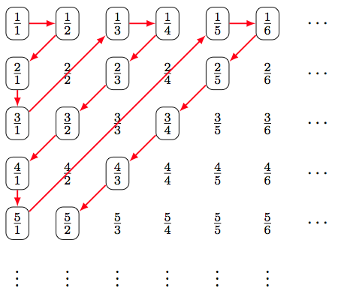
Countable Sets
The set of rational numbers is Countable.
f(N)→f(Q)
f(0)→f(1/1)
f(1)→f(1/2)
f(2)→f(2/1)
f(3)→f(3/1)
f(4)→f(1/3)
f(5)→f(1/4)
. . .
Notes:
The set of rational numbers is also countable.
In this representation, we first need to remember that rational numbers are calculated by taking the ratio of two integers to each other. With this logic, in a two-dimensional table, the rows change the numerator value and the columns change the denominator value. After preparing such a table, natural numbers start counting rational numbers using Cantor's zigzag labeling method. The example on the right shows which rational number is marked by a few natural number labels.

Slide 7
Countable Sets
What about the set of real numbers?
Is it a countable set?
Did you hear Cantor's diagonal argument?
Notes:
Both integers and rational numbers are countable with this logic. But what about the set of real numbers?
Is it also a countable set? Could Cantor's zigzag labeling method be used here as well? Considering that the real numbers are indeed an incredibly large set, we can say that this will not be enough.
Okay, but have you heard of Cantor's diagonal argument?

Slide 8
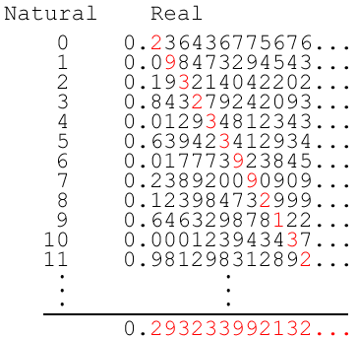
Countable Sets
Cantor's diagonal argument about real numbers
In this list, we wrote all
numbers between [0 1].
Infinite numbers with
each line of infinite length.
Notes:
Here we will see Cantor's diagonal argument about real numbers.
Considering that the real numbers are very large, it was thought that it would be very difficult to discard the integer part and label only the real numbers between 0 and 1.
Therefore, after the point, infinite numbers that are assumed to be of infinite length are written one down the other. In the example here, the numbers are specifically mixed up. After all, we can say that this is not a concern as we have to write infinite numbers.
After this process, each digit on the diagonal in the list is marked in red. Like the first digit after the dot in the first line, the second digit after the dot in the second line.

Slide 9
Countable Sets
Cantor's diagonal argument on real numbers
Can we find a new number?
Let's select the symbols on
the diagonal in red.
???
Notes:
Selected red digits are written at the bottom and it is evaluated whether there is a new number. Do you think it could be a new number?

Slide 10
Countable Sets
Cantor's diagonal argument on real numbers
Can we find a new number?
Let's select the symbols on
the diagonal in red.
it is probably somewhere up
Notes:
You can say No. The red number is probably somewhere in the list.

Slide 11
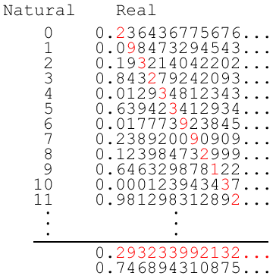

Countable Sets
Cantor's diagonal argument on real numbers
If we change symbols in red
we find a new number
Notes:
And now it's magic time.
We will try a method to write a new number. Each digit on the diagonal marked in red is changed and written at the bottom. If the first digit is 2 then we have to write a digit other than the number 2. Here we started with 7. Red 9 appears in the second digit. So we have to find a different number. In the figure, 4 is written instead. So we try to write a new number.
The number has been written, but we need to explain with a logical explanation that the new number is really new.
The bottom number is different from the first row because its first digit is changed, and it is also different from the second row because its second digit is changed. This explanation goes on like this to an infinite number of numbers. Therefore, it is considered that a new number has been added, and we say that it is not possible to count real numbers with natural numbers.

Slide 12
Countable Sets
If Cantor's diagonal argument is applied on the set of all languages over a ﬁnite alphabet such as binary symbols
s₁ : 0000000… w₁ : aaaaaaa…
s₂ : 1111111… w₂ : bbbbbbb…
s₃ : 0101010… w₃ : abababa…
s₄ : 1010101… w₄ : bababab…
s₅ : 1100110… w₅ : aabaaba…
s₆ : 0011001… w₆ : bbbabbb…
s₇ : 1001001… w₇ : aabaaba…
s_{d}: 0100101… w_{d} : abaaaba…
Notes:
If Cantor's diagonal argument is applied on the set of all languages over a ﬁnite alphabet such as binary symbols.
We can first think of the symbols 0 and 1, then a and b in the same way.
The lists we have prepared here represent a set of infinitely long binary strings and, in fact, all possible languages. Again we make the diagonal red, try to add a new string below. But we say that it is not possible to count the set of all languages, since it is possible to add a new string here, as in real numbers.

Slide 13
Countable vs. Enumerable
If P is Enumerable, then P is Countable.
(P ∈ E) → (P ∈ C)
But not vice versa. Σ* is countable, so all its subsets are countable.
If every countable language were enumerable, then every language would be decidable.
Notes:
Now we will talk about the relationship between countable and enumerable languages.
If P is an Enumerable problem or language, then the P is also Countable. But not vice versa. Because we know that sigma star is countable, so all its subsets are countable.
If every countable language were enumerable, then every language would be decidable.

Slide 14
That’s all.
Thanks for listening.
Notes:
That’s all.
Thanks for listening.

