Slide 1
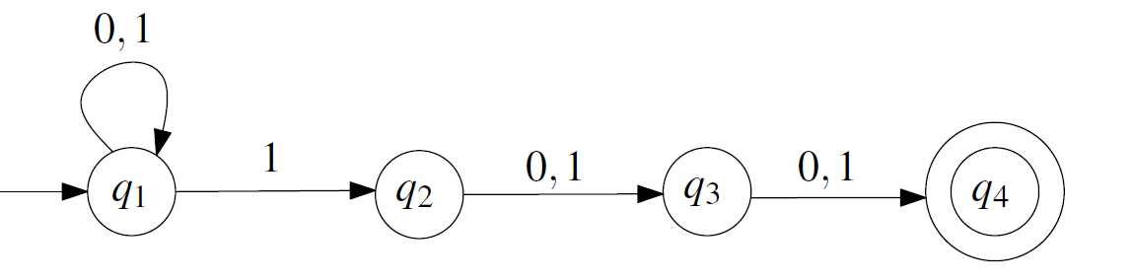
Theory of Computation Lesson 2
Non-Deterministic Finite State Automata
Notes:
It’s the second lesson of Theory of Computation. We will go on with Non-Deterministic Finite State Automata. Let’s start to lesson.

Slide 2
Why we need Non-Deterministic Automata ?
Non-deterministic finite automata (NFA) focus on how they accept the inputs. For this reason, NFA are smaller and easier to construct than deterministic finite automata (DFA).
NFA are used for humans, DFA are prepared for machines.
Besides, they are equivalent to each other. Thus, we can solve especially difficult problems in NFA, then convert into DFA.
Notes:
Why we need Non-Deterministic Automata?
Non-deterministic finite automata focus on how they accept the inputs. For this reason, Non-deterministic finite automata are smaller and easier to construct than deterministic finite automata.
Non-deterministic finite automata are used for humans, deterministic finite automata are prepared for machines.
Besides, they are equivalent to each other. Thus, we can solve especially difficult problems in Non-deterministic finite automata, then convert into deterministic finite automata.

Slide 3
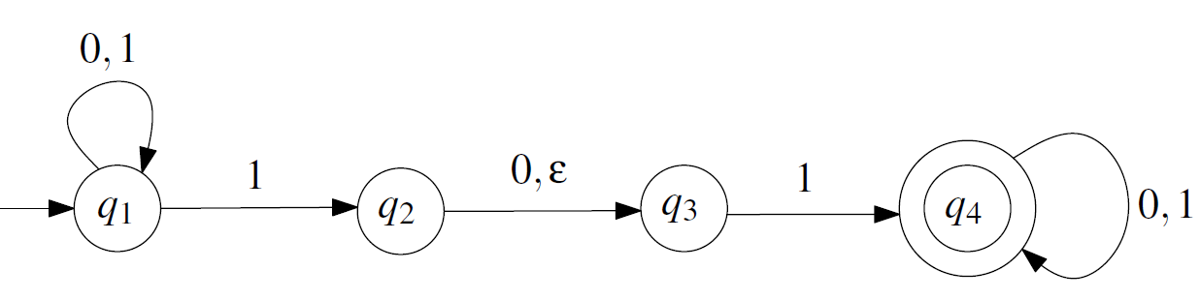
Uncertainties in NFA
There are 3 types of uncertainty to use in NFA:
1. Additional out-goings edges,
2. Undefined out-going edges,
3. Arbitrarily out-going edges.
Notes:
There are 3 types of uncertainty to use in NFA:
The first one is Additional out-goings edges,
The second one is Undefined out-going edges,
And the last one is Arbitrarily out-going edges.
You can see all of these uncertainties at following transition diagram. For example, look at Q-one state. There are two different outgoing edges for input symbol 1. So, when the user enter a one symbol, the system can not find which one it must chose.
To see the second kind of uncertainty, look at q-two state. There is no definition for symbol 1. If the user enter a one at there, the system cannot find any choice.
And, when you look at the transition between q-two and q-three, you will see an arbitrary transition epsilon. Epsilon means that the system can pass to q-three any time from q-two.

Slide 4
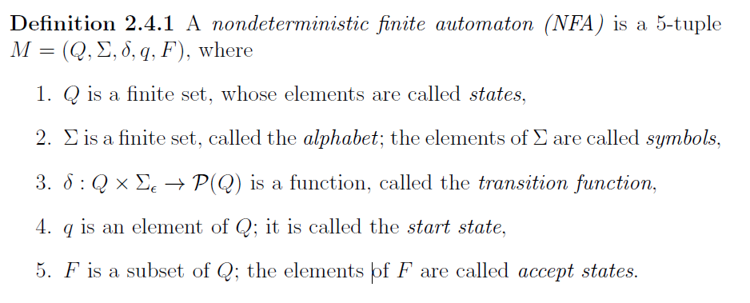
Formal Definition
We now come to the formal definition of a NFA.
Notes:
We now come to the formal definition of a non-deterministic finite automaton:
Definition 2.4.1 A nondeterministic finite automaton is a 5-tuple
M = (Capital Q, Capital sigma, delta, lowercase q, capital F), where
Capital Q is a finite set, whose elements are called states,
Capital sigma is a finite set, called the alphabet, the elements of Capital sigma are called symbols,
Delta is a function defined as cartesian product of Capital Q and Capital sigma epsilon goes Capital P Q, called the transition function,
Lowercase q is an element of Q; it is called the start state,
Capital F is a subset of Capital Q, the elements of Capital F are called accept states.

Slide 5
A first example
A = {w : w is a binary string containing 101 or 11 as a substring}.
Here, our alphabet will be binary Σ = {0, 1}. Then we should find the states at first.
We can directly focus on 101 and 11 strings. We can design them two different sub solution, but if you can see, they have a common solution.
Notes:
A = {w : w is a binary string containing an odd number of 1s}.
Here, our alphabet will be binary Σ = {0, 1}. Then we should find the states at first.
We can directly focus on 101 and 11 strings. We can design them two different sub solution, but if you can see, they have a common solution.

Slide 6
A first example
When we design states, we can define their workings as follows:
q₁ : start state
q₂ : first symbol is OK, it doesn’t matter 101 or 11
q₃ : second symbol is OK for 101 or directly pass for 11
q₄ : last symbol is OK
Notes:
When we design states, we can define their workings as follows:
q₁ : start state
q₂ : first symbol is OK, it doesn’t matter 101 or 11
q₃ : second symbol is OK for 101 or directly pass for 11
q₄ : last symbol is OK

Slide 7

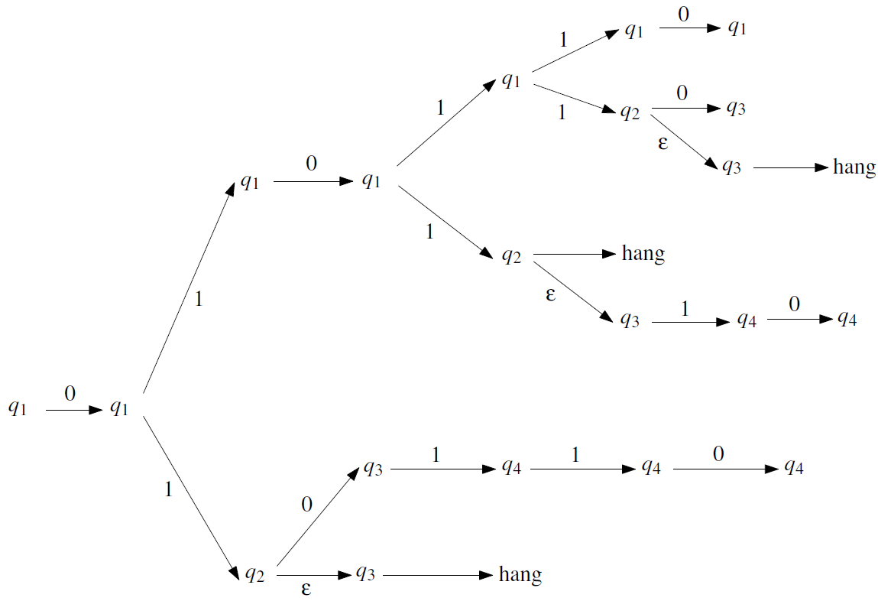
A first example
Now, we can run the NFA defined for input 010110
Notes:
Now, we can run the NFA defined here for entry 010110.
For the first symbol 0, we must start and stay on the Q-one. But we have an option for the second symbol 1. We can stay on Q-one or move on to Q-2. In this way, you can also examine the tree of possible transitions.

Slide 8
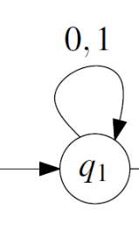
A second example
A = {w ∈ {0,1}∗ : w has a 1 in the third position from the RIGHT}
This problem is easier than the one in DFA. Again, we can focus to design solution directly.
{0,1}* 1 {0,1} {0,1}
In the previous solution, there was a concept used to mean "whatever symbol comes" in start and end states. We will use this solution, shown on the right, in this question as well.
Notes:
A second example
The capital letter A contains the binary words w such that w has a 1 in the third position from the RIGHT.
We solved this problem while learning DFA. But this one will be easier than the one in DFA. Again, we can focus to design solution directly.
Remember! In the previous solution, there was a concept used to mean "whatever symbol comes" in start and end states. We will use this solution, shown on the right, in this question as well. But we will only use it at initial state. Because no matter what symbol comes first, we need the last three symbols.

Slide 9
A second example
q₁: Both the initial state and the time elapsed state until the third letter from the right
q₂: 3rd symbol from the right came
q₃: 2nd symbol from the right came
q₄: The last symbol from the right came
Notes:
Here, the number of states is not important as much as at DFA.
q1: Both the initial state and the time elapsed state until the third letter from the right
q2: 3rd symbol from the right came
q3: 2nd symbol from the right came
q4: The last symbol from the right came

Slide 10
A third example
A = {0^{k} : k ≡ 0 mod 2 or k ≡ 0 mod 3}
The string can contain only 0 symbols. We can accept the string when its length is a multiple of two or three.
00 00 00 00 00 … or 000 000 000 000 000 …
If we misunderstand the question here and create a common solution to the two problems, the following problem may arise: {(00)or(000)}* Then this wrong solution may mistakenly accept the following string.
00 000 00 00 00 X
Notes:
A = {0 to the power of k such that k equivalent 0 mod 2 or k equivalent 0 mod 3}
The string can contain only 0 symbols. We can accept the string when its length is a multiple of two or three.
If we misunderstand the question here and create a common solution to the two problems, the following problem may arise: {(twice 0)or(three times 0)}star
Then this wrong solution may mistakenly accept the following string.

Slide 11
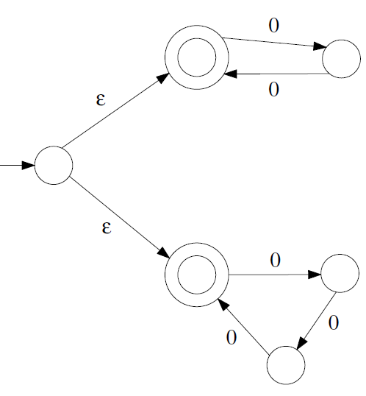
A third example
In fact, this solution is the union of the two languages.
A = A₁ U A₂
A₁ accepts the strings when their lengths are multiple of two. A₂ accepts when the length is multiple of three.
Notes:
In fact, this solution is the union of the two languages.
A₁ accepts the strings when their lengths are multiple of two. A₂ accepts when the length is multiple of three.

Slide 12
That’s all.
Thanks for listening.
Notes:
That’s all.
Thanks for listening.

