Slide 1
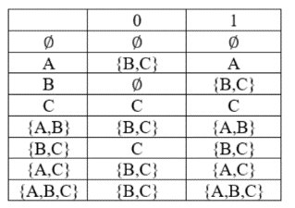
Theory of Computation Lesson 3
Converting a NFA to a DFA
Notes:
This is the third lesson of Theory of Computation. Today we will learn how an NFA can be converted to a DFA. Let's start.

Slide 2
Equivalence of DFAs and NFAs
You may have the impression that nondeterministic finite automata are more powerful than deterministic finite automata.
In this section, we will show that this is not the case. That is, we should know that a language can be accepted by a DFA if and only if it can be accepted by an NFA.
What about converting a DFA to an NFA? Well, there is nothing to do, because a DFA is also an NFA.
Notes:
Equivalence of DFA's and NFA's
You may have the impression that nondeterministic finite automata are more powerful than deterministic one.
In this section, we will show that this is not the case. At first, we should know that a language can be accepted by a DFA if and only if it can be accepted by an NFA.
What about converting a DFA to an NFA? Well, there is nothing to do, because a DFA is also an NFA.

Slide 3
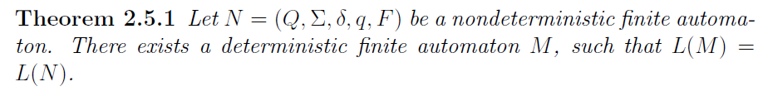
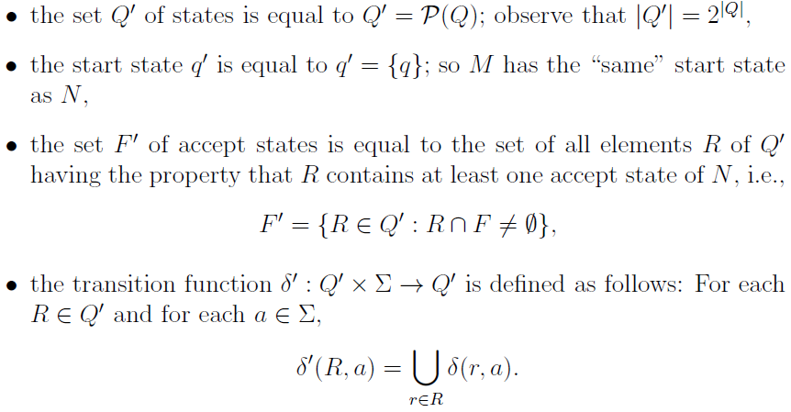
Converting a NFA to a DFA
Notes:
Let N = (Capital Q, Capital sigma, delta, lowercase q, and capital F) be a nondeterministic finite automaton. There exists a deterministic finite automaton M, such that Language M = Language N.
Let the DFA M be defined as M = (Capital Q prime, Capital sigma, Delta prime, lowercase q prime, and Capital F prime), where the set Capital Q prime of states is found by Power set of Capital Q
the start state lowercase q prime is determined by considering epsilon transitions of lowercase q
all the elements of the set Capital Q prime that intersects with the set Capital F are assigned as the elements of the set Capital F prime.
But perhaps the most important and difficult one is the definition of the Delta prime transition function. We will learn it in detail on the example.

Slide 4
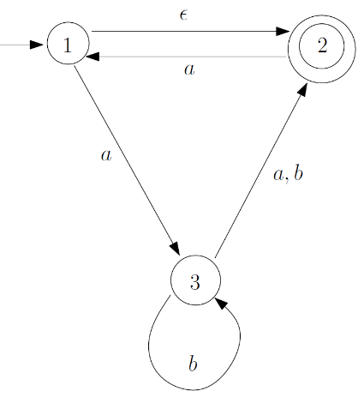
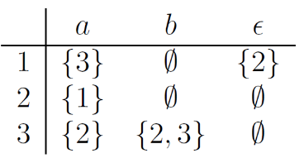
NFA to DFA example
Notes:
In this example, we will convert the NFA problem for which both the transition diagram and the table of the Delta function are given to DFA. Notice that there is one epsilon transition, two missing transitions, and one extra transition in the question.

Slide 5


NFA to DFA example
First, set of states Q’ is easily determined by using power set of Q.
Writing the start state q’ is also simple.
The third one, to find new accept states.
Notes:
First, set of states capital Q prime is easily determined by using power set of capital Q. Because of all subsets of capital Q, the number of elements in capital Q prime will be 8.
Writing the start state lowercase q prime is also simple. When we look at the first row of the table, we see an epsilon transition. It means that, lowercase q is the state one, but when we start the automaton, it can arbitrarily pass and start at the state two.
The third one is to find new accept states. Here we can again look at the table. We know that the state two is the only accept state in NFA. Therefore, in the set capital Q prime, we mark all new elements which contain 2 as the accept state.

Slide 6
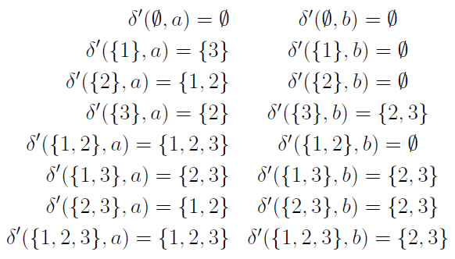
NFA to DFA example
Now, it is time to define δ’
Notes:
Now, it is time to define delta prime. However, many of my former students in this course said me that the method used in our lecture notes was not easy. Since they suggest using the table method, we will learn it now.

Slide 7
NFA to DFA example
First, write all the elements of the Q’ as the labels of rows and Σ as the label of columns.
 | a | b
Ø
{1}
{2}
{3}
{1,2}
{1,3}
{2,3}
{1,2,3}
Notes:
First, write all the elements of the capital Q prime as the label of rows and input symbols as the label of columns.

Slide 8
NFA to DFA example
The first row in the table should be filled with empty sets. It will be our black hole reject state.
 | a | b
Ø | Ø | Ø
{1}
{2}
{3}
{1,2}
{1,3}
{2,3}
{1,2,3}
Notes:
The first row in the table should be filled with empty sets. It will be our black hole reject state. When you go there, never gonna escape.

Slide 9
NFA to DFA example
Then import the partition matching the NFA into the table exactly.
 | a | b
Ø | Ø | Ø
{1} | {3} | Ø
{2} | {1} | Ø
{3} | {2} | {2,3}
{1,2}
{1,3}
{2,3}
{1,2,3}
Notes:
Then import the partition matching the NFA into the table exactly. Ignore the epsilon column in this section.

Slide 10
NFA to DFA example
Now, use the ε column and update the section you just filled out.
 | a | b
Ø | Ø | Ø
{1} | {3} | Ø
{2} | {1,2} | Ø
{3} | {2} | {2,3}
{1,2}
{1,3}
{2,3}
{1,2,3}
Notes:
Now, use the epsilon column and update the section you just filled out. Here, since there is a epsilon transition to state 2 from state 1, add 2 wherever you see 1 in the table on the right.

Slide 11
NFA to DFA example
Last, fill the empty elements by using union operation among the filled elements.
 | a | b
Ø | Ø | Ø
{1} | {3} | Ø
{2} | {1,2} | Ø
{3} | {2} | {2,3}
{1,2} | {1,2,3} | Ø
{1,3} | {2,3} | {2,3}
{2,3} | {1,2} | {2,3}
{1,2,3} | {1,2,3} | {2,3}
Notes:
Last, fill the empty elements by using union operation among the filled elements.

Slide 12
NFA to DFA example
Now our DFA solution is ready. However, this may also include some unnecessary states. We can make an optimization so that we can delete unnecessary states.
q'={1,2}
 | a | b
Ø | Ø | Ø
{1} | {3} | Ø
{2} | {1,2} | Ø
{3} | {2} | {2,3}
{1,2} | {1,2,3} | Ø
{1,3} | {2,3} | {2,3}
{2,3} | {1,2} | {2,3}
{1,2,3} | {1,2,3} | {2,3}
Notes:
Now our DFA solution is ready. However, this may also include some unnecessary states. We can make an optimization so that we can delete unnecessary states. Starting from the initial state q', all possible states are marked. Unmarked ones are deleted.

Slide 13
NFA to DFA example
Finally, we found a DFA with only four states. Now we can draw its transition diagram.
q'={1,2}
F'=[{2},{1,2},{2,3},{1,2,3}]
 | a | b
Ø | Ø | Ø
{1} | {3} | Ø
{2} | {1,2} | Ø
{3} | {2} | {2,3}
{1,2} | {1,2,3} | Ø
{1,3} | {2,3} | {2,3}
{2,3} | {1,2} | {2,3}
{1,2,3} | {1,2,3} | {2,3}
√
√
√
√
Notes:
Finally, we found a DFA with only four states. Now we can draw its transition diagram.

Slide 14
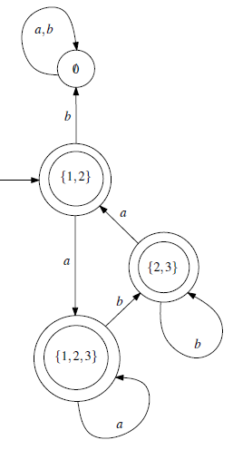
NFA to DFA example
Here, we have both the table and the transition diagram of the DFA solution.
q'={1,2}
F'=[{1,2},{2,3},{1,2,3}]
 | a | b
Ø | Ø | Ø
{1,2} | {1,2,3} | Ø
{2,3} | {1,2} | {2,3}
{1,2,3} | {1,2,3} | {2,3}
Notes:
Here, we have both the table and the transition diagram of the DFA solution.

Slide 15
That’s all.
Thanks for listening.
Notes:
That’s all.
Thanks for listening.

