Slide 1

Theory of Computation Lesson 4
Regular Expressions
Notes:
It’s the fourth lesson of Theory of Computation. We will go on the Regular Language chapter with Regular Expressions. Let’s start to lesson.

Slide 2
Regular Language Tools
There are three tools under the regular language:
Deterministic finite automata (DFA)√
Non-deterministic finite automata (NFA) √
Regular Expressions (RegEx)
We'll first review this tool and apply it to problem solving, then focus on its conversion to other tools.
Notes:
There are three tools under the regular language. Until now, we learned two of these three tools as DFA and NFA.
And also we made a transformation between these two tools. Now it's time to learn the third one, RegEx. We'll first review this tool and apply it to problem solving, then focus on its conversion to other tools.

Slide 3
Regular Operations
In this section, we define three operations on languages. We know that the set of all regular languages is closed under these three operations. These are:
Union
Concatenation
Star
Notes:
In this section, we define three operations on languages. We know that the set of all regular languages is closed under these three operations. These are
Union
Concatenation
Star

Slide 4
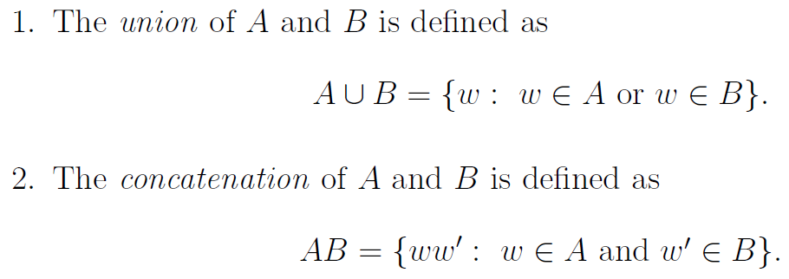
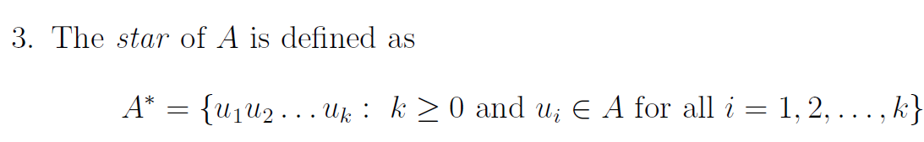
Regular Operations
Notes:
Let A and B be two languages over the same alphabet.
In the first regular operation, the union of A and B is defined as
A. union B contains w words so that w element of A or B.
The second operation, the concatenation of A and B is defined as
A.B. covers w w prime so that w element of A and w prime element of B
In words, A.B. is the set of all strings obtained by taking an arbitrary string w in A and an arbitrary string w prime in B, and gluing them together (such that w is to the left of w prime).
The third one, the star of A is defined as
A. star includes u1 u2 dot dot U.k. Here k greater than or equals to zero and u.i. Elements of A for all i = 1, 2, dot dot , k}.
In words, A is obtained by taking any finite number of strings in A, and gluing them together. Observe that k = 0 is allowed; this corresponds to the empty string epsilon. Thus, epsilon is an element of A star.

Slide 5

An Example
In the example below, you can see these three operations:
Union: (0 U 1) is an example of union operation. Here, you can choose 0 or 1 to write.
Concatenation: The expression glues three symbols, so this can be an example of concatenation.
Star: The last symbol 1 in the expression has a star operation. It can produce many 1 symbols in sequence.
Notes:
In the example below, you can see these three operations:
Union: (0 union 1) is an example of union operation. Here, you can choose 0 or 1 to write.
Concatenation: The expression glues three symbols, so this can be an example of concatenation.
Star: The last symbol 1 in the expression has a star operation. It can produce many 1 symbols in sequence.

Slide 6
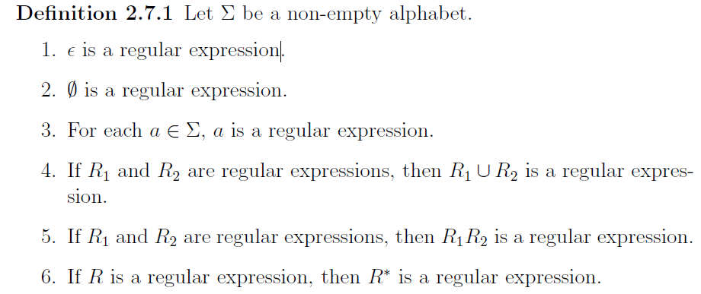
Formal Definition
Notes:
After these examples, we give a formal and inductive definition of regular expressions.
Definition 2.7.1
Let capital Sigma be a non empty alphabet.
The first, epsilon is a regular expression
The second, empty set is a regular expression
The Third, for each a. element of capital Sigma, a is a regular expression
The Fourth, if R1 and R2 are regular Expressions, then R1 union R2 is a regular expression
The fifth, if R1 and R2 are regular Expressions, then R1 R2 is a regular expression
The sixth, if R is a regular expression, then R star is a regular expression.
Here, you can regard first, second and third as being the "building blocks" of regular expressions. Items 4th, 5th and 6th give rules that can be used to combine regular expressions into new and larger regular expressions.

Slide 7

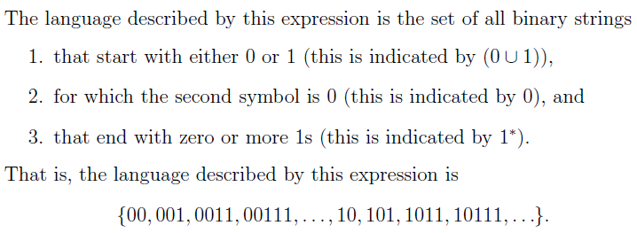
A first example
Notes:
The language described in this example is the set of all binary strings
that start with either zero or one
for which the second symbol is 0
and the string can end here or produce one or more ones
that is the language described by this expression is
0 0, 0 0 1, 0 0 1 1, 0 0 1 1 1, dot dot, 1 0, 1 0 1, 1 0 1 1, 1 0 1 1 1, and so on

Slide 8
A second example
The language {w : w contains exactly two 0s} is described by the following expression
1*01*01*
In this example, we should guarantee only two zeros in anywhere in the string. Each 1* can produce ε or only 1 or more 1s. Therefore, it can overcome the problem and generate all the following strings.
00,100,1100,…,1010,10110,…,10101,101011,…, 010, …
Notes:
The language of w words where w contains exactly two 0s is described by the following expression
1 star 0 1 star 0 1 star
In this example, we should guarantee only two zeros in anywhere in the string. Each one star can produce epsilon or only 1 or more 1s. Therefore, it can overcome the problem and generate all the following strings.
00, 1 00, 1 1 00, dot dot 1 01 0, 1 01 1 0, dot dot 1 01 01, 1 01 01 1, dot dot 01 0, so on

Slide 9
A second example
Let's take a look at how the same regular expression generates words. Here each star operation can turn into independent numbers.
1*01*01*
1ª 01^{b} 01^{c}
a | b | c | string
0 | 0 | 0 | 00
0 | 0 | 1 | 001
0 | 0 | 2 | 0011
0 | 1 | 0 | 010
0 | 2 | 0 | 0110
1 | 0 | 0 | 100
3 | 2 | 4 | 11101101111
Notes:
Let's take a look at how the same regular expression generates words. Here each star operation can turn into independent numbers. We can call the first star as a, the second as b and the third as c. While all stars are zero, the word contains only two zeros as shown in the first row of the table. But when a is 3, b is 2, and c is 4, the word produces the sequence in the last row of the table. Now, examine the table carefully.

Slide 10
A third example
The language {w : w contains at least two 0s} is described by the following expression
(0 U 1)* 0 (0 U 1)* 0 (0 U 1)*
In this example, we should guarantee at least two zeros in anywhere in the string. In the answer of the previous question, 1*'s will be replaced with (0 U 1)*.
Notes:
The language of w words where w contains at least two 0s is described by the following expression
zero union 1 star
0
zero union 1 star
0
zero union 1 star
In this example, we should guarantee at least two zeros in anywhere in the string. It is similar to the previous question. In the answer of the previous question, one stars will be replaced with zero union 1 star

Slide 11
A fourth example
The language {w : 1011 is a substring of w} is described by the expression
(0 U 1)* 1011 (0 U 1)*
Here, when we guarantee 1011 as a substring, it doesn’t matter. The string can start and also end with any substring.
Notes:
In the fourth example, we will see a substring. The language of w words where 1011 is a substring of w is described by the expression
0 union 1 star
1 0 1 1
0 union 1 star
Here, when we guarantee 1 0 1 1 as a substring, it doesn’t matter. The string can start and also end with any substring.

Slide 12
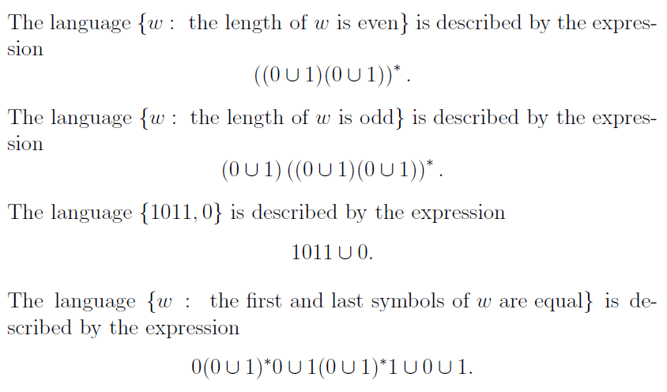
A other examples
Notes:
There are more examples in our lecture notes. You can review these examples for a minute. After you're ready, you'll have the extra bonus question.

Slide 13
That’s all.
Thanks for listening.
Notes:
That’s all.
Thanks for listening.

