Slide 1
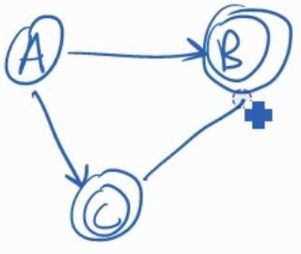

Theory of Computation Lesson 5
Converting RegEx to NFA
Notes:
It’s the fifth lesson of Theory of Computation. We will go on the Regular Language chapter with another conversion approach. We are gonna learn to convert Regular Expressions into NFA’s.

Slide 2
RegEx to NFA
Since there are three types of operations in Regular Language, we need to define a transformation for each.
Union
Concatenation
Star
Notes:
Since there are three types of operations in Regular Language, we need to define a transformation for each.
Union
Concatenation
Star

Slide 3
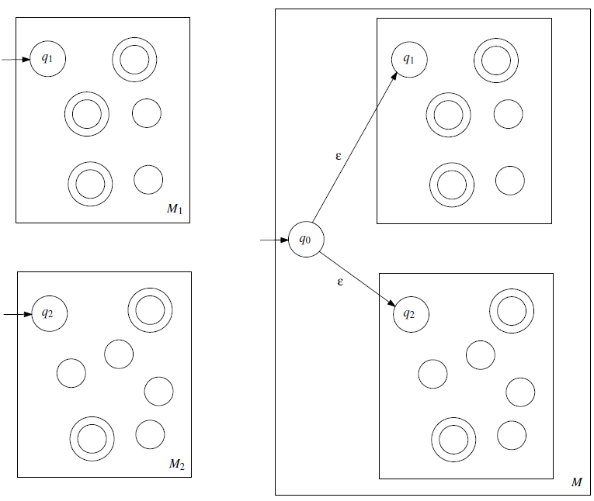
Union
M₁ U M₂
RegEx
(M₁ U M₂)
Notes:
Any regular expression can be converted to an NFA using these epsilon transitions. Here, we add a new start state and then connect it in parallel with epsilons to two old start states.

Slide 4
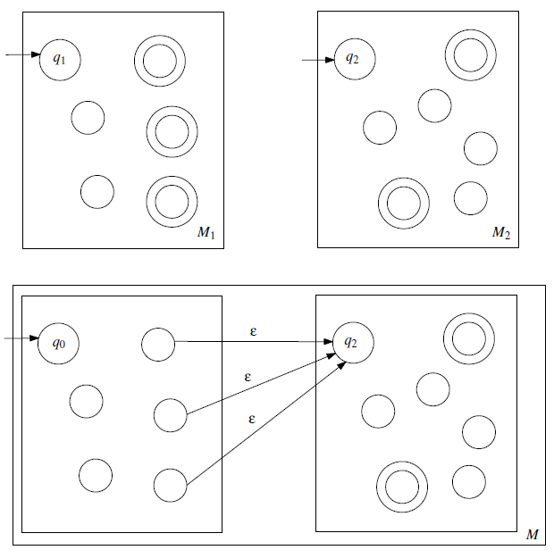
Concatenation
M₁ M₂
RegEx
M₁ M₂
Notes:
Concatenation is also performed with a similar manner. But we don't need a new start state here. Only the acceptance states of the first language are connected with epsilons to the start state of the second language.

Slide 5
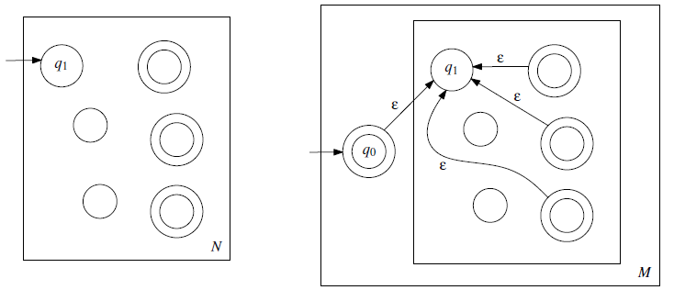
Star
N*
RegEx
N*
Notes:
In the Star operation, two kind of connectios are performed: both a new start state is added and returned to the old start state, and the accept states are connected to the old start state. All connections are again made with epsilon. Note that the new start state added here must be an accept state.

Slide 6


A first example
(ab U a)*
We can start to define input symbols as follow
Notes:
a b union a. star
We can start to define input symbols as follow
The first one represents symbol a
And the second one is symbol b

Slide 7
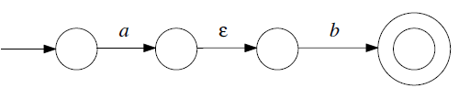
A first example
(ab U a)*
Then we can combine both symbols to get concatenation of a and b.
Notes:
Then we can combine both symbols to get concatenation of a and b.

Slide 8
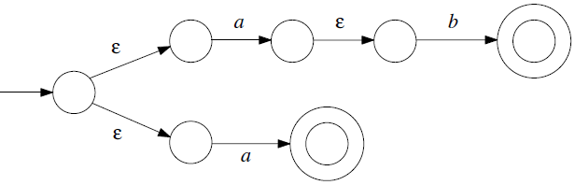
A first example
(ab U a)*
After that, we should use parallel epsilon transitions to get union operation.
Notes:
After that, we should use parallel epsilon transitions to get union operation.

Slide 9
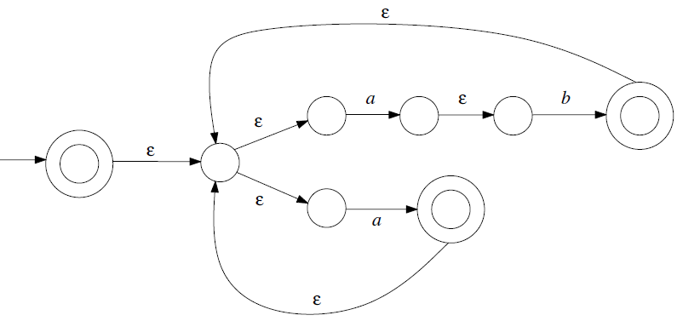
A first example
(ab U a)*
And finally, we apply a transformation for the star operation.
Notes:
And finally, we apply a transformation for the star operation.

Slide 10
That’s all.
Thanks for listening.
Notes:
That’s all.
Thanks for listening.

