Slide 1
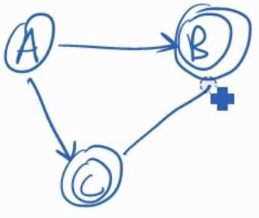

Theory of Computation Lesson 6
Converting DFA to RegEx
Notes:
It’s the sixth lesson of Theory of Computation. We will go on the Regular Language chapter with conversion of DFA's into Regular Expressions.

Slide 2

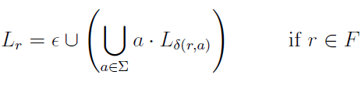
DFA to RegEx
In this transformation approach, unlike the others, outgoing transitions of each state are modeled. Finally, the aim is to reach a reduced expression for the start state.
q₃
1
q₄
0
q₅
Notes:
In this transformation approach unlike the others outgoing transitions of each state are modeled. Finally the aim is to reach a reduced expression for the start state.

Slide 3
DFA to RegEx
In the example below, let's just focus on the q3 state. When modeling the state for RegEx, an expression is written for each outgoing as "Symbol concatenation Target State".
q₃
1
q₄
0
q₅
Notes:
In the example below let's just focus on the Q3 state. When modeling the state for RegEx an expression is written for each outgoing as symbol concatenation target state. On the right there are two rules. If the state to process is not an accept state then the first rule is used otherwise the second.

Slide 4
DFA to RegEx
Since state q3 is not an accept state, we will use the first rule.
Lq3 = 1 ∙ Lq4 U 0 ∙ Lq5
q₃
1
q₄
0
q₅
Notes:
Since state q3 is not an accept state we will use the first rule. In this example to model the q3 state we write L q3 variable as that.

Slide 5
DFA to RegEx
But there is a problem here. If we continue with this approach, it will create a lot of recursion. That's why we need a solution for recursive expressions.
L = B ∙ L U C
L = B* C
Notes:
But there is a problem here. If we continue with this approach it will create a lot of recursion. That's why we need a solution for recursive expressions.
The transformation indicated by the arrow is the solution that will save us from recursive expressions. Therefore the expressions after modeling are reduced and made suitable for this transformation.

Slide 6
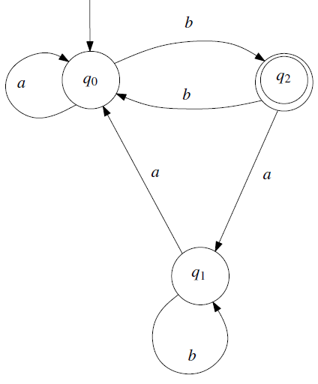
A first example
Let's transform the DFA transition diagram on the right into a regular expression.
We must first start by modeling the expression of each state.
Notes:
Let's transform the DFA transition diagram on the right into a regular expression.
We must first start by modeling the expression of each state.

Slide 7
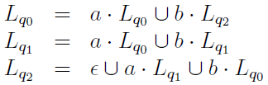
A first example
Our final goal is to write the reduced expression of the start state.
Notes:
Our final goal is to write the reduced expression of the start state. However, when we look at the expression of the q0 state, we see a different state on the right. That is, we need to clean up the unwanted ones on the right. Now is the time to make some magic.

Slide 8
A first example
When we use our solution to clean up the recursions, these two expressions will turn into:
L = B ∙ L U C
a*bLq2
Notes:
When we use our solution to clean up the recursions, these two expressions will turn into expressions indicated by arrows. But since we cannot convert L q2 to a simple expression, we focus on it at first.

Slide 9
A first example
When we write the expression of the q2 state instead of the variable Lq2 on the right hand side of the start state expression, we see the expression Lq1 on the right this time.
Notes:
When we write the expression of the q2 state instead of the variable L q2 on the right hand side of the start state expression, we see the expression L q1 on the right this time.

Slide 10

A first example
After arranging the equation we have in common brackets, we will understand that we should get rid of the unwanted variable Lq1.
Notes:
After arranging the equation we have in common brackets, we will understand that we should get rid of the unwanted variable L q1. Otherwise, we cannot implement our recursive solution.

Slide 11

A first example
Fortunately, the Lq1 expression fits our recursive solution. Not only that, but the obtained expression depends only on Lq0. This made our work easier.
L = B ∙ L U C
Notes:
Fortunately the L q1 expression fits our recursive solution. Not only that but the obtained expression depends only on L q0. This made our work easier.

Slide 12

A first example
The simplified expression we have is dependent only on Lq0. Now we can get rid of all our unwanted variables by doing the recursive solution.
Notes:
The simplified expression we have is dependent only on L q0. Now we can get rid of all our unwanted variables by doing the recursive solution.

Slide 13


A first example
Finally, we obtained the regular expression of the DFA transition diagram on the right.
L = B ∙ L U C
Remember our solution template
Notes:
Finally, we obtained the regular expression of the DFA transition diagram on the right.

Slide 14
That’s all.
Thanks for listening.
Notes:
That’s all.
Thanks for listening.

