Slide 1
Theory of Computation Lesson 7
S → 0 S 1 | ε
Context Free Languages
Notes:
It is seventh lesson and we will start a new chapter: Context Free Languages. In this context, we will start with Context Free Grammar.

Slide 2
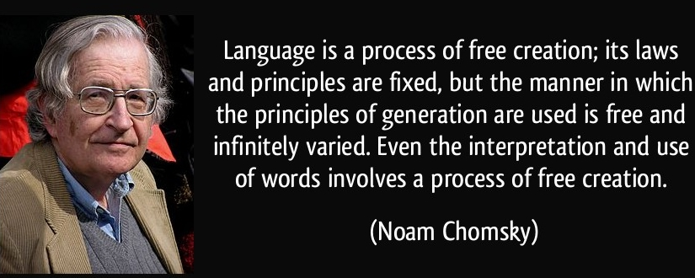
Noam Chomsky
Notes:
This is one of the important words of the American linguist and cognitive scientist Noam Chomsky.
Language is a process of free creation; its laws and principles are fixed, but the manner in which the principles of generation are used is free and infinitely varied. Even the interpretation and use of words involves a process of free creation.

Slide 3
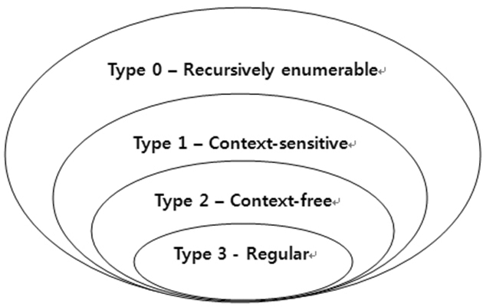
Chomsky Hierarchy
Notes:
According to Chomsky Hierarchy defined by Noam Chomsky in 1956, depending on restrictions and complexity present in the grammar, languages find a place in the hierarchy of formal languages.
In the previous chapter, we saw the regular language called Type-3. Now we will learn the Context Free Language title, which he calls Type-2. Within the scope of this course, we will also see Turing machines at the Type-0 level. There is not only a Type-1 level context-sensitive topic in our lecture notes.

Slide 4
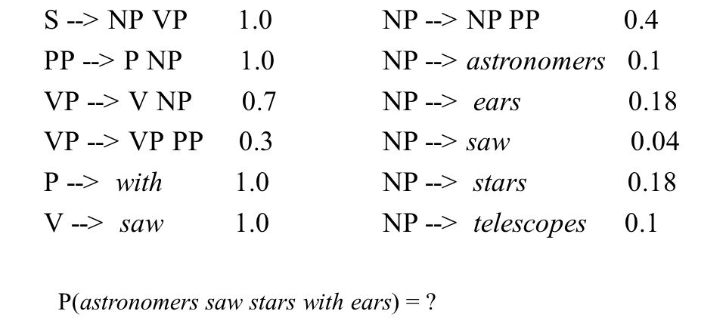
Context Free Grammar
Notes:
From the point of view of natural language processing, Context free grammar aims to formulate sentences people make up. For example, if we say that a sentence consists of two parts as noun-phrase (NP) and verb-phrase (VP), the different expansion states of NP and VP can be modeled as follows. After all, any sentence in natural language can be constructed or confirmed with the help of this grammar.

Slide 5


Context Free Grammar
How can we generate a 0^{n}1^{n} word or sentence with memoryless tools just like in regular language?
Notes:
We can think of the context free grammar structure as follows. How can we generate a zero to the power of n one to the power of n word or sentence with memoryless tools just like in regular language? It may seem difficult at first glance. But there is actually a simple method.

Slide 6
Context Free Grammar
This is also a method that people with a weak memory can use: getting the job done on time.
0 0 0 0 0 1 1 1 1 1
Notes:
This is also a method that people with a weak memory can use: getting the job done on time.
If we generate a 0 every time we generate a 1, then we don't have to worry about whether the two symbols are equal in number.

Slide 7
Context Free Grammar
S → 0 S 1 | ε
0 0 0 0 0 1 1 1 1 1
Notes:
It's also very easy to design as a grammar. We can create a recursion with one rule. Thus, we can expand our sentence as much as we want by adding the symbol 0 to both its left and 1 to its right at the same time. But just as every recursion operation has a stopping criterion, here too we need a termination rule.

Slide 8
Context Free Grammar
S → 0 S 1 | ε
^{OR}
0 0 0 0 0 1 1 1 1 1
Notes:
The termination rule here could be epsilon. We can use pipeline which means OR to write rules side by side.

Slide 9
Formal Definition
A context-free grammar is a 4-tuple G = (V,Σ,R,S) where
V is a finite set, whose elements are called variables,
Σ is a finite set, whose elements are called terminals,
V ∩ Σ = Ø,
S is an element of V; it is called the start variable,
R is a finite set, whose elements are called rules. Each rule has the form A → w, where A is element of V and w is element of (V U Σ)*.
Notes:
Formal Definition
A context-free grammar is a 4-tuple
G = capital V, capital sigma, capital R, and capital S where
Capital V is a finite set, whose elements are called variables,
Capital sigma is a finite set, whose elements are called terminals,
For this lecture note, intersection of Capital V and capital sigma must be empty set. Don't be surprised to see that it's not mandatory in other notes.
Capital S is an element of V ; it is called the start variable,
Capital R is a finite set, whose elements are called rules. Each rule has the form capital A goes to w, where A is element of capital V and w is element of capital V union capital sigma star.

Slide 10
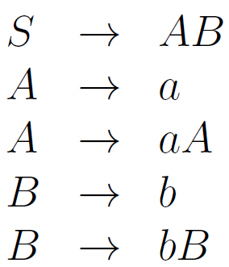

Derivation of ‘aaaabb’
a^n b^m
1
1
2
3
4
5
Notes:
Now, we will learn to derivate any string by using grammar rules. Here, our example is a to the power of 4 b to the power of 2. First, we should label the grammar rules as 1, 2, 3 so on. Then begining from start variable, and we must expand all variables we hold.

Slide 11
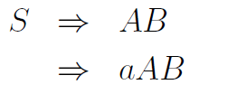
Derivation of ‘aaaabb’
1
3
1
2
3
4
5
Notes:
On the right are the variables we hold. In the first line, both variables capital A and capital B are waiting to be expanded. We must find the best derivative, but we must not forget that there is no single absolute solution.
In this example, we choose to expand variable A in the first row using the third rule.

Slide 12
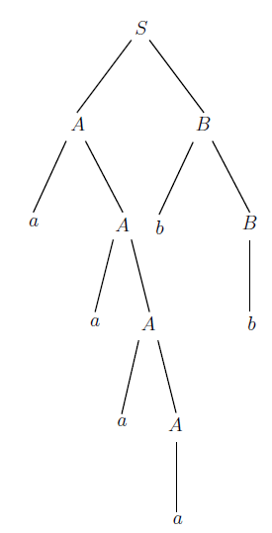
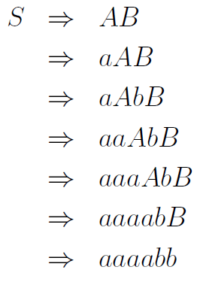
Derivation of ‘aaaabb’
1
3
5
3
3
2
4
1
2
3
4
5
Notes:
The derivation solution is up to you. You can show that the word is an element of this grammar by going a different way.
Here, the red circles show the variables chosen to expand in the next step in derivation.
For easy understanding, you can follow the derivation steps on the right parse tree.

Slide 13
New Grammar
How can we derivate ‘1010101’
Improve the grammar
S → 1S1 | 0S0 | ε 101 ε 101
S → 1S1 | 0S0 | 0 | 1 101 0 101
101 1 101
S → 1S1 | 0S0 | 0 | 1 | ε
S → 10S|01S|0S1|1S0| ε
Notes:
It is your turn
Solve it if you can...
Can we derivate ‘1010101’
using the grammar S goes 1S1 or 0S0 or ε

Slide 14
A first example: Properly nested parentheses
In this first example, we will model the spelling of parenthetical symbols used in mathematics. You know, when a left parenthesis is used, it has to match a right parenthesis typed later. Otherwise, there will be a typo in the use of parentheses.
(3*(x^{(x-2)}+1))-(y+1)*(x+5)
( ( ( ) ) ) ( ) ( )
aaabbb ab ab
Notes:
In this first example, we will model the spelling of parenthetical symbols used in mathematics. You know, when a left parenthesis is used, it has to match a right parenthesis typed later. Otherwise, there will be a typo in the use of parentheses. In this problem, we use symbol-a instead of left parenthesis and symbol-b for right parenthesis.

Slide 15
A first example: Properly nested parentheses
( ( ( ) ) ) ( ) ( )
aaabbb ab ab
There are three critical details that need to be modeled here:
Notes:
There are three critical details that need to be modeled here:

Slide 16
A first example: Properly nested parentheses
( ( ( ) ) ) ( ) ( )
aaabbb ab ab
S →aSb
There are three critical details that need to be modeled here:
1. Nested parentheses,
Notes:
The first one is the nested parentheses. We need a rule to model this kind of parentheses. Capital S goes a-capital S-b rule represent the nested parentheses.

Slide 17
A first example: Properly nested parentheses
( ( ( ) ) ) ( ) ( )
aaabbb ab ab
S →aSb S →SS
There are three critical details that need to be modeled here:
1. Nested parentheses,
2. Side-by-side parentheses,
Notes:
The second one is side-by-side parentheses. We know that the parentheses can be used in the same level. Capital S goes double capital S rule solves this situation.

Slide 18
A first example: Properly nested parentheses
( ( ( ) ) ) ( ) ( )
aaabbb ab ab
S →aSb S →SS
S →ε
There are three critical details that need to be modeled here:
1. Nested parentheses,
2. Side-by-side parentheses,
3. Termination of recursive steps
Notes:
The last one is termination of recursive steps. Since first two rules contain recursions, we know we must stop them with another rule. Capital S goes epsilon will make this.

Slide 19
A second example: a^{n}b^{m}c^{n+m}
a³b²c⁵
Consider the language
L={a^{n}b^{m}c^{n+m} : n ≥ 0, m ≥ 0}
Notes:
This is the second example in context free grammar. Consider the language capital L = a to the power of n b to the power of m c to the power of n + m so that n and m are greater than or equal to 0.
As an example, the word a to the power of 3 b to the power of 2 c to the power of 5 is an element of the L language used in this problem.

Slide 20
A second example: a^{n}b^{m}c^{n+m}
a³b²c⁵
aaa bb ccccc
S →aSc S →bSc
Consider the language
L={a^{n}b^{m}c^{n+m} : n ≥ 0, m ≥ 0}
Notes:
If we paint all the a symbols on the right and the same number of c symbols with blue and the remaining symbols green, we may immediately think of writing the following rules.

Slide 21
A second example: a^{n}b^{m}c^{n+m}
a³b²c⁵
aaa bb ccccc
S →aSc S →bSc
abaccc
Consider the language
L={a^{n}b^{m}c^{n+m} : n ≥ 0, m ≥ 0}
Notes:
If the rules are written without proper planning, some incorrect words may be produced. Here, we must start to write our algorithm at first.

Slide 22
A second example: a^{n}b^{m}c^{n+m}
aaa bb ccccc
Consider the language
L={a^{n}b^{m}c^{n+m} : n ≥ 0, m ≥ 0}
S → A | ε
A
B
Notes:
Since the definition of the language starts with the symbol a, we must first model the symbols a and c attached to it. So we think of the language as outer layer and inner layer. Once the outer layer is derived, we can move on to the inner layer. So let the variable S goes to the outer layer A first. In addition, while writing each rule, it should be checked whether the language can be epsilon at that rule level and if necessary, the epsilon rule should be added. Since the n and m values in the question can be zero, the language accepts the completely empty string. So language can go to epsilon at this level.

Slide 23
A second example: a^{n}b^{m}c^{n+m}
aaa bb ccccc
Consider the language
L={a^{n}b^{m}c^{n+m} : n ≥ 0, m ≥ 0}
S → A | ε
A → aAc | B | ε
A
B
Notes:
Variable-A can be derived with the symbol-a from the left and the symbol-c from the right. Once the derivation for outer layer-A is finished, the grammar should move to inner layer-B. In this rule, the grammar can be terminated with epsilon.

Slide 24
A second example: a^{n}b^{m}c^{n+m}
aaa bb ccccc
Consider the language
L={a^{n}b^{m}c^{n+m} : n ≥ 0, m ≥ 0}
S → A | ε
A → aAc | B | ε
B → bBc | ε
A
B
Notes:
Likewise, variable B can be derived with the symbol b from the left and the symbol c from the right. Once the derivation for inner layer B is finished, the grammar must be terminated with epsilon.

Slide 25
That’s all.
Thanks for listening.
Notes:
That’s all.
Thanks for listening.

