Slide 1
Theory of Computation Lesson 8
S → S S | 1 | ε
Chomsky Normal Form
Notes:
It is the eighth lesson in Theory of Computation. In this lesson we will learn Chomsky Normal Form

Slide 2
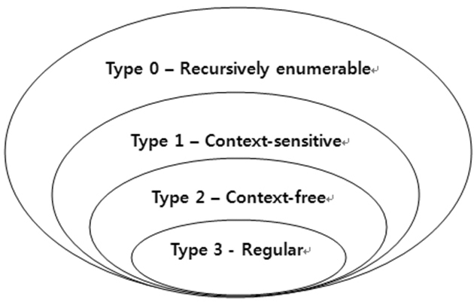
Regular languages are context-free
Y
X
Notes:
Because context free language encompasses regular language, the grammar of any regular expression or automaton can be written. The reverse is not always true. For example, let X be a regular language problem. Since this language is also Context free, its grammar can be written. On the other hand, another problem Y is grammatically writable as a context free language problem. But the finite state automaton or regular expression of problem Y cannot be written. Thus, every regular language problem such as X can be transformed into the context free grammar, but every context free problem such as Y may not be transformed into a regular one.

Slide 3
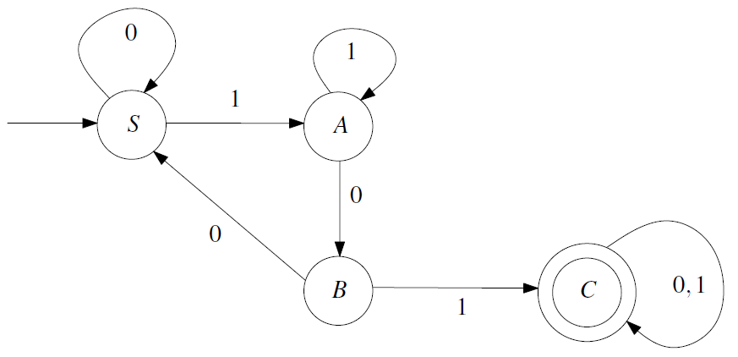
Regular languages are context-free
Notes:
Here you see the transition diagram of the problem given the deterministic finite state automaton. Let's try to write a context free grammar of the same language problem by looking at this diagram. Considering the situation we just described, this is a solvable question.

Slide 4
Regular languages are context-free
S → 0 S | 1A
A → 1A | 0B
B → 0S | 1C
C → 0C | 1C | ε
Notes:
Just as we begin the process of converting deterministic finite-state automata to regular expressions, we just need to write the language rule for each state. The rules on the right are the solution to this problem. That's all.

Slide 5
Chomsky normal form
Consider the following three grammar rules:
S → SS | 1 | ε
Using this grammar we can write a '1' symbol in different ways. For example, you can only use the second rule, or 1th, 2nd, 3rd rules respectively.
1 2 3
Notes:
Consider the following three grammar rules. S goes to SS or symbol 1 or ε
Using this grammar we can write a '1' symbol in different ways. For example, we can only use the second rule. But it's not the only way. We can choose to use the first, second and third rules, respectively. Let's take a look at this.

Slide 6
Chomsky normal form
1 2 3
How can we derivate ‘1’ with this CFG?
S → SS | 1 | ε
2
S → 1
S → SS → 1S → 1
S → SS → SSS → 1SS → 1S → 1
S → SS → SSS → SSSS → 1SSS → 1SS → 1S → 1
…
1 2 3
1 1 2 3 3
1 1 1 2 3 3 3
Notes:
The ways to generate the single-symbol word '1' using which grammatical rules sequentially are shown below. As can be seen, it is possible to produce words in an infinite way by combining the first and third rules. But this is not a method that can be automated. Therefore, it is no longer a problem where we can give the grammar rules to a computer and say "try all combinations and find the result". Nobody wants a program that can run forever. So we have to look at the way to standardize the rules. Chomsky normal form is an approach that emerged at this point and eliminated this problem.

Slide 7
Formal Definition
A context-free grammar G = (V,Σ,R,S) is said to be in Chomsky normal form, if every rule in R has one of the following three forms:
A → BC, where A, B, and C are elements of V, B≠S, and C≠S.
A → a, where A is an element of V and a is an element of Σ.
S → ε, where S is the start variable.
Notes:
Formal Definition
A context-free grammar G = (V, Capital sigma, R, S) is said to be in Chomsky normal form, if every rule in R has one of the following three forms:
Capital-A goes to Capital BC, where A-B and C are elements of V, and B is not equal to S, and C is not equal to S.
Capital-A goes to lowercase-a, where Capital-A is an element of V and lowercase-a is an element of Capital sigma.
S goes to epsilon, where S is the start variable.

Slide 8
Transforming CFG to CNF
S → SS | 1 | ε
When we revise the above grammar with Chomsky Normal Form, it will turn into the following grammar.
S → AA| 1 | ε
A → AA | 1
Notes:
When we revise the above grammar with Chomsky Normal Form, it will turn into the following grammar. Again try to derive symbol 1. There is only one way now. But we may not always do this easily. We need a transformation method.

Slide 9
Transforming CFG to CNF
Here we will learn a five-step transformation method.
1. Eliminate the start variable on the right.
2. Eliminate all ε-rules.
3. Eliminate all unit-rules.
4. Eliminate all rules having more than two symbols.
5. Eliminate all rules, whose right-hand side contains exactly two symbols, which are not both variables.
Notes:
Here we will learn a five-step transformation method. If we write the rules briefly, we will have the steps as follows.
The first, Eliminate the start variable on the right.
The second, Eliminate all ε-rules.
The third, Eliminate all unit-rules.
The fourth, Eliminate all rules having more than two symbols.
The fifth, Eliminate all rules, whose right-hand side contains exactly two symbols, which are not both variables.

Slide 10
An Example on CFG2CNF
Consider the context-free grammar G = (V, Σ, R, A), where V = {A, B}, Σ = {0, 1}, A is the start variable, and R consists of the rules
A → BAB | B | ε
B → 00 | ε
Notes:
Let's look at an example on context-free grammar to Chomsky normal form.
Consider the context-free grammar G = (V, capital sigma, R, A), where V = {A, B}, capital sigma = {0, 1}, A is the start variable, and R consists of the rules
A goes to B-A-B or B or epsilon
B goes to double 0 or epsilon

Slide 11
An Example on CFG2CNF
A → BAB | B | ε
B → 00 | ε
1. Eliminate the start variable on the right.
S → A
A → BAB | B | ε
B → 00 | ε
Notes:
Our first rule says to eliminate the starting variable on the right. Instead, it's easier to add a new start variable that goes to the old start variable. This is how we start.

Slide 12
An Example on CFG2CNF
A → BAB | B | ε
B → 00 | ε
2. Eliminate all ε-rules.
S → A S → A | ε
A → BAB | B | ε A → BAB | B | BB
B → 00 | ε B → 00 | ε
S → ε
A → BB
A → ε
Notes:
The second rule says to eliminate all epsilon rules. Looking at our rules, we see two epsilons. First, we start by eliminating the capital A's going epsilon rule. However, this deletion causes some skills to be lost in our grammar. To make up for this deficiency, grammar needs to regain what it has lost. Therefore, we reconsider all rules containing A on the right. There are two such rules: S goes to A and A goes to B-A-B. These two rules give rise to two new rules by writing epsilon instead of A: S goes to epsilon and A goes to B-B.

Slide 13
An Example on CFG2CNF
A → BAB | B | ε
B → 00 | ε
2. Eliminate all ε-rules.
S → A | ε S → A | ε
A → BAB | B | BB A → BAB|B|BB|AB|BA|A
B → 00 | ε B → 00
B → ε
A → AB|BA|A
Notes:
Next, we go on by eliminating the capital B's going epsilon rule. When we reconsider all rules containing B on the right, we see three rules: A goes to B-A-B and B also B-B. By writing epsilon instead of B’s, we found three new rules.

Slide 14
An Example on CFG2CNF
A → BAB | B | ε
B → 00 | ε
2. Eliminate all ε-rules.
A → BAB | B | BB A → BAB|B|BB|AB|BA|A
εAB
ABε
εAε
ε
εε
εB
Bε
AB
BA
A
ε
B
B → ε
A → AB|BA|A
Notes:
Here we show how the three newly found rules are derived. You see, we're actually obtaining five new rules. But we already have the rule that A goes to B. On the other hand, in the step of deleting the rule where A goes to epsilon, it is absurd to reproduce this rule. So writing these two rules has no sense.

Slide 15
An Example on CFG2CNF
A → BAB | B | ε
B → 00 | ε
3. Eliminate all unit-rules.
S → A
S → A | ε A → B
A → BAB|B|BB|AB|BA|A A → A
B → 00
S → ε | BAB | BB | AB | BA | 00
A → BAB | BB | AB | BA | 00
B → 00
Notes:
Our third rule tells us, to eliminate all unit-rules. There are three unit-rules observed on the right. Among these, A goes to A-rule can be deleted directly, because it does not cause any loss. The other two rules are deleted with the replace approach. First, we delete the rule-A goes to B, by writing the rule-B goes to double 0, where we see B on the right. Similarly, we delete the rule S goes to-A, by adding the right side of rule-A, to the right of rule-S as it is.

Slide 16
An Example on CFG2CNF
A → BAB | B | ε
B → 00 | ε
4. Eliminate all rules having more than two symbols.
S → ε | BAB | BB | AB | BA | 00
A → BAB | BB | AB | BA | 00
B → 00
S → ε | BC | BB | AB | BA | 00
A → BC | BB | AB | BA | 00
B → 00
C → AB
Notes:
The fourth one commands to eliminate all rules having more than two symbols. Here, we only have the terms B-A-B in two places. To eliminate them, we need a new variable, such as C, that will contain two of the three symbols of this term. If we define that C goes to A-B, we can use this C instead of A-B at the end of the term B-A-B.

Slide 17
An Example on CFG2CNF
A → BAB | B | ε
B → 00 | ε
5. Eliminate all rules, whose right-hand side contains exactly two symbols, which are not both variables.
S → ε | BC | BB | AB | BA | 00
A → BC | BB | AB | BA | 00
B → 00
C → AB S → ε | BC | BB | AB | BA | DD
A → BC | BB | AB | BA | DD
B → DD
C → AB
D → 0
Notes:
In the last step, we should eliminate all rules, whose right-hand side contains exactly two symbols, which are not both variables. The thing is, this step requires defining each terminal symbol with a variable. Since only the symbol-0 is used in our example, it is sufficient to define a variable like D and assign it to this terminal. Then we will write the name of this new variable wherever we see symbol-0 on the right.

Slide 18
That’s all.
Thanks for listening.
Notes:
That’s all.
Thanks for listening.

