Slide 1
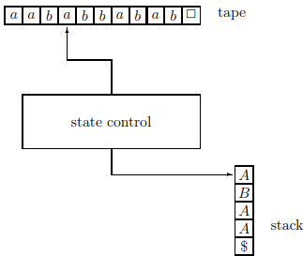
Theory of Computation Lesson 9
Push-Down Automata
Notes:
This is the lesson nine in Theory of Computation. We continue the chapter Context Free Languages. We will learn Push Down Automata.

Slide 2
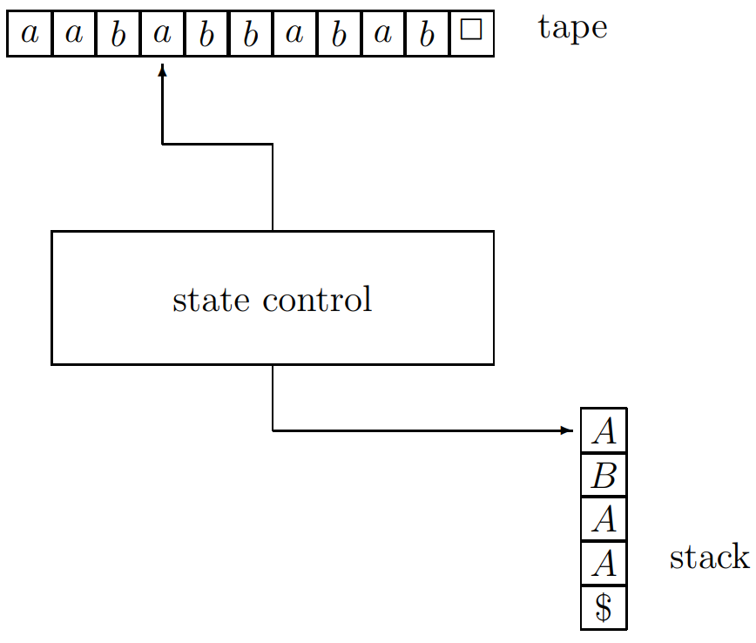
Push Down Automata
Notes:
Today, we will introduce a new automaton system. As we will see, the class of languages that can be accepted by these automata is, exactly the class of context-free languages. Let's start with informal description of deterministic pushdown automaton. Such an automaton looks like the figure at the screen.

Slide 3
Push Down Automata
1. There is a tape which is divided into cells. Each cell stores a symbol belonging to a finite set Σ, called the tape alphabet. There is a special symbol # that is not contained in Σ; this symbol is called the blank symbol. If a cell contains #, then this means that the cell is actually empty.
Notes:
The first, There is a tape which is divided into cells. Each cell, stores a symbol belonging to a finite set Capital sigma, called the tape alphabet. There is a special symbol, here we can use hashtag symbol instead, that is not contained in Capital sigma; this symbol is called the blank symbol. If a cell contains blank symbol, then this means that the cell is actually empty.

Slide 4
Push Down Automata
2. There is a tape head which can move along the tape, one cell to the right per move.
This tape head also read the cell it currently scans.
Notes:
The second, There is a tape head, which can move along the tape, one cell to the right per move. But it can not go to the left. This tape head also read the cell it currently scans.

Slide 5
Push Down Automata
3. There is a stack. So we can store something now.
But we can use only symbols defined in Γ, called the stack alphabet.
This set contains a special symbol $.
Notes:
The third, There is a stack. So we can store something now. But we can use only symbols defined in gamma, called the stack alphabet. This set contains a special symbol dollar.

Slide 6
Push Down Automata
4. There is a stack head which can read the top symbol of the stack.
This head can also pop the top symbol, and it can push symbols of Γ onto the stack.
Notes:
The fourth, There is a stack head, which can read the top symbol of the stack.
This head can also pop the top symbol, and it can push symbols of gamma onto the stack.

Slide 7
Push Down Automata
5. There is a state control, which can be in any one of a finite number of states.
The set of states is denoted by Q. The set Q contains one special state q, called the start state.
Notes:
The fifth, There is a state control, which can be in any one of a finite number of states.
The set of states is denoted by capital Q. The set capital Q contains one special state lowercase q, called the start state.

Slide 8
Formal Definition
A deterministic PDA is a 5-tuple M = (Σ, Γ, Q, δ, q), where
Σ is a finite set, called the tape alphabet; the blank symbol # is not contained in Σ,
Γ is a finite set, called the stack alphabet; this alphabet contains the special symbol $,
Q is a finite set, whose elements are called states,
q is an element of Q; it is called the start state,
δ is called the transition function, which is a function
Q × (Σ ∪ {#}) × Γ → Q × {N, R} × Γ*
Notes:
Formal Definition
A deterministic pushdown automata is a 5-tuple, capital M = sigma, gamma, capital Q, delta, lowercase q), where
sigma is a finite set, called the tape alphabet; the blank symbol hashtag is not contained in sigma,
Gamma is a finite set, called the stack alphabet; this alphabet contains the special symbol dollar,
Capital Q is a finite set, whose elements are called states,
Lowercase q is an element of capital Q; it is called the start state,
Delta is called the transition function, which is a function
capital Q cartesian product sigma with blank symbol cartesian product Gamma goes to capital Q cartesian product capital N or capital R cartesian product Gamma star

Slide 9
A Sample Delta Rule
qa$ → qR$S
When we focus on the states here, we will see that the state has not changed. Thus, we can read it as 'stay in the same state'.
states
Notes:
For easy understanding, we will first give an example delta rule.
When we focus on the states here, we will see that the state has not changed. Thus, we can read it as 'stay in the same state'.

Slide 10
A Sample Delta Rule
qa$ → qR$S
When the tape head reads an ‘a’ symbol from the tape, the tape head must go one cell to the right.
tape
Notes:
Then, we can focus at the second letters on the rule. When we look at the second letter on left handside, there is an A-symbol. It means that tape head read this symbol from the tape.
The second letter at the right hand-side, there is a capital-R-symbol. It means that 'tape head must go one cell to the right'. If we use N-symbol instead, then it means 'tape head must stay the same tape cell'. Now we can read the rule as
'when the tape head reads an A-symbol from the tape in state q, state controller have to stay the same state and the tape head must go one cell to the right'.

Slide 11
A Sample Delta Rule
qa$ → qR$S
When stack head pop the dollar symbol from the stack, the stack head must push $S symbols into the stack in order.
{
stack
Notes:
And last, the third part of the rule is read. On the left hand-side, there is a dollar symbol. We can understand that 'when stack head pop the dollar symbol from the stack, this rule can start'.
On the right handside, there are two symbols for the third part: a dollar and an S-symbol. When this rule run, the stack head must push these two symbols into the stack in order. At first the dollar, then the S symbol.

Slide 12
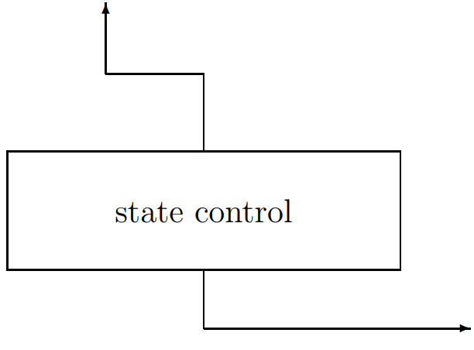
A Sample Delta Rule
a
qa$ → qR$S
q
$
Notes:
When the state controller is in the q state, if the tape head read an a-symbol and the stack head pop a dollar symbol

Slide 13
A Sample Delta Rule
a
qa$ → qR$S
move to the Right
q
stay the q state
push $S
S
$
Notes:
Stay the q state,
move the tape head one cell to the right,
and push a dollar and the an S symbol into the stack

Slide 14

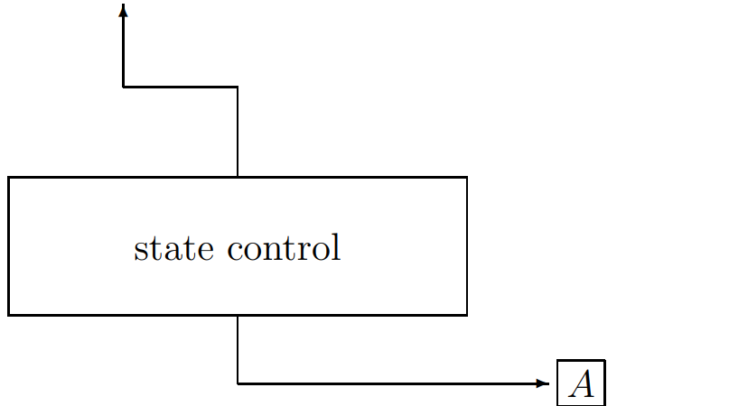

Execution of PDA
User can enter a string into the tape, but cannot see the stack. Only state controller can use the stack.
When the program is started, we will assume that the tape head is on the first letter of the string written by the user.
Notes:
User can enter a string into the tape, but cannot see the stack. Only state controller can use the stack.
When the program is started, we will assume that the tape head is on the first letter of the string written by the user.

Slide 15
Execution of PDA
State controller starts on the start state q and the stack has only one dollar symbol.
A command is selected according to the symbol to be read from the tape, and the operation on the right hand side is performed.
Notes:
State controller starts on the start state q, and the stack has only one dollar symbol.
A command is selected according to the symbol to be read from the tape, and the operation on the right hand side is performed.
After that process, a new command is selected according to these three parameters
1) the state controller stay on which state, 2) what is read from the tape, 3) what is popped from the stack. Then the working steps the selected rule say are continued.

Slide 16

Execution of PDA
When the stack gets empty, PDA terminates.
When PDA terminates, if the tape head is on the cell immediately to the right cell of the last symbol of the string, this is good news.
Because the string on the tape is accepted.
q#$ → qNε
Notes:
When the stack gets empty, Pushdown Automata terminates.
When Pushdown Automata terminates, if the tape head is on the cell immediately to the right cell of the last symbol of the string, this is good news.
Because the string on the tape is accepted.

Slide 17
A first example: Properly nested parentheses
Algorithm: remember the number of ‘a’s, then match them with ‘b’s.
Use the stack to remember the a's. For each ‘a’ reading, push a symbol (let's say S) into the stack. Delete one from the stack each time ‘b’ is read.
(3*(x^{(x-2)}+1))-(y+1)*(x+5)
( ( ( ) ) ) ( ) ( )
aaabbb ab ab
Notes:
We've seen the problem before when learning context free grammar. We will use symbol-a instead of left parenthesis and symbol-b instead of right parenthesis.
Algorithm: remember the number of a's, then match them with b's.
We can use the stack to remember the a's. For each a-symbol reading, we push a symbol we defined (let's say S) into the stack. We then delete one of these symbols from the stack each time b is read.

Slide 18
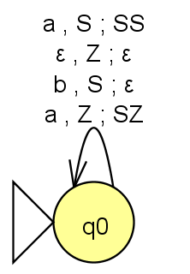
A first example: Properly nested parentheses
qa$ → qR$S remember
qb$ → qNε reject
q#$ → qNε accept
qaS → qRSS remember
qbS → qRε forget
q#S → qNS reject with loop-forever
Notes:
This is our solution. There are two rejection situations and one acceptance situation. In two rules, we must push a symbol onto the stack to remember the number of a's. We also have a rule to forget these stored symbols by deleting them from the stack.

Slide 19
A first example: Properly nested parentheses
qa$ → qR$S remember
qb$ → qNε reject
q#$ → qNε accept
qaS → qRSS remember
qbS → qRε forget
q#S → qNS reject with loop-forever
When do you think the top part will work?
Notes:
Notice that we have divided the rules into two groups according to the symbol coming from the stack. When do you think the top part will work?

Slide 20
A first example: Properly nested parentheses
qa$ → qR$S remember
qb$ → qNε reject
q#$ → qNε accept
qaS → qRSS remember
qbS → qRε forget
q#S → qNS reject without termination
At the start of PDA
When |a|=|b|
Notes:
If the stack is empty in the start state, the initialization of the pushdown automaton should come to mind immediately. So that should be our first answer.
The other case is that after some a-symbols arrive, when an equal number of b-symbols arrive, all the stored ones in the stack are forgotten. Briefly, at that moment when the number of a's equals the number of b's, the stack is empty.

Slide 21
A first example: Properly nested parentheses
qa$ → qR$S remember
qb$ → qNε reject
q#$ → qNε accept
qaS → qRSS remember
qbS → qRε forget
q#S → qNS reject without termination
So when does this part work?
Notes:
So when does this part work? How can we define it?

Slide 22
A first example: Properly nested parentheses
qa$ → qR$S remember
qb$ → qNε reject
q#$ → qNε accept
qaS → qRSS remember
qbS → qRε forget
q#S → qNS reject without termination
If |a|>|b|
Notes:
This part is easier to describe. Whenever the number of a's is at least one more than the number of b's, one of these rules works, depending on the symbol from the tape.

Slide 23
A second example: 0^{n}1^{n}
q₀0$ → q₀R$S remember
q₀1$ → q₀N$ reject without termination
q₀#$ → q₀Nε accept
q₀0S → q₀RSS remember
q₀1S → q₁Rε forget
q₀#S → q₀NS reject without termination
q₁0$ → q₁N$ reject without termination
q₁1$ → q₁N$ reject without termination
q₁#$ → q₁Nε accept
q₁0S → q₁NS reject without termination
q₁1S → q₁Rε forget
q₁#S → q₁NS reject without termination
0³1³ : 000111
Notes:
As in the previous slide, we will have remember, forget, accept and reject rules in this solution.
Let's do a different 'it's your turn' to answer this question.
Whoever gets on the board, tells the solution to his friends, and answers all coming questions will get extra points.

Slide 24

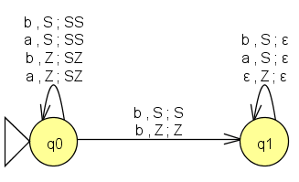
A third example: Find b in the middle
qa$ → qR$S remember
qb$ → q'R$ middle b
qb$ → qR$S remember
q#$ → qN$ reject without termination
qaS → qRSS remember
qbS → q'RS middle b
qbS → qRSS remember
q#S → qNS reject without termination
q'a$ → q'Nε reject
q'b$ → q'Nε reject
q'#$ → q'Nε accept
q'aS → q'Rε forget
q'bS → q'Rε forget
q'#S → q'NS reject without termination
q: the state before b in the middle
q': the state after b in the middle
Notes:
Here we will use the term non-deterministic push-down automata. Because we cannot solve it with the deterministic one.
If you notice in the previous examples, we wrote a rule for each situation. But since we weren't sure about the b symbol in middle here, we will add extra rules where we are in doubt.
The example string shown on the right has b in the middle, but someone else might not. Moreover, it is not possible to find the middle letter b with a limited stack unit. That's why we should look at every letter b that is read as the letter b in the middle.

Slide 25
Equivalence of PDA and CFG
Theorem: Let Σ be an alphabet and A ⊆ Σ* be a language. Then A is CFG if and only if there exists a nondeterministic PDA that accepts A.
Each A → BC rule transforms qaA → qNCB, for all a ∈ Σ
Each A → a rule transforms qaA → qRε
Each $ → ε rule transforms q#$ → qNε
Notes:
Theorem. Let sigma be an alphabet and capital A subset of sigma star be a language. Then capital A is Context Free, if and only if there exists a nondeterministic Push Down Automaton that accepts capital A.
In order to apply the transformation here, context-free grammar must be in the chomsky normal form.
The first transformation rule say that. Each A goes to BC rule transforms as q-lowercase-a-capital-A goes to q-N-C-B, for all lowercase-a is element of sigma
The second transformation rule say that. Each capital-A goes to symbol-a rule transforms as q-lowercase-a-capital-A goes to q-R-epsilon
The third transformation rule say that. Each dollar goes to epsilon rule transforms as q-hashtag-dollar goes to q-N-epsilon

Slide 26
That’s all.
Thanks for listening.
Notes:
That’s all.
Thanks for listening.

