Slide 1

An AI-Assisted decision making system for thyroid nodule evaluation
Stefanos Stefanou (27020363) 2020-2021 Bsc thesis project
Supervisor : Mrs Huizhi Liang

Slide 2
Motivation
Motivation
The dominant way of determining the category of a thyroid nodule is a process called Fine Needle Aspiration(FNA or Biopsy)
FNA is a complex process involving experienced doctors and expensive laboratories. Overall a very expensive operation.
In the last years, Image analysis and AI had significant breakthroughs in medical applications, especially in thyroid nodule classification
My Vision
To build a complete platform to be the middleware between doctors and researchers, making academic research on thyroid module classification accessible to doctors and radiologists. It is a comprehensive, dynamic, modern, and easy-to-use platform to make experimental prediction models accessible to the people using them, capable of receiving feedback for the researcher's behalf and collecting data for further use by academics for further improvements and research.

Slide 3
Technology stack
For building the infrastructure i used the most modern stack available, ensuring the viability of the project in terms of maintainability for time to come. Let's have a quick look at the technologies used in this project.
Frontend: React v18.0/Bootstrap 4/axios
Backend: Python3/Django/gunicorn server/Postgres/pykka-actors
Machine Learning Prediction Models : SVC and ResNet
SVC Model: Numpy/Scipy/Scikit-learn
ResNet Model: torch-cpu/torchvision-cpu/PIL/Base64
Deploy : 3x Heroku Performance-m Dynos / docker / docker-compose
CI/CD: git-github/Circleci/Heroku-Procfile-deploy

Slide 4
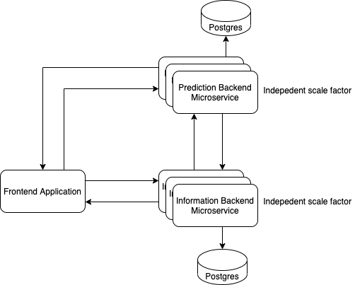
Architecture
Microservice-inspired-architecture
Separation of Concepts between services
Able to handle arbitrary number of users, as it is designed to scale automatically and adjust to heavy load(heroku-autoscale/pykka-actors)
Clean and well-documented json-based, REST-full A.P.I for intercoms

Slide 5
Prediction
Two models have been developed for the prediction process, a simple C-Support Vector Classifier(SVC) and a more advanced Residual Neural Network(ResNet). Both algorithms have been trained using the TDID Dataset, a dataset containing 400 ultrasound scans images, on a standardized format, and metadata about those scans, such as the classification of the given nodule(TIRADS) and the region of interest.

Slide 6
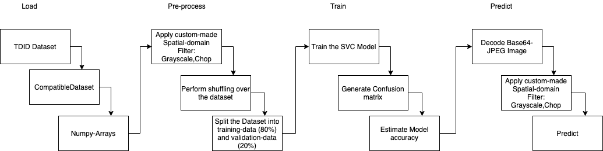
SVC Prediction Model

Slide 7
ResNet Prediction Model
For proving the viability of the application to handle deep learning models, with the contribution of my supervisor’s research team (Mrs Liang), we loaded a real-world model (ResNet)
The application handled the more complicated model successfully (demo will follow)

Slide 8
Demo
Frontend Application and Features
Add Patient
Add Scan
Wait for scan to be completed, notification system
View Patients, View Scans
View Scan Prediction and Provide feedback
Use both models
Login as admin, get feedback from doctor and see logs of algorithm

Slide 9
Demo time!

