Slide 1
System Overview
University of Southampton Small Satellite (UoS3)

Slide 2
History
1U (10x10x10 cm) research CubeSat started in 2014
Designed by 4th year Group Design Project (GDP) students
Previously part of ESA’s Fly Your Satellite! (FYS) programme
Work still needed on software and electronics to reach FlatSat testing

Slide 3
Mission
Scientific – to collect position and attitude data over the mission lifetime to assist space debris re-entry research at Southampton
Outreach – to capture images of Europe and transmit a telemetry beacon for public outreach
Educational – provide students with experience of industry-standard design processes, and to get hands-on experience with space-grade hardware

Slide 4
Requirements
Two root requirements sources:
ESA FYS Design Specification (FDS) – ESA requirements on the CubeSat
Mostly related to physical dimensions, safety of the CubeSat in the ISS launcher etc.
Technical Specification (TS) – UoS3 specific requirements
Give technical specs of the CubeSat and mission operational requirements
Examples of derived specifications:
Design Definition File (DDF) – gives detailed design of CubeSat with reasoning for design choices
Interface Control Document (ICD) – specifies interfaces between hardware boards
Software ICD – specifies interfaces between software components (i.e. EPS and OBC)

Slide 5
Standards
External:
ECSS for project management, documentation, some specific areas (like packet utilisation standard)
Internal:
Software writing standard (SWS) for ALL code
Keep a logbook which refers to AIV roadmap tasks (the design journal standard)
Document templates should be used

Slide 6
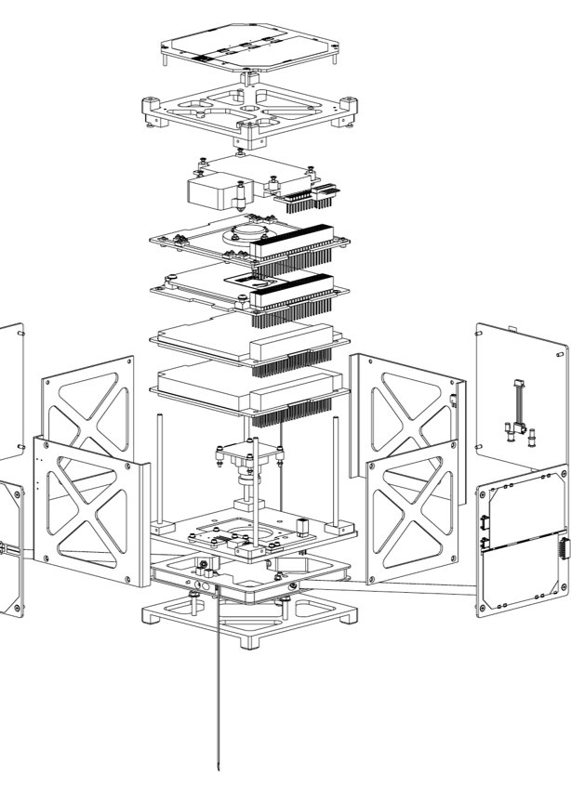
Subsystems
Structure
supports the CubeSat’s components
Antenna Deployment Mechanism (ADM)
allows the antenna to be extended after deployment from the ISS
Electrical Power Subsystem (EPS)
collects and provides regulated power to the rest of the satellite
Onboard Computer (OBC)
controls other subsystems and executes the flight software
Payload
collects data to fulfil the mission objectives
Telemetry, Tracking, and Command (TT&C)
provides 2-way communications between the satellite and ground
Attitude and Orbital Control Subsystem (AOCS)
passively controls the attitude (orientation) of the satellite

Slide 7
Subsystems Status
Subsystem |  | Hardware Status |  | Software Status
Structure |  | Flight ready |  | N/A
ADM |  | Engineering qualification model (EQM) ready |  | Not implemented
EPS |  | New boards to be ordered, design changes verified and tested |  | Partial implementation & interface tests with OBC, see eps-firmware status
OBC |  | New boards to be ordered, design changes verified and tested |  | In development
Payload |  | EQM models available |  | In development
TT&C |  | New TOBC board to be ordered, tested |  | Development not started
AOCS |  | EQM models available |  | Simulations written but not completely verified

Slide 8
Hardware Organisation
Two main circuit boards need development:
EPS
contains: the EPS microcontroller (MCU), connectors for solar panels and battery, voltage regulation circuitry
status: problems with boards have been identified and fixed in design, needs new PCB ordered and assembled, which will be engineering qualification model (EQM)
Telecommunications and Onboard Computer (TOBC)
contains: the OBC MCU, the TX Manager MCU, the radio communications circuitry, IMU, auxiliary OBC components like FRAM
status: faults found and corrected in design, needs new PCB ordered and assembled, which should be EQM
Other boards include the battery, AOCS, and camera

Slide 9
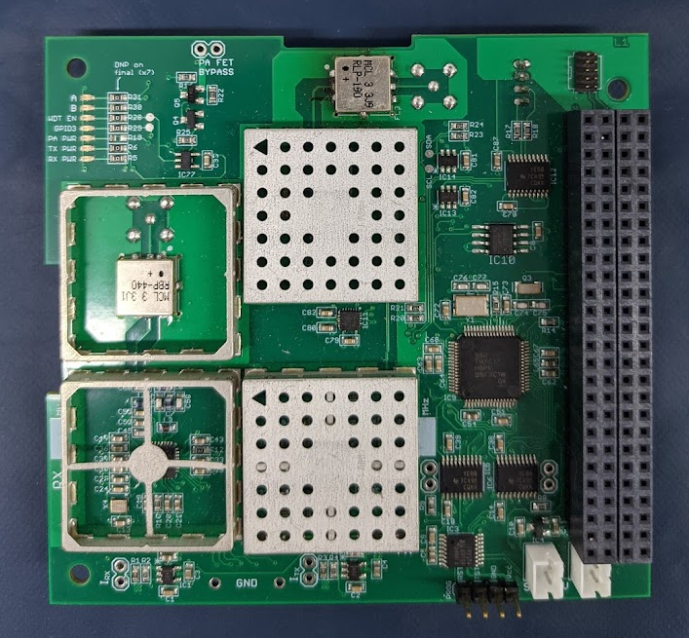
Circuit Boards
All printed circuit boards (PCBs) meet the PC104 standard
Common PC104 bus connects all PCBs
Power and data are contained on this bus
Left: Engineering model (EM) telecommunications and onboard computer (TOBC) board, with PC104 header on the right

Slide 10
Electronics Tooling
All circuit board designs in Eagle
Latest EPS is v3.2 on sharepoint:
https://sotonac.sharepoint.com/:f:/r/teams/UniversityofSouthamptonSmallSatelliteUoS3/FEE%20GDP%20202021/EPS/Power_Boardv3.2_270321?csf=1&web=1&e=u4JDre
Lates TOBC is v1.5 on sharepoint:
https://sotonac.sharepoint.com/:f:/r/teams/UniversityofSouthamptonSmallSatelliteUoS3/FEE%20GDP%20202021/EPS/Power_Boardv3.2_270321?csf=1&web=1&e=u4JDre
Propulsion lab (current CubeSat home) has power supplies, soldering iron, etc.
Technicians in electronics lab B13 introduced to TOBC board this year and helped with debugging

Slide 11
Software Organisation
Four main software parts:
obc-firmware: code that runs on the OBC and executes the mission, 45% complete
(also called "the software", "flight software" etc.)
eps-firmware: controls the EPS circuitry, is commanded by the OBC, 80% complete
tx-manager-firmware: purpose not entirely clear, runs on TX Manager and prevents transmission before required ESA timeout after launch, not started
Ground station software: runs on the ground and is used to send commands/receive telemetry from the satellite, status unknown

Slide 12
Software Tooling
All firmwares written in C
Stored on github at https://github.com/uos3, use of git branches and pull requests is strongly advised
MUST follow software writing standard https://github.com/uos3/obc-firmware/blob/master/docs/standards/sws.md
Linux machine required for development, if on windows use Windows Subsystem for Linux (WSL), or a virtual machine for development

Slide 13
Internship Training
This week:
Get sharepoint and github access
Read last year's GDP report:
https://sotonac.sharepoint.com/:b:/r/teams/UniversityofSouthamptonSmallSatelliteUoS3/FEE%20GDP%20202021/GDP%20Module%20Documents/Report/FEEG6013_GDP50_FinalReport.pdf?csf=1&web=1&e=ryAxu8
Read design journals (Duncan, Daniel, and Roberto for now)
https://sotonac.sharepoint.com/:f:/r/teams/UniversityofSouthamptonSmallSatelliteUoS3/FEE%20GDP%20202021/GDP%20Module%20Documents/Design%20Journals?csf=1&web=1&e=vjk07Y
Setup software development environment (live call, probably Friday)
Next week:
Guided tour of current software & electronics state
C crash course
(potential) demo of hardware in propulsion lab

