Slide 1

Bluetooth Communication and MIT APP Inventor
By : Delveer Singh

Slide 2
Short Intro…
WHY MIT APP INVENTOR?:
No coding experience required.
It is simply drag and drop.
Gives the idea and thought process.
Easy to use

Slide 3
Before we proceed…
Make sure The Tx and Rx is disconnected when you upload code into the Maker Uno.
Reconnect Tx and Rx after code to board upload is complete!!

Slide 4
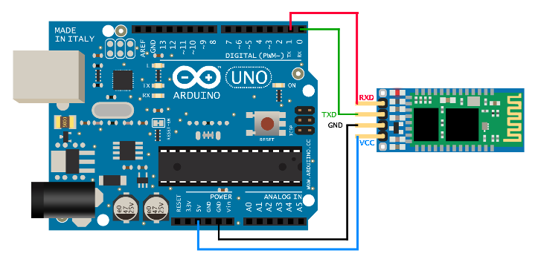
Bluetooth Communication with the Arduino
Make sure you connect the Bluetooth Module like this:

Slide 5
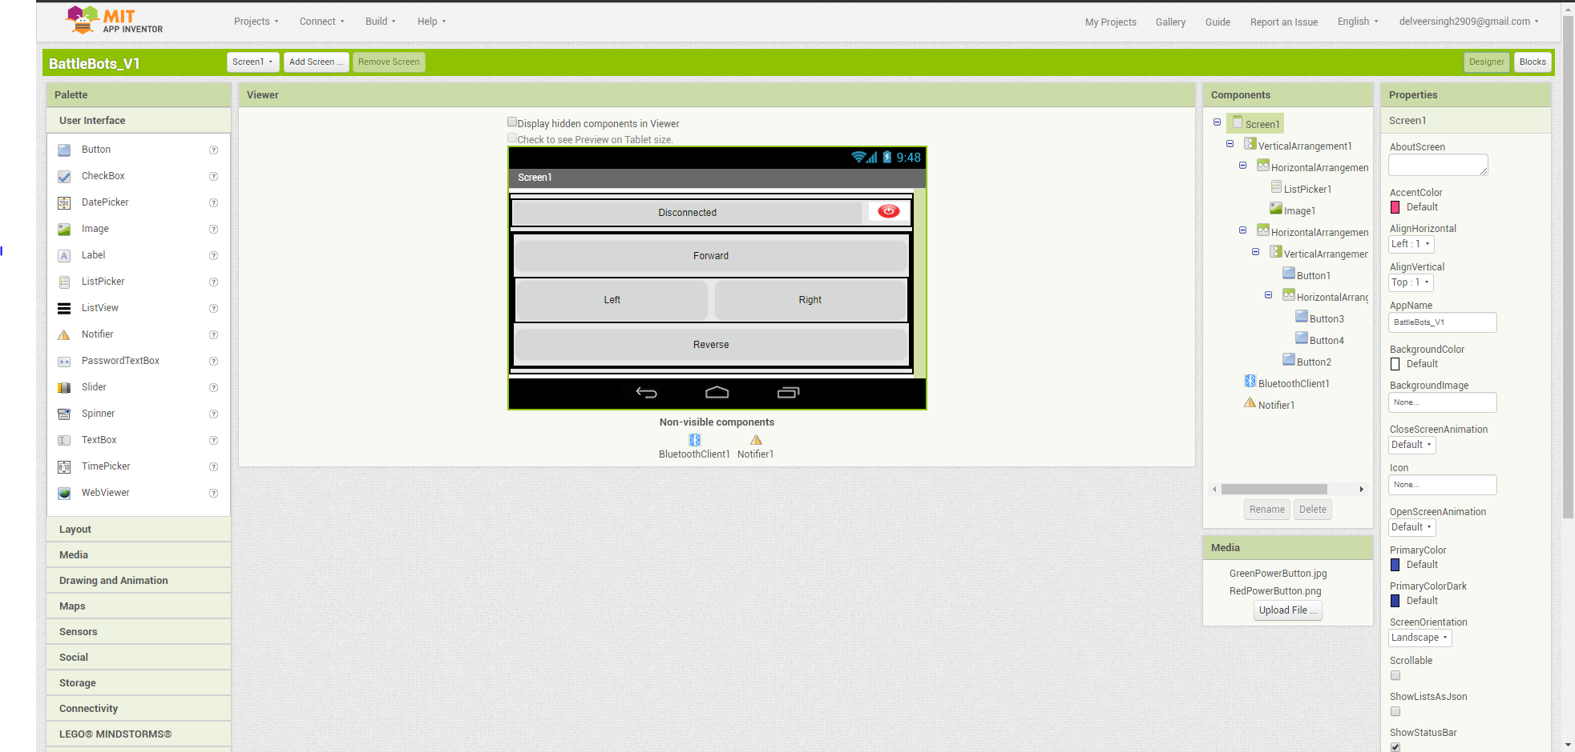
What the layout looks like?
Component properties
Select The items that you want to use from the palette.
Drag and drop onto the viewer to preview.
List of all the components on the screen.

Slide 6
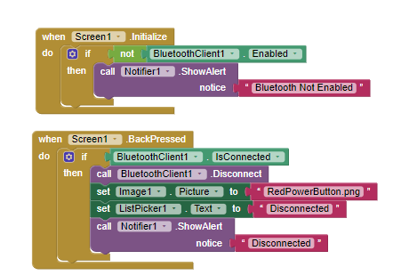
Bluetooth Communication with the Arduino
This is just to ensure Bluetooth is enabled on the phone when screen is initialised
Deactivate Bluetooth if we press back.

Slide 7
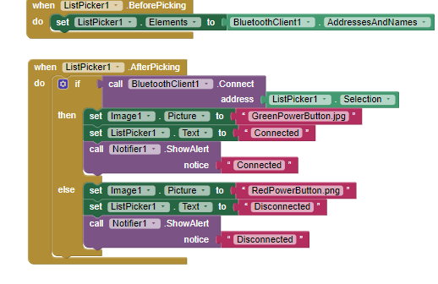
Bluetooth Communication with the Arduino
Display all the names of the devices we can connect to our phone
Gives notice if connected or disconnected
Connect to the selected Bluetooth network.

Slide 8
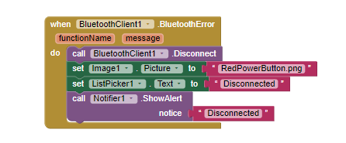
Bluetooth Communication with the Arduino
Bluetooth error exception handling
Gives notice if connected or disconnected
Disconnect Bluetooth

Slide 9
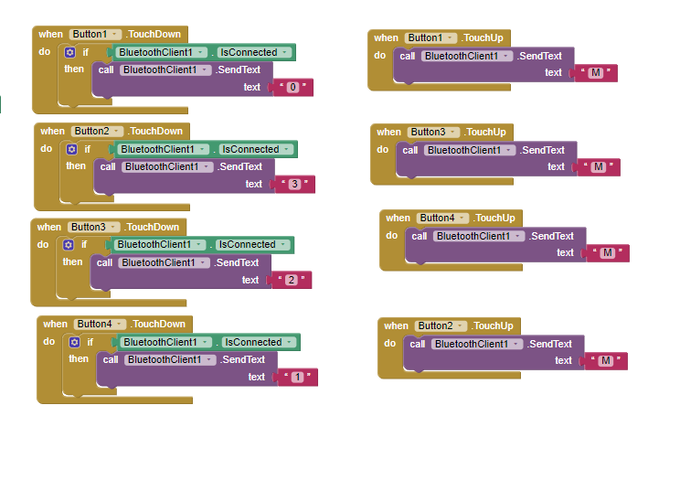
Bluetooth Communication with the Arduino
When button 1 is not pressed, send a “M”.
When button1 is being pressed, send a “0” to the Bluetooth module.
But! Why send a M. And why must the string sent be “0”,”1”,”2” or “3”?

Slide 10
Bluetooth Communication with the Arduino
Great! Now, We need to program the Arduino to get the Bluetooth to receive something from our app!
Open Up the Arduino IDE
Then, Follow me.

Slide 11
All that’s left?
Lets try it out!

Slide 12
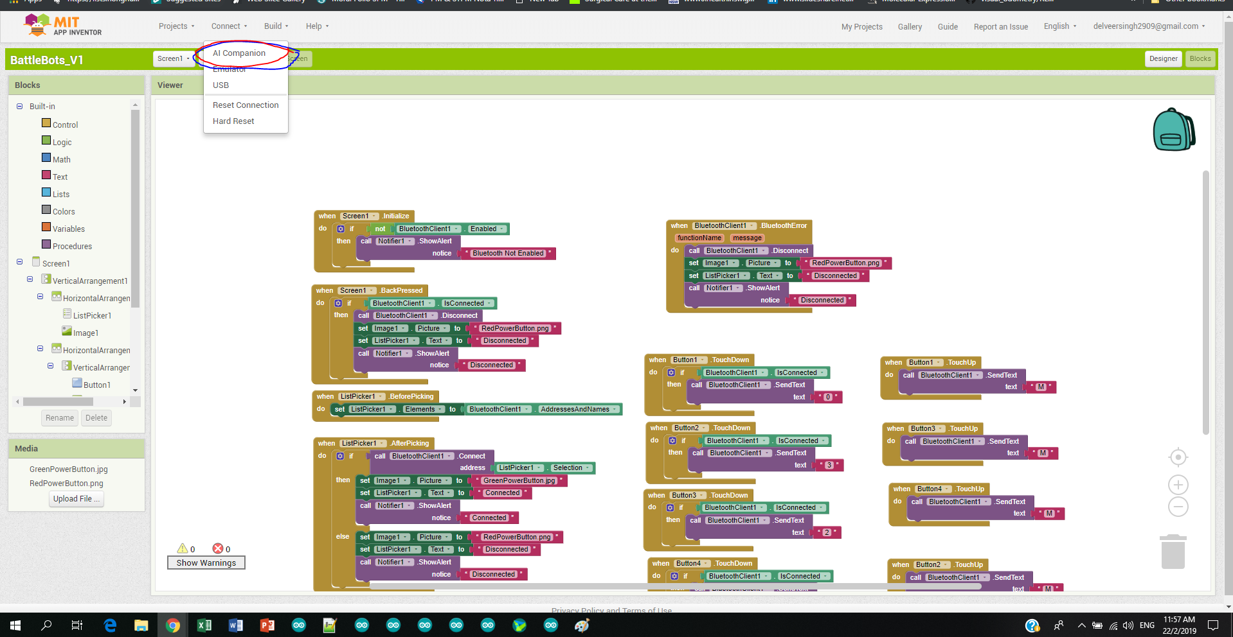
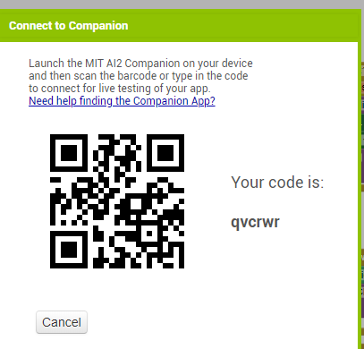
Open the MIT AI companion app on your smartphone and scan the QR code as follows!

Slide 13
Test What you have made
Login into the MIT App inventor application
Connect to your project
Test to see if it works
There you have it!

Slide 14
Thank You!!

