Slide 1
Team A3

Slide 2
Requirements & Perceived Functionality
Reduce the running cost by offering clients to claim their insurance online
System structure should allow easy addition for other types of claim and policy
Policyholders should be able to hold multiple policies (portfolio) and make claims
System should be able to calculate risk factor, premium, excess charge and driver ratings for appropriate policies and claims
System should record policyholder’s last claim date and no claim bonus if eligible
Assessors should be able to update claims (Accepted/Rejected/Suspicious)
Investigators should be able to access suspicious claims
Additional admin role for inserting crucial data, ie adding policyholders, policies, processing claims

Slide 3
Usecase Diagram
Use Case Scenario 1
Policyholder wants to make a car insurance claim
Use Case Scenario 2
The Assessor assessing the insurance claims

Slide 4
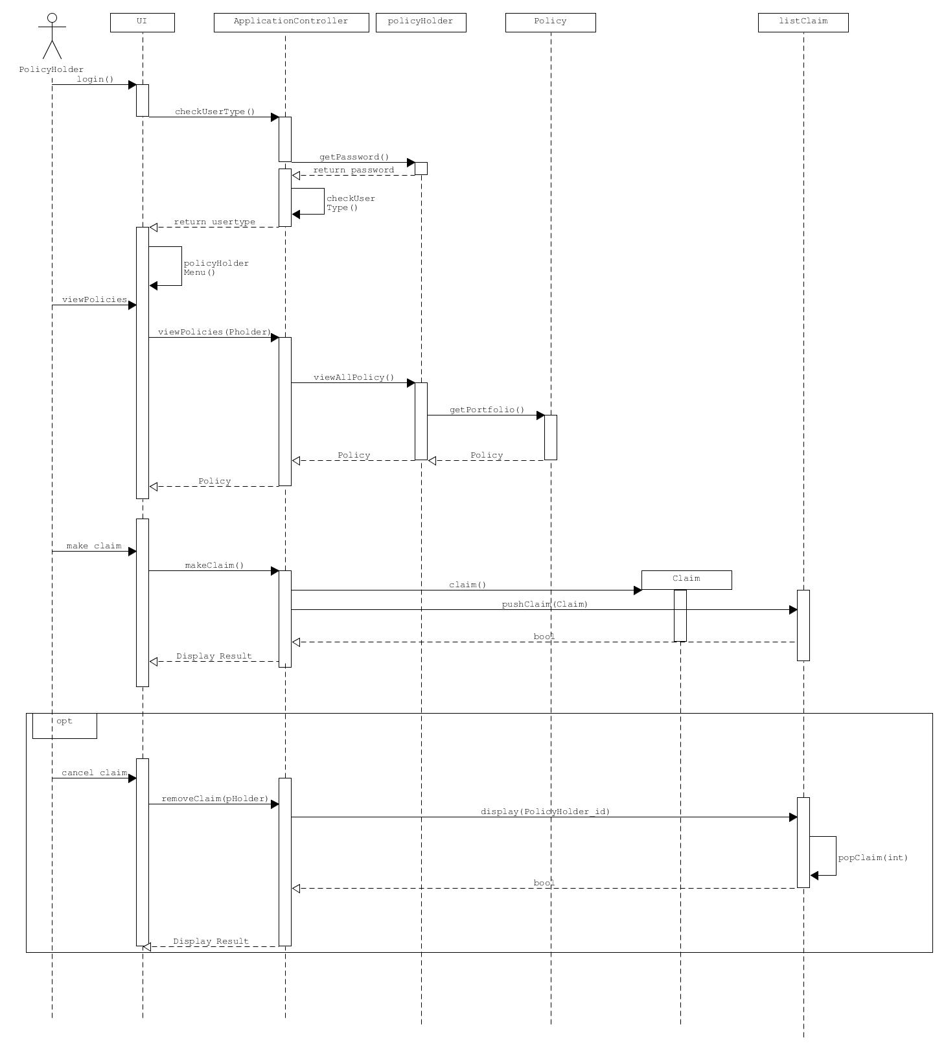
Sequence Diagram #1
Policyholder wants to make a car insurance claim

Slide 5
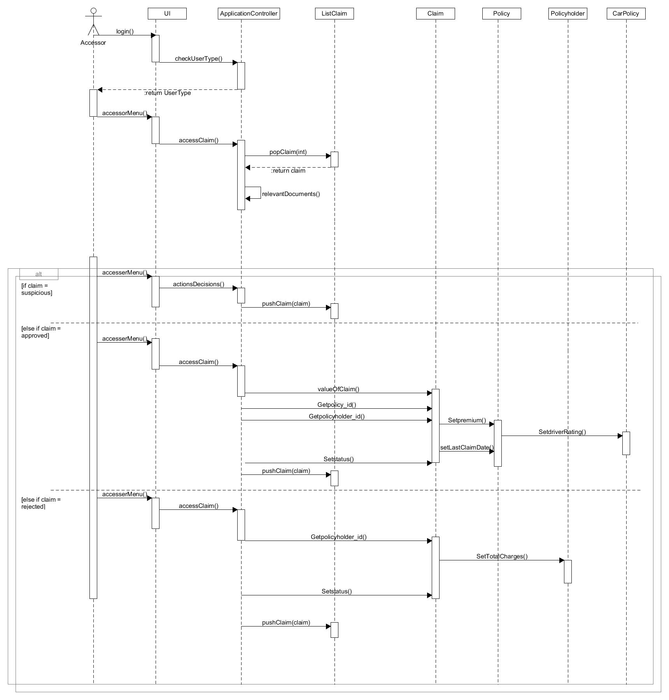
Sequence Diagram #2
The Assessor assessing the insurance claims

Slide 6
Class Diagram
Data Dictionary : ApplicationController
ListClaim
CarPolicy

Slide 7
Data Dictionary
Class (Name) | Attribute Name | Description | Type | Format | Range | Req’d | Related Class(es) | Nature of relationship
CarPolicy | TPPassDate | Drivers TP Pass Date | String | DD/MM/YYYYY |  | Y | POLICY | Specialization
 | LostLicense | Indicates if driver lost license before | Bool |  | Y/N | Y | POLICY | Specialization
 | carAge | Age of vehicle under policy | Int |  | 0 - 30 | Y | POLICY | Specialization
 | modifiedValue | Index describing level of modification on vehicle | float |  | 0.0 – 10.0 | Y | POLICY | Specialization
 | covType | Enum describing type of policy and classification | enum |  | 0 - 2 | Y | POLICY | Overrides Inheritance Superclass -> POLICY
 | covValue | Value of coverage provided by policy | float |  |  | Y | POLICY | Overrides Inheritance Superclass -> POLICY POLICY
 | driverRating | Rating of driver | float |  | 0.0 – 20.0 | Y | POLICY | Specialization
 | carType | Enum describing car class and type | enum |  |  | Y | POLICY | Specialization
ListClaim | claimVec | Container for all Claim objects | Vector (CLAIM) |  |  | Y | CLAIM | Aggregation (CLAIM)
 | counterWaiting | Counter recording all Claims (Assessor) | Int |  | 0 < | Y
 | counterApproved | Counter recording all Claims (Admin) | Int |  | 0 < | Y
ApplicationController | Username | Current user’s username | String |  |  | Y | ADMIN, POLICYHOLDER, ASSESSOR
 | Password | Current user’s password | String |  |  | Y | ADMIN, POLICYHOLDER, ASSESSOR

Slide 8
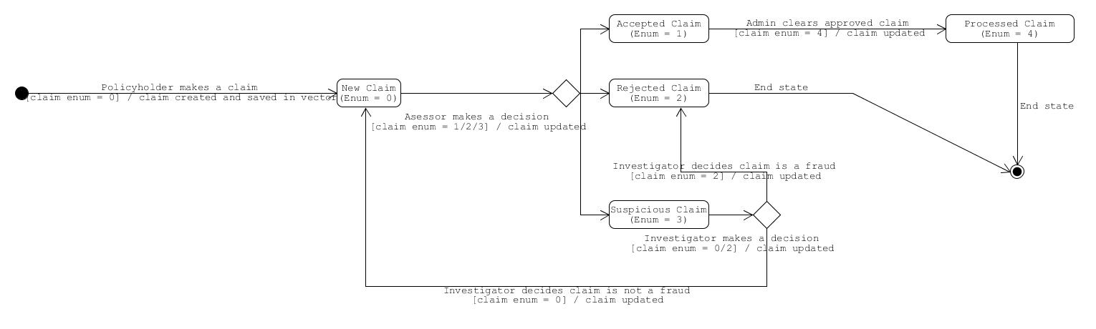
Claim State Diagram

