Slide 1
Team A3

Slide 2
Requirements
To create a Warehouse Management (WM) Tool that :
- manages the stock item
- provides a report view (daily, weekly, monthly, yearly)
VCS used : GitHub

Slide 3
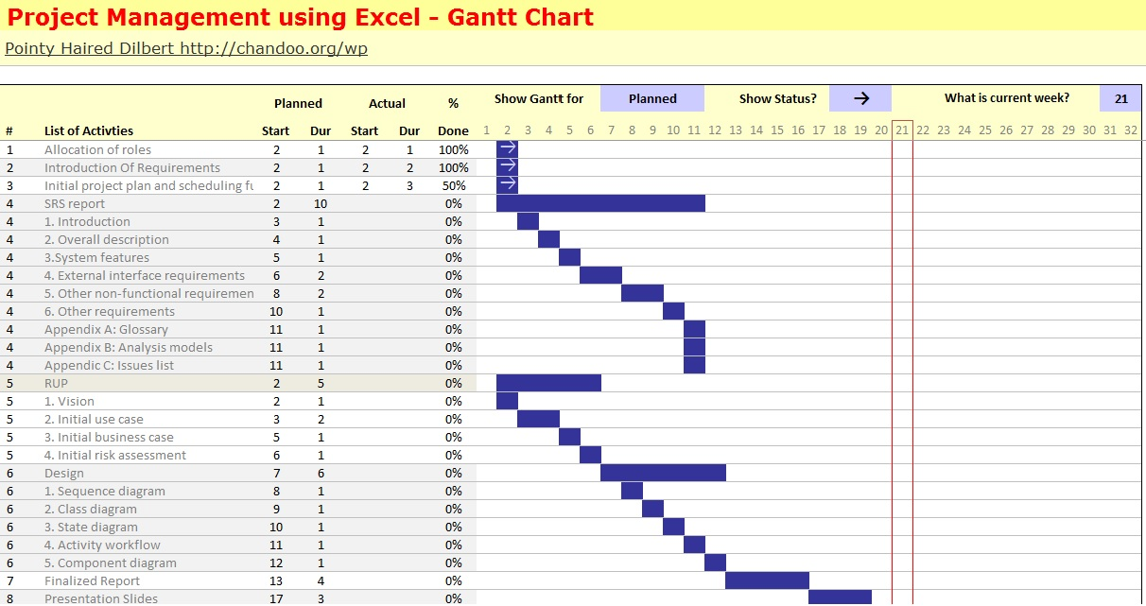
GANTT Chart

Slide 4
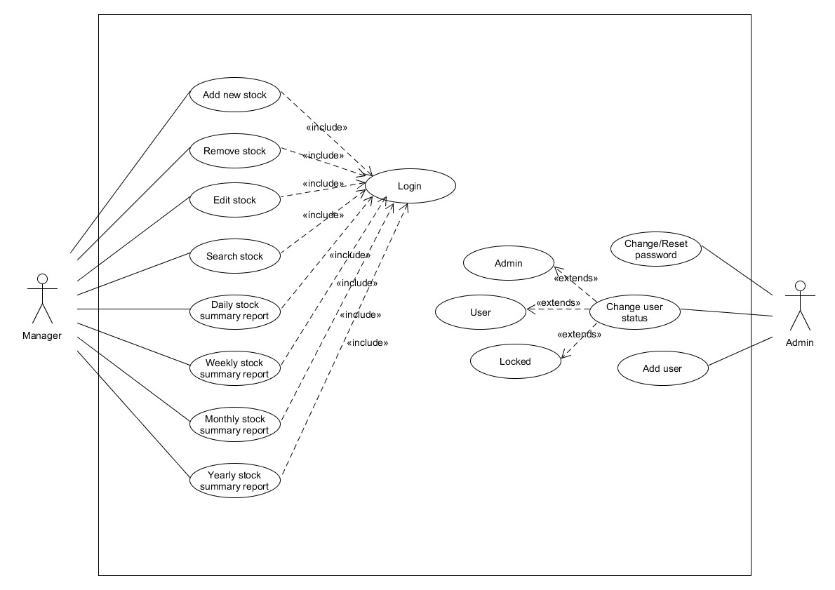
Use Case Diagram – Iteration 1

Slide 5
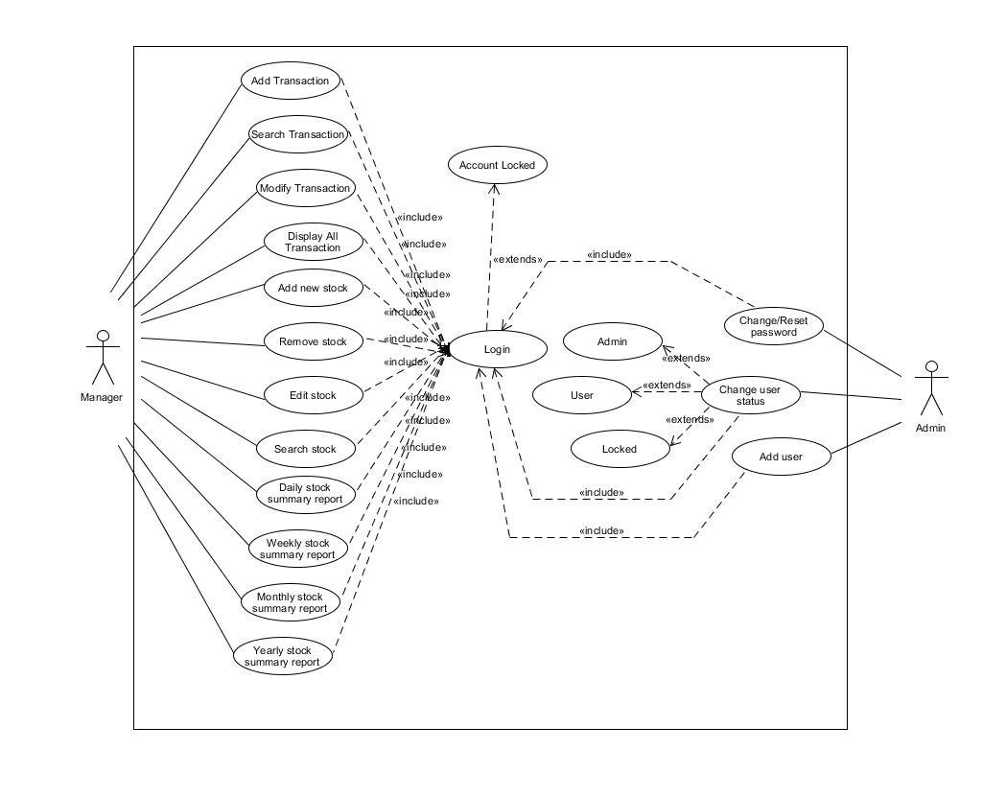
Use Case Diagram – Iteration 2

Slide 6
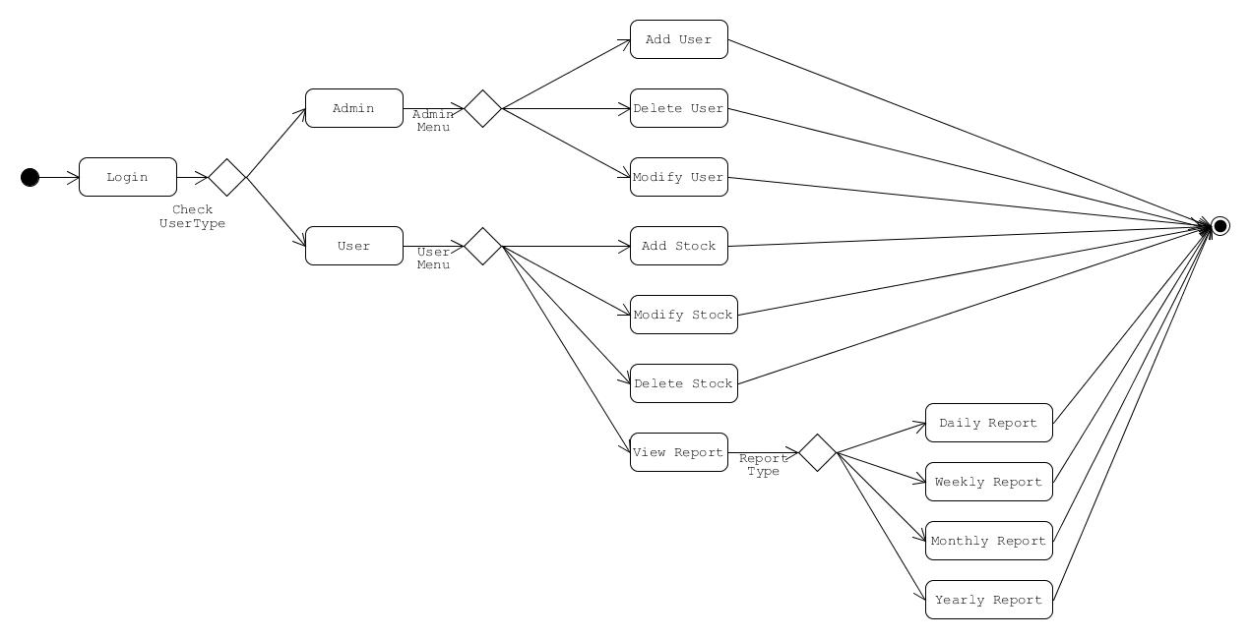
Activity Workflow Diagram – Iteration 1

Slide 7
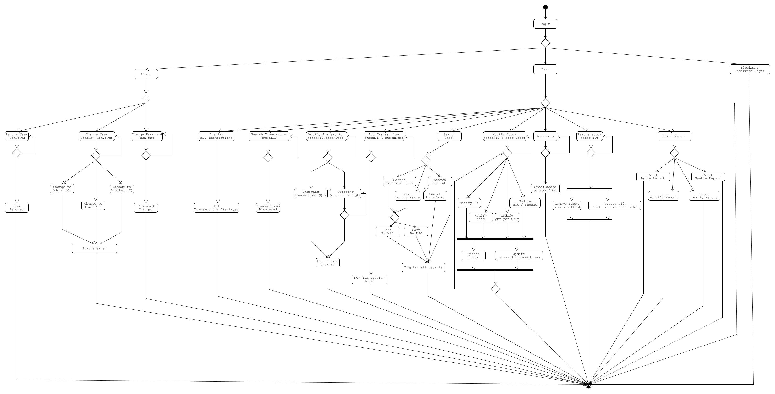
Activity Diagram – Iteration 3 (Overview)

Slide 8
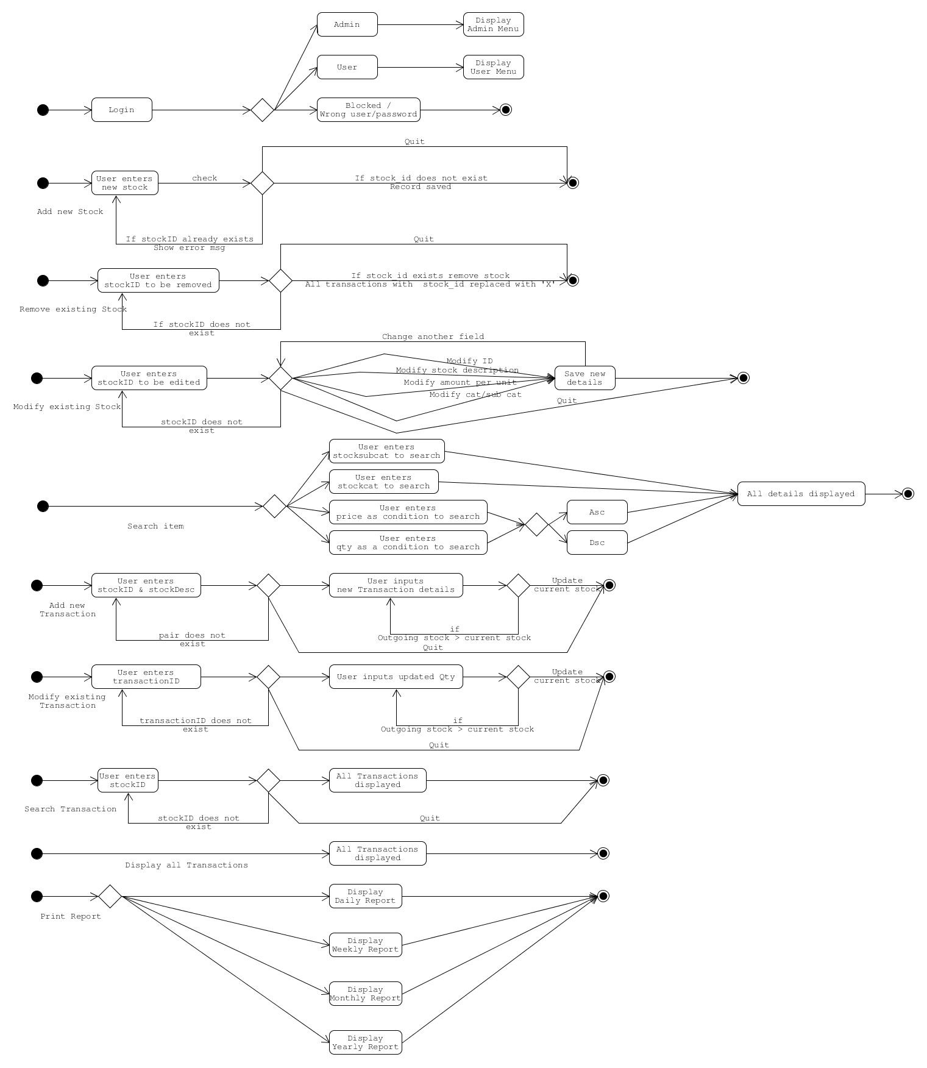
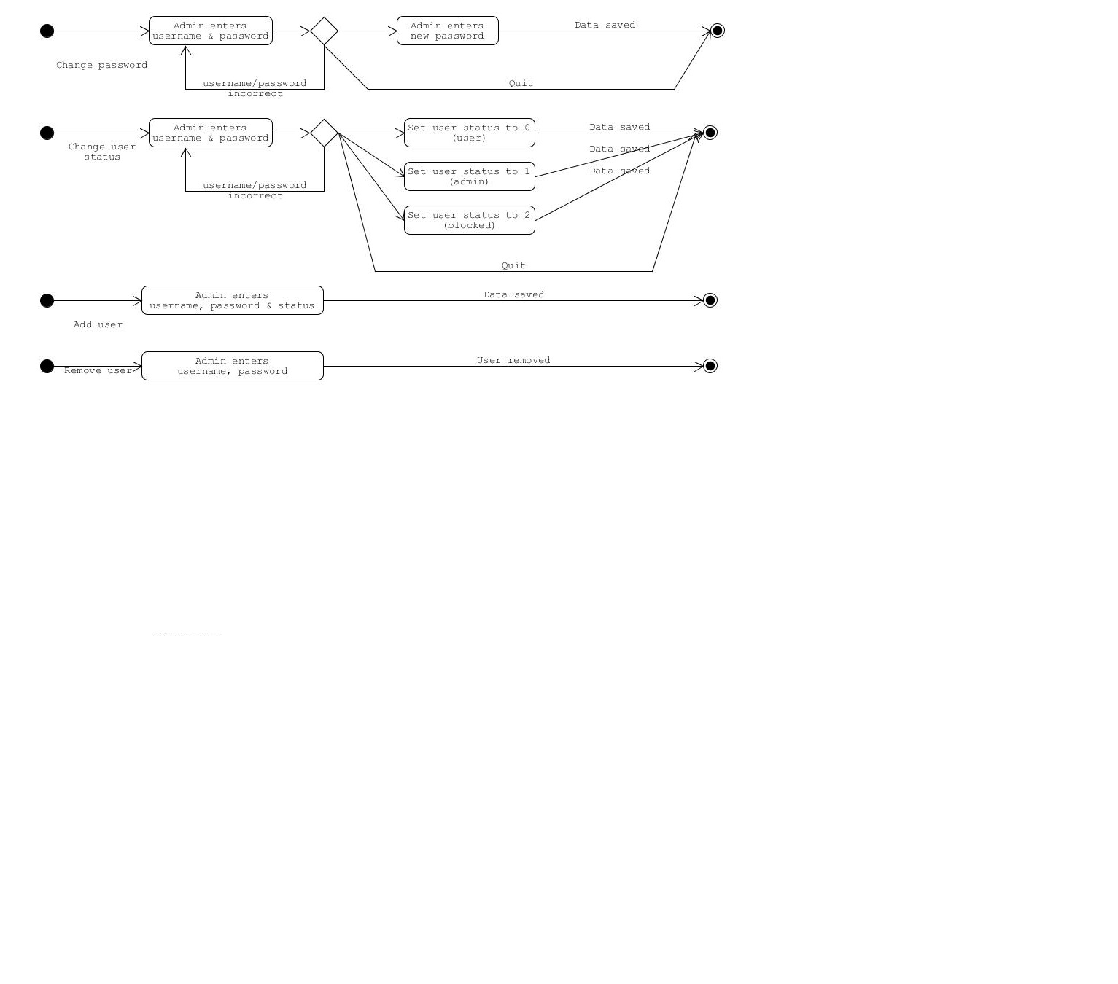
Activity Diagram – Iteration 3 (Detailed)

Slide 9
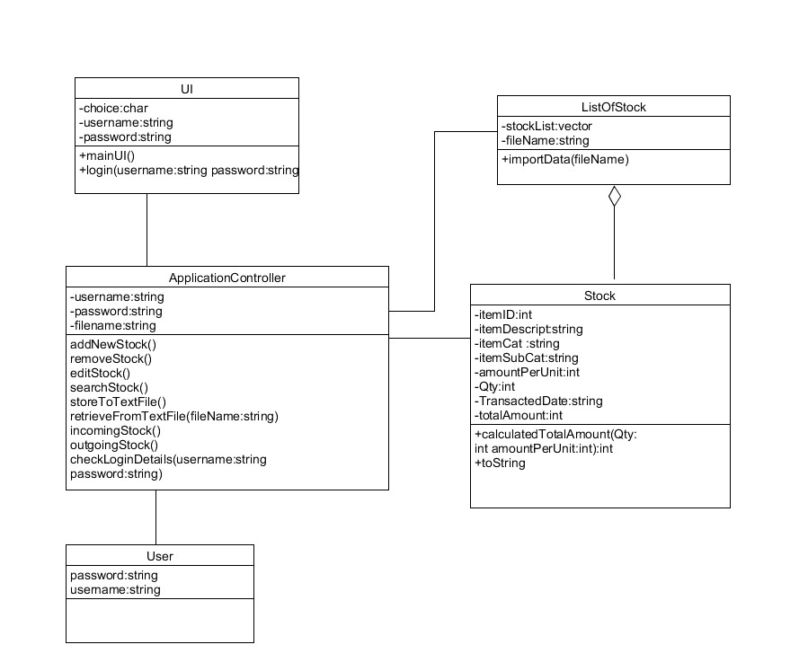
Class Diagram – Iteration 1

Slide 10
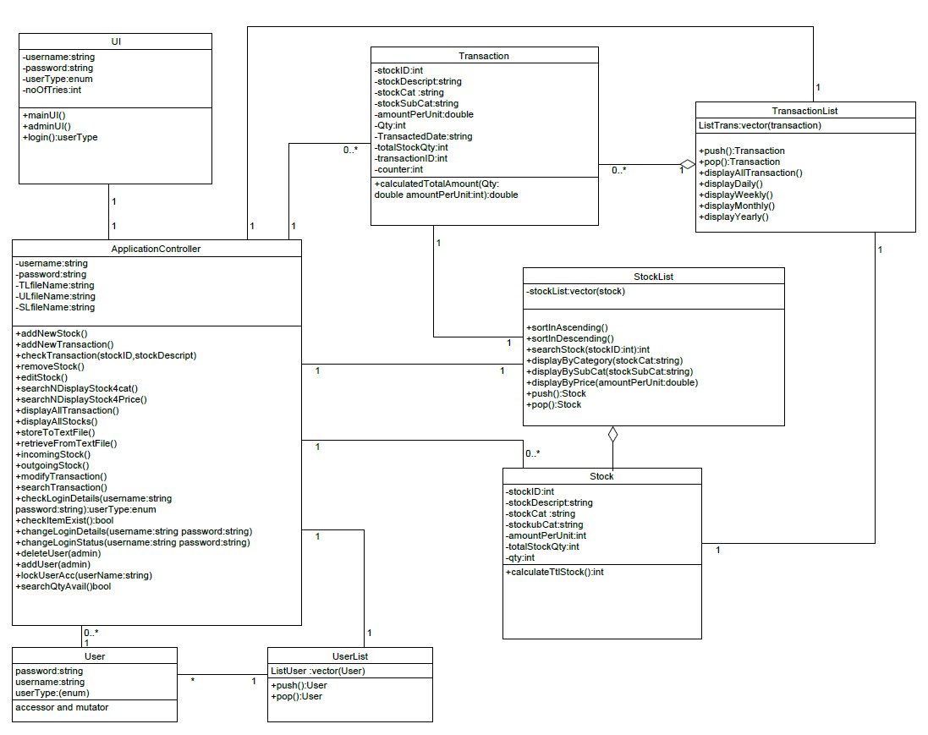
Class Diagram – Iteration 3

Slide 11
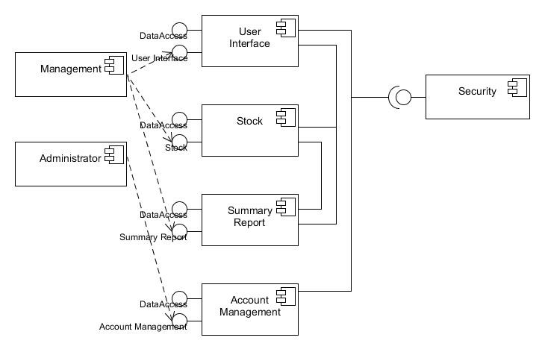
Component Diagram – Iteration 1

Slide 12
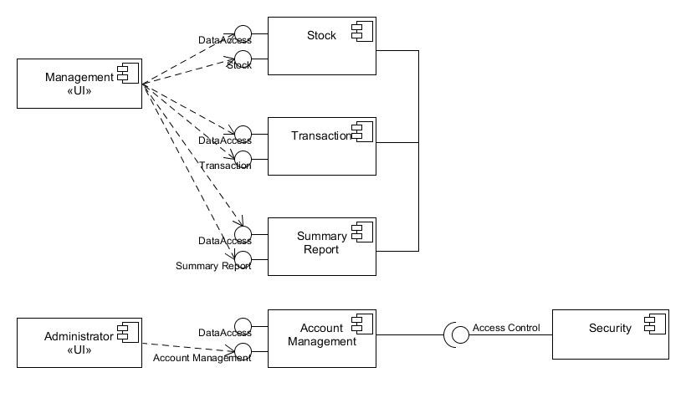
Component Diagram – Iteration 2

