Slide 1

Kaiming He, Xinlei Chen, Saining Xie, Yanghao Li, Piotr Dollár, Ross Girshick
Masked Autoencoders
Are Scalable Vision Learners
(CVPR 2022)
Paper Authors:
Umut Özyurt
Presentation author:
This presentation was prepared for the CENG502 - Advanced Deep Learning course for the Spring 2024 term.
It is part of the coursework assigned by our lecturer, Prof. Sinan Kalkan.

Slide 2
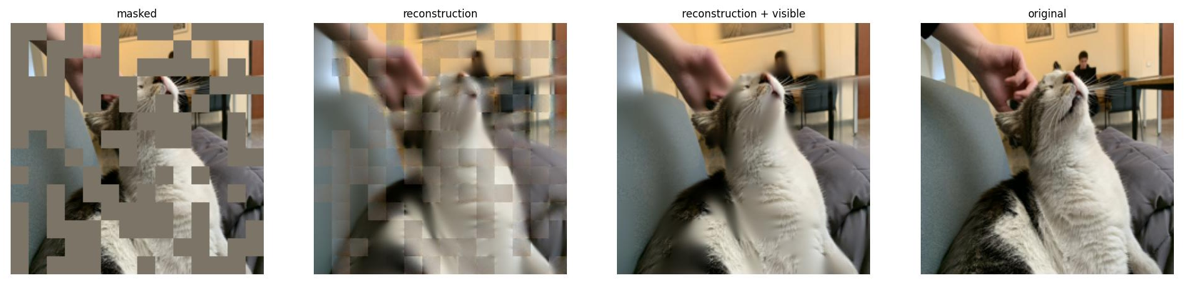
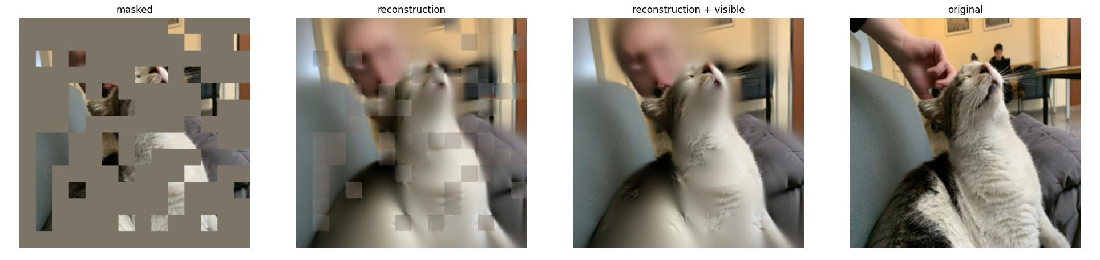

Reconstruction example of METU CENG's cat, "Java"
50% masking ratio
75% masking ratio
75% masking ratio

Slide 3
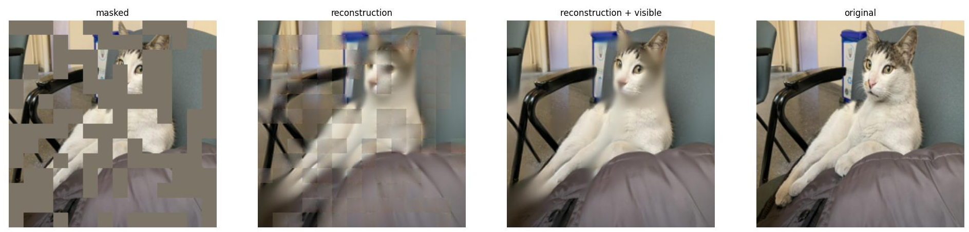
Reconstruction example of METU CENG's cat, "Java"
50% masking ratio

Slide 4
Reconstruction example of METU CENG's cat, "Java"
50% masking ratio

Slide 5
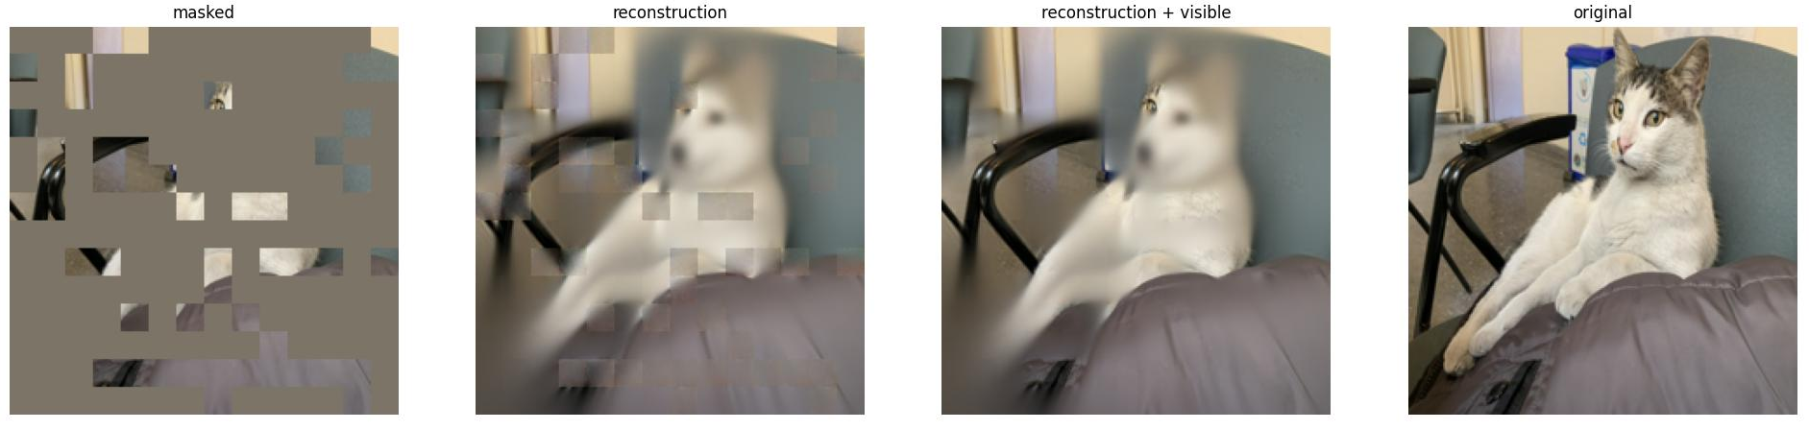
Reconstruction example of METU CENG's cat, "Java"
75% masking ratio

Slide 6
Reconstruction example of METU CENG's cat, "Java"
75% masking ratio

Slide 7
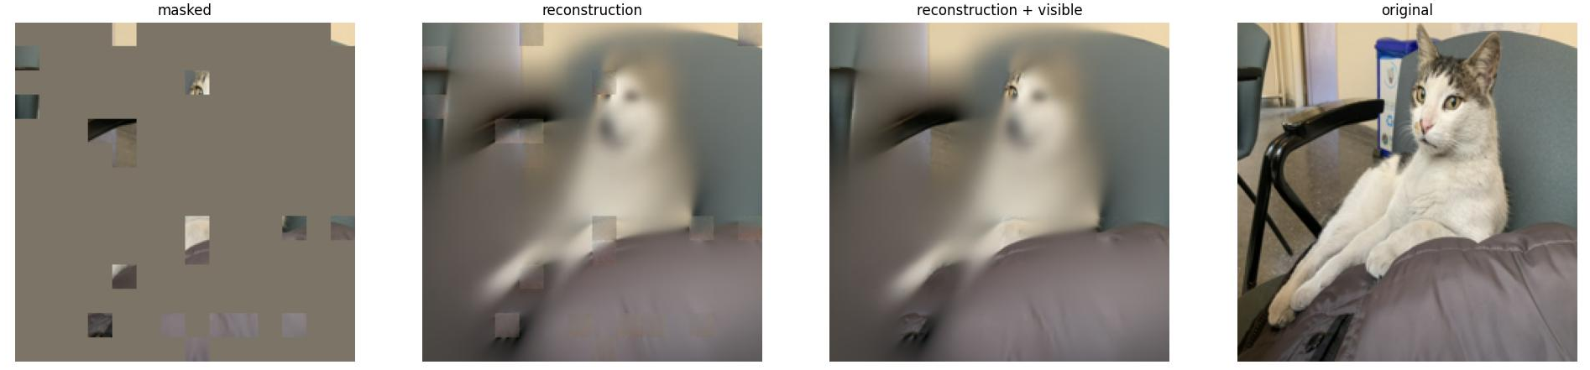
Reconstruction example of METU CENG's cat, "Java"
90% masking ratio

Slide 8
Reconstruction example of METU CENG's cat, "Java"
90% masking ratio

Slide 9
Overview of the presentation
Introduction
Related work
Approach and method
Pre-training experiments
Transfer Learning Experiments
Discussion and Conclusion
Q & A

Slide 10
1-
Introduction

Slide 11
Dataset needs in Computer Vision
For a vision model to perform well, datasets should:
Contain a massive amount of samples
Be labeled
Despite gigantic datasets, pre-training methods do not scale efficiently.

Slide 12
Dataset needs in Computer Vision
For a vision model to perform well, datasets should:
Contain a massive amount of samples
Be labeled
Despite gigantic datasets, pre-training methods does not scale efficiently.
feasibly
large
or unlabeled (pre-training)
With datasets like
imagenet-1k (*),
* ImageNet: A Large-Scale Hierarchical Image Database:
https://www.image-net.org/static_files/papers/imagenet_cvpr09.pdf

Slide 13
Vision vs NLP
We can adopt pre-training techniques from NLP (like BERT*), which scales well.
Caution! Information density is different!
Architecture differences.
Decoder goal differences.
* BERT: Pre-training of Deep Bidirectional Transformers for Language Understanding:
https://arxiv.org/pdf/1810.04805

Slide 14
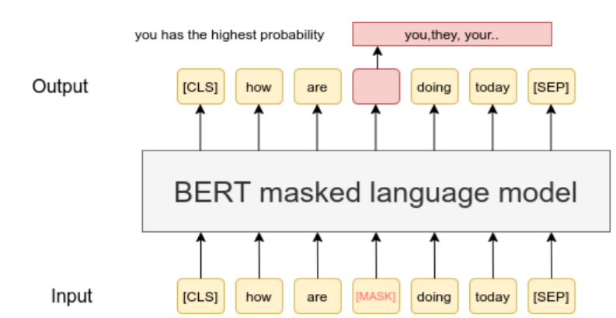
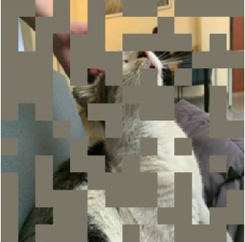
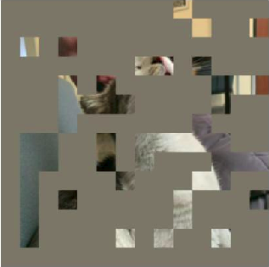
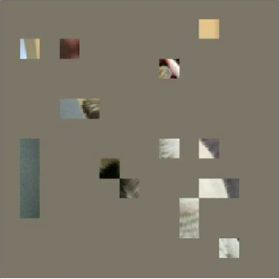
Vision vs NLP
Caution! Information density is different!
Figure 1. Masked images of METU CENG's cat "Java" at masking ratios of 50%, 75%, and 90% (from left to right).
Figure 2. Masked input sentence for an NLP pre-training task.
* BERT: Pre-training of Deep Bidirectional Transformers for Language Understanding:
https://arxiv.org/pdf/1810.04805
Figure 2:
https://www.sbert.net/examples/unsupervised_learning/MLM/README.html

Slide 15
Vision vs NLP
The nature of inputs are different in terms of information density.
In NLP, signals (words) are highly semantic and rich in information.
Imagine masking
high ratios in NLP
Figure 1. Masked images of METU CENG's cat "Java" at masking ratios of 50%, 75%, and 90% (from left to right).
Figure 2. Masked input sentence for an NLP pre-training task.
(60% masked) (edited)
* BERT: Pre-training of Deep Bidirectional Transformers for Language Understanding:
https://arxiv.org/pdf/1810.04805
Figure 2 (edited):
https://www.sbert.net/examples/unsupervised_learning/MLM/README.html

Slide 16
The paper's main goal
Design a method to learn visual representations.
Utilize unlabeled datasets for this process.
Ensure scalable performance.
Ultimately, provide a backbone for other tasks through transfer learning.

Slide 17
2–
Related Work

Slide 18
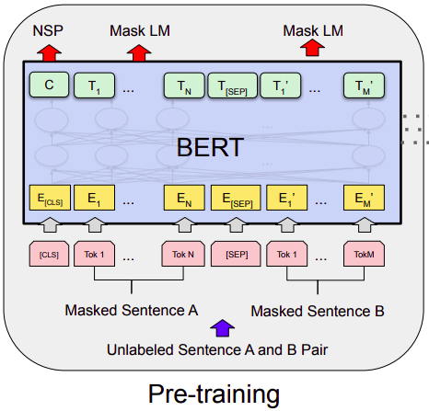
Masked Language Modeling
Masking some of the input, learning to predict the masked content.
In NLP tasks, masked language modeling works well on pre-training.
They provide high scalability**
Figure 3. BERT* pre-training
* BERT: Pre-training of Deep Bidirectional Transformers for Language Understanding:
https://arxiv.org/pdf/1810.04805
** Language Models are Few-Shot Learners:
https://arxiv.org/pdf/2005.14165

Slide 19
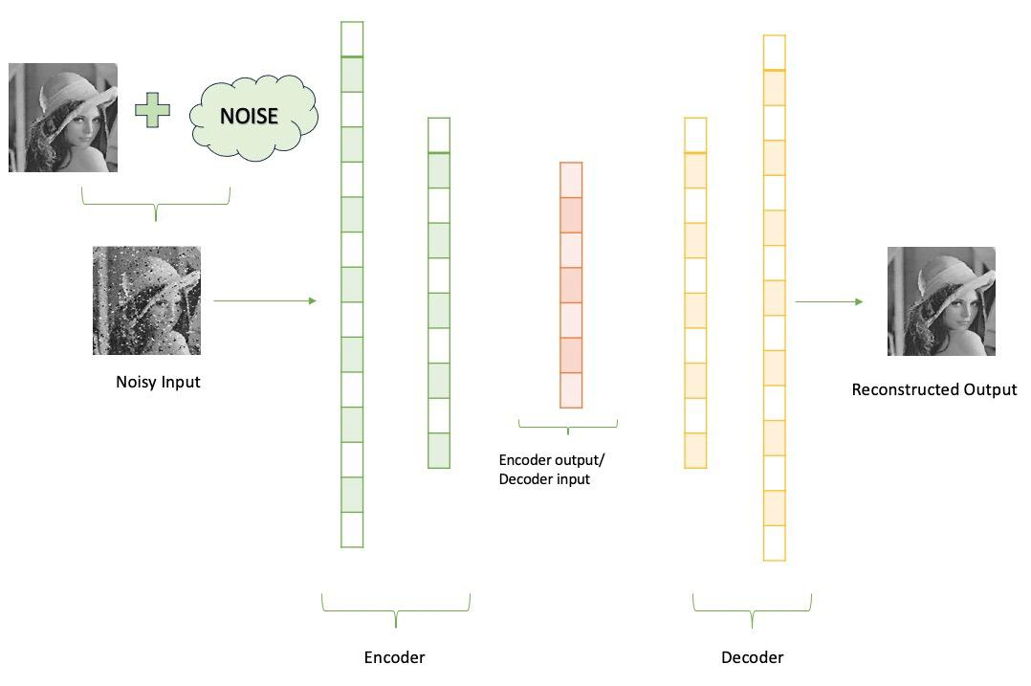
(Denoising) Autoencoders
Autoencoders learn representations by mapping input to a latent space, and attempting to reconstruct it using this latent representation.
Denoising autoencoders (DAE) (*) are autoencoders that corrupt the input and learn to reconstruct it.
Masking some of the input can be regarded as a form of corruption. Hence, MAE is a type of DAE, albeit with differences
Figure 4. DAE example
Figure 4:
https://www.geeksforgeeks.org/denoising-autoencoders-in-machine-learning
* Extracting and composing robust features with denoising autoencoders:
https://www.cs.toronto.edu/~larocheh/publications/icml-2008-denoising-autoencoders.pdf

Slide 20
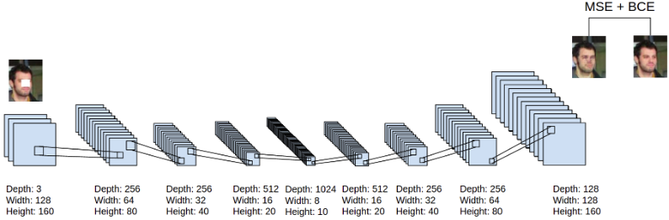
Masked image encoding
Pixel masking is used as a noise to learn better representations in DAEs.(*)
The original ViT paper (**) uses masked patch prediction as a pre-training, method, replacing approximately 45% of patches with mask embeddings or any random patch embedding.
Figure 5. example of a DAE using
pixel masking as a noise
* : Stacked Denoising Autoencoders: Learning Useful Representations
in a Deep Network with a Local Denoising Criterion:
https://www.jmlr.org/papers/volume11/vincent10a/vincent10a.pdf
** : An Image is Worth 16x16 Words: Transformers for Image Recognition at Scale:
https://arxiv.org/pdf/2010.11929
Figure 5:
https://faculty.cc.gatech.edu/~hays/7476/projects/Avery_Wenchen/

Slide 21
Self-supervised learning
Self-supervised learning aims to learn representations without using labels.
For pre-training, various self-supervised techniques have been used, such as contrastive learning (MoCo v3) (*), which compares two crops.
* : An Empirical Study of Training Self-Supervised Vision Transformers:
https://arxiv.org/pdf/2104.02057

Slide 22
3-
Approach
and
Method

Slide 23
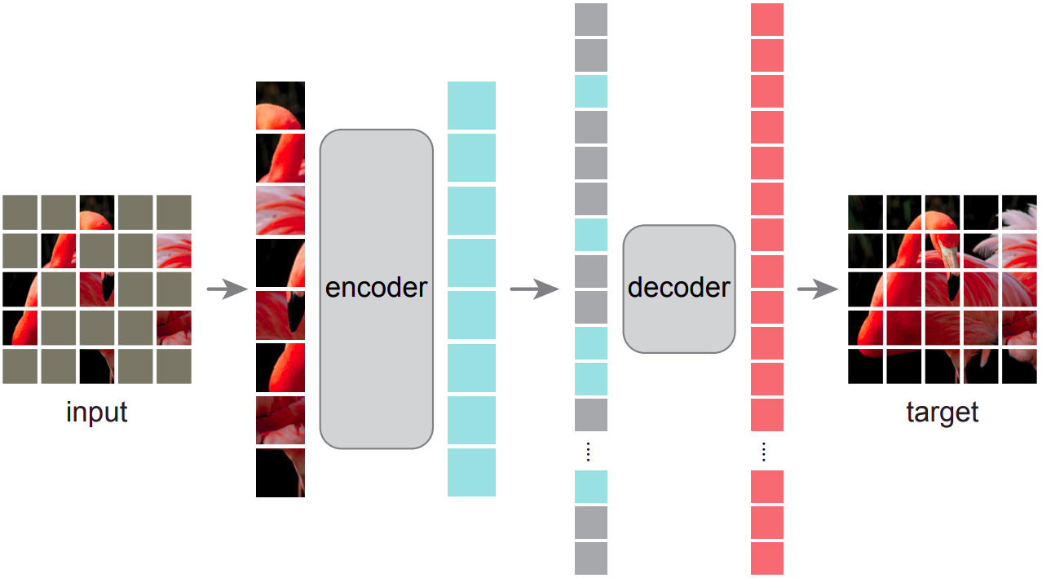
Overall Architecture
Figure 6. MAE architecture from the paper
Figure 6 (from the presented paper):
https://arxiv.org/pdf/2111.06377

Slide 24
Masking Method
Similar to the original ViT (*), they divide the input to non-overlapping patches.
They uniformly sample a very large proportion (75%) of these patches and mask them, which is a departure from previous methods.
They do not use mask tokens in masking operation, differing from the previous work.
Masking a high ratio makes predicting task challenging and meaningful.
Also, not using mask tokens and picking a high sampling ratio enables the encoder to be very large.
Figure 6. MAE architecture
from the paper
Figure 6 (from the presented paper):
https://arxiv.org/pdf/2111.06377
* An Image is Worth 16x16 Words: Transformers for Image Recognition at Scale:
https://arxiv.org/pdf/2010.11929

Slide 25
Mae Encoder
As stated, the encoder only operates on unmasked patches (25%).
It embeds the patches by linear projection and add positional embeddings.
It uses transformer blocks.
Since the input patches is a small part of the input, the encoder is chosen to be very large. (encoder has over 9 times computations per token vs decoder)
Figure 6. MAE architecture
from the paper
Figure 6 (from the presented paper):
https://arxiv.org/pdf/2111.06377

Slide 26
Mae Decoder
Merges encoder outputs with the shared mask tokens in previously masked places, adding positional encodings to them.
It also uses transformer blocks, followed by a linear projection for finalizing pixel reconstruction.
It is solely responsible for reconstruction, meaning it is not used post-training. Hence, it is independent of the encoder design, making it flexible.
Experiments made with light-weight decoders, significantly reducing the training time. Also, this choice implies an asymmetrical autoencoder design. (This is different than the previous work)
Figure 6. MAE architecture
from the paper
Figure 6 (from the presented paper):
https://arxiv.org/pdf/2111.06377

Slide 27
Reconstruction Target
Basically, the MSE (mean squared error loss) in the pixel space between input image and reconstructed image is adopted.
Loss is only computed for masked patches, following the BERT (*)
They also tried to normalize all patches with their mean and std. Using normalized pixels as the reconstruction target enhanced the representation quality.
* BERT: Pre-training of Deep Bidirectional Transformers for Language Understanding:
https://arxiv.org/pdf/1810.04805

Slide 28
4-
Pre-training
Experiments

Slide 29


Baseline Model and Dataset
ViT (*) Large model is used as a baseline. (Very big and normally prone to overfitting.)
Pre-training is made with ImageNet-1K (IN1K) (**) dataset.
Baseline MAE outperforms the trained from scratch ViT (*) model, even with a good training technique.
Figure 7. top-1 validation accuracy on IN1K
* An Image is Worth 16x16 Words: Transformers for Image Recognition at Scale:
https://arxiv.org/pdf/2010.11929
** ImageNet: A Large-Scale Hierarchical Image Database:
https://www.image-net.org/static_files/papers/imagenet_cvpr09.pdf
Figure 7 (from the presented paper):
https://arxiv.org/pdf/2111.06377

Slide 30
Linear Probing vs Full Fine-tuning
In linear probing, the pre-trained model is fixed, and only one linear layer is added at the end, to predict the labels (or produce the output). This method is used to assess the quality of representations from a pre-trained feature extraction model. (*)
In fine-tuning, pre-trained model is further trained (not fixed), and one or more layers, possibly with non-linearities are added.
Hence, linear probing provides a measure of representation quality of a pre-training in restricted conditions, while fine-tuning exploits models near-true potential to adopt for new tasks.
In linear probing, since only 1 linear layer is trained, is fast to train and less computationally expensive.
* Self-Supervised Learning of Pretext-Invariant Representations:
https://arxiv.org/pdf/1912.01991

Slide 31
Ablation Experiments
8 topics are considered in ablation studies:
Masking ratio
Decoder depth
Decoder width
Mask token (used or not in encoder)
Reconstruction target
Data augmentation
Mask sampling method
Training schedule

Slide 32
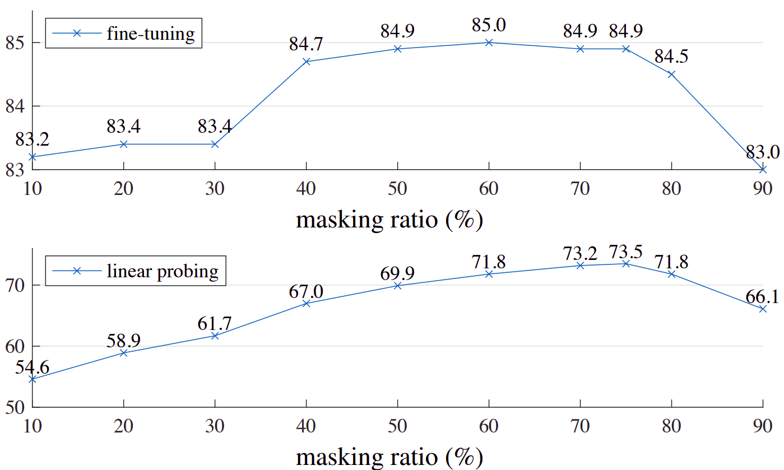
Masking Ratio
High masking ratios (≈75%) works well for both cases, considering the information density difference with NLP.
Choosing high masking ratios increases the speed in both training and inference time since encoders computations
From 10% to 90%, all masking ratios produce better results when compared to trained from scratch (82.5% accuracy)
Figure 8. Effect of masking ratio on fine-tuning and linear probing
top-1 accuracies on IN1K
Figure 8 (from the presented paper):
https://arxiv.org/pdf/2111.06377

Slide 33
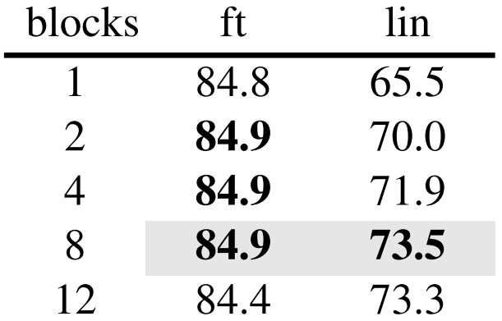
Decoder Depth
Using a decoder with an 8-block depth is effective for both fine-tuning and linear probing.
Decoder depth is not critical for fine-tuning.
However, decoder performance deteriorates with shallow decoders. If the decoder is not deep enough, then the encoders output will possibly be less abstract and more focused on reconstruction task.
Only 1 decoder block is enough for fine-tuning task. This can speed up the training even more if needed!
Figure 9. Effect of decoder depth on fine-tuning and linear probing
top-1 accuracies on IN1K
Figure 9 (from the presented paper):
https://arxiv.org/pdf/2111.06377

Slide 34
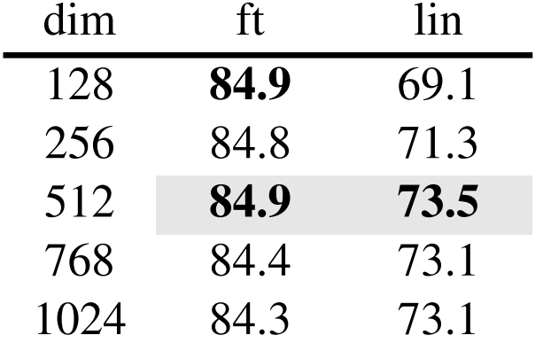
Decoder Width
Choosing a decoder width of 512 is a viable option for both fine-tuning and linear probing.
Narrower decoders also yield strong performance in fine-tuning tasks.
These depth and width choices makes the decoder lightweight, which has 9% FLOPs per token vs ViT-L (24 blocks, 1024-d)
From now on, 8-blocks 512-width decoder is used if not specified.
Figure 10. Effect of decoder width on fine-tuning and linear probing
top-1 accuracies on IN1K
Figure 10 from the presented paper):
https://arxiv.org/pdf/2111.06377

Slide 35
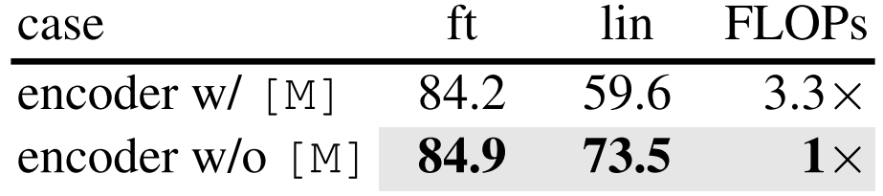
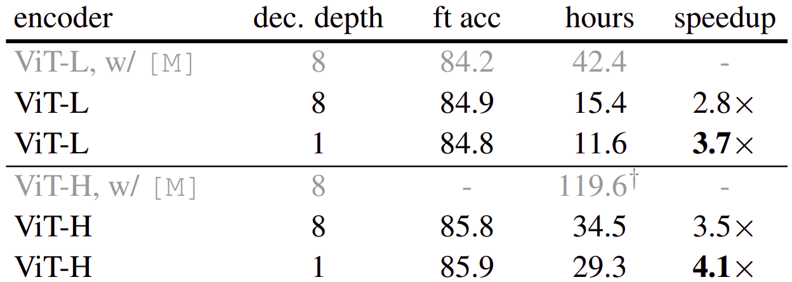
Mask Token (for encoder)
Not using mask tokens on encoder is one of the key-features of the paper.
It reduces overall FLOPs by 3.3x which significantly reduces the training time. (using 1-block decoder further boosts the speed!)
Moreover, accuracy considerably drops, especially in linear probing when mask tokens are used.
Also, memory usage is reduced which makes training larger models possible or increase batch-size for even faster trainings.
Figure 11. Effect of using mask token on encoder on fine-tuning and linear probing
top-1 accuracies on IN1K
Figure 12. Effects of not using mask tokens and decoder depth as training times and fine-tuning top-1 accuracies on IN1K
Figure 11 and 12 (from the presented paper):
https://arxiv.org/pdf/2111.06377

Slide 36
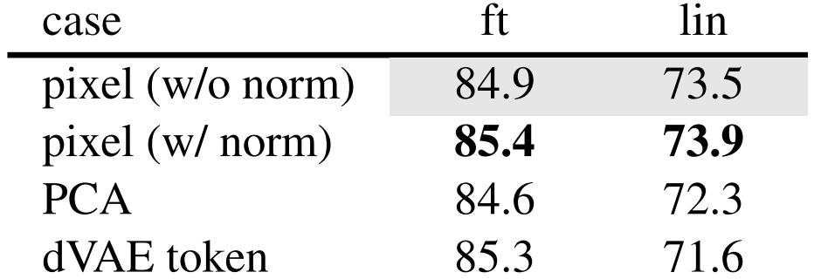
Reconstruction Target
Using pixel MSE loss with normalization improves accuracy.
In PCA, they perform PCA and use largest 96 coefficients as the target.
They also compared the target in BEiT (*), using dVAE (**) as the tokenizer, where the MAE decoder is predicts token indices using cross-entropy loss.
The BEiT(*) target has no advantages to normalized pixel MSE loss. Moreover, it is more complex and slower since dVAE (**) tokenizer is large (40% of ViT-L).
Figure 13. Effect of reconstruction target on fine-tuning and linear probing
top-1 accuracies on IN1K
* BEIT: BERT Pre-Training of Image Transformers:
https://arxiv.org/pdf/2106.08254
Figure 13 (from the presented paper):
https://arxiv.org/pdf/2111.06377
** Zero-Shot Text-to-Image Generation:
https://arxiv.org/pdf/2102.12092

Slide 37
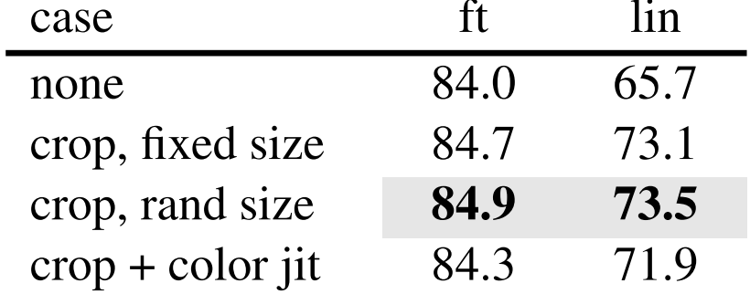
Data Augmentation
The method is robust to not using augmentations, which is significantly differs from the contrastive learning that heavily relies on augmentation.
Using random size (or even fix size) cropping increases the accuracies.
Adding color jittering drops the accuracy.
Figure 14. Effect of data augmentation on fine-tuning and linear probing
top-1 accuracies on IN1K
Figure 14 (from the presented paper):
https://arxiv.org/pdf/2111.06377

Slide 38
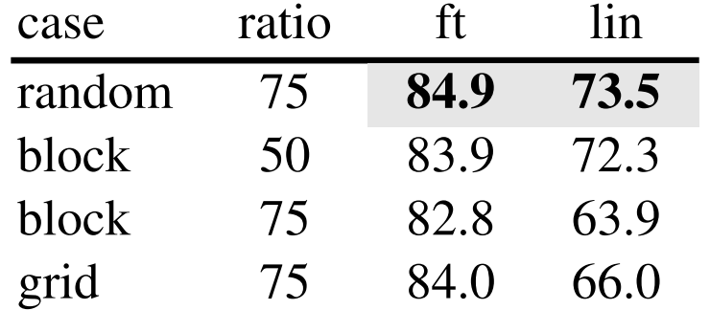
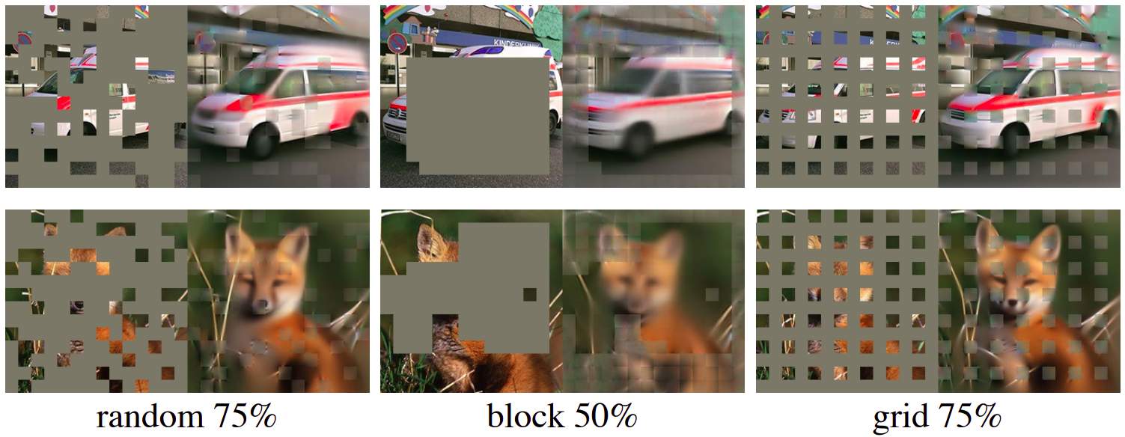
Mask Sampling Method
Works best with the random sampling.
Block sampling is better as 50% ratio, but still, it is worse.
Grid sampling makes the task easier with a lower training loss and better reconstruction. However, the representation quality is worse.
Figure 15. Effect of decoder depth on fine-tuning and linear probing
top-1 accuracies on IN1K
Figure 16. Sampling method visualizations
Figure 15 and 16 (from the presented paper):
https://arxiv.org/pdf/2111.06377

Slide 39
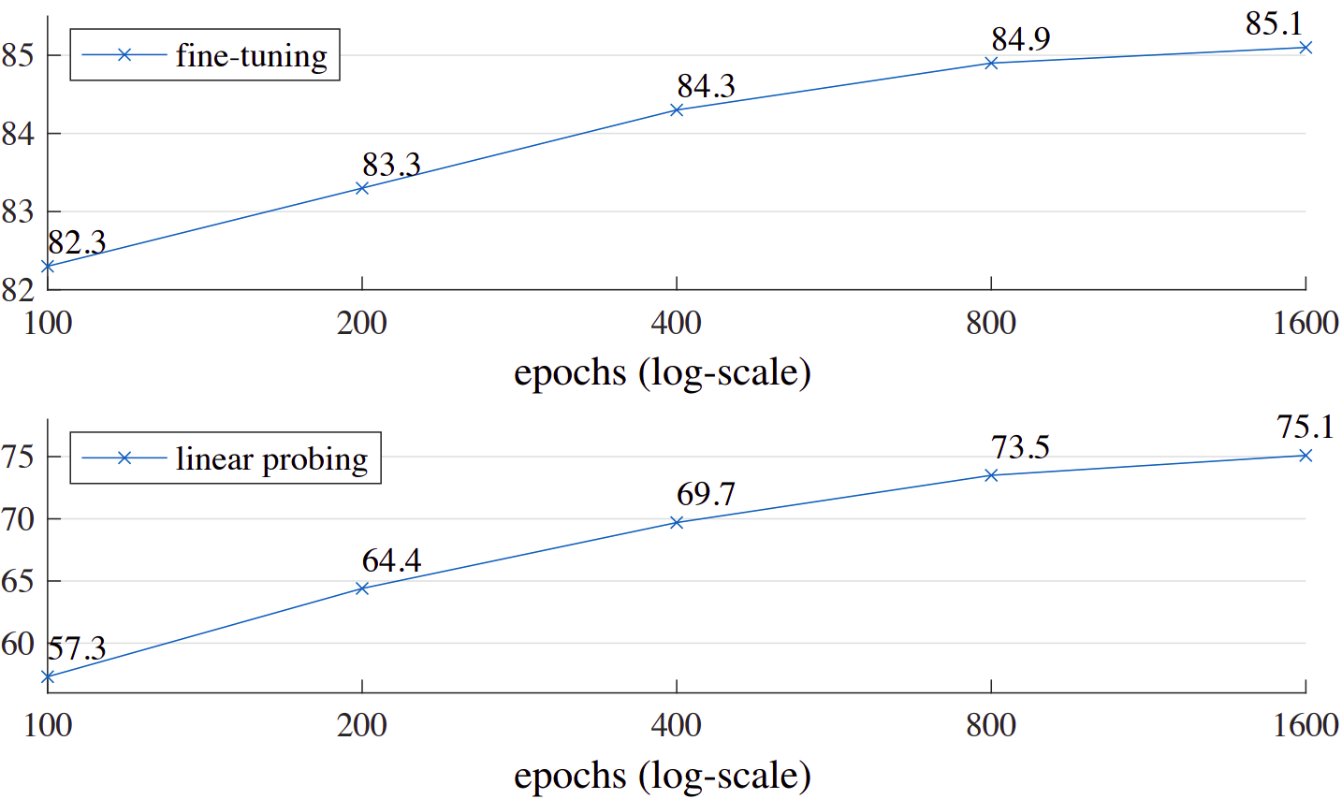
Training Schedule
No saturation is observed even after 1600 epochs.
This trend demonstrates that the method is highly scalable for extended training periods.
To compare, MoCo v3 (*) saturates around 300 epochs.
MAE only sees 25% of the patches, where contrastive learning methods see 200% (two-crop) or even more.
Figure 17. Effect of training schedule on fine-tuning and linear probing
top-1 accuracies on IN1K (each point is a full training)
Figure 17 (from the presented paper):
https://arxiv.org/pdf/2111.06377
* : An Empirical Study of Training Self-Supervised Vision Transformers:
https://arxiv.org/pdf/2104.02057

Slide 40
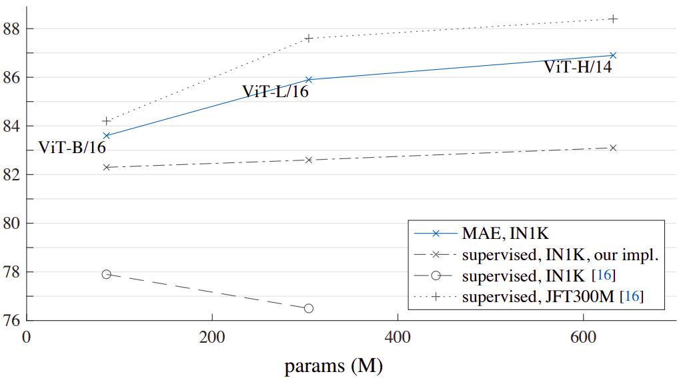
Comparison with Previous Results
Even when trained with robust techniques, ViT-L exhibits worse performance and not lacks the scalability in a supervised setting.
MAE can easily scale up.
SOTA (87.8%) on methods which only uses IN1K dataset. Previous best (*) is 82.1%.
Supervised pre-training with JFT300M dataset is more accurate but regarding the pre-training dataset size, results are comparable. Also, trends are similar.
Figure 18. Comparisons with previous work on accuracy and scalability
Figure 18 (from the presented paper):
https://arxiv.org/pdf/2111.06377
* VOLO: Vision Outlooker for Visual Recognition:
https://arxiv.org/pdf/2106.13112

Slide 41
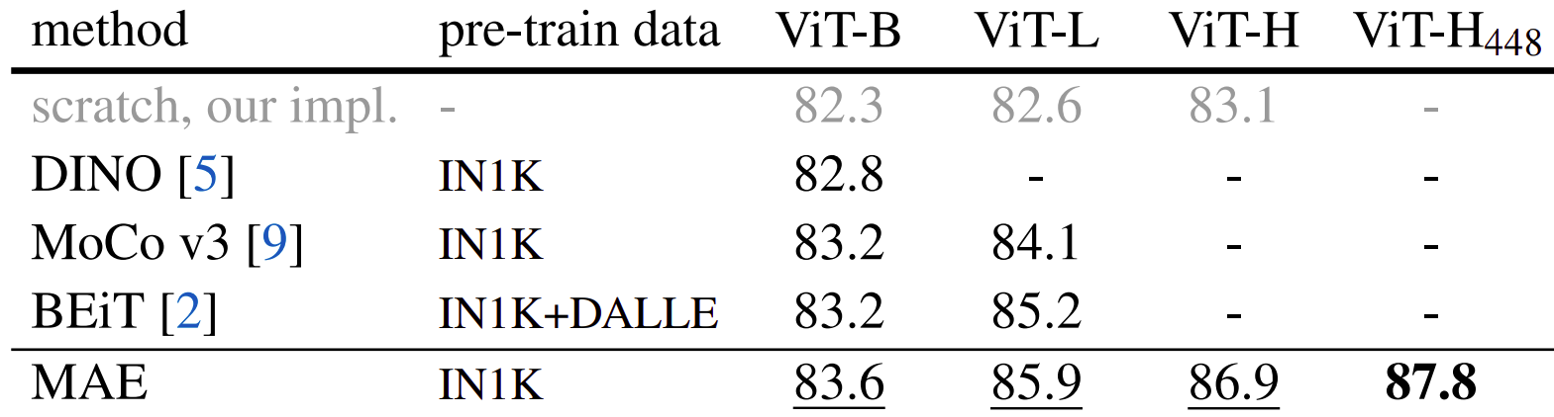
Comparison with BEIT (*) and MoCo v3 (**)
MAE is more accurate, faster and simpler.
MAE reconstructs pixels, whereas BEIT (*) predict tokens.
MAE is 3.5 times faster per epoch than BEIT.
MAE result in the figure is for 1600 epoch pre-training. Still, pre-training time is less than other methods. MAE and MoCo v3 (**) has the training durations of 31 hours and 36 hours, respectively.
Figure 19. Comparisons of MAE
with BEIT and MoCo v3
* BEIT: BERT Pre-Training of Image Transformers:
https://arxiv.org/pdf/2106.08254
Figure 19 (from the presented paper):
https://arxiv.org/pdf/2111.06377
** An Empirical Study of Training Self-Supervised Vision Transformers:
https://arxiv.org/pdf/2104.02057

Slide 42
Partial fine-tuning
It is clear that linear probing and fine-tuning results are uncorrelated.
Linear probing cannot measure how well the representations can be used with non-linear combinations, which is important. The linear separability of the features is not the only thing for measuring the representation quality.
Also, linear probing is not highly correlated with transfer learning (*), which is the ultimate goal of pre-training.
So, authors also used partial fine-tuning, where some of the last layers are trained while others stay fixed.
* Exploring Simple Siamese Representation Learning:
https://arxiv.org/pdf/2011.10566

Slide 43
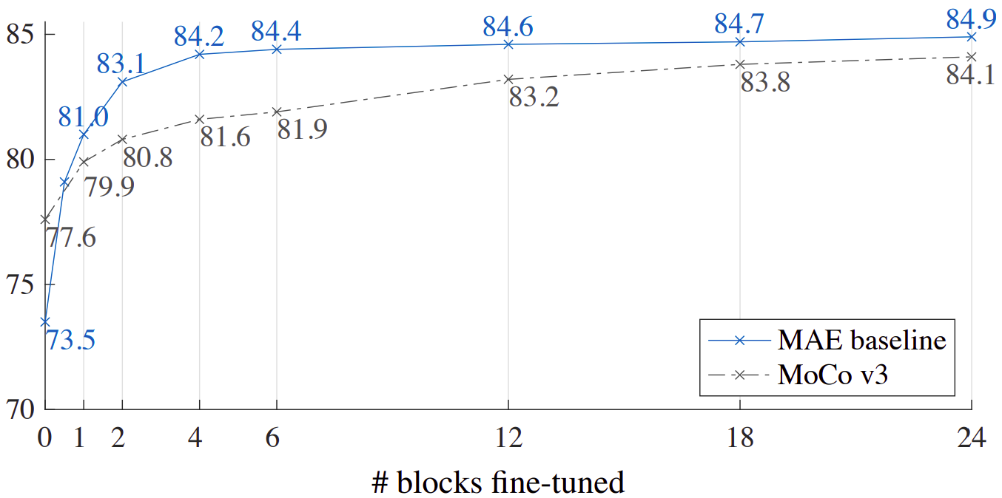
MoCo v3 (*) vs MAE with Partial Fine-Tuning
As it can be seen, MoCo v3 (*) performs better on linear probing. However, when allowing the models some last layers to relearn, there is a significant accuracy improvement in the favor of MAE.
This means MAE features are less linearly separable than MoCo v3 (*), but they are still stronger representations when a non-linear head will be tuned.
Figure 20. Comparisons of MAE
with MoCo v3 on partial fine-tuning
Figure 20 (from the presented paper):
https://arxiv.org/pdf/2111.06377
* An Empirical Study of Training Self-Supervised Vision Transformers:
https://arxiv.org/pdf/2104.02057

Slide 44
5-
Transfer Learning
Experiments

Slide 45
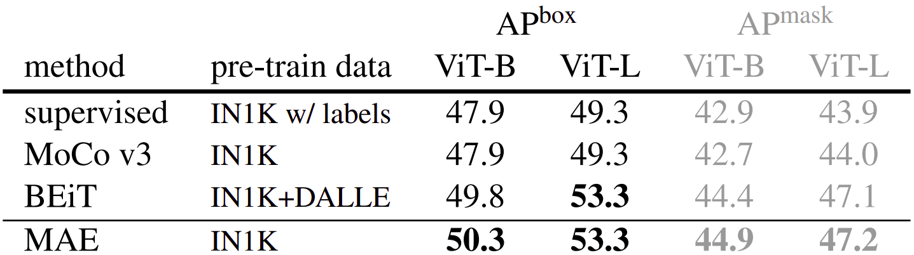
Object Detection and Segmentation
The authors fine-tune the Mask R-CNN (*) on the COCO (**) dataset for object detection and segmentation tasks.
When using only IN1K dataset for pre-training, MAE surpasses all other supervised and self-supervised pre-training techniques.
Figure 21. Comparisons of MAE
with BEIT and MoCo v3 on COCO detection and segmentation.
* Mask R-CNN:
https://arxiv.org/pdf/1405.0312
Figure 21 (from the presented paper):
https://arxiv.org/pdf/2111.06377
** Microsoft COCO: Common Objects in Context:
https://arxiv.org/pdf/1405.0312

Slide 46
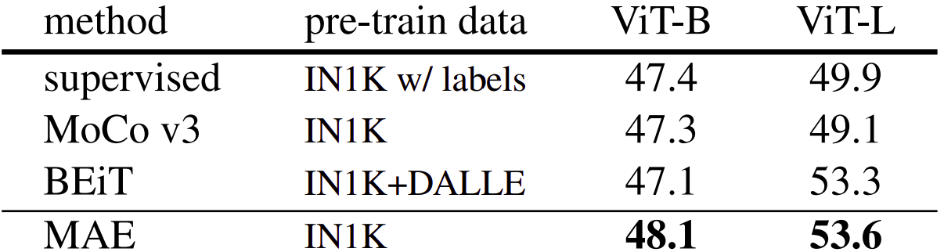
Semantic Segmentation
The authors used UperNet (*) for the semantic segmentation on the ADE20K (**) dataset.
Results demonstrate that MAE outperforms all supervised and self-supervised pre-training techniques once again. These results are consistent with the former object detection and segmentation task.
Figure 22. Comparisons of MAE
with BEIT and MoCo v3 on iNat and Places semantic segmentation task.
* Unified Perceptual Parsing for Scene Understanding:
https://arxiv.org/pdf/1807.10221
Figure 22 (from the presented paper):
https://arxiv.org/pdf/2111.06377
** Semantic Understanding of Scenes through the ADE20K Dataset:
https://arxiv.org/pdf/1608.05442

Slide 47
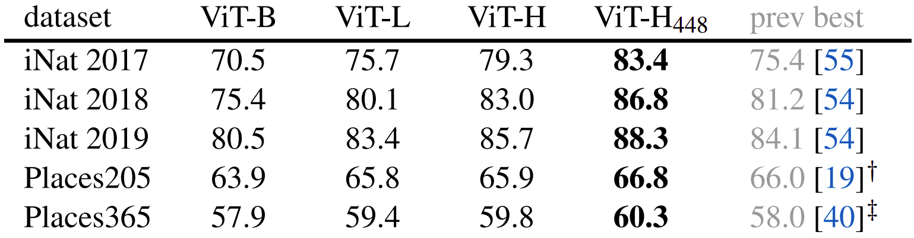
Classification
The authors used the iNaturalist (*) and Places (**) tasks for comparison.
Especially on iNat (*), MAE has a very large gap with the previous SOTA results.
On Places (**) task, previous SOTA were obtained with pre-training on billions of images.
Also, MAE shows significant scaling behavior.
Figure 23. Comparisons of MAE
with BEIT and MoCo v3 on iNat and Places classification task.
* The iNaturalist Species Classification and Detection Dataset:
https://arxiv.org/pdf/1707.06642
Figure 23 (from the presented paper):
https://arxiv.org/pdf/2111.06377
** Learning Deep Features for Scene Recognition using Places Database:
https://papers.nips.cc/paper_files/paper/2014/file/3fe94a002317b5f9259f82690aeea4cd-Paper.pdf

Slide 48
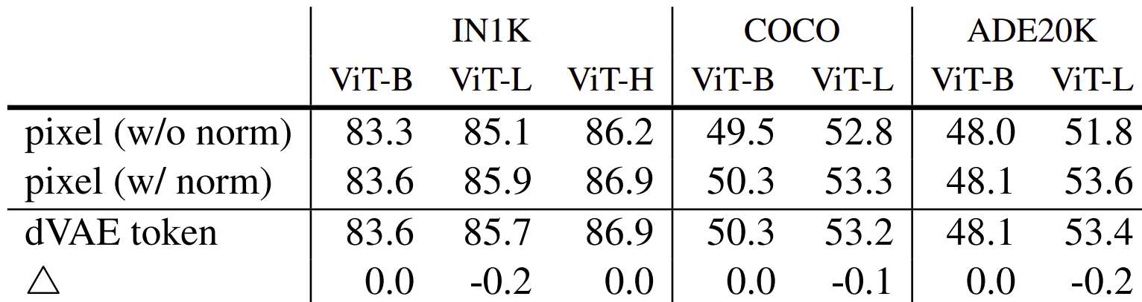
Pixels vs Tokens
In transfer learning, using dVAE(*) tokens as the target is yields better results then the unnormalized pixel target.
However, per-patch normalization with a pixel target can be applied, rendering the use of dVAE (*) tokens redundant.
Figure 24. Effect of using pixels vs tokens as target
Figure 24 (from the presented paper):
https://arxiv.org/pdf/2111.06377
* Zero-Shot Text-to-Image Generation:
https://arxiv.org/pdf/2102.12092

Slide 49
6-
Discussion
And
Conclusion

Slide 50
Summary
LLM pre-training methods are promising for vision domain and they can be adopted regarding the information difference.
Masking a high proportion in vision works well.
Encoder not uses mask tokens. Thus, it can be very large.
Decoder can be lightweight, further speeding up the training.
Linear probing alone is not enough to measure feature quality.
* Exploring Simple Siamese Representation Learning:
https://arxiv.org/pdf/2011.10566

Slide 51
References (1 of 4)
Bao, H., Dong, L., & Wei, F. (2021). BEiT: BERT Pre-Training of Image Transformers. ArXiv:2106.08254 [Cs]. https://arxiv.org/abs/2106.08254
Brown, T. B., Mann, B., Ryder, N., Subbiah, M., Kaplan, J., Dhariwal, P., Neelakantan, A., Shyam, P., Sastry, G., Askell, A., Agarwal, S., Herbert-Voss, A., Krueger, G., Henighan, T., Child, R., Ramesh, A., Ziegler, D. M., Wu, J., Winter, C., & Hesse, C. (2020). Language Models are Few-Shot Learners. Arxiv.org. https://arxiv.org/abs/2005.14165
‌ Chen, X., & He, K. (2020). Exploring Simple Siamese Representation Learning. ArXiv:2011.10566 [Cs]. https://arxiv.org/abs/2011.10566
‌ Chen, X., Xie, S., & He, K. (2021, August 16). An Empirical Study of Training Self-Supervised Vision Transformers. ArXiv.org. https://doi.org/10.48550/arXiv.2104.02057
‌ Chen, X., Xie, S., & He, K. (2021, August 16). An Empirical Study of Training Self-Supervised Vision Transformers. ArXiv.org. https://doi.org/10.48550/arXiv.2104.02057
Devlin, J., Chang, M.-W., Lee, K., Google, K., & Language, A. (n.d.). BERT: Pre-training of Deep Bidirectional Transformers for Language Understanding. https://arxiv.org/pdf/1810.04805
‌ Dosovitskiy, A., Beyer, L., Kolesnikov, A., Weissenborn, D., Zhai, X., Unterthiner, T., Dehghani, M., Minderer, M., Heigold, G., Gelly, S., Uszkoreit, J., & Houlsby, N. (2020). An Image is Worth 16x16 Words: Transformers for Image Recognition at Scale. ArXiv:2010.11929 [Cs].

Slide 52
References (2 of 4)
Fei-Fei, L., Deng, J., & Li, K. (2010). ImageNet: Constructing a large-scale image database. Journal of Vision, 9(8), 1037–1037. https://doi.org/10.1167/9.8.1037
He, K., Chen, X., Xie, S., Li, Y., Dollár, P., & Girshick, R. (2021). Masked Autoencoders Are Scalable Vision Learners. ArXiv:2111.06377 [Cs]. https://arxiv.org/abs/2111.06377
‌ ‌ Lin, T.-Y., Maire, M., Belongie, S., Bourdev, L., Girshick, R., Hays, J., Perona, P., Ramanan, D., Lawrence, Z. C., & Dollár, P. (2014). Microsoft COCO: Common Objects in Context. ArXiv.org. https://arxiv.org/abs/1405.0312
‌ Misra, I., & van der Maaten, L. (2019). Self-Supervised Learning of Pretext-Invariant Representations. ArXiv:1912.01991 [Cs]. https://arxiv.org/abs/1912.01991
Ramesh, A., Pavlov, M., Goh, G., Gray, S., Voss, C., Radford, A., Chen, M., & Sutskever, I. (n.d.). Zero-Shot Text-to-Image Generation. https://arxiv.org/pdf/2102.12092
Van Horn, G., Mac Aodha, O., Song, Y., Cui, Y., Sun, C., Shepard, A., Adam, H., Perona, P., & Belongie, S. (2018). The iNaturalist Species Classification and Detection Dataset. ArXiv:1707.06642 [Cs]. https://arxiv.org/abs/1707.06642
Vincent, P., Larochelle, H., Bengio, Y., & Manzagol, P.-A. (2008). Extracting and Composing Robust Features with Denoising Autoencoders. https://www.cs.toronto.edu/~larocheh/publications/icml-2008-denoising-autoencoders.pdf

Slide 53
References (3 of 4)
Xiao, T., Liu, Y., Zhou, B., Jiang, Y., & Sun, J. (2018, July 26). Unified Perceptual Parsing for Scene Understanding. ArXiv.org. https://doi.org/10.48550/arXiv.1807.10221
‌ Yuan, L., Hou, Q., Jiang, Z., Feng, J., & Yan, S. (2022). VOLO: Vision Outlooker for Visual Recognition. 1–13. https://doi.org/10.1109/tpami.2022.3206108
‌ Zhou, B., Lapedriza, A., Xiao, J., Torralba, A., & Oliva, A. (n.d.). Learning Deep Features for Scene Recognition using Places Database. https://papers.nips.cc/paper_files/paper/2014/file/3fe94a002317b5f9259f82690aeea4cd-Paper.pdf

Slide 54
References for figures (4 of 4)
- Figure 1: From local experiments with the model from: https://github.com/facebookresearch/mae
- Figure 2: https://www.sbert.net/examples/unsupervised_learning/MLM/README.html
- Figure 3: https://arxiv.org/pdf/1810.04805
- Figure 4: https://www.geeksforgeeks.org/denoising-autoencoders-in-machine-learning/
- Figure 5: https://faculty.cc.gatech.edu/~hays/7476/projects/Avery_Wenchen/
- Figure 6, 7, 8, 9, 10, 11, 12, 13, 14, 15, 16, 17, 18, 19, 20, 21, 22, 23, 24: From the presented paper, Masked Autoencoders Are Scalable Vision Learners: https://arxiv.org/abs/2111.06377

Slide 55
Attribution
Keep this page and the following notice AS IS.
This presentation has been prepared with METU Presentation Template by Devrim Çavuşoğlu licensed under the CC BY-SA 4.0. Also read, the full LICENSE content.
Refer to github.com/devrimcavusoglu/metu-presentation-template

Slide 56
Thank you for listening
Q & A

