Slide 1
Sale

Slide 2
Request Format
GET /sale
Header
Accept: "application/json"

Slide 3
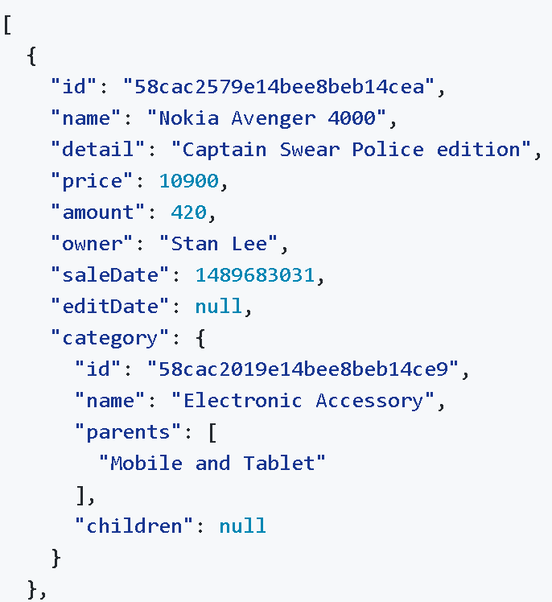
Response Format
Header
content-type: "application/json"
status: 200
Body

Slide 4
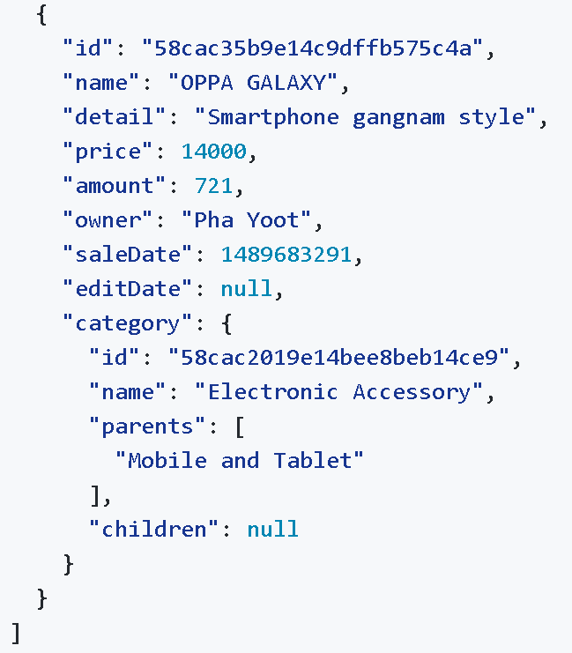
Response Format (Cont.)

Slide 5
Request Format
GET /sale/{id}
Header
Accept: "application/json"

Slide 6
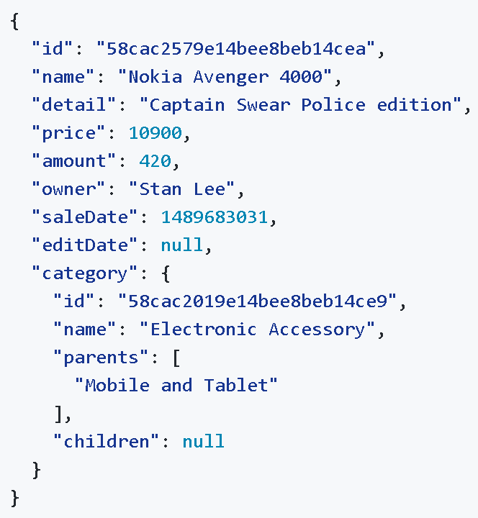
Response Format
Header
content-type: "application/json"
status: 200
Body

Slide 7
Request Format
GET /sale/category/{categoryName}
Header
Accept: "application/json"

Slide 8
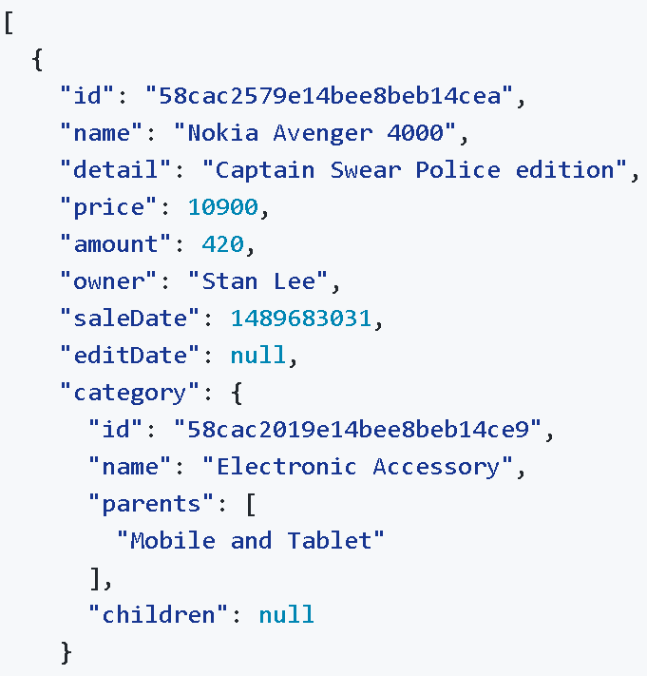
Response Format
Header
content-type: "application/json"
status: 200
Body

Slide 9
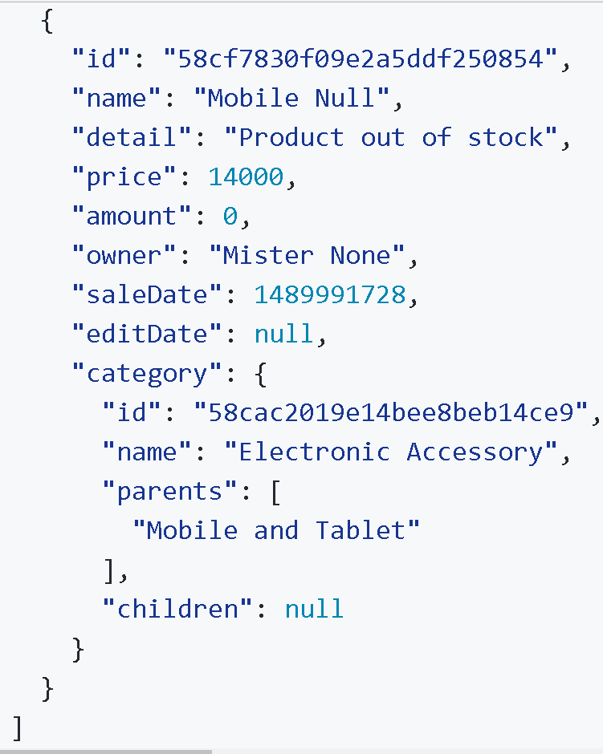
Response Format (Cont.)

Slide 10
Request Format
POST /salehistory
Header
Accept: "application/json“
Content-Type: "application/json"

Slide 11
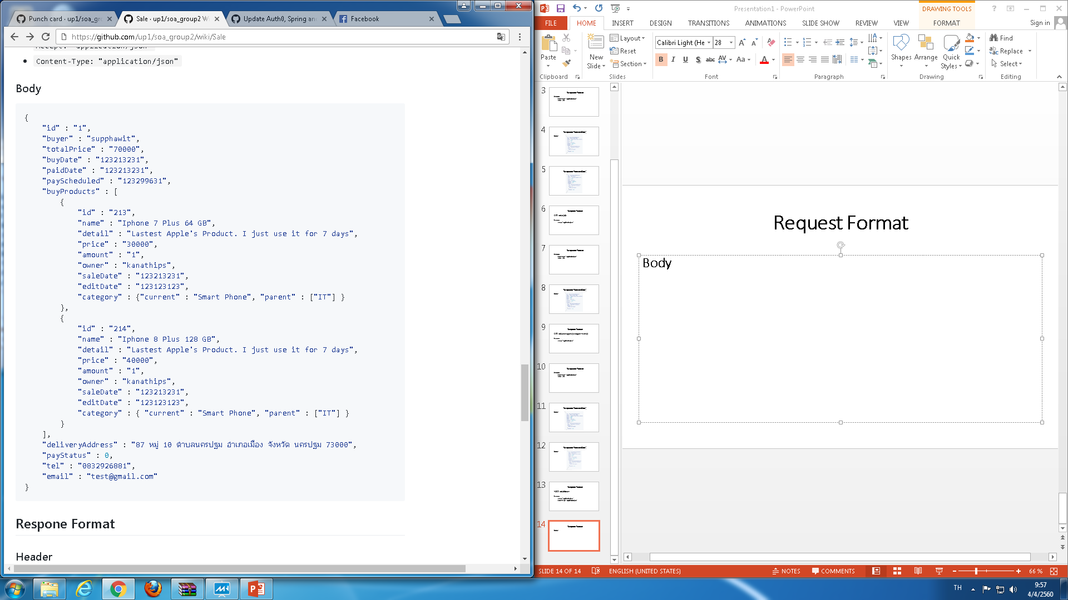
Request Format
Body

Slide 12
Request Format (Cont.)

Slide 13
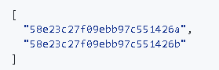
Response Format
Header
content-type: "application/json"
status: 201
Body

Slide 14
Request Format
GET /salehistory/member/{owner}
Header
Accept: "application/json“

Slide 15
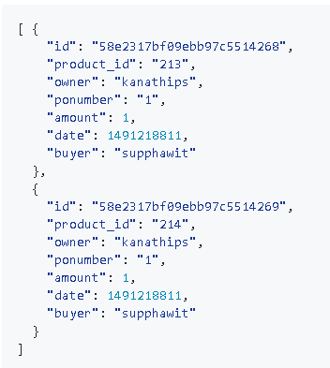
Response Format
Header
content-type: "application/json"
status: 200
Body

Slide 16
Request Format
GET /salehistory/product/{productId}
Header
Accept: "application/json“

Slide 17
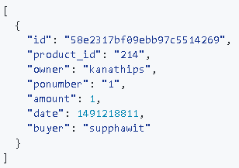
Response Format
Header
content-type: "application/json"
status: 200
Body

Slide 18
Billing

Slide 19
Request Format
GET /purchaseorder
Header
Accept: "application/json“

Slide 20
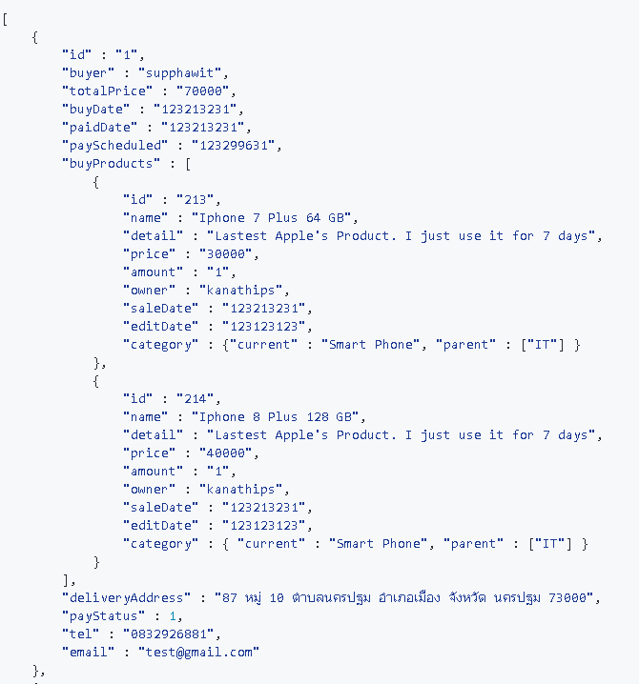
Response Format
Header
content-type: "application/json"
status: 200
Body

Slide 21
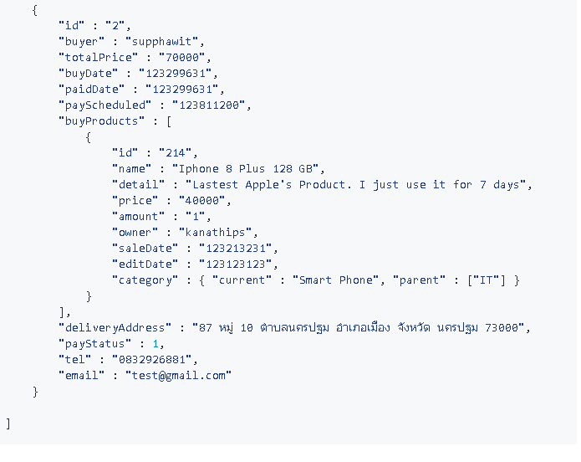
Response Format (Cont.)

Slide 22
Request Format
GET /purchaseorder/{id}
Header
Accept: "application/json“

Slide 23
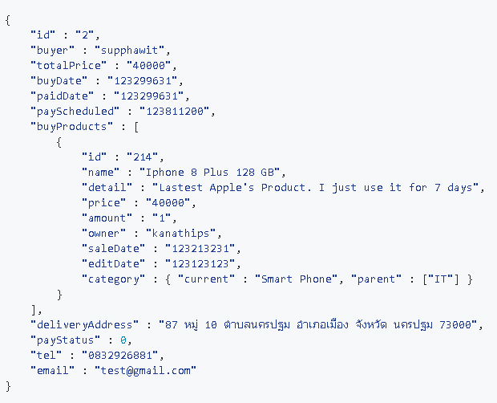
Response Format
Header
content-type: "application/json"
status: 200
Body

Slide 24
Request Format
PUT /purchaseorder/{id}
Header
Content-type: "application/json"

Slide 25
Response Format
Header
content-type: "text/plain; charset=utf-8"
status: 200
Body
2 // Purchase order's id

Slide 26
Request Format
PATCH /purchaseorder/{id}/cancel
Header
Accpet: "text/plain; charset=utf-8"

Slide 27
Response Format
Header
content-type: "text/plain; charset=utf-8"
status: 200
Body
2 // Purchase order's id

Slide 28
Request Format
POST /purchaseorder
Header
Content-type: "application/json"

Slide 29
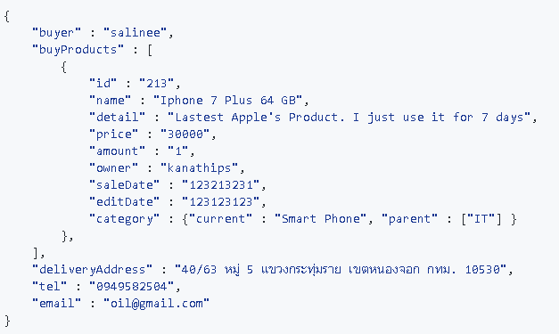
Request Format (Cont.)
Body

Slide 30
Response Format
Header
content-type: "text/plain; charset=utf-8"
status: 200
Body
3 // Purchase order's id

Slide 31
Request Format
POST /purchaseorder
Header
Accept: "application/json"

Slide 32
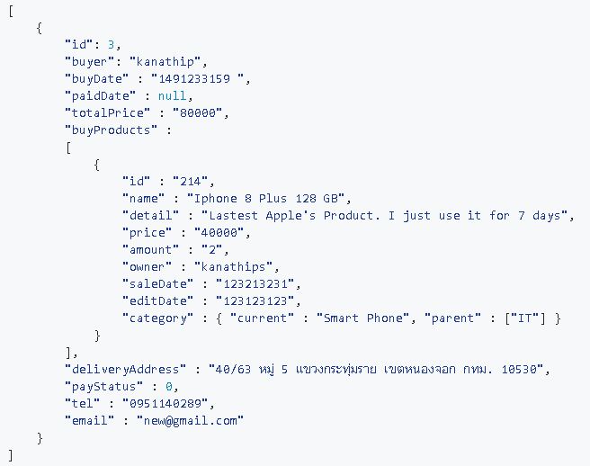
Response Format
Header
content-type: "text/plain; charset=utf-8"
status: 200
Body

Slide 33
Request Format
GET /payslip/paid
Header
Accept: "application/json"

Slide 34
Response Format
Header
content-type: "text/plain; charset=utf-8"
status: 200

Slide 35
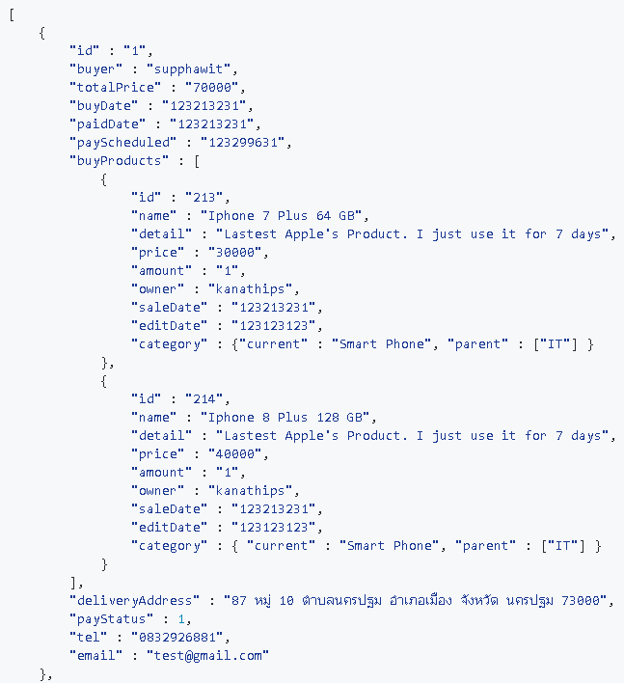
Response Format (Cont.)
Body

Slide 36
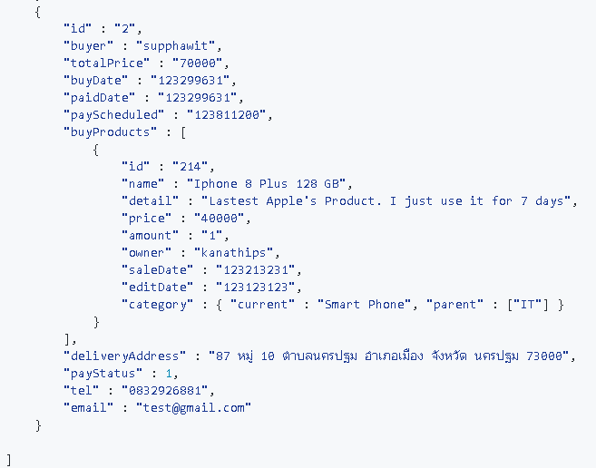
Response Format (Cont.)

Slide 37
Request Format
GET /payslip/outoftime
Header
Accept: "application/json"

Slide 38
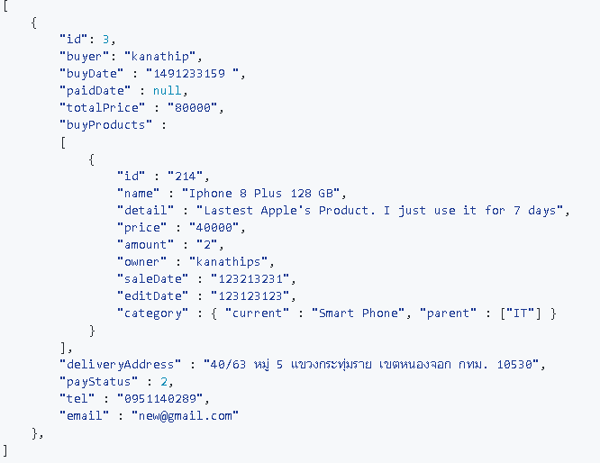
Response Format
Header
content-type: "text/plain; charset=utf-8"
status: 200
Body

Slide 39
Request Format
GET /payslip/{poNumber}
Header
Accept: "application/json"

Slide 40
Response Format
Header
content-type: "application/pdf"
status: 200
Body
Pay Slip File // (*.pdf)

Slide 41
Request Format
PATCH /payslip/paid/{poNumber}
Header
Accept: "text/plain; charset=utf-8"

Slide 42
Response Format
Header
content-type: "text/plain; charset=utf-8"
status: 200
Body
3 // Purchase order’s id

Slide 43
Stock

Slide 44
Request Format
GET /product
Header
Accept: "application/json“

Slide 45
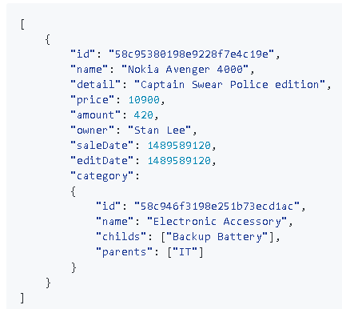
Response Format
Header
content-type: "application/json"
status: 200
Body

Slide 46
Request Format
POST /product
Header
Accept: "application/json“

Slide 47
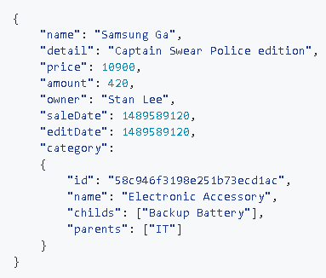
Response Format
Header
content-type: "application/json"
status: 200
Body

Slide 48
Request Format
GET /product/{id}
Header
Accept: "application/json“

Slide 49
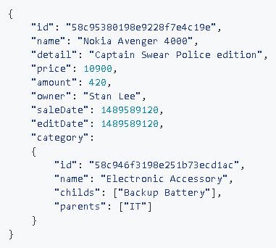
Response Format
Header
content-type: "application/json"
status: 200
Body

Slide 50
Request Format
PUT /product/{id}
Header
Accept: "application/json“

Slide 51

Response Format
Header
content-type: "application/json"
status: 200
Body

Slide 52
Request Format
DELETE/product/{id}
Header
Accept: "text/plain; charset=utf-8"

Slide 53
Response Format
Header
Content-type: "text/plain; charset=utf-8"
Status: 200
Body
58c95380198e9228f7e4c19e // Product’s id

Slide 54
Request Format
POST /product/image?productId={id}
Header
Content-type: "multipart/form-data“
Body
Product's Image

Slide 55
Response Format
Header
Content-type: "text/plain; charset=utf-8"
Status: 201
Body
58c95380198e9228f7e4c19e // Product’s id

Slide 56
Request Format
GET /product/image/{productId}
Header
Accept: "image/jpeg"

Slide 57
Response Format
Header
Content-type: "image/jpeg"
Content-Disposition: attachment; filename="{filename.jpg}"
Status: 200
Body
Image of Product

