Slide 1
Stock

Slide 2
Request Format
GET /product
Header
Accept: "application/json“

Slide 3
Response Format
Header
content-type: "application/json"
status: 200

Slide 4
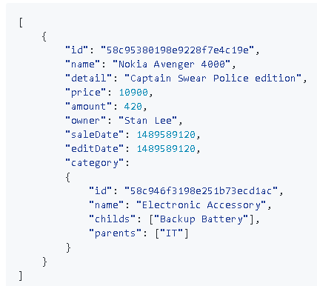
Response Format (Cont.)
Body

Slide 5
Request Format
POST /product
Header
Accept: "application/json“

Slide 6
Response Format
Header
content-type: "application/json"
status: 200

Slide 7
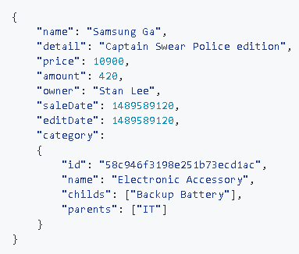
Response Format (Cont.)
Body

Slide 8
Request Format
GET /product/{id}
Header
Accept: "application/json“

Slide 9
Response Format
Header
content-type: "application/json"
status: 200

Slide 10
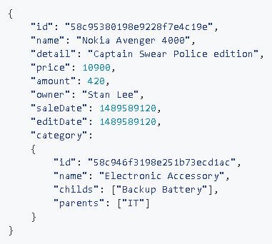
Response Format (Cont.)
Body

Slide 11
Request Format
PUT /product/{id}
Header
Accept: "application/json“

Slide 12
Response Format
Header
content-type: "application/json"
status: 200

Slide 13

Response Format (Cont.)
Body

Slide 14
Request Format
DELETE/product/{id}
Header
Accept: "text/plain; charset=utf-8"

Slide 15
Response Format
Header
Content-type: "text/plain; charset=utf-8"
Status: 200

Slide 16

Response Format (Cont.)
Body

Slide 17
Request Format
POST /product/image?productId={id}
Header
Content-type: "multipart/form-data"

Slide 18
Request Format (Cont.)
Body
Product's Image

Slide 19
Response Format
Header
Content-type: "text/plain; charset=utf-8"
Status: 201

Slide 20

Response Format (Cont.)
Body

Slide 21
Request Format
GET /product/image/{productId}
Header
Accept: "image/jpeg"

Slide 22
Response Format
Header
Content-type: "image/jpeg"
Content-Disposition: attachment; filename="{filename.jpg}"
Status: 200

Slide 23

Response Format (Cont.)
Body

