Slide 1

Introduction to Apache Solr 4.4
@somkiat

Slide 2
Features
Full Text Search
Optimize for high volume web traffic
Support XML, JSON
Near Real time indexing
Admin interface
Support JMX
XML configuration
Extensible with plugin

Slide 3
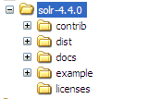
Download
Download Apache Solr 4.4 from http://lucene.apache.org/solr/

Slide 4
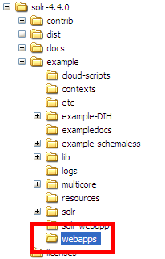
Install on Apache Tomcat
Using /example/webapps/solr.war

Slide 5
Create app1.xml
In %CATALINA_HOME%\conf\Catalina\localhost
<?xml version="1.0" encoding="UTF-8"?> <Context docBase=“c:\\solr-4.4.0 \\example\\webapps\\solr.war" debug="0" crossContext="true" >
<Environment name="solr/home" type="java.lang.String" value="c:\\app11" override="true" />
</Context>

Slide 6
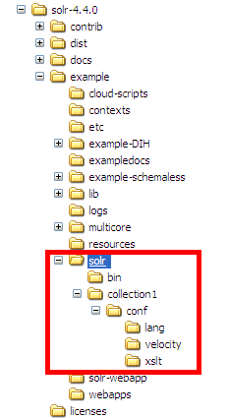
Structure of c:\\app1
Copy all files and folder from

Slide 7
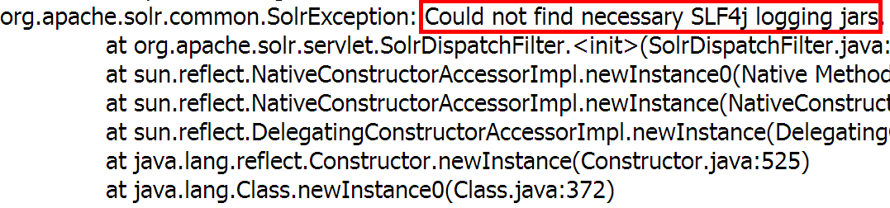
Start Tomcat

Slide 8
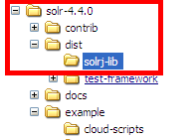
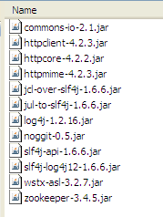
** Need SLF4J **
http://www.slf4j.org
Copy all jar files from … to %CATALINA_HOME/libs

Slide 9
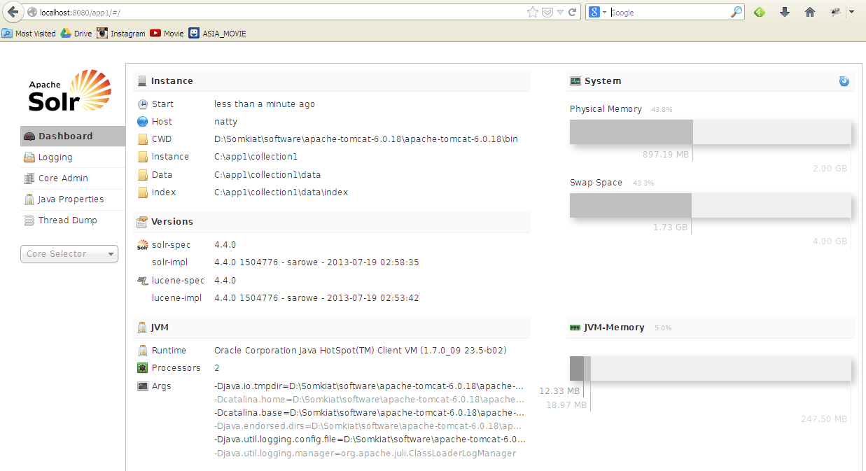
Restart Tomcat
Goto http://localhost:8080/app1

Slide 10
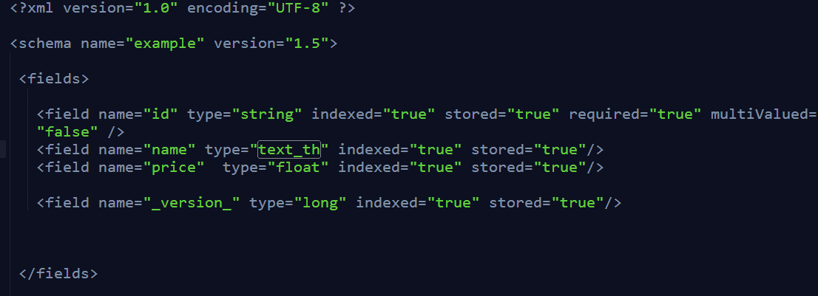
Edit schema.xml

Slide 11
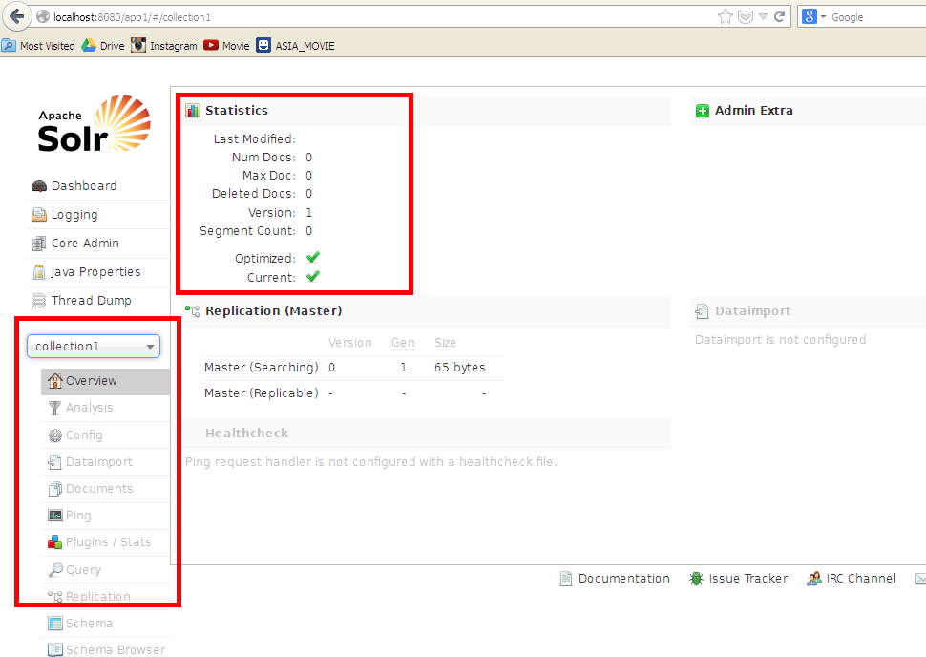
Solr Admin

Slide 12
Solr Client
http://wiki.apache.org/solr/IntegratingSolr
Java
http://wiki.apache.org/solr/Solrj

Slide 13
Demo
$git clone https://github.com/up1/solr_4_demo.git

Slide 14
Indexing Data
String url = "http://localhost:8080/app1/collection1";
SolrServer server = new HttpSolrServer(url);
SolrInputDocument doc1 = new SolrInputDocument();
doc1.addField("id", "1", 1.0f);
doc1.addField("name", "doc 1", 1.0f);
doc1.addField("price", 10);
SolrInputDocument doc2 = new SolrInputDocument();
doc2.addField("id", "2", 1.0f);
doc2.addField("name", "doc 2", 1.0f);
doc2.addField("price", 100);
Collection<SolrInputDocument> docs = new ArrayList<SolrInputDocument>();
docs.add(doc1);
docs.add(doc2);
server.add(docs);
server.commit();

Slide 15
Indexing Data with Bean
String url = "http://localhost:8080/app1/collection1";
SolrServer server = new HttpSolrServer(url);
Product product1 = new Product("1", "product 1", 100f);
Product product2 = new Product("2", "product 2", 200f);
List<Product> products = new ArrayList<Product>();
products.add(product1);
products.add(product2);
server.addBeans(products);
server.commit();

Slide 16
Delete Data
String url = "http://localhost:8080/app1/collection1";
SolrServer server = new HttpSolrServer(url);
server.deleteByQuery("*:*");
server.commit();

Slide 17
Query Data
String url = "http://localhost:8080/app1/collection1";
SolrServer server = new HttpSolrServer(url);
SolrQuery query = new SolrQuery();
query.setQuery("*:*");
query.addSort("price", SolrQuery.ORDER.asc);
QueryResponse rsp = server.query(query);
SolrDocumentList docs = rsp.getResults();
for (SolrDocument solrDocument : docs) {
System.out.print("ID:" + solrDocument.getFieldValue("id"));
System.out.print(", Name:" + solrDocument.getFieldValue("name"));
System.out.println(", Price:" + solrDocument.getFieldValue("price"));
}

