Slide 1
PROJECT: VENORA
Κοντόπουλος Δημήτριος
Μπιτσώρη Δανάη
Εφαρμογή κρατήσεων εισιτηρίων πολιτιστικών εκδηλώσεων

Slide 2
 | GUEST | REGISTERED USER | ADMIN
LOG IN
CREATE ACCOUNT
BROWSE EVENTS
BUY/ RESERVE TICKET
SAVE AN EVENT

Slide 3
 | GUEST | REGISTERED USER | ADMIN
COSTUMIZE PROFILE
REQUEST NEW EVENT
DELETE PROFILE
SEE ACTIVE & INACTIVE TICKETS
CREATE EVENT
DELETE/ EDIT EVENT
INSPECT PAYMENTS

Slide 4
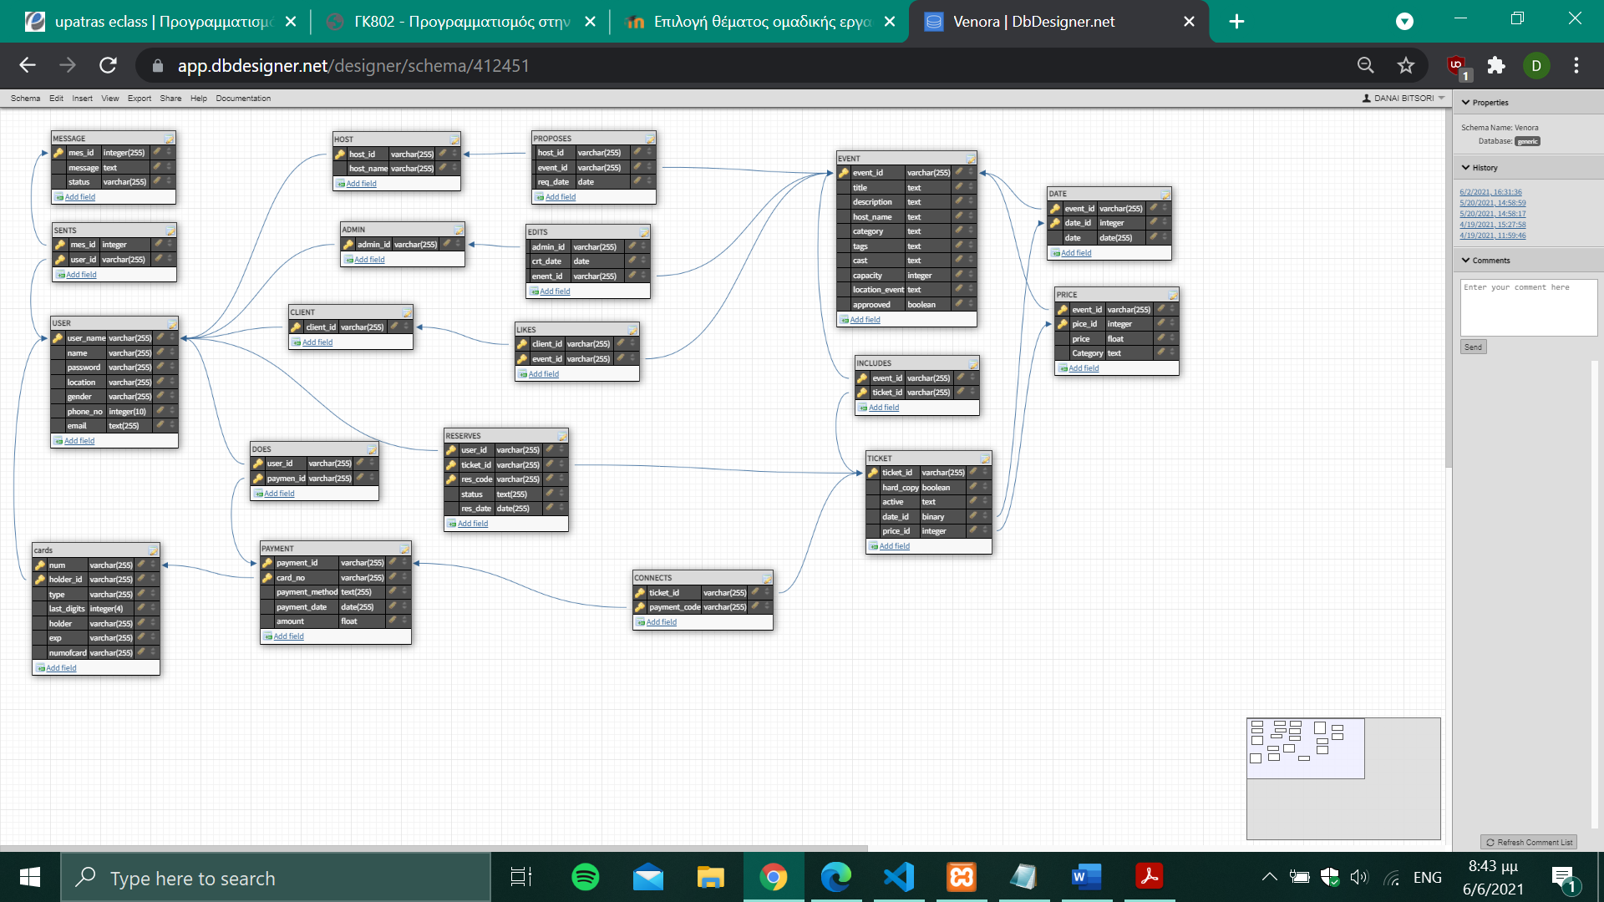
Σχεσιακό Μοντέλο

Slide 5
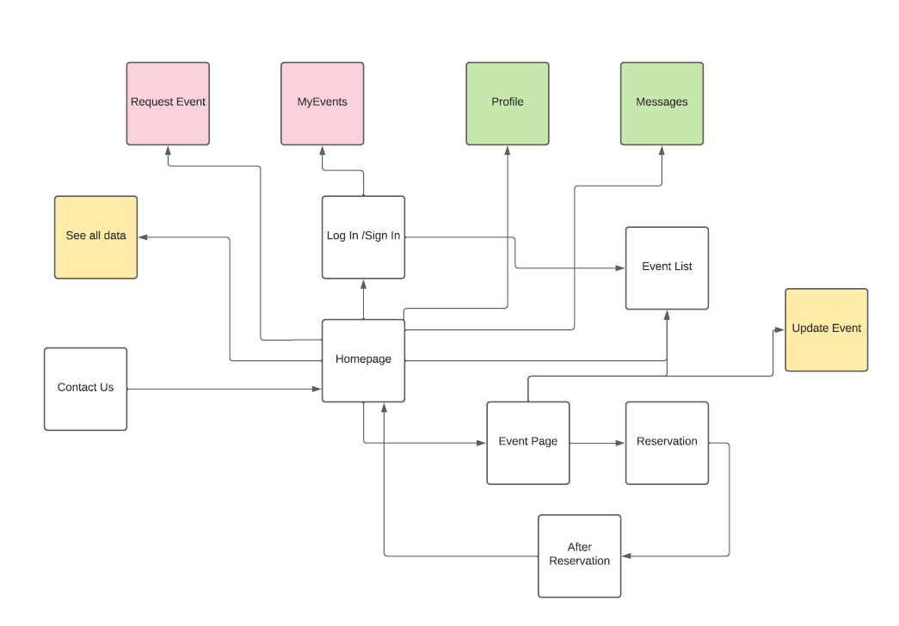
HTTP FILES CONNECTION DIAGRAM

