Slide 1

Classifying Reddit Posts With Natural Language Processing and Machine Learning BY Upasana Mahanta

Slide 2

Introduction
Star Trek and Star Wars are American media franchises which present alternative scenarios of space adventure.
The two franchises are dominant in this setting of storytelling and have offered various forms of media productions for decades that manage billions of dollars of intellectual property, providing employment and entertainment for billions of people around the world.

Slide 3
Cont.…..
As we may have gathered, posts in Star War and Star Trek will definitely have a lot of crossover. Whether you’re boldly going where no man has gone before or you’re already in a galaxy far, far away, you’ve probably heard the age-old debate about which of science fiction’s two biggest franchises is better. Geeks, freaks, scientists and even casual fans have long been arguing in every corner of the galaxy about Star Wars and Star Trek. Which is better and why?

Slide 4

Sample : post
Class 0 : Star Wars
Class 1: Star Trek

Slide 6
The Problem
Build a binary classification model that can distinguish which of two subreddits, (r/Star Trek or r/Star Wars), a particular post belongs to.
In this post go through a process using Natural Language Processing (NLP) and classification modeling to classify Reddit posts from Star Wars and Star Trek

Slide 7
Data Cleaning & Exploration
Checking for and cleaning null values and duplicates; and visualizing the data to better understand it.

Slide 8
The Unclean Data
Duplicates
Decided to remove duplicate text and title features as duplicate information would only add noise and hurt our models.
Nulls
Null values occurred in text feature. This happens when a reddit user decides to only use the title field. So, decided not to drop null values as we did not want to lose valuable title info and instead filled them with unique text.

Slide 9
Data Cleaning & Exploration
The dataset contains information (post text and titles) on posts acquired via Reddit’s API.
Dataset contains 1060 documents (rows) and 3 features (columns) of said info.

Slide 10
FEATURE ENGINEERING
Split the data into two sets – Training and test data
Count vectorizer
Converts a collection of text documents (my rows of text data) to a matrix of token counts
Hyperparameters:
stop words = ‘English' (text & title)
max_features = 5_000
ngram_range = (1, 2)
min_df = .3
max_df = .95
New Data Frame shape = (710, 350)

Slide 11
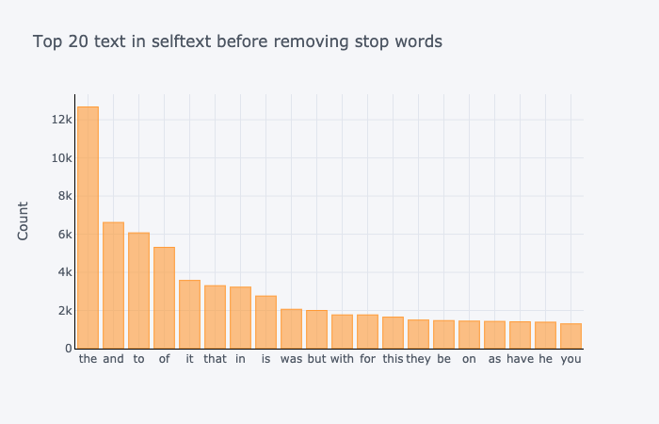

Slide 12
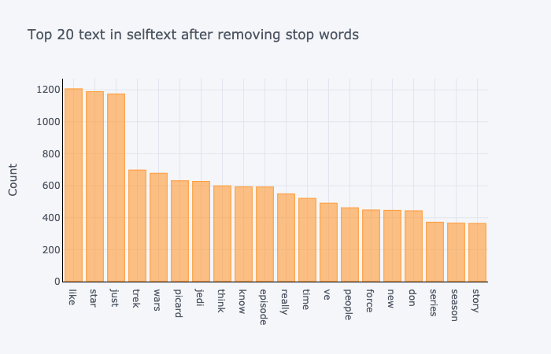

Slide 14
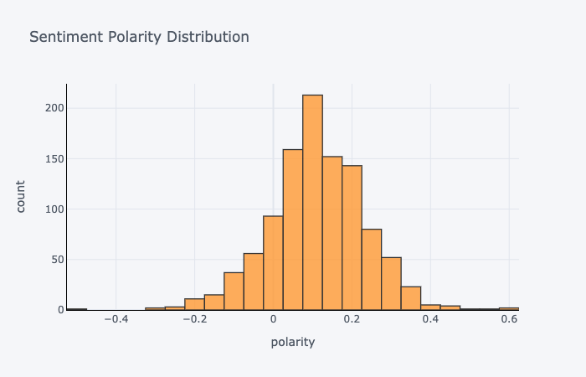

Slide 15
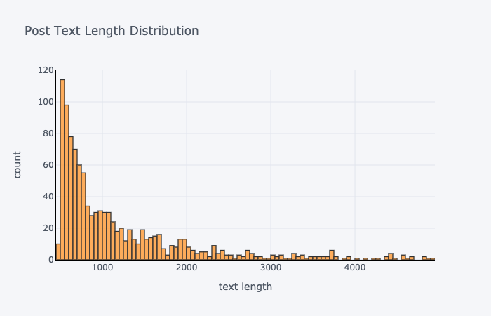

Slide 17
Model Fitting
Logistic Regression
Model #1
Best params = {solver: ‘lbfgs’, penalty: l2}
Score = Train: 99%, Test: 95%
Multinomial NB
Model #2
Best params = {alpha: 1, fit prior: True}
Accuracy = 99%

Slide 18
Insights
Our 2nd Multinomial NB was our best model
Accuracy score = 99%
All of our models were slightly overfit

Slide 19
Recommendations
Go with Multinomial Naive Bayes Model #2
handled bias/variance the best
Explore new features
Upvotes
Post comments

