Slide 1
Agile Software Development

Slide 2
Topics covered
Agile methods
Plan-driven and agile development
Extreme programming
Agile project management
Scaling agile methods

Slide 3
Rapid software development
Why?
Need to react to changes more quickly than 2 year long waterfall projects
2 years and then you got the design wrong anyway! Small deliveries aren't abstract
How?
Goal - Deliver working software quickly
Compromise - less functionality in a delivery, not lower quality
Less documentation
Focus on the code rather than the design
Interleave
Specification, design and implementation are inter-leaved
Deliver small versions and get user (stakeholder) input

Slide 4

Painpoints
Your Favorite!
Responsiveness
Transparency
Complexity
Productivity
Long Cycle Times
Quality
Brittle Code
Ouch!

Slide 5
Agile manifesto
Our values:
Individuals and interactions over processes and tools
Working software over comprehensive documentation
Customer collaboration over contract negotiation
Responding to change over following a plan
That is, while there is value in the items on the right, we value the items on the left more.

Slide 6
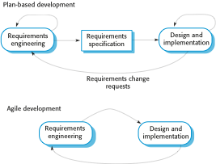
Plan-driven and agile specification
separate development stages with the outputs to be produced at each of these stages planned in advance.
Iteration within stage
Not necessarily waterfall model – plan-driven, incremental development is possible
User's full agreement at end, not before code
Iteration of stage

Slide 7
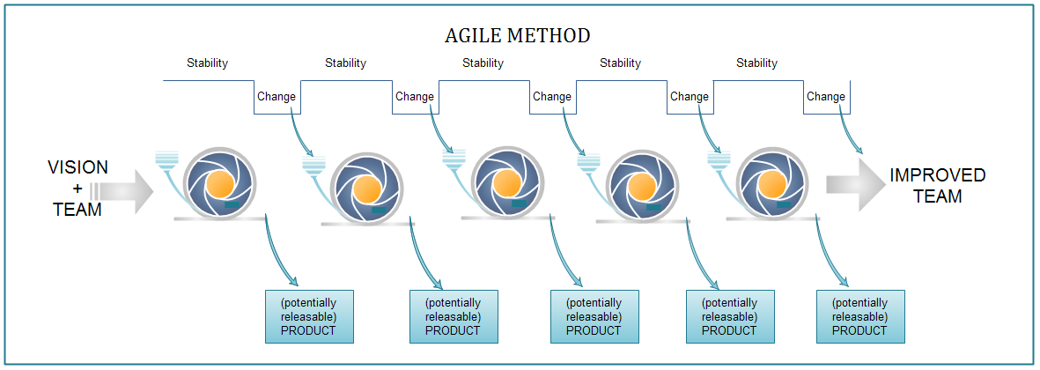
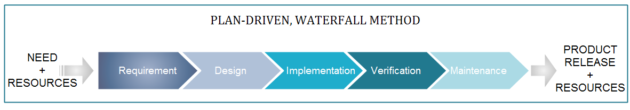

Slide 8
Problems with agile methods
It can be difficult to keep the interest of customers / users who are involved in the process.
Team members may be unsuited to the intense involvement that characterizes agile methods.
Prioritizing changes can be difficult where there are multiple stakeholders.
Maintaining simplicity requires extra work.
Contracts may be a problem as with other approaches to iterative development.
Because of their focus on small, tightly-integrated teams, there are problems in scaling agile methods to large systems.
Less emphasis on documentation - harder to maintain when you get a new team for maintenance

Slide 9
Balance plan driven and agile
Not great for Agile:
What type of system is being developed?
Plan-driven approaches may be required for systems that require a lot of analysis before implementation (e.g. real-time system with complex timing requirements).
What is the expected system lifetime?
Long-lifetime systems may require more design documentation to communicate the original intentions of the system developers to the support team.
What technologies are available to support system development?
Agile methods rely on good tools to keep track of an evolving design
How is the development team organized?
Many teams; Outsourcing ---> need design documents to control borders
Culture or contract needs detailed specification
Is rapid feedback from users realistic?
Large scale, not co-located may require more formal communication methods
Need high level programming skills - refactoring, work with little spec
Outside regulation documentation requirements

Slide 10
Extreme programming
A popular form of Agile
Extreme Programming (XP) takes an ‘extreme’ approach to iterative development.
New versions may be built several times per day;
Increments are delivered to customers every 2 weeks;
All tests must be run for every build and the build is only accepted if tests run successfully.
Customer involvement means full-time customer engagement with the team. - Specifications through user stories broken into tasks
People not process : pair programming, collective ownership and a process that avoids long working hours.
Regular system releases. - release set of user stories
Maintaining simplicity through constant refactoring of code.

Slide 11
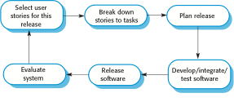
The extreme programming release cycle

Slide 12
The Parts and the Whole
Iteration Plan
Daily Stand-Up
Controller
Set Target
Adapt
Inspect
Clean Design & Code & Refactor
User Stories - Late Elaboration
Shared Code Ownership
Test Driven Development…..
Pair Programming
Customer Reviews & Feedback
Retrospectives
AutoTest…..
Sustainable pace
Collective Ownership with users
Minimal documentation for sprint

Slide 13
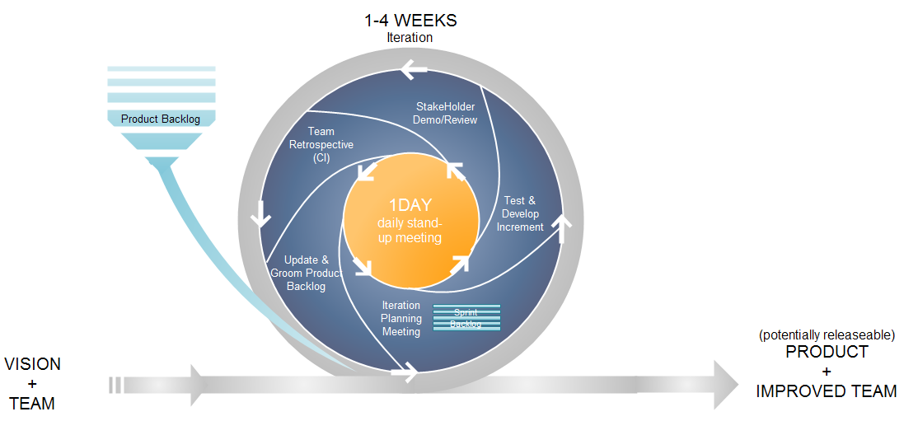
The Life of an Iteration

Slide 14

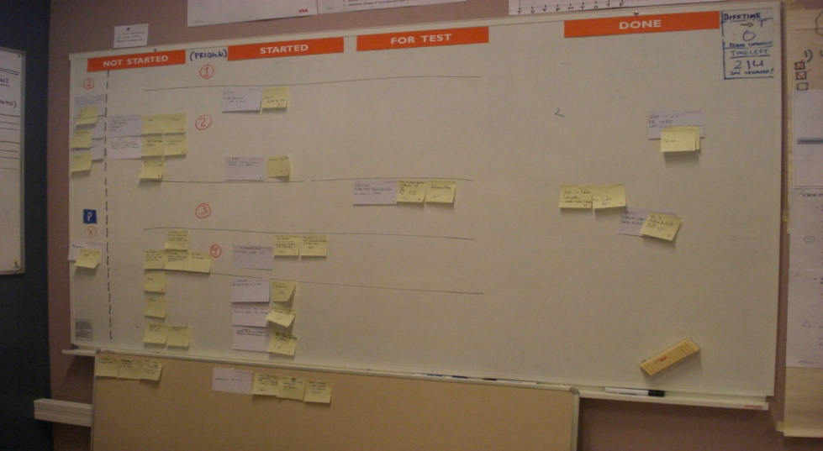
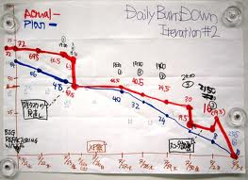
Transparency
“Tell me how you will measure me and I’ll tell you how I’ll behave”

Slide 15
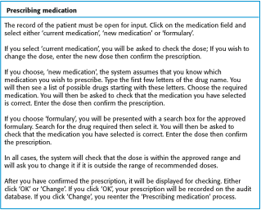
A ‘prescribing medication’ story

Slide 16
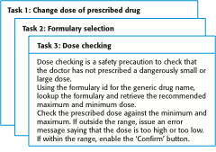
Examples of task cards for prescribing medication

Slide 17
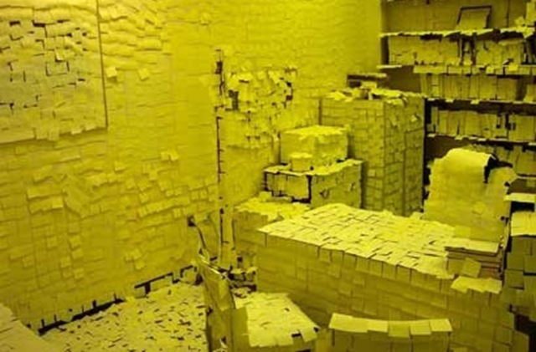

Slide 18
Refactoring
Programming team look for possible software improvements and make these improvements even where there is no immediate need for them.
This improves the understandability of the software and so reduces the need for documentation.
Changes are easier to make because the code is well-structured and clear.
However, some changes requires architecture refactoring and this is much more expensive.
RISK:
Changes the user does not test
Changes to working software break it

Slide 19
Examples of refactoring
Re-organization of a class hierarchy to remove duplicate code.
Tidying up and renaming attributes and methods to make them easier to understand.
The replacement of inline code with calls to methods that have been included in a program library.

Slide 20
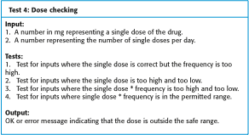
Test case description for dose checking

Slide 21
Test automation
Automate tests (junit)
Run upon checkin
Difficulties:
Time constraints
Programmer preferences to not test
Test coverage

Slide 22
Pair programming
In XP, programmers work in pairs, sitting together to develop code.
Common ownership
Knowledge spread
Informal review
Refactoring
Similar output to two people coding

Slide 23
Scrum
Project Manager's job: - Deliver needed system on time within budget
The Scrum approach - manage the iterations
There are three phases in Scrum.
outline planning phase - general picture and architecture
Sprint cycles releasing increments of the system.
The project closure phase - final delivery, documentation and review of lessons learned.

Slide 24
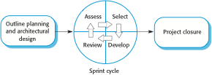
The Scrum process

Slide 25
The Sprint cycle
Every 2–4 weeks (a fixed length).
1) Project team with customer: Look at product backlog - select stories to implement
2) implement with all customer communication through scrum master (protecting pgmr at this point)
Scrum master has project manager role during sprint
Daily 15 min meetings
Stand up often
Team presents progress and impediments
Scrum master tasked with removing impediments
3) Review system release with user

Slide 26
Scrum benefits
The product is broken down into a set of manageable and understandable chunks.
Unstable requirements do not hold up progress.
The whole team have visibility of everything and consequently team communication is improved.
Customers see on-time delivery of increments and gain feedback on how the product works.
Trust between customers and developers is established and a positive culture is created in which everyone expects the project to succeed.

Slide 27
Summary
Plan Driven (Ex: Waterfall) vs Incremental (Ex: Agile )
Structure and benefits and downfalls
XP - an implementation of Agile - Power to the Programmer
User story requirements
Test driven design with continual retest and integration
Pair Programming
Refactoring encouraged
Scrum - project management of Agile using sprints
Iterations of full team contact / Scrum master protection of programmers / full team release review

