Slide 1

Hyperledger
By Dr. Rajesh Upadhyay

Slide 2
Contents
What is Hyperledger ?
Channel
Hyperledger Testnetwork
Why Hyperledger ?
MSP
Deploy smart contract
Private vs Public Blockchain
Nodes
Hyperledger Fabric
Hyperledger Transaction Flow

Slide 3
Prerequisites
No Perquisites

Slide 4



What is Hyperledger ?
Private Permissioned Blockchain

Slide 5

Why Hyperledger (Enterprise Blockchain) ?
Why
Issues with Public blockchain

Slide 6

Issues with public blockchain
A
B
E
F
C
Public Blockchain

Slide 7
Issues with public blockchain
A
B
E
Confidentiality
F
Public Blockchain

Slide 8
Issues with public blockchain
A
B
E
F
C

Slide 9
Issues with public blockchain
A
B
Slow
E
F
C

Slide 10
Issues with public blockchain
A
B
Scalable
E
F
C

Slide 11


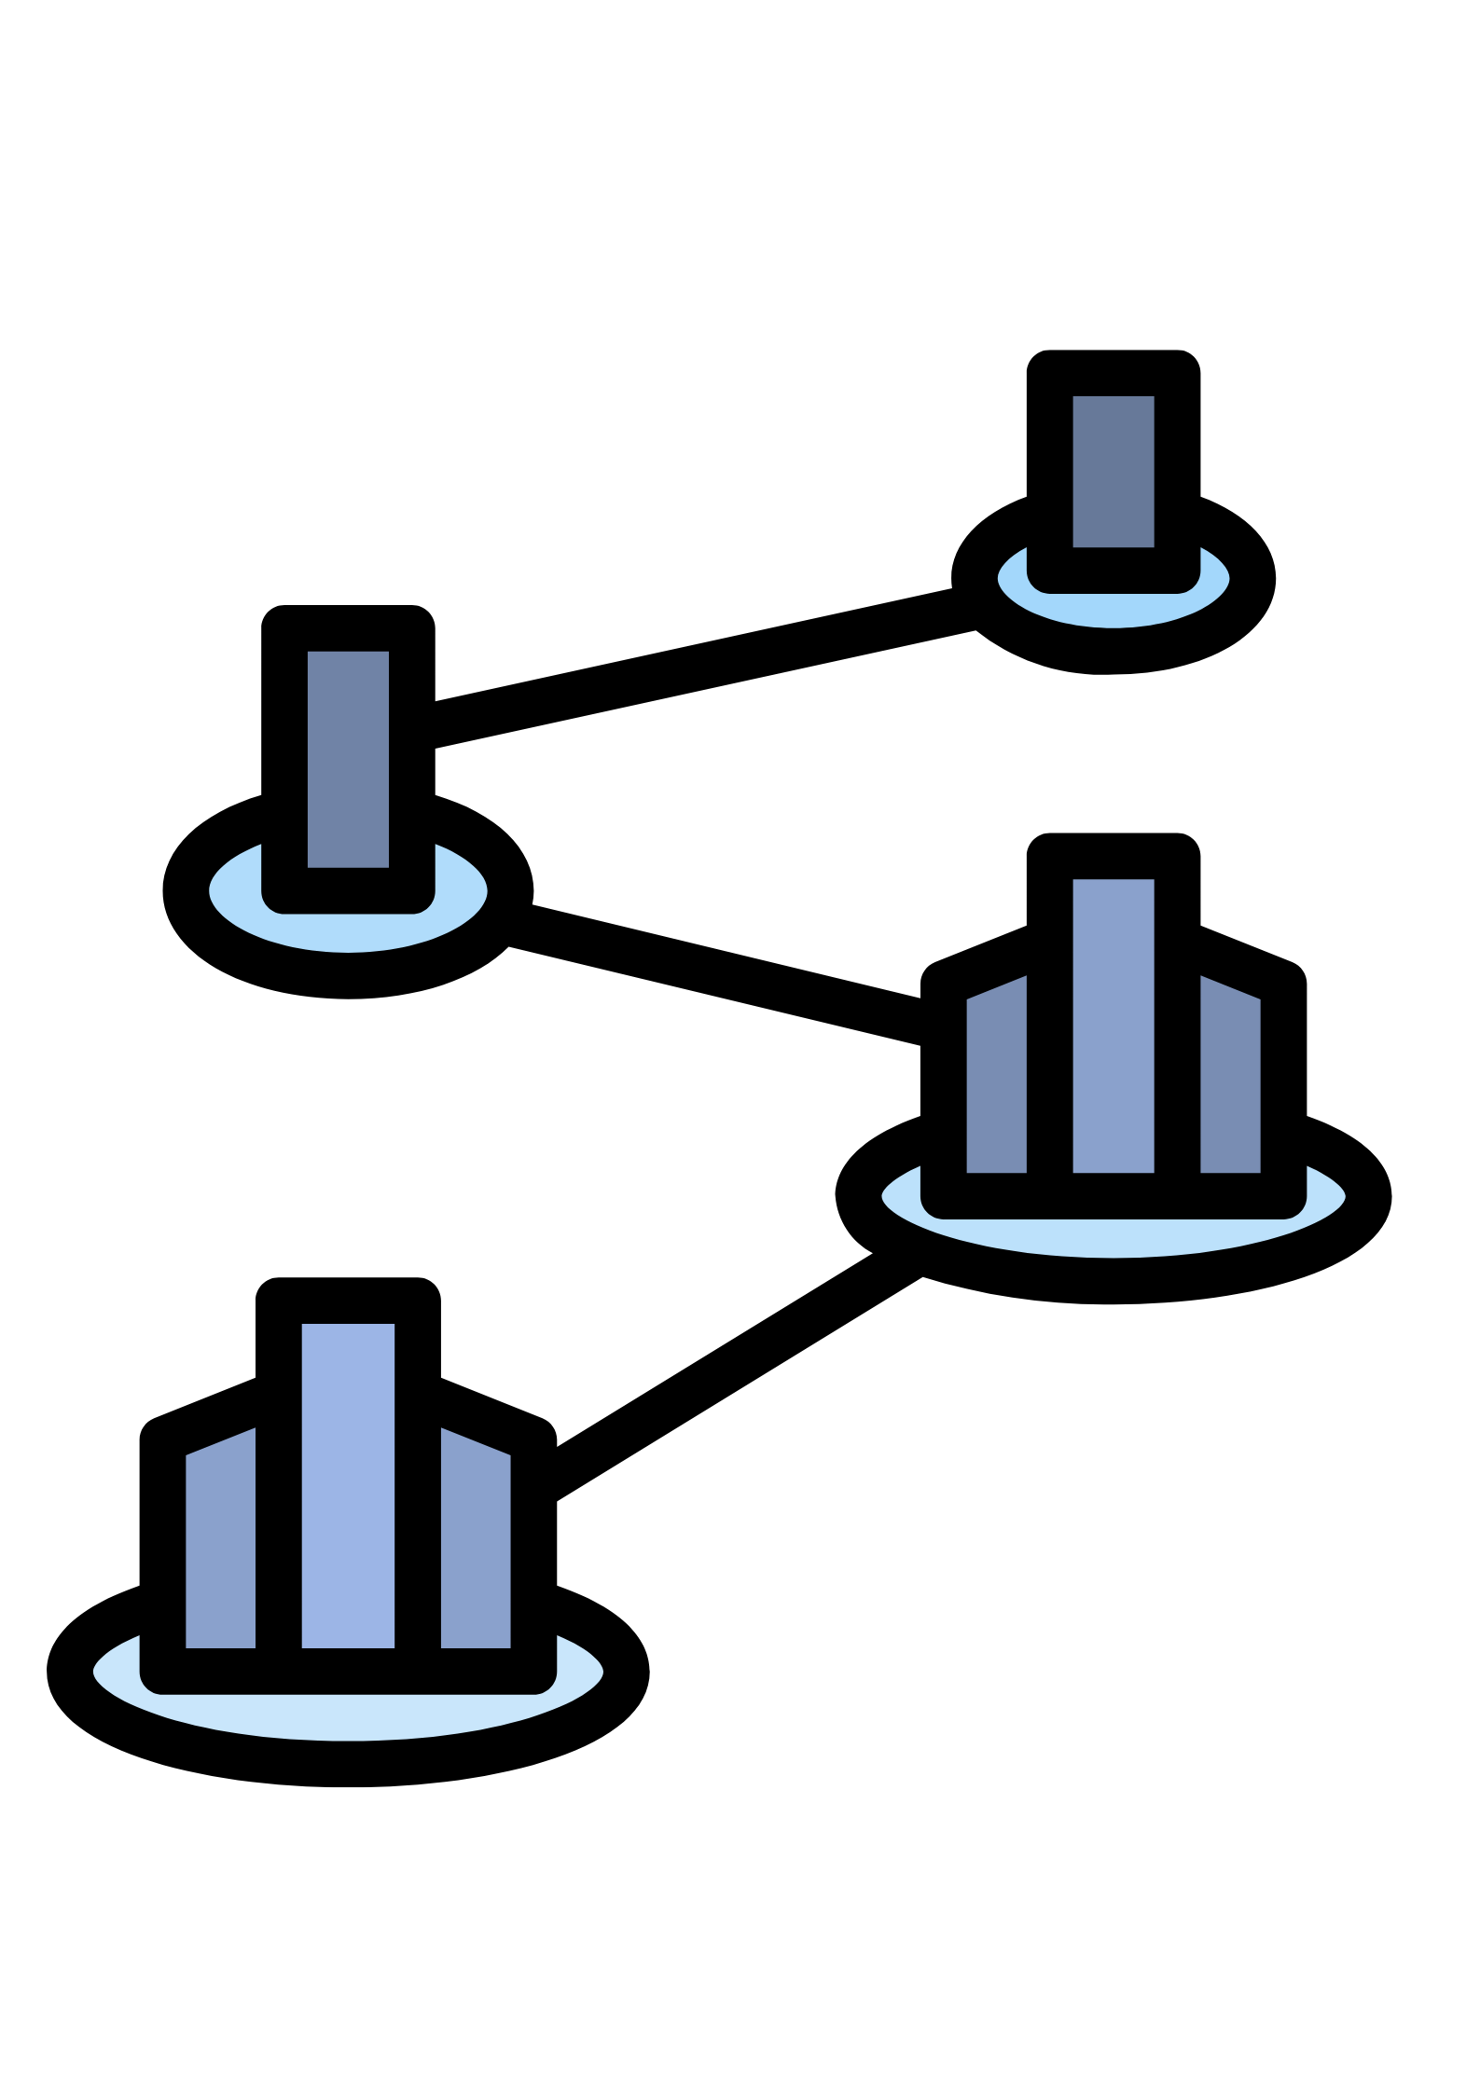
Why Hyperledger (Enterprise Blockchain) ?

Slide 12


Public Blockchain vs Private Blockchain
Properties
Public Blockchain
Private Blockchain
Decentralize Ledger
Same Ledger
Immutable
Anonymous
All node verification
Smart Contract
Transparent

Slide 13

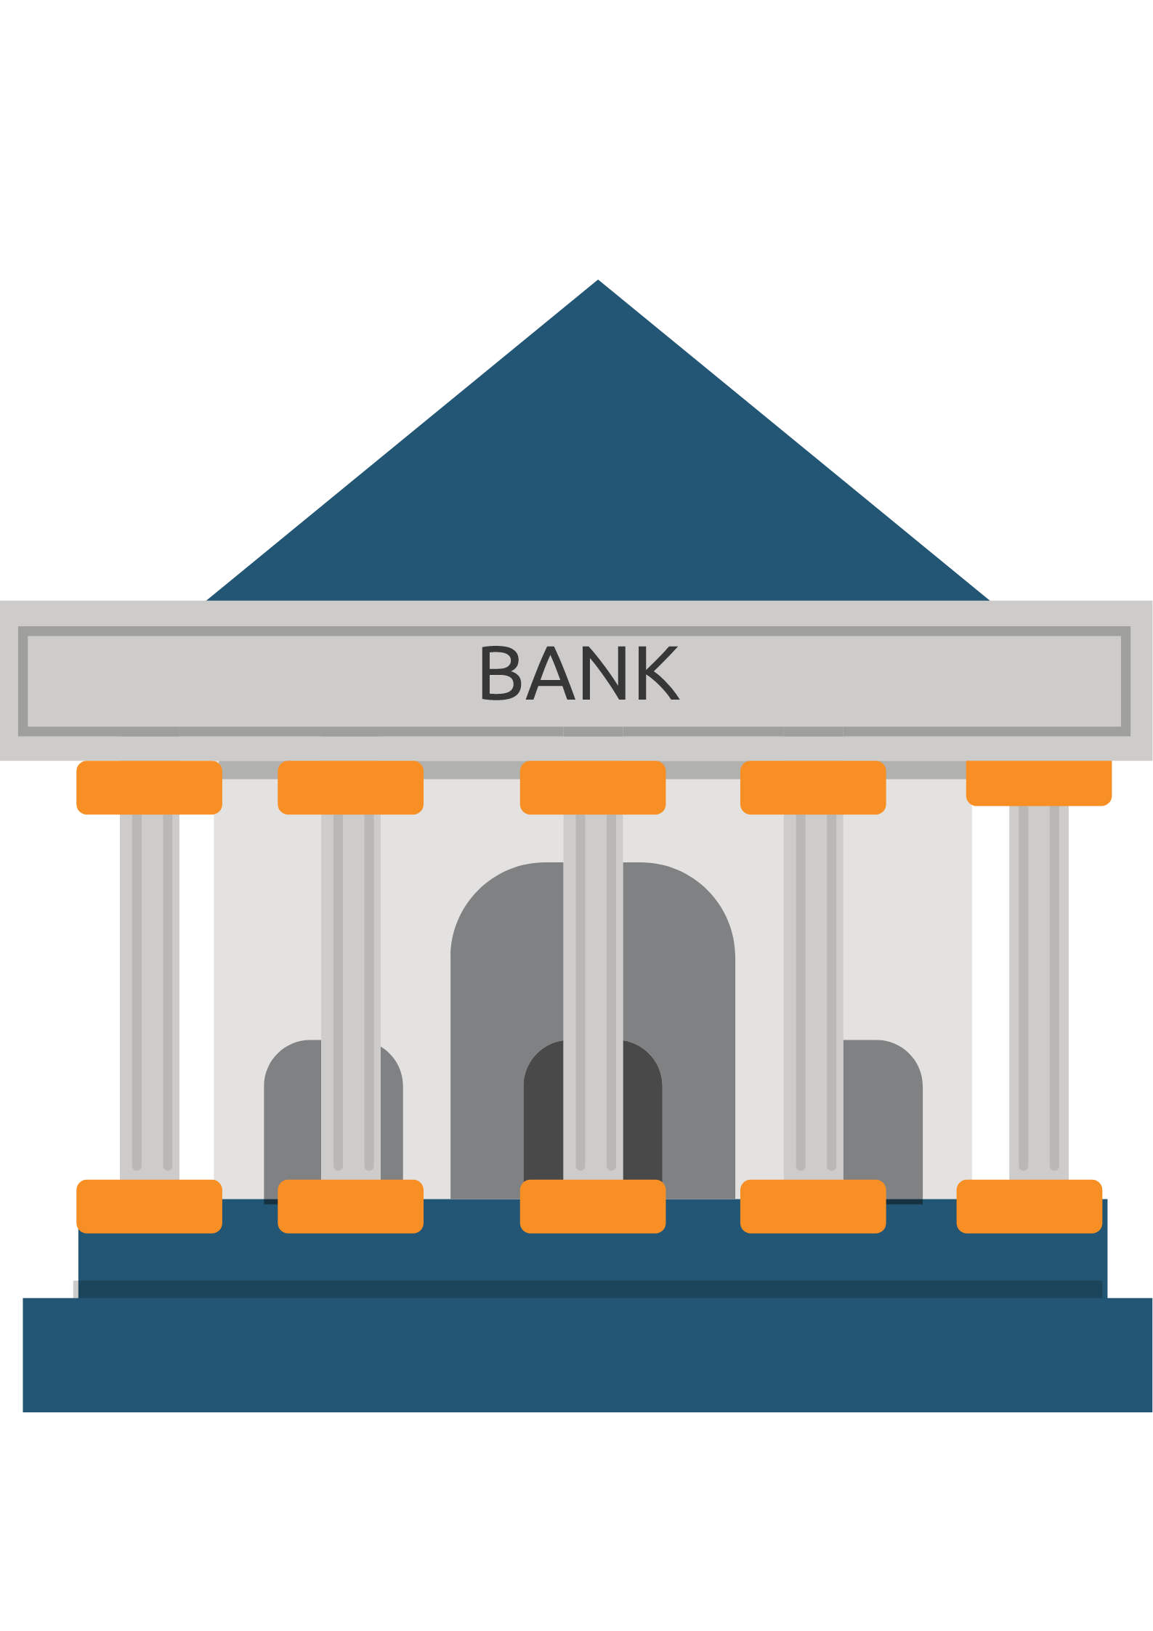




Example
Bank
Shipment
Computer
Manufacture
Marketing
Retail Shop

Slide 14
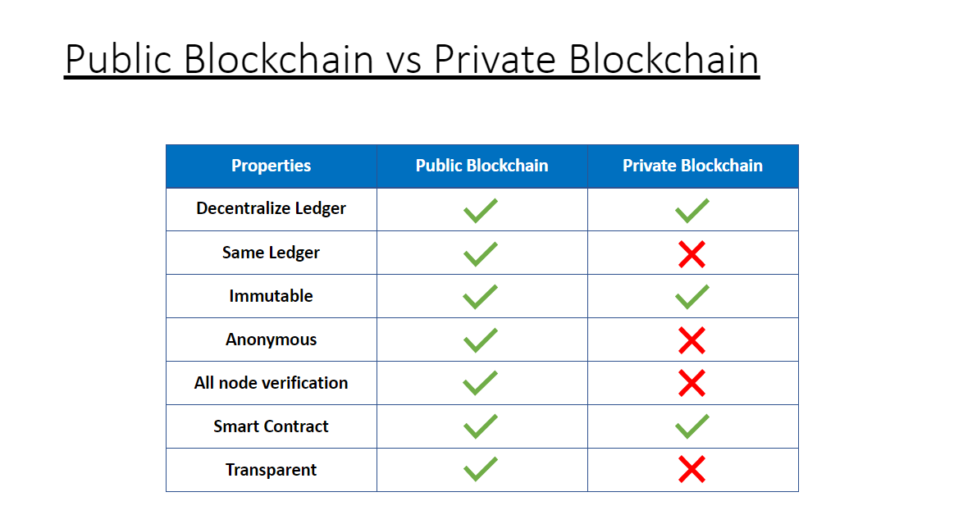

Slide 15
Introduction to Hyperledger Fabric
Hyperledger (or the Hyperledger project) is an umbrella project of open source blockchains and related tools, started in December 2015 by the Linux Foundation.

Slide 16
Hyperledger Fabric
Modular
Scalable
Secure

Slide 17
Hyperledger Fabric
Chain code
MSP
Channel

Slide 18
Channel
A channel is a private communication pathway between two or more members of a Hyperledger.

Slide 19
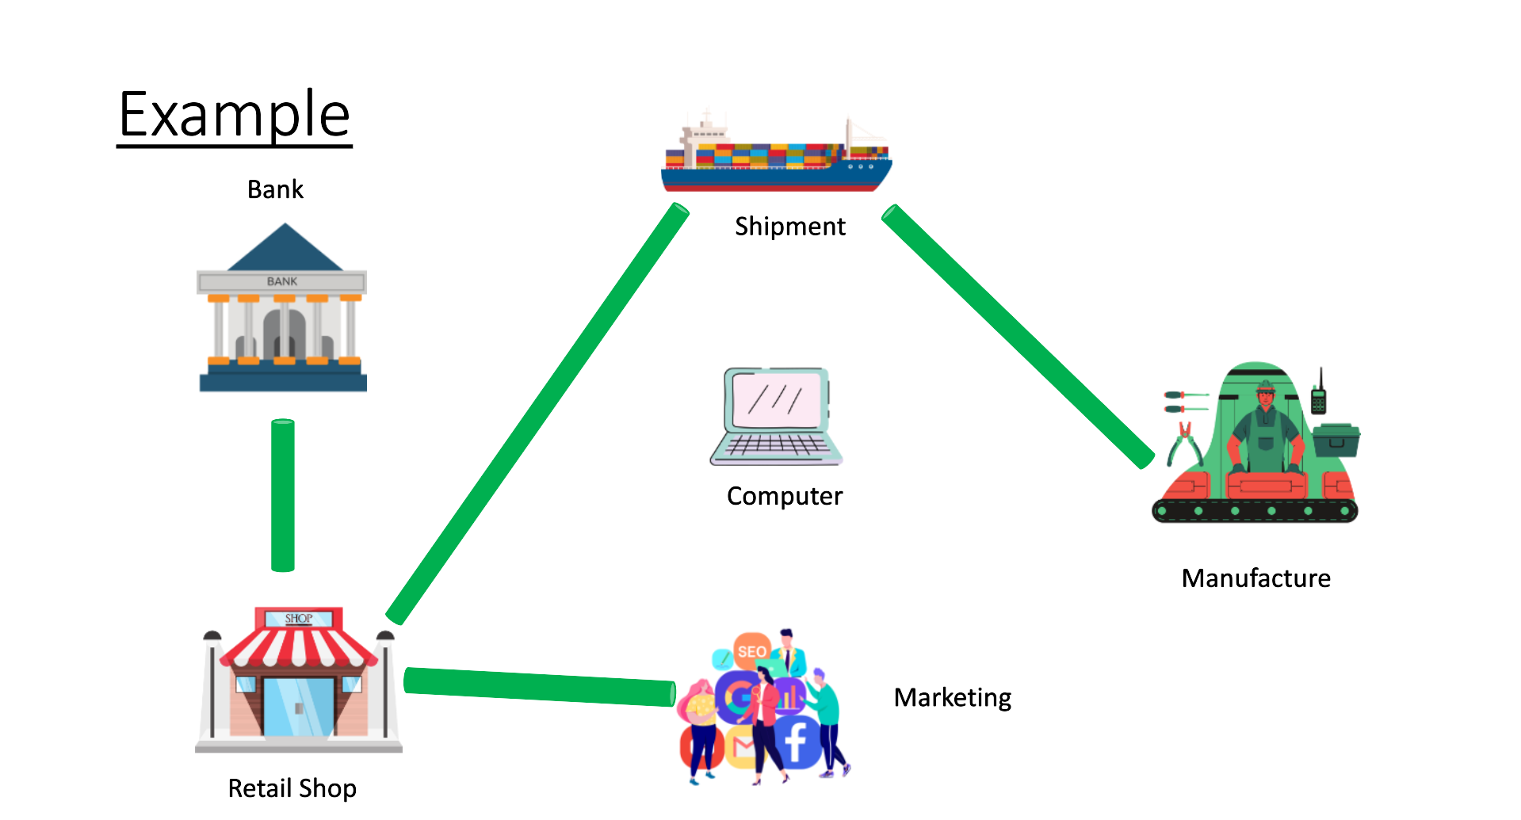
Channel

Slide 20
MSP (Member Service Provider)
MSP is a modular component that is used to manage identities on the blockchain network. This provider is used to authenticate clients who want to join the blockchain network.

Slide 21
Access Control List
An access control list (ACL) is a list of rules that specifies which users or systems are granted or denied access to a particular object or system resource.
Full access of transaction can be restricted with this.

Slide 22
Different Types of Nodes
Committing Nodes - Nodes that have all the copies of the ledger.
Endorsing Nodes - Nodes that can execute chain code.
Ordering Nodes - Nodes that maintain the sequence of transactions.

Slide 23
Chaincode
Chaincode is a program, written in Go, node. js, or Java that implements a prescribed interface.

Slide 24



Hyperledger Transaction Flow
1) Client initiating a transaction
Read
MSP
Access Control List

Slide 25
Hyperledger Transaction Flow
2) Validation of transaction

Slide 26

Hyperledger Transaction Flow
2) Validation of transaction
Transaction Proposal
Endorsing Node
Transaction Proposal
Transaction Proposal
Endorsing Node
Endorsing Node

Slide 27
Hyperledger Transaction Flow
3) Simulating the transaction

Slide 28
Hyperledger Transaction Flow
3) Simulating the transaction
Signed Transaction Proposal (Output 1)
Endorsing Node
Signed Transaction Proposal (Output 2)
Endorsing Node
Signed Transaction Proposal (Output 3)
Endorsing Node

Slide 29

Hyperledger Transaction Flow
4) Verifying Proposal Response
Signed Transaction Proposal (Output 1)
Endorsing Node
Signed Transaction Proposal (Output 2)
Endorsing Node
Signed Transaction Proposal (Output 3)
51% consensus
Endorsing Node

Slide 30

Hyperledger Transaction Flow
5) Broadcast transaction to the orderer
Orderer Node

Slide 31
Hyperledger Transaction Flow
6) Order transaction and create block
Orderer Node

Slide 32

Hyperledger Transaction Flow
6) Order transaction and create block
Endorsing Node
Committing Node
Endorsing Node
Committing Node
Orderer Node
Endorsing Node

Slide 33
Hyperledger Transaction Flow
7) Peers validate each transaction in the block
Endorsing Node
Committing Node
Endorsing Node
Committing Node
Orderer Node
Endorsing Node

Slide 34
Hyperledger Transaction Flow
7) Peers validate each transaction in the block
Endorsing Node
Committing Node
Endorsing Node
Committing Node
Endorsing Node

Slide 35
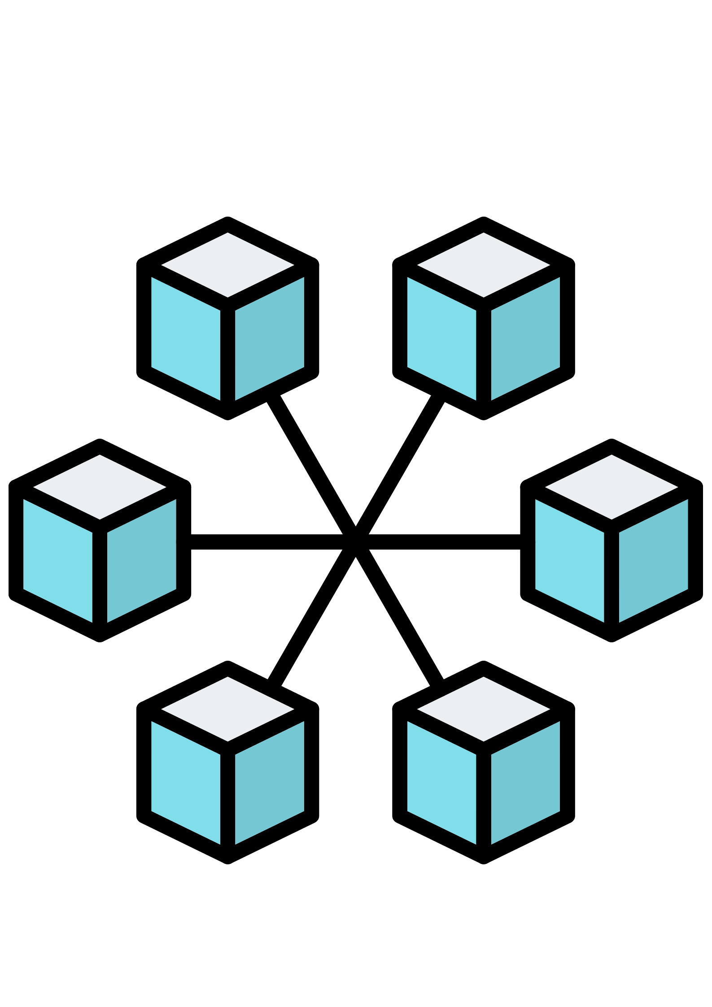
Hyperledger Transaction Flow
8) Committing to their ledger
Endorsing Node
Committing Node
Endorsing Node
Committing Node
Endorsing Node

Slide 36
Hyperledger Transaction Flow
1) Client initiating a transaction
8) Committing to their ledger
2) Validation of transaction
3) Simulating the transaction
4) Verifying Proposal Response
5) Broadcast transaction to the orderer
6) Order transaction and create block
7) Peers validate each transaction in the block

Slide 37
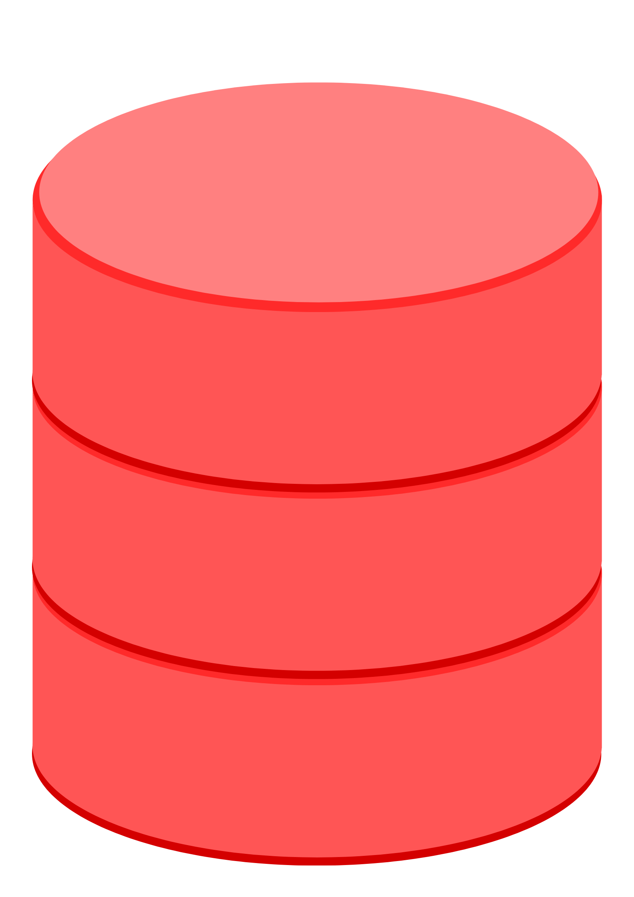
Hyperledger Test Network
Ordering Organization
Ordering
Node
CA
Organization 1
Organization 2
Peer1
Peer1
CA
CA

Slide 38
State Database
Comp Id –123
Ownership - Kshitij
Comp Id –123
Ownership - Karan
Comp Id –123
Ownership - Kim
Comp Id –123
Ownership - Raj
Comp Id –123
Ownership - Rahul
Latest Transaction
Comp Id –123
Ownership - Rahul

Slide 39

Congratulations

Slide 40
Thank You

