Slide 1
CI/CD
Rajesh Upadhyay

Slide 2
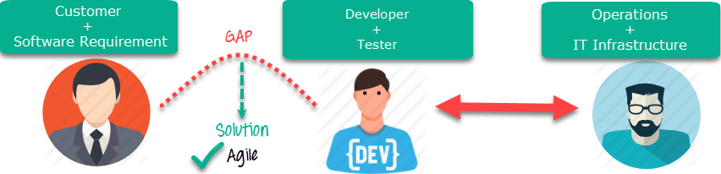
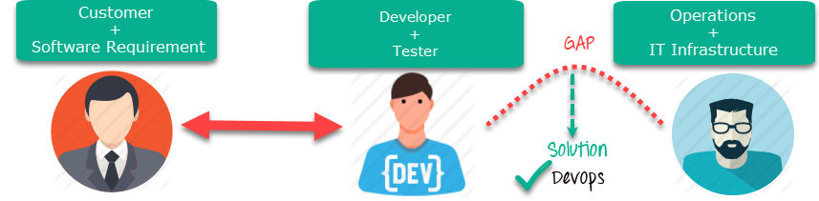
Agile vs Devops

Slide 3
DevOps
Releasing software isn’t an art, but it is an engineering discipline. Continuous Deployment can be thought of as an extension to Continuous Integration which makes us catch defects earlier.

Slide 4
DevOps Principles
1. Customer-Centric Action: DevOps team must take customer-centric action for that they should constantly invest in products and services.
2. End-To-End Responsibility: The DevOps team need to provide performance support until they become end-of-life. This enhances the level of responsibility and the quality of the products engineered.
3. Continuous Improvement: DevOps culture focuses on continuous improvement to minimize waste. It continuously speeds up the improvement of product or services offered.
4. Automate everything: Automation is a vital principle of DevOps process. This is not only for the software development but also for the entire infrastructure landscape.
5. Work as one team: In the DevOps culture role of the designer, developer, and tester are already defined. All they needed to do is work as one team with complete collaboration.
6. Monitor and test everything: It is very important for DevOps team to have a robust monitoring and testing procedures.

Slide 5
Continuous Deployment
It is an approach of releasing software on the production servers continuously in an automated fashion.
So, once a code passes through all the stages of compiling the source code, validating the source code, reviewing the code, performing unit testing & integration testing, packaging the application continuously, it will then be deployed onto the test serves to perform User Acceptance tests.
Once that is done, the software will be deployed onto the production servers for release and this is said to be Continuous Deployment.

Slide 6
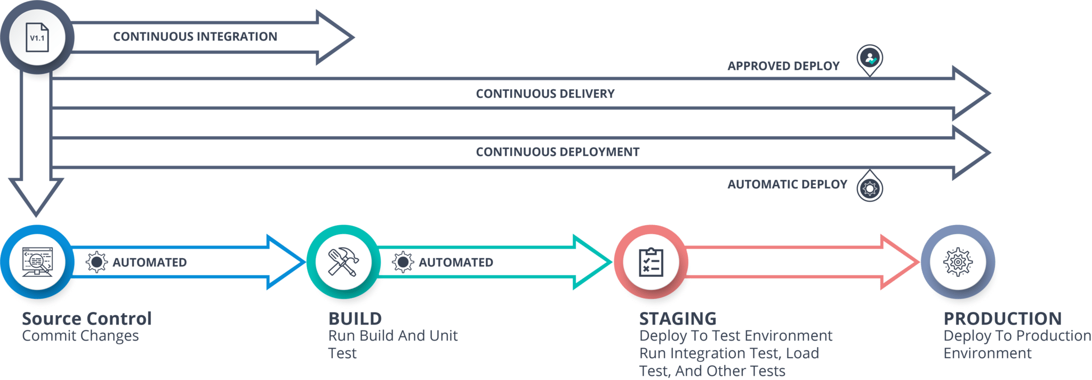
Continuous Delivery vs Continuous Deployment

Slide 7
Continuous Delivery
Continuous Delivery does not involve deployment to production on every change that occurs. You just need to ensure that the code is always in a deployable state, so you can deploy it easily whenever you want.
On the other hand, Continuous Deployment requires every change to be deployed automatically, without human intervention.

Slide 8
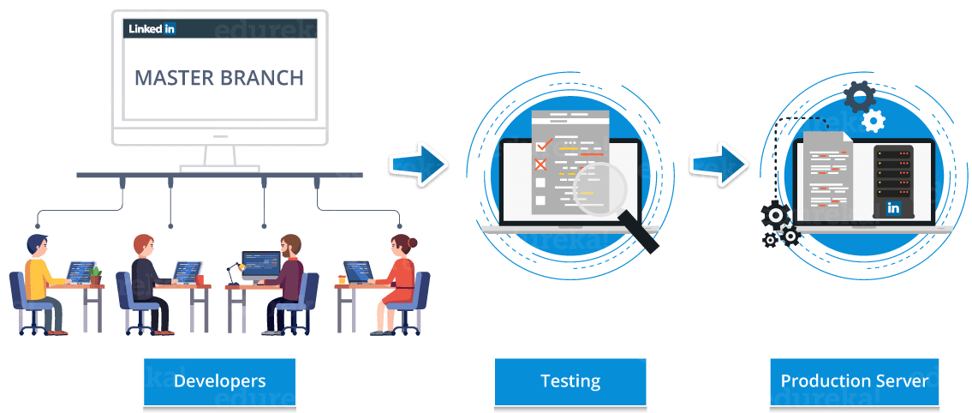
Linkedln’s Case Study Of Continuous Deployment traditional

Slide 9
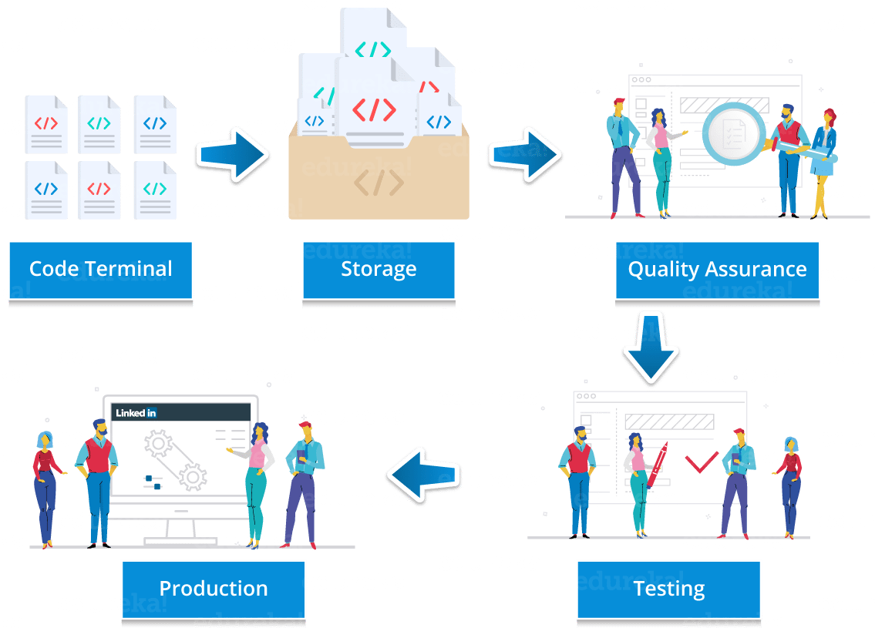
New approach

Slide 10
Linkedln’s
LinkedIn’s framework after using continuous deployment included developers writing code in tidy, distinct chunks, and checking each chunk into the trunk shared amongst all LinkedIn developers.
The newly-added code is then subjected to a series of automated tests to remove bugs.
Once the code passes the tests it is merged into trunk and listed out in a system that shows managers what features are ready to go live on the site or in newer versions of LinkedIn’s apps.
So, that was Linkedln’s success story!

Slide 11
Benefits of Continuous Deployment
Speed – Development does not pause for releases so it is developed really fast.
Secure – Releases are less risky as before releasing testing is performed and all the bugs are solved.
Continuous Improvements – Continuous Deployment support continuous improvements which are visible to customers.

Slide 12
Hands on
Problem Statement: Deploy an application in headless mode through Jenkins server, using selenium test files.
Solution: Follow the steps below to deploy the application in a headless mode.

Slide 13
Continuous Delivery vs Continuous Deployment
What is DevOps?
DevOps is basically a software development strategy which bridges the gap between the dev side and the ops side of the company. In simple terms, you can say that DevOps is, how a developer gets a new feature, an enhancement request, or a change out to production, so that, when the customers give feedback, the developers can improve based on that feedback.

Slide 14
what are the factors that developers can work on?
developers can work on mainly 3 important factors:
The software which is delivered.
The efficiency and performance of environment to which the software is delivered.
Making the process of delivering software more efficient, capable and faster at a lower cost.

Slide 15
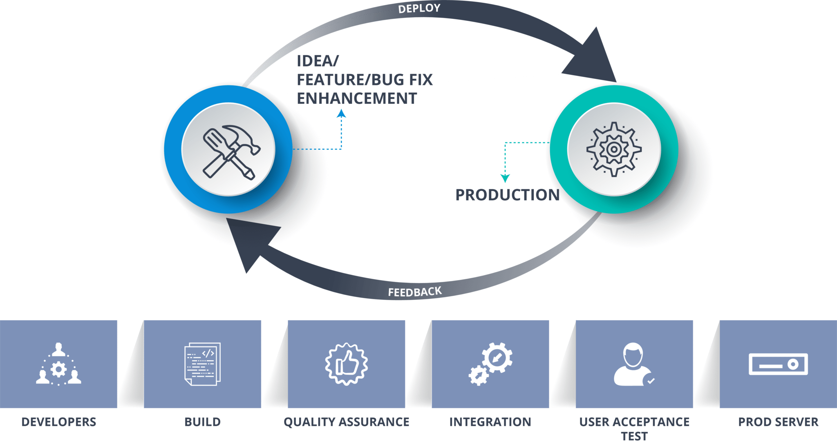
Devops cycle
So, when you deliver software it’s not just delivering it to the production, but, there’s an entire software delivery lifecycle involved with it.

Slide 16
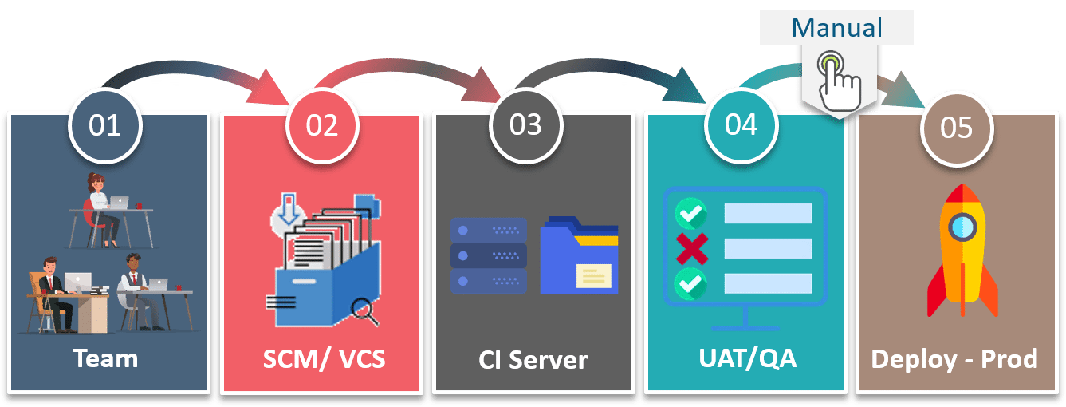
Continuous Delivery
Continuous Delivery is a software development practice where you build software in such a way that the software can be released to the production at any time.
You achieve Continuous Delivery by continuously integrating the products built by the development team, running automated tests on those built products to detect problems and then push those files into production-like environments to ensure that the software works in production.

Slide 17
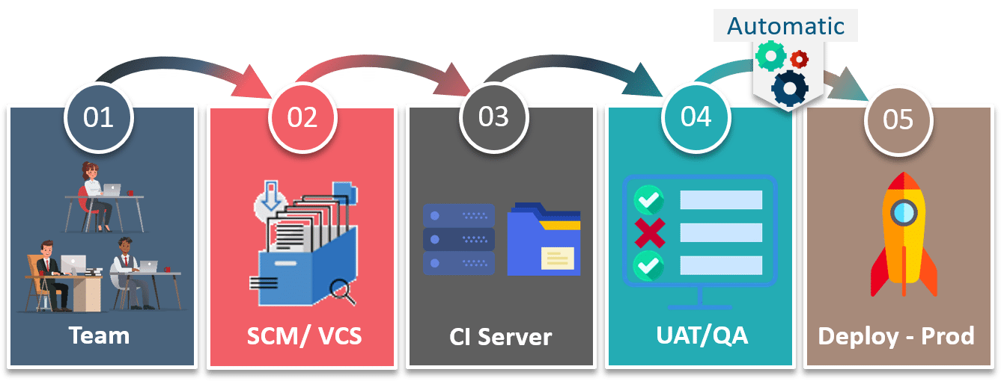
Continuous Deployment
Continuous deployment means that every change that you make, goes through the pipeline, and if it passes all the tests, it automatically gets deployed into production. So, with this approach, the quality of the software release completely depends on the quality of the test suite as everything is automated.

Slide 18
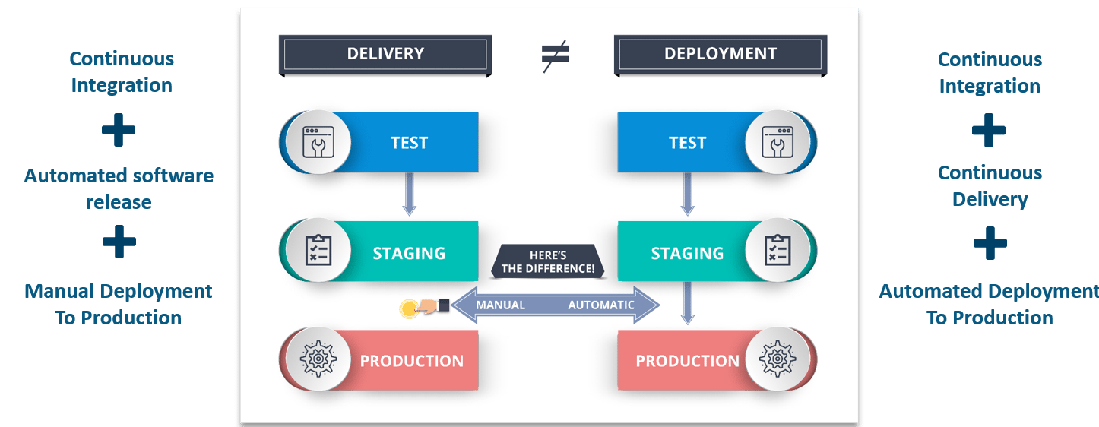

Slide 19
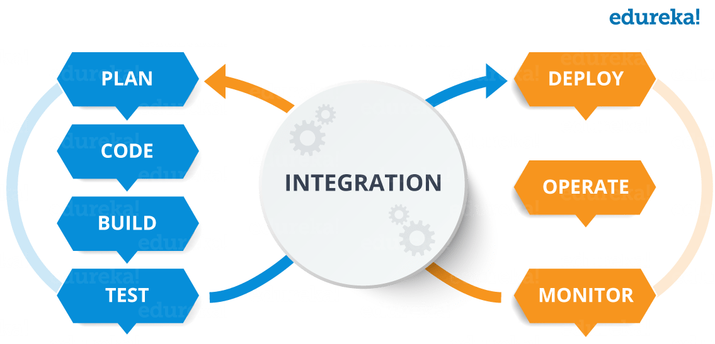
CI CD Pipeline
What is DevOps?

Slide 20
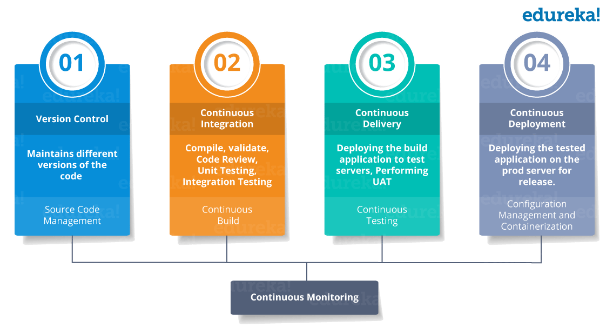
DevOps Stages

Slide 21
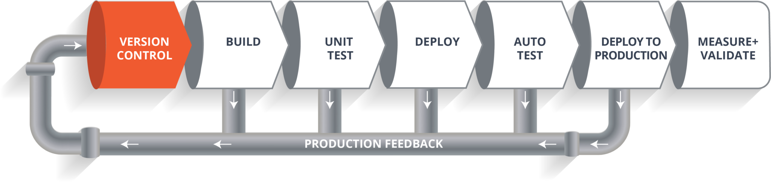
What is CI CD Pipeline?
Now, when this code is committed into a version control system(such as git, svn) by the team of developers. Next, it goes through the build phase which is the first phase of the pipeline, where developers put in their code and then again code goes to the version control system having a proper version tag.

Slide 22
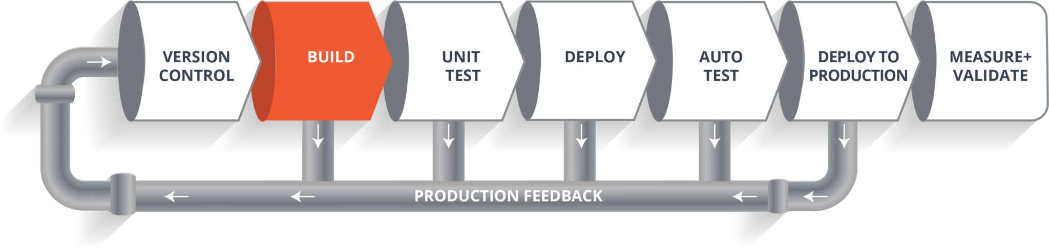
build phase
Suppose we have a Java code and it needs to be compiled before execution. So, through the version control phase, it again goes to build phase where it gets compiled. You get all the features of that code from various branches of the repository, which merge them and finally use a compiler to compile it. This whole process is called the build phase.

Slide 23
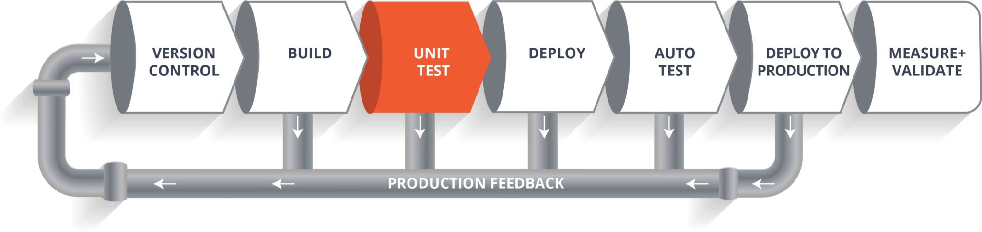
Testing Phase:
the build phase is over, then you move on to the testing phase. In this phase, we have various kinds of testing, one of them is the unit test (where you test the chunk/unit of software or for its sanity test).

Slide 24
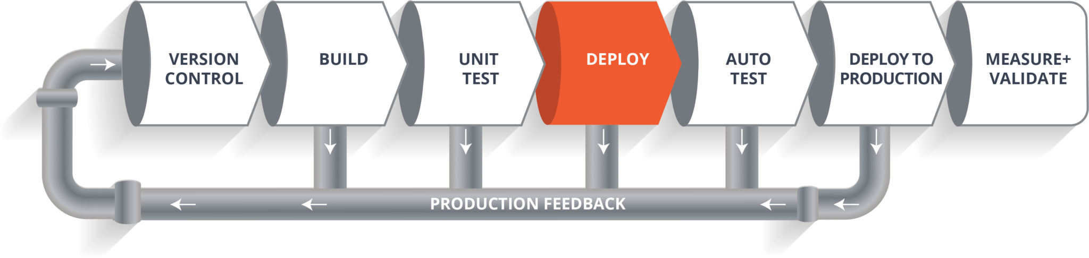
Deploy Phase:
When the test is completed, you move on to the deploy phase, where you deploy it into a staging or a test server. Here, you can view the code or you can view the app in a simulator.

Slide 25
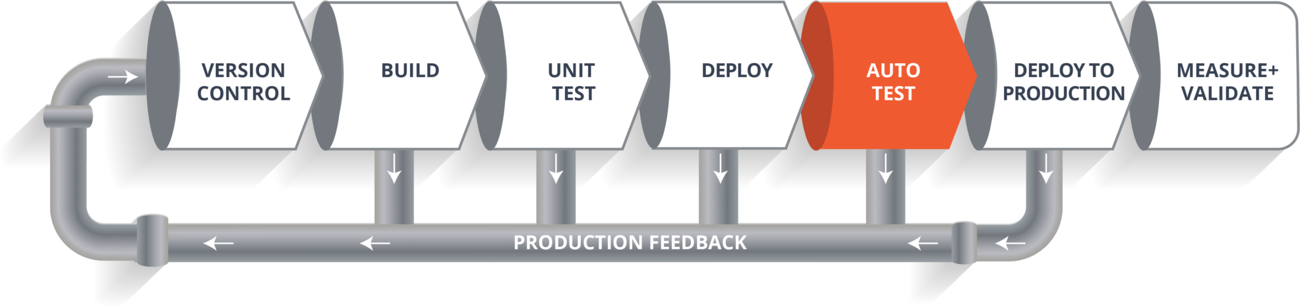
Auto Test Phase:
Once the code is deployed successfully, you can run another set of a sanity test. If everything is accepted, then it can be deployed to production.

Slide 26
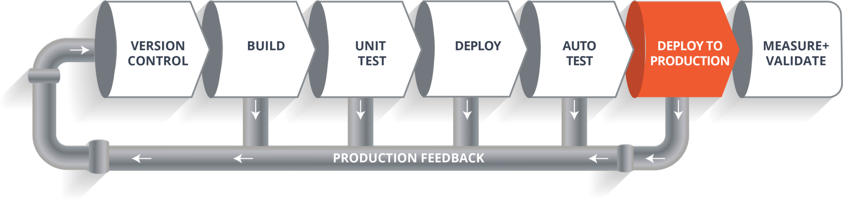
Deploy to Production:
Meanwhile in every step, if there is some error, you can shoot a mail back to the development team so that they can fix them. Then they will push it into the version control system and goes back into the pipeline.
Once again if there is any error reported during testing, again the feedback goes to the dev team where they fix it and the process re-iterates if required.

Slide 27
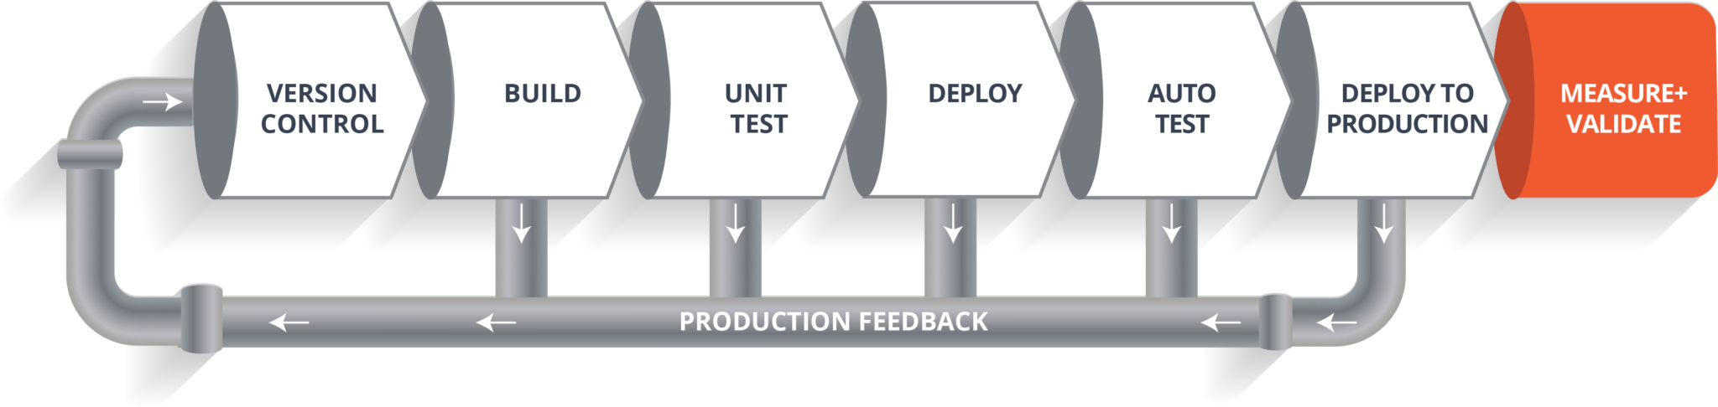
Measure+Validate:
this lifecycle continues until we get a code or a product which can be deployed in the production server where we measure and validate the code.

Slide 28
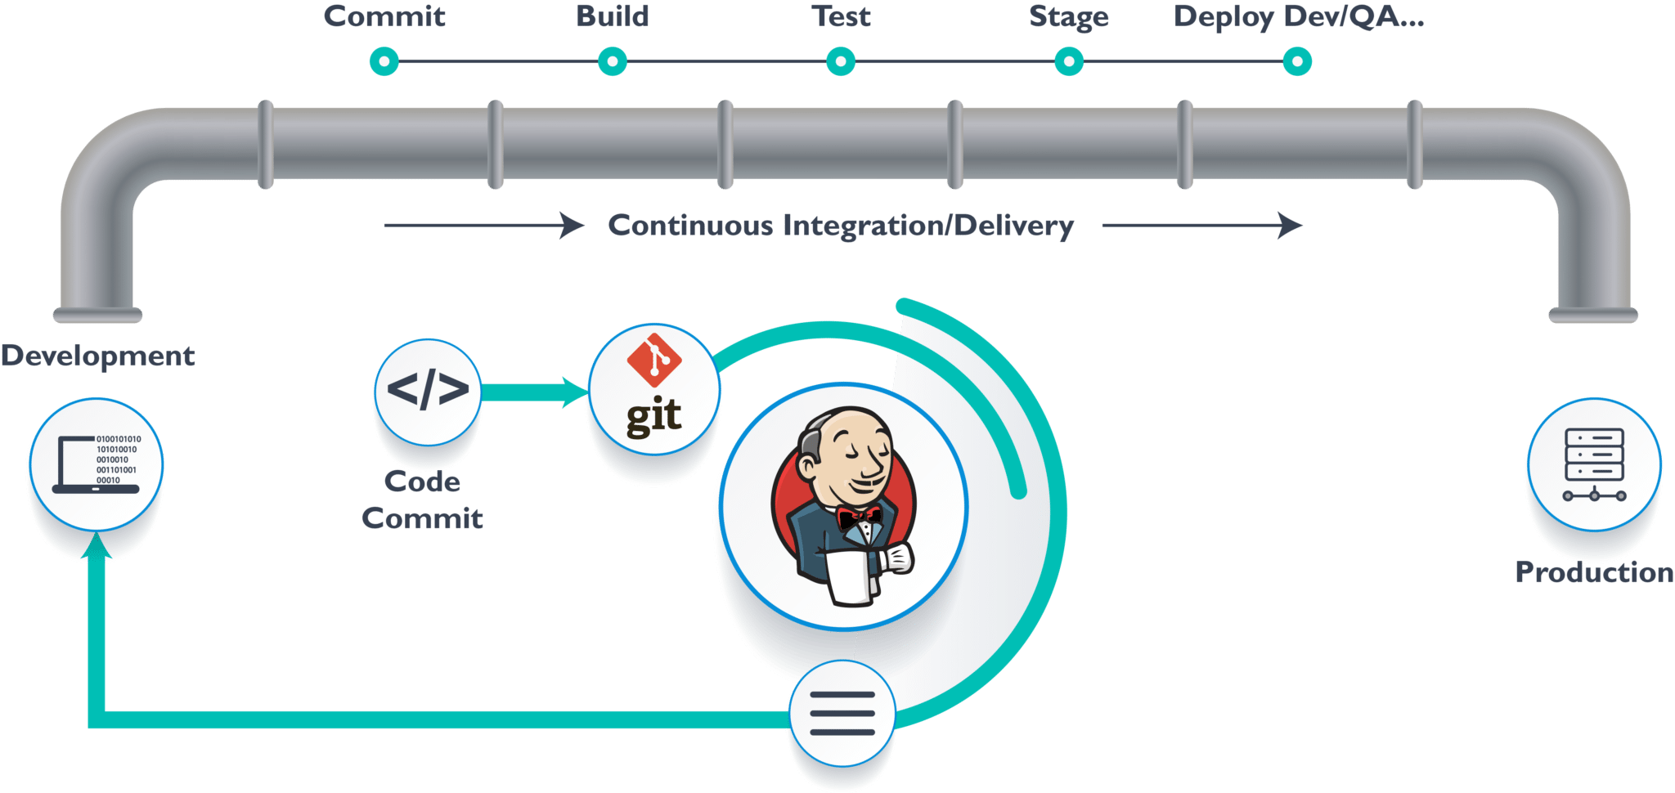
Jenkins – The Ultimate CI Tool and Its Importance in CI CD Pipeline
Our task is to automate the pipeline in order to make the entire software development lifecycle on the dev-ops mode/ automated mode. For this, they would need automation tools.

Slide 29
jenkins
Jenkins provides us with various interfaces and tools in order to automate the entire process.
So what happens, we have a git repository where the development team will commit the code.
Then Jenkins takes over from there which is front-end tool where you can define your entire job or the task.
Our job is to ensure the continuous integration and delivery process for that particular tool or for the particular application.

Slide 30
From Git, Jenkins pulls the code and then moves it to the commit phase, where the code is committed from every branch.
Then Jenkins moves it into the build phase where we compile the code.
If it is Java code, we use tools like maven in Jenkins and then compile that code, which we can be deployed to run a series of tests. These test cases are overseen by Jenkins again.
Then it moves on to the staging server to deploy it using docker. After a series of Unit Tests or sanity test, it moves to the production.

Slide 31
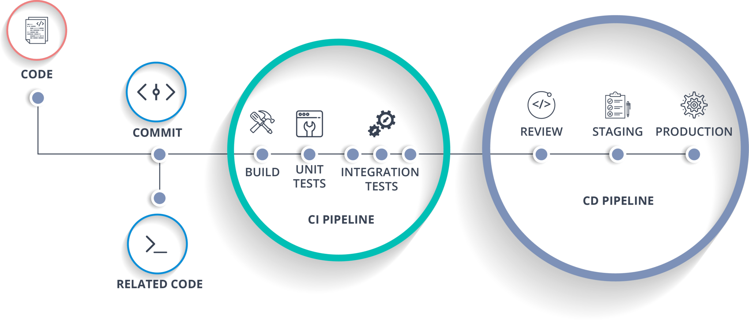
Docker
This is how the delivery phase is taken care by a tool called Jenkins, which automate everything. Now in order to deploy it, we will need an environment which will replicate the production environment, I.e., Docker.

