Slide 1
Module 1: Delivering Services From The Cloud
DevOps Academy
Notes:
Welcome people and say we’re glad to have them,
DevOps is really important
It’s going to be great to spend 2 days going through the course

Slide 2
Content of Module 1
Sections
Basics of the Cloud
Basics of using Amazon Web Services
Lab – Implementing the DevOps tooling stack that we'll use today
Types of tools we’ll be deploying
SCM
Build and Release Orchestration
Automated QA
Overview of the tooling stack that we are going to build in AWS (ADOP)
Lab – Configuring the DevOps tools that we'll use today
Review of Lab Exercise
Discussion
Notes:
Stress that we should have only about 30 mins of slides
Then 45 mins of playing
Then 15 mins of discussion

Slide 3

CLOUD AND AWS BASICS

Slide 4
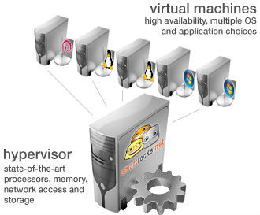
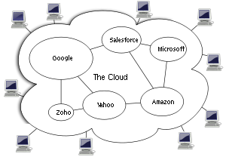
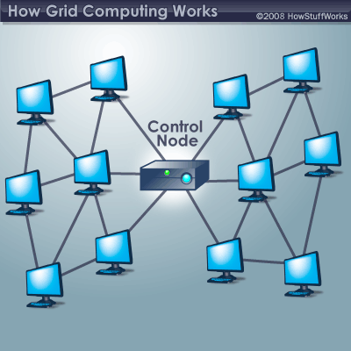
Cloud Basics
What is Cloud Computing?
Virtualization
One computer acting like many
Cloud Computing
A combination of both Virtualization and Grid, but the end user does not have to care about the underlying architecture.
Grid Computing
Many computers acting like one
Utility Computing It is a model in which a service provider makes resources and infrastructure management available as needed, and charges them for specific usage rather than a flat rate.
Collection of computing services (compute, storage, network, etc.)
Accessible on-demand over a network.
Business and technology model for delivering and acquiring IT services in a utility-like fashion.
Notes:
Prompt discussion
We’ve just seen this slide – can people remember?

Slide 5
Benefits of the cloud
Efficiency of cost and operations, and flexibility
Abstract Resources
Application
Content
Communication
On-Demand Provisioning
Monitoring
Collaboration
Finance
Platform
Scalability in Minutes
Cloud Computing
Object Storage
Identity
Runtime
Queue
Database
Pay Per Consumption
Infrastructure
Efficiency of Experts
Compute
Block Storage
Network
Phones
Laptops
Servers
Desktops
Tablets
Notes:
Ask for people to suggest
What makes the cloud attractive?
Abstract Resources
•Focus on your needs, not hardware specs. As needs change, so should your resources.
•On-Demand Provisioning
•Ask for what you need, exactly when you need it; get rid of it when you don’t.
•Scalability in Minutes
•Scale out or in, up or down, depending on usage or needs
Pay Per Consumption
•No long-term commitments. Pay only for what you use.
•Efficiency of Experts
•Utilize the skills, knowledge and resources of experts.

Slide 6
AWS Overview
Introduction to Amazon Web Services (AWS)
Launched in 2006
Provides computing resources and services that you can use to build applications within minutes
Pay-as-you-go pricing (and other options)
Easy to make resilient
More and more services by the month
Low Cost
Openness and Flexibility
Agility and Instant Elasticity
Security
Notes:
AWS launched in 2006 when it began offering developer access to IT infrastructure in the form of web services – now commonly known as cloud computing.
Amazon Web Services (AWS) provides computing resources and services that you can use to build applications within minutes at pay-as-you-go pricing.
Advantages of AWS:
Low Cost- Building on-premise infrastructure can be slow and expensive. Many components need to be in place before you or your customer can run applications. With AWS, customers can have servers running in minutes. AWS offers low, pay-as-you-go pricing with no up-front expenses or long-term commitments.
Agility and Instant Elasticity- Elasticity is the power to scale computing resources up and down easily, while only paying for actual resources used. The elasticity provides –Quickly deploy new applications, Instantly scale up as the workload grows, instantly shut down resources that are no longer required
Open and Flexible- AWS supports many technology stacks and operating systems for running workloads. Customers choose the target platform that makes the best sense for their business.
Secure- AWS is secure, durable technology platform. AWS build services in accordance with security best practices, provides appropriate security features in those services, and documents how to use those features.

Slide 7
AWS Basics
AWS anti-patterns
Hoping things won’t fail
With the cloud you have to expect failure and design-in your ability to recover
Manual Processes
When direct, manual intervention is required to start new resources, scale existing ones will be a blocker
Tightly-coupled architectures
Application components in which a single unit depends on another specific single unit behave poorly when the dependency fails
Stateful
Applications that store state on one instance are more challenging to scale horizontally
Vertical
Vertical scaling will eventually run out of the room
Design to support horizontal scaling
Notes:
Presenter’s note – If this slide seems to be duplicating the same info as in slide 8, consider skipping it

Slide 8
AWS Basics
The 7 best practices for building systems with AWS
AWS
1
2
3
4
5
6
7
Design for failure and nothing fails
Loose coupling sets you free
Implement elasticity
Build security in every layer
Don’t fear constraints
Think parallel
Leverage different storage options
Notes:
1.Design for failure and nothing fails –
Applications should continue to function even if the underlying physical hardware fails or is removed/replaced.
2.Loose coupling sets you free -
The more loosely they’re coupled, the bigger they scale
Load balance clusters
Use a queue to pass messages between components
3.Implement elasticity –
Elasticity is a fundamental property of the cloud
4.Build security in every layer –
Security is a shared responsibility.
You decide how to: Encrypt data in transit and at rest ; Enforce principle of least privilege ;Create distinct, restricted Security Groups for each application role ;Use multi-factor authentication
5.Don’t fear constraints-
Need more RAM?
Consider distributing load across machines or a shared cache
Need better IOPS for database?
Instead, consider multiple read replicas, sharding, or DB clustering
Hardware failed or config got corrupted?
“Rip and replace”—simply toss bad instances and instantiate replacement
6.Think parallel-
Experiment with parallel architectures
1 server working on a job sequentially for 4 hours or
4 servers working on a job in parallel for 4 hours
Same cost (i.e., 4 instance hours), but parallel is 4x faster

Slide 9
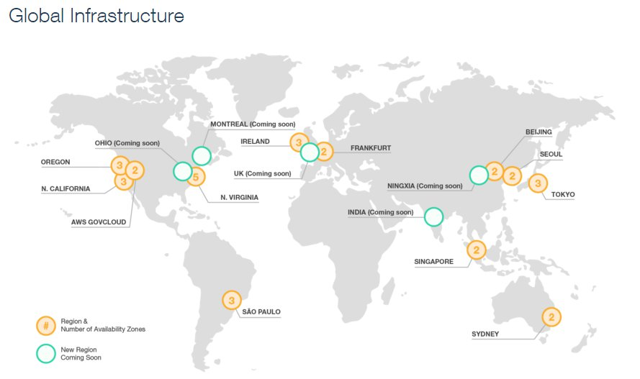
AWS Physical View
May already be out of date!
AWS Locations
Availability zones (data centers)
Regions (closely related data centers)
Amazon Web Services
Region
Region
Availability Zone
Availability Zone
Availability Zone
Availability Zone
Availability Zone
Availability Zone
https://aws.amazon.com/about-aws/global-infrastructure/
http://docs.aws.amazon.com/AWSEC2/latest/UserGuide/using-regions-availability-zones.html
Notes:
AWS Regions –is an independent collection of AWS computing resources in a defined geography. It provides customers with the flexibility to place instances and store data within multiple geographic locations. The number of AWS Regions is dynamic and growing. AWS currently has nine Regions throughout the world.
AWS Availability Zones- AZ's are distinct locations within an AWS Region that are engineered to be isolated from failures in other AZ's and provide inexpensive, low latency network connectivity to other AZ's in the same AWS Region. Within a given AWS Region, AWS allows customers to place instances and store across multiple AZ's.
AWS Edge Locations-AWS Edge Locations host Amazon CloudFront, a content distribution network which is used to distribute content to users. Requests for content are automatically routed to the nearest edge location, so content is delivered with the best possible performance.

Slide 10
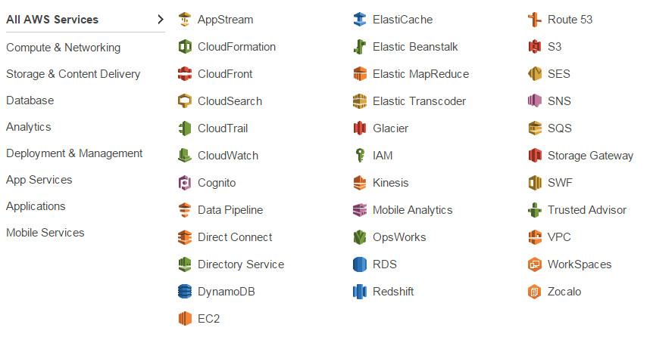
AWS Basics
May already be out of date!
AWS Services
Notes:
Use this slide to highlight important services e.g. EC2, CloudFormation, IAM, CloudWatch, S3
Ask if people what to discuss any others.
All services are grouped into 8 categories.

Slide 11
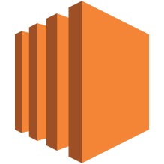

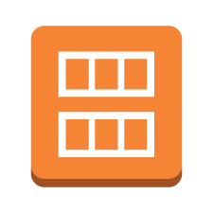


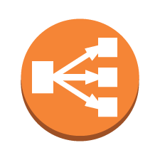
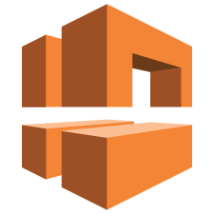
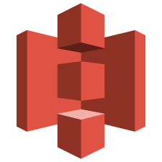


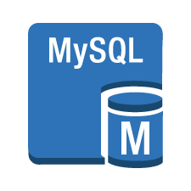







AWS Icons
May already be out of date!
AWS provides a standard icon library to use in design diagrams
Amazon EC2
Instance
AMI
Auto Scaling
Elastic IP
Elastic Load
Balancing
Amazon VPC
Amazon S3
Volume
DynamoDB
MySQL DB Instance
AWS CloudFormation
CloudWatch
Alarm
AWS
VPC
Amazon SES
Email
Amazon SNS
AWS Cloud
Virtual Private Cloud
Traditional Server
Notes:
AWS has defined set of icons to represent its services.
It includes some non AWS services like AWS Cloud, VPC, traditional server etc.

Slide 12
AWS Icons
May already be out of date!
Make a note of the main services we’ll be using…
Amazon EC2
Instance
AMI
Auto Scaling
Elastic IP
Elastic Load
Balancing
Amazon VPC
Amazon S3
Volume
MySQL DB Instance
AWS CloudFormation
CloudWatch
Security Group
AWS
VPC
AWS Cloud
Virtual Private Cloud
Notes:
Describe any you missed (high level)
We’re going to use these

Slide 13

WHAT DOES THIS MEAN FOR PEOPLE?
Notes:
Some suggestions:
DevArch need to know cloud
What gets build for dev and test can be done faster and can be prod ready

Slide 14
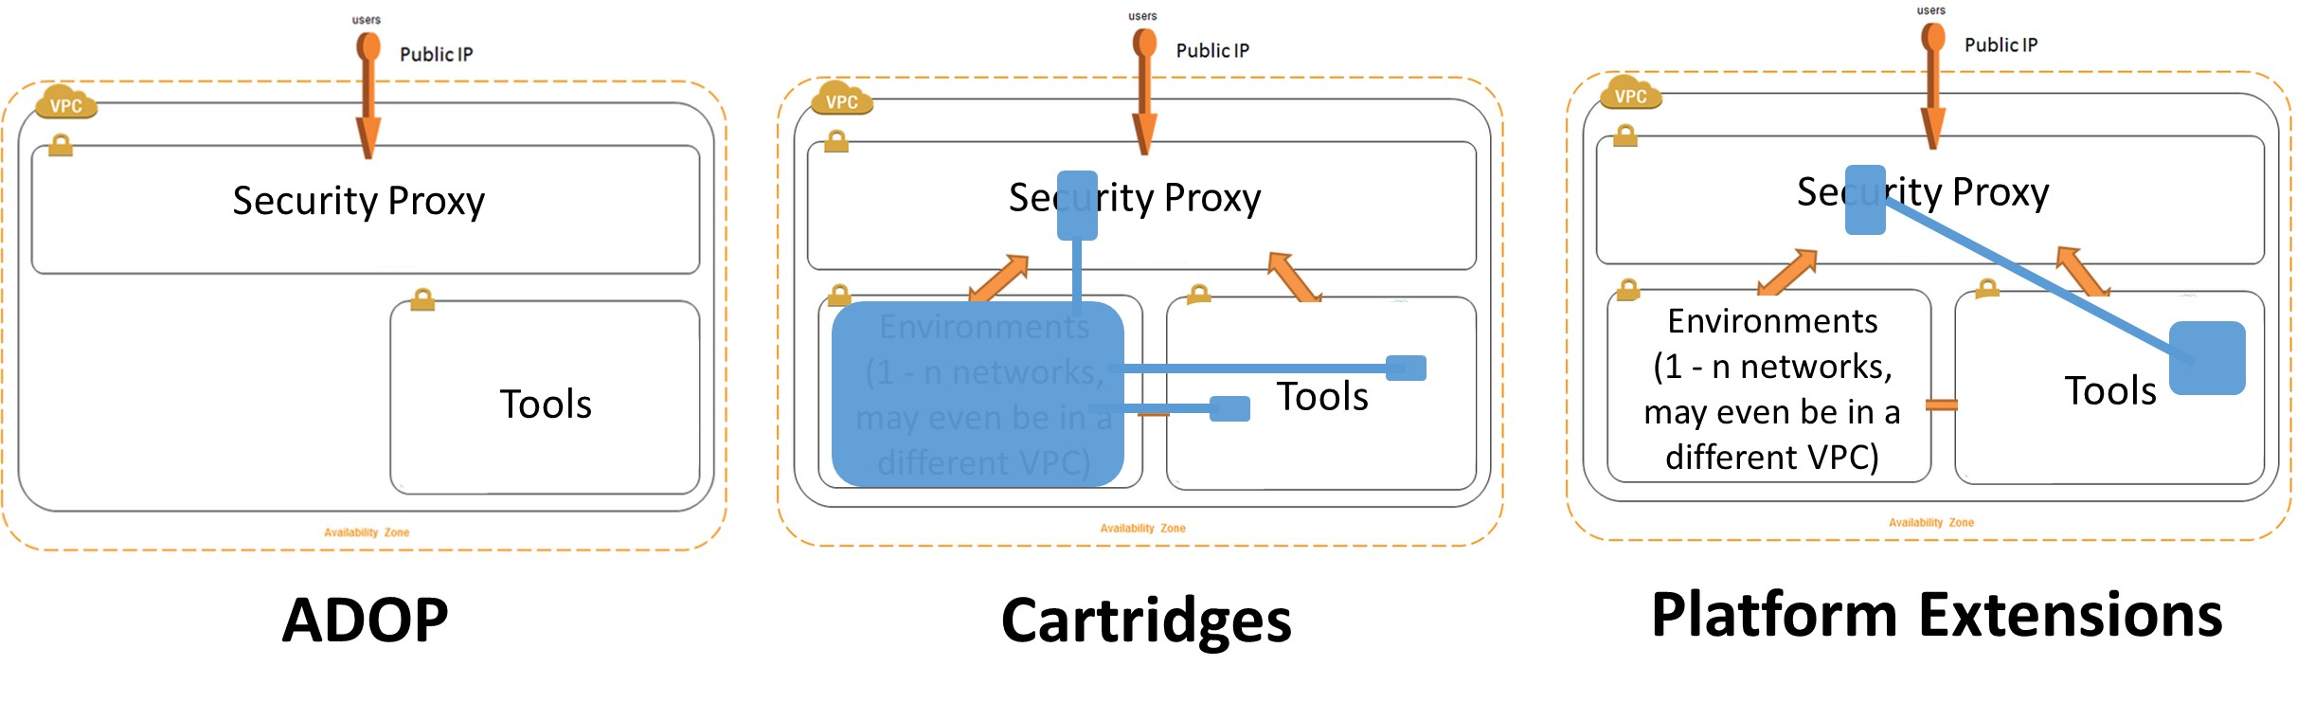
Tooling stack that we built in the lab
Component Overview
Three main components:
Core – the bundle of pre-configured tools in ADOP (Accenture DevOps Platform)
Cartridges
Platform Extensions
Notes:
Up to presenter whether to go into details about cartridges here or mention that we will come back to it

Slide 15
Tooling stack that we built in the lab
Cartridges
Standardised approach of packaging and sharing reusable software delivery assets
Defines the Git repositories with sample code, Jenkins jobs and pipelines that define a reference implementation for a particular technology
Notes:
Up to presenter whether to go into details about cartridges here or mention that we will come back to it

Slide 16
Tooling stack that we built in the lab
Platform Extensions
Provides the ability to extend the Core and add new tools or extensions to existing tools
For example:
Jenkins plugins
Sonar plugins
Tools (via Docker or EC2)
…the list goes on
If it’s not in the Core and it could be used by multiple cartridges, it is probably a platform extension
Notes:
Up to presenter whether to go into details about platform extensions here or mention that we will come back to it

Slide 17

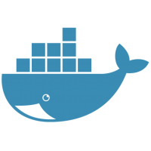
Tooling stack that we built in the lab
High-level provisioning view
Internet
AWS
AWS cloud
AWS
AWS region EU (Ireland)
AWS Cloud
VPC
Availability Zone
CF template json
Public subnet
Public security group
ADOP Provisioning
CloudInit
Tomcat
Environment
Single ADOP VM
Load Cartridge
AWS CloudFormation
Nexus
Nginx
Jenkins
Platform Extensions
Chef
Server
Gerrit
ELK
Sonar
Notes:
Describe each high level step

Slide 18

Tooling stack that we built in the lab
https://hub.docker.com/
Detailed view
Internet
AWS
AWS cloud
AWS
AWS region EU (Ireland)
AWS Cloud
VPC
Availability Zone
CF template json
Public subnet
Public security group
ADOP Provisioning
Single ADOP VM
Tomcat
Environment
Load Cartridge
AWS CloudFormation
Nexus
Nginx
Jenkins
CloudInit
Platform Extensions
Chef
Server
Gerrit
ELK
Sonar
Notes:
Describe each step
- Mention that Jenkins does a lot of the work post provisioning for us to standup environments in the form of cartridges or load platform extensions

Slide 19

DEVOPS TOOLS

Slide 20
Tools we will be deploying
Broadly we will deal with:
SCM
How are we going to safely store software, data and media and track and control it?
BUILD & RELEASE ORCHESTRATION
How are we going to move software, data and media around and configure it (remember infrastructure “is” software as well)
AUTOMATED QUALITY ASSURANCE
How do we know the software does / is doing what it is supposed to. “The continuum of testing and monitoring”
Notes:
Mention the high level
“The continuum of testing and monitoring” means that if you continually run your tests you are basically monitoring.

Slide 21
How work flows through the tools
Orchestration
Compile & Package
Committer: jdoe Story:25
Run Unit Tests
Create ST env
Deploy Code
Load Test Data
Run Test(s)
Create clustered env
Deploy Code
Run Perf Test
Commit ID: 113
Sonar Code Analysis
Tear down ST env
Run Security Test
Prod deploy
SCM
Run Ops Test
Quality Assurance
Notes:
Relate to the pipeline

Slide 22

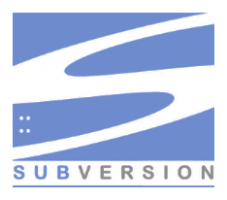

Tools we will be deploying
SCM
In SCM, a discipline comprising the tools and techniques to manage change to software assets -- source code is an important such asset
We need revision control of source code
We need to ensure integration of code changes
We need to maintain revision history
Revert to previous file revisions
Compare versions and changes
Ability to merge changes
We’re going to deploy Gerrit, a code review tool which uses Git as its version control system
Notes:
Explain key features

Slide 23
Tools we will be deploying
Build and Release Orchestration
In DevOps, our software builds and deployments need to run more frequently and in less time
Incremental and iterative improvements to the code
Continuous integration workflow
Continuous delivery enabling the ability to deploy to production environments and production like environments at any time
Workflows that we orchestrate:
Continuous Integration
Continuous Delivery
We’re going to install Jenkins as our build and release orchestration tool
Notes:
Explain key features

Slide 24
Tools we will be deploying
Automated QA
Automated Quality Assurance
Post-Commit Automated Build
Run automated Unit Tests (assume no external dependencies e.g. integrated/downstream services)
Run automated Static Code Analysis
Functional Suite
Test suites against an environment
UI or API driven
Performance profilers
We’re installing Selenium Grid as our Functional Testing capable tool
We’re installing SonarQube as our static code analysis tool
Notes:
Explain key features

Slide 25
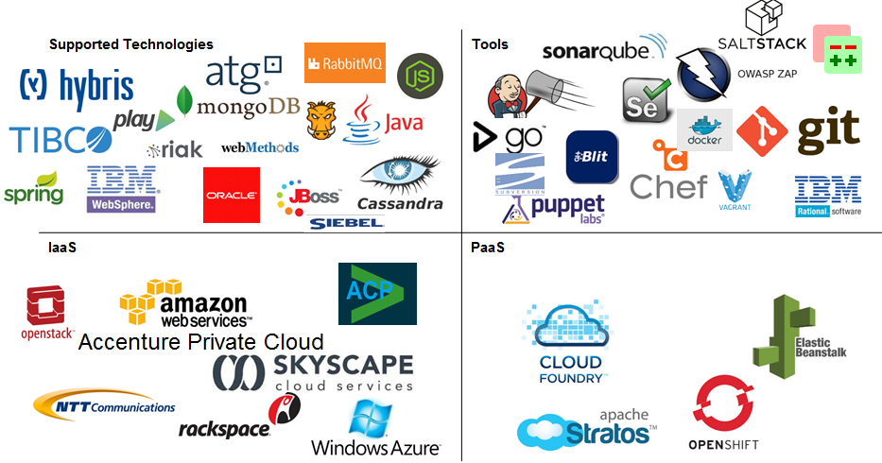
More tools…
Any questions about these or any other DevOps enabling tools?
Technology Platforms
Tools
IaaS
PaaS
Notes:
Describe the 4 quadrants
Ask if people want to know what any of the tool/technology is?

Slide 26
WHAT DOES THIS MEAN FOR PEOPLE?
Notes:
Some suggestions:
DevArch need to know cloud
What gets build for dev and test can be done faster and can be prod ready

Slide 27
Summary
We’ve covered
What is Cloud
Amazon AWS overview
Three key tools types:
SCM
Build & Release Orchestration
Automated QA
Stood up project tooling environment using CloudFormation from provided DevOps Academy assets.
Notes:
Lead a discussion about what we’ve learnt

Slide 28
OBSERVATION AND DISCUSSION

Slide 29

QUESTIONS

