Slide 1
Module 3:
Continuous Delivery and Pipeline Flow
DevOps Academy

Slide 2
Content
Sections
Business case for rapid releasing
Introduction to Continuous Integration
Principles of a production line and flow
Continuous Integration (CI) origins
Benefits of CI
Continuous Integration standard implementation
Typical CI Workflow using a Pipeline
Typical Architecture Practices of CI
Examples of Automated Build and Deployments
Recommended tools to do this
Summary
Intro to lab
Discussion
References

Slide 3

Introduction to
Continuous Integration

Slide 4
Value Stream
Idea
Value
Notes:
If we take what we do in IT down to the simplest form, basically we are taking ideas and turning them into some type of system which involves computers and hoping that this will make money.
The process for taking an idea and getting it into the state where it can start delivering business value is our main focus
Using the terminology from lean we can call that part the Value Stream

Slide 5
Release
Ideas
Values
Notes:
What we typically do in traditional delivery is group those ideas into a release and that would then batch up at the end of a release all of the expected value outcomes.
And as those things start going wrong, our natural tendency is to do them less frequently by having bigger and bigger and bigger releases, so you enter a kind of destructive spiral.

Slide 6
Value Released
Guessed Well
Time
Notes:
The second challenge that inspires from it, in addition to the longer time and big bang nature, is none of the value actually gets realized from the release until it goes live and into operations. So all that time, the business has been providing investment and sinking work-in-progress into the release, but hasn’t yet started to see any return on investment. And, going back to the hypothesis, that’s only true if we guessed well.

Slide 7
Release
Ideas
Values
Notes:
If, in fact, a number of those ideas were flawed or faulty or didn’t have significance in the expected value case, the end result from the release is going to be less.

Slide 8
Problem #1: Long cycle time
Value Released
Guessed Well
Guessed Badly
Time
Notes:
The second challenge that inspires from it, in addition to the longer time and big bang nature, is none of the value actually gets realized from the release until it goes live and into operations. So all that time, the business has been providing investment and sinking work-in-progress into the release, but hasn’t yet started to see any return on investment. And, going back to the hypothesis, that’s only true if we guessed well.

Slide 9
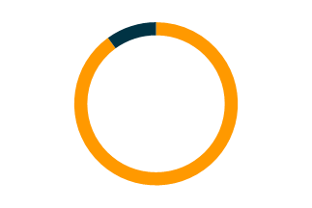
only about 1/3 of ideas improve the
metrics they were designed to improve
Microsoft
Netflix considers 90%
of what they try to be wrong.
http://ai.stanford.edu/~ronnyk/ExPThinkWeek2009Public.pdf
Notes:
From Microsoft’s research learn statically ideas aren’t good

Slide 10
Problem #2: Release risk
Release
Ideas
Values
Notes:
What we typically do in traditional delivery is group those ideas into a release and that would then batch up at the end of a release all of the expected value outcomes.
And as those things start going wrong, our natural tendency is to do them less frequently by having bigger and bigger and bigger releases, so you enter a kind of destructive spiral.

Slide 11
Problem #3: hotfixes, merge, risk, waste
"Release"
"Release"
"Release"
"Release"
"Release"
"Release"
"Release"
Release
"Release"
"Release"
"Release"
"Release"
"Release"
"Release"
"Release"
"Release"
"Release"
"Release"
"Release"
"Release"
"Release"
Ideas
Values
Notes:
Finally the normal reality is that live systems still take various types of updates whilst releases are still being developed
This leads to risk and cost in the form of regression testing and merge

Slide 12
Value Delivered
Rapid
Feedback
Value Stream
Idea
Value
Rapid
Feedback
Value Stream
Idea
Value
Value Stream
Idea
Value
Time
Notes:
Looking at the agile and lean concepts, the concept is that we try to deliver individual ideas or individual changes, seeking to drive down – to use the parallel to manufacturing – drive down that batch size until we’re working on just-in-time manufacturing, just making the product immediately to order. And by that smaller batch size, firstly, the business gets the value as they go, but we also start to get the feedback from the customer base – is this product working? – and with that, the nimbleness and the agility to change direction. And, we get to optimize our delivery process so that by the end of the release, hopefully, we’re delivering far more efficiently as the machine starts to perform optimally.

Slide 13
Size of change
Risk of Releasing
Time
Time
Waste
Time
Notes:
We can also expect that as the change size gets smaller, so will the risk and the associated waste

Slide 14
Value Stream
Value Stream
Idea
Idea
Value
Value
Continuous Delivery
Notes:
So we need an approach to optimising the SDLC for ease of regular releasing aka high throughput
We call that Continuous Delivery
Which is basically like building an initialised factory

Slide 15

“BUILDING PIPELINES”

Slide 16
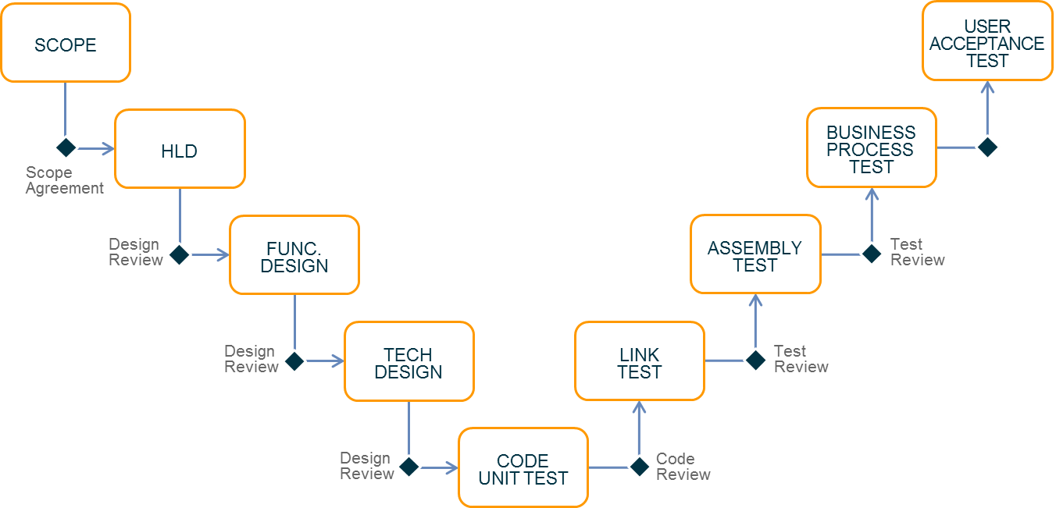
Continuous Integration
CODE
UNIT TEST
Compile
& Package
Committer: jdoe
Story:25
Run Unit Tests
Commit ID: 113
Static Code Analysis
Notes:
As we’ve seen, CI is the start

Slide 17
Continuous Delivery
USER ACCEPTANCE TEST
BUSINESS PROCESS TEST
ASSEMBLY
TEST
LINK TEST
CODE
UNIT TEST
Compile
& Package
Committer: jdoe
Story:25
Run Unit Tests
Commit ID: 113
Create ST env
Deploy Code
Load Test Data
Run Tests
Create clustered env
Deploy Code
Run Perf Test
Static Code Analysis
Tear down ST env
Run Security Test
Prod deploy
Run Ops Test
Notes:
CD is the logical conclusion

Slide 18
Where CI Came From
Continuous Integration Definition
Continuous Integration is a software development practice where members of a team integrate their work frequently, usually each person integrates
at least daily - leading to multiple integrations per day. Each integration is verified by an automated build (including test) to detect integration errors
as quickly as possible.
Many teams find that this approach leads
to significantly reduced integration problems
and allows a team to develop cohesive software more rapidly.
Martin Fowler
1 May 2006
http://www.martinfowler.com/articles/continuousIntegration.html
Notes:
Mention that Martin said that all software projects had an integration stage which was impossible to estimate
Took forever and wasteful
It it’s difficult, do it regularly until it’s easier (like building a muscle)

Slide 19
Where CD Came From
2001
Principles behind the Agile Manifesto
We follow these principles:
Our highest priority is to satisfy the customer through early and continuous delivery of valuable software.
2010
Continuous Delivery
Reliable Software Releases through
Build, Test and Deployment Automation.
http://www.amazon.co.uk/Continuous-Delivery-Deployment-Automation-Addison-Wesley/dp/0321601912
http://agilemanifesto.org/principles.html
Notes:
Mention that Martin said that all software projects had an integration stage which was impossible to estimate
Took forever and wasteful
It it’s difficult, do it regularly until it’s easier (like building a muscle)

Slide 20
Origins of Production Lines
Over 200 years in the making
Oliver Evans invents the automated
flour mill
steam powered conveyor belts for unloading ships
Henry Ford Assembly Line: iron ore to finished car in 81 hours
Taiichi Ohno developed the Toyota Way
(multi load production line)
Agile manifesto written and mentioned “Continuous Delivery”
Toyota Way book published
Continuous delivery book written
1790
1885
1913
1960s
2001
2004
2010
http://upload.wikimedia.org/wikipedia/commons/4/42/Oliver_Evans_-_Automated_mill.jpg
Notes:
Describe significance of each date and event

Slide 21
Production Line as an Analogy to CD
Continuous Delivery as a production line
It is useful to picture the software delivery lifecycle as a factory that should be highly optimized for delivering new software.
Raw materials can be considered to represent:
Requirements about what is needed
Standards controlling how to deliver what is needed
Components or artefacts that can be used
Finished goods can be considered to represent:
Software to provide the required service
Data services to be consumed by others
Infrastructure configured ready to host the required service
Raw materials
(Requirements, Standards, Artefacts)
Factory
(Development, QA, Release)
Finished goods
(Software, data, infrastructure)
The Factory can be considered to represent all processes for turning requirements into working software of sufficient quality to release into production.
Notes:
Explain the analogy between CD and a factory

Slide 22
Principles of a Production Line
Continuous Integration Factory Analogy Benefits
The primary benefit of this analogy is that almost all considerations applicable to optimizing
a factory are appropriate to optimizing a software delivery lifecycle:
Simplifying co-ordination through automated orchestration (a conveyor belt / production
line in a factory)
Maximize efficiency through
standardization, automation and tooling
(machines and robots in a factory)
Optimize globally to reduce bottlenecks
(e.g. parallel workstations in a factory)
Eliminate waste (un-used inventory
in a factory)
Detecting and responding to problems in quality (workers with the authority to stop the line)
Raw materials
(Requirements, Standards, Infrastructure)
Factory
(Development, QA, Release)
Finished goods
(Software, Data, APIs)
Notes:
Describe the benefits

Slide 23

WHAT DOES THIS
MEAN FOR PEOPLE?
Notes:
Some suggestions:
Git means less admin work (cf ClearCase!)
Developers to train

Slide 24

CI Workflow

Slide 25
CD Pipeline
What are the advantages?
Immediate start after check-in.
One new change per new pipeline
Visible project status
Since environments are created from version control, users can be provided access to perform diagnostics without concerns about corrupting an environment.
Parallel execution
Easy to drill down to outputs of each stage e.g. details of failure
Infrastructure resources recycled
Compile
& Package
Committer: jdoe
Story:25
Run Unit Tests
Commit ID: 113
Create ST env
Deploy Code
Load Test Data
Run Tests
Create clustered env
Deploy Code
Run Perf Test
Static Code Analysis
Tear down ST env
Run Security Test
Prod deploy
Servers and environments built from version control
Tested build package re-used
Code analysis used as enforceable gates
Failed gate
(end of pipeline)
Committer notified
Consistently executed automated
test harness
Run Ops Test
Highly visible historic information
Committer: fbar
Story:12
Compile
& Package
Commit ID: 112
Run Unit Tests
Create
ST env
Deploy
Code
Load Test
Data
Run Test
Harness
Create
clustered env
Deploy
Code
Run Perf
Test
Static Code Analysis
Tear down
ST env
Run Security
Test
Tear down
ST env
Run Ops
Test
Committer: jdoe
Story:13
Compile
& Package
Commit ID: 111
Run Unit Tests
Create
ST env
Deploy
Code
Load Test
Data
Run Test
Harness
Create
clustered env
Deploy
Code
Run Perf
Test
Static Code Analysis
Tear down
ST env
Run Security
Test
Tear down
ST env
Run Ops
Test
Notes:
We’ve been through the CI/CD workflow (assembly line) but what are the advantages?
Get people to guess then reveal
Reduced Project Risk:
Early warning of broken/incompatible code and of conflicting changes.
Code coverage and deployments are validated in advance and not until the day of release.
The effect of finding and fixing code integration bugs early in the development process saves both time and money over the lifespan of a project
Improved Code Quality:
Immediate feedback to developers on the code quality, functionality, or system-wide impact of code they wrote. Corrective actions can be taken immediately which can improve code quality.
Metrics generated from automated testing and Continuous Integration (such as metrics for code coverage, code complexity, and features complete) focus developers on developing functional, quality code, and help develop momentum in a team.
Rapid Testing:
Immediate unit testing/regression testing of all changes.
Developers detect and fix integration problems early - avoiding last-minute chaos at release dates, (when everyone tries to check in their slightly incompatible versions).
Constant availability of a "current/latest" code for testing, demo, or release purposes.

Slide 26
Accenture slide from circa 2006
The idea isn’t so new
At a given point a
baseline of code is taken
REPOSITORY
The baseline is compiled, customised and deployed to test environments. This process varies depending on
the software being developed.
CM Integration
Compile
Publish
TEST
Test teams execute tests as defined by the test approach and model. SIRs are raised for any defects found and passed to the Development Team
REPOSITORY
DEVELOP/FIX
Customise
DEVELOP/FIX
Development/Fix Teams make
code modifications in development environment these are controlled
via version control software
Deploy
TEST
SIR/Defect
Notes:
Just mention that this is an older diagram showing the same thing

Slide 27
Working with Multiple Components
Component Granularity
Whole Solution
Version: 46
Website
Order
Service
Email
Service
Payment Service
Deployment tools
Platform
Version: 12
Version: 1.0.3.19
Version: 1.0.0.9
Version: 1.0.0.3
Version: 47
Version: 83
Cloud Foundry
MySQL
Cassandra
RabbitMQ
Infrastructure
Version: 23
Version: 12
Version: 12
Version: 24
Version 20
MicroBosh
Server template
Version: 24
Version: 5
Notes:
Remember we are probably dealing with lots of components
Explain how composite components work – you keep a manifest of child versions so that you can track just the top level version number
change a child, all parents get a new version number.

Slide 28
Working with Multiple Components
Component Granularity
Whole Solution
Version: 47
Website
Order
Service
Email
Service
Payment Service
Deployment tools
Platform
Version: 12
Version: 1.0.3.19
Version: 1.0.0.9
Version: 1.0.0.3
Version: 47
Version: 84
Cloud Foundry
MySQL
Cassandra
RabbitMQ
Infrastructure
Version: 23
Version: 12
Version: 12
Version: 24
Version 21
MicroBosh
Server template
Version: 24
Version: 6
Notes:
I there is a new version of a child, all parents get a new version number
Play animation to demonstrate

Slide 29
Each Component Gets a CI Pipeline
Website
Compile
and package
Unit Tests
Static Code Analysis
CT env
deploy
Run Functional Tests
Run Security Tests
PT env deploy
Run Tech Tests
Production deploy
Version 12
Check in
Order Service
Compile
and package
Unit Tests
Static Code Analysis
CT env
deploy
Run Functional Tests
Run Security Tests
PT env deploy
Run Tech Tests
Production deploy
Version 1.0.3.15
Check in
Email Service
Compile
and package
Unit Tests
Static Code Analysis
CT env
deploy
Run Functional Tests
Run Security Tests
PT env deploy
Run Tech Tests
Production deploy
Version 1.0.0.9
Check in
Payment Service
Compile
and package
Unit Tests
Static Code Analysis
CT env
deploy
Run Functional Tests
Run Security Tests
PT env deploy
Run Tech Tests
Production deploy
Version 1.0.0.3
Check in
Cloud Foundry
Compile
and package
Unit Tests
Platform env deploy
Monitoring tests
Version 23
Check in
My SQL
Compile
and package
Unit Tests
Platform env deploy
Monitoring tests
Version 12
Check in
Cassandra
Compile
and package
Unit Tests
Platform env deploy
Monitoring tests
Version 12
Check in
RabbitMQ
Compile
and package
Unit Tests
Platform env deploy
Monitoring tests
Version 24
Check in
Infrastructure
Compile
and package
Unit Tests
Platform env deploy
Monitoring tests
Version 20
Check in
Notes:
The component breakdown is on the right here.
Each one needs it’s own pipeline for example the website component

Slide 30
And Flow
Website
Compile
and package
Unit Tests
Static Code Analysis
CT env
deploy
Run Functional Tests
Run Security Tests
PT env deploy
Run Tech Tests
Production deploy
Version 12
Check in
Order Service
Compile
and package
Unit Tests
Static Code Analysis
CT env
deploy
Run Functional Tests
Run Security Tests
PT env deploy
Run Tech Tests
Production deploy
Version 1.0.3.15
Check in
Email Service
Compile
and package
Unit Tests
Static Code Analysis
CT env
deploy
Run Functional Tests
Run Security Tests
PT env deploy
Run Tech Tests
Production deploy
Version 1.0.0.9
Check in
Payment Service
Compile
and package
Unit Tests
Static Code Analysis
CT env
deploy
Run Functional Tests
Run Security Tests
PT env deploy
Run Tech Tests
Production deploy
Version 1.0.0.3
Check in
Cloud Foundry
Compile
and package
Unit Tests
Platform env deploy
Monitoring tests
Version 23
Check in
My SQL
Compile
and package
Unit Tests
Platform env deploy
Monitoring tests
Version 12
Check in
Cassandra
Compile
and package
Unit Tests
Platform env deploy
Monitoring tests
Platform
Cassandra
Version 12
Check in
Version 12
RabbitMQ
Compile
and package
Unit Tests
Platform env deploy
Monitoring tests
Version 24
Check in
Infrastructure
Compile
and package
Unit Tests
Platform env deploy
Monitoring tests
Version 20
Check in
Notes:
And we need to plumb together where we have multiple integrations

Slide 31
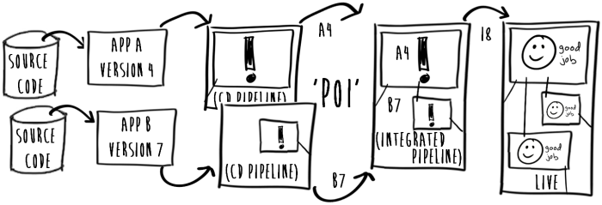
The Pattern for Integration
We define two pipeline types
CI Pipelines
Integrated
CD Pipeline
Notes:
CI pipelines are type 1 – start from Check-in
The second type of pipeline is an integrated pipeline
These start every time a new combination of code is tested together
So App A and B have now been integrated in a common environment.
Now we want them to progress as one composite component
You often end up with integrated pipelines containing other integrated pipelines
And by the time you are in production, you just operate at the top of the component break down tree
The key thing is that is scales very nicely

Slide 32
Real World Challenges
Tame the COTS/Packaged products – it IS possible!
1
Trunks
2
BUILD
STATIC CODE ANALYSIS
DEPLOY CODE
LOAD
TEST
DATA
RUN TEST HARNESS
DEPLOY CODE
Branches
3
SCM Repo
4
Merges
Binary or
proprietary XML
Can you
even flatten
CLI?
Headless IDE
Write
your own
CLI?
etc.
Notes:
The takeaway from this slide is that COTS products can be hard work. But in Accenture we have lots of experience overcoming the challenges.
Many COTS products can literally make every step painful
Especially if they expect you to do everything
with the mouse and have a maximum of 2 environments
Getting the code out and into version control can be a problem
As can then keeping it in sync
Sometimes even apparent commandline processes actually run the IDE in headless mode
Which can be very slow and cumbersome
Static code analysis is often the case of writing it yourself
It can mean pain
The solution here is basically determination, commitment and
demanding support from the vendors.
It’s a sad day when you need to start screenscraping, but it is possible and worth it

Slide 33
WHAT DOES THIS
MEAN FOR PEOPLE?
Notes:
Some suggestions:
Git means less admin work (cf ClearCase!)
Developers to train

Slide 34
Recommended
Tools

Slide 35
Typical CI Architecture Practices
Option 1
Where does a CD tool fit into DevOps?
Your CI/CD “tool” is your orchestrator
Code Quality
Test Automation
Code Review
CI Tool
Build
SCM
Artefact Manager
Environments
Notes:
We’re just saying it’s the orchestrator and at the centre
Highlight that CI tool is the tool that connects to every other tool
Expand on the relationship CI tool has with each individual tool
SCM/Code Review: Will pick up changes in SCM to start CI
Code Quality: Will pass code to test the code against code quality gates (this includes all types of quality gates – more in the next module).
Build/Deploy: Will pass code to produce deployable packages from code
Environments: Will deploy packages onto environments

Slide 36
Typical CI Architecture Practices
Option 2
Where does a CD tool fit into DevOps?
Your CI/CD “tool” is your orchestrator
Code Quality
Test Automation
Code Review
CI Tool
Build
SCM
Artefact Manager
Environments
Notes:
We’re just saying it’s the orchestrator and at the centre
Highlight that CI tool is the tool that connects to every other tool
Expand on the relationship CI tool has with each individual tool
SCM/Code Review: Will pick up changes in SCM to start CI
Code Quality: Will pass code to test the code against code quality gates (this includes all types of quality gates – more in the next module).
Build/Deploy: Will pass code to produce deployable packages from code
Environments: Will deploy packages onto environments

Slide 37
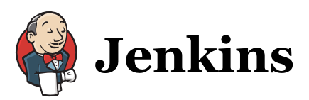
Recommended Tools
Recommended CI tool to use
Jenkins
An open source Continuous Integration
(CI) server
Wide developer base for plugins, regularly extending possibilities for integrating into
your world
Runs as Java web application on container such as Tomcat
Simple to operate, and manage
Setup time takes minutes
Installable on most OS (Java) and compatible with many popular version control systems

Slide 38
Example Pipelines from Real Projects
Real Examples
Projects | B2B Service Provider | E-Commerce platform | Cloud Broker
Orchestration | Jenkins | Jenkins | Jenkins
SCM | Git | SVN | Git
Build | Maven, Grunt | Maven, Ant | Maven
Test | Selenium | Selenium | Selenium
Deploy | Jenkins and Shell scripts | Jenkins and Shell scripts | Jenkins and Chef
Static Code Analysis | SonarQube | SonarQube | SonarQube
Notes:
Ask for projects with other solutions
Ask for people with dramatically different stuff e.g. Microsoft
Capture any radically different ones and update this slide

Slide 39
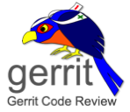


Easy way to create a pipeline – Cartridges!
What is a cartridge?
A Cartridge encapsulates a reference implementation for a particular technology or product, typically consisting of:
Reference Application (source code)
Build/deploy pipeline
Environment Creator
Monitoring Checks
Let’s see this in pictures...
Cartridge Def.
Source Code
Source Code
Source Code
Source Code
Step 1: Deploy ADOP
Source Code
Step 2: Load Cartridge Instance 1
Pipeline(s)
Checks
Pipeline(s)
Pipeline(s)
Checks
Step 3: Load Cartridge Instance 2
Pipeline(s)
Checks
Pipeline(s)
Checks
Checks
Notes:
Describe the benefits of cartridges

Slide 40
Why Cartridges?
Cartridges support:
Multi-tenancy capability of ADOP Core
Modularity – avoids the development of bespoke systems
Reuse
Addition of new technologies without platform downtime
Capability for internal and external teams to contribute to the platform
Cartridges can:
Be loaded at any time
Be combined to build support for complex systems development
Be extended to include additional configuration beyond Jenkins pipelines, Git repositories and Sensu Checks.
Cartridge directory: https://alm.accenture.com/wiki/display/DOT/ADOP+Blueprint+Directory
Notes:
Describe the benefits
Motivate people to use cartridges in their day to day DevOps work

Slide 41
LET’S TALK
ABOUT THE LAB

Slide 42
Introduction to Lab
CI Pipeline in Action
Go here!
https://alm.accenture.com/wiki/display/DOT/Module+3+Introduction
Duration: ~30 minutes
Notes:
Presenter Notes:
- Students to make a change in code repo and start off a new pipeline

Slide 43
DO THE LAB!

Slide 44
Summary
Key Points
Principles of a production line
and flow
Origins of CI
Continuous Integration
standard implementation
Benefits of CI – Reduced risk, Improved project quality and
Rapid testing
Typical CI Workflow using a Pipeline
Typical Architecture Practices of
CI – CI tool connects to most tools
Examples of Automated
Build and Deployments
Jenkins recommended tool
to do this
Notes:
Presenter’s Notes:
- Briefly expand the key points

Slide 45
OBSERVATION
AND DISCUSSION

Slide 46

QUESTIONS

