Slide 1
Day 1 Recap & Day 2 Overview
DevOps Academy

Slide 2
Content
Sections
Day 1 Recap
Cloud and AWS in nutshell
Top 3 tool types for DevOps
SCM
Orchestration
Automated Quality Assurance
Day 2 Overview
Introduction to Environments
Convergent Infrastructure
Immutable Infrastructure
Architecture orchestration using AWS CloudFormation
Operations & monitoring in the Cloud
Lab – Standing up Day 2 environments
Discussion and Observation
Summary
Questions

Slide 3

MODULE 5 Day 1 Recap

Slide 4
Format Of Training Course (reminder)
Training Structure
A total of 9 modules (0-8)
4 modules per day
Module format
Slides > Labs
Discussion > Summary > Questions
DAY 1: TOOLS & CONTINUOUS DELIVERY
Delivering Services on the Cloud
Software Configuration Management
Continuous Integration
Code Quality
DAY 2: ENVIRONMENTS
Configuration Management
Containers
Platform Applications
Operations
Notes:
Quick reminder

Slide 5
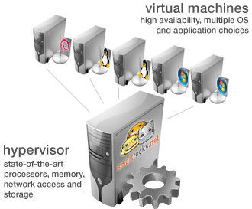
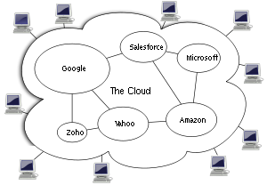
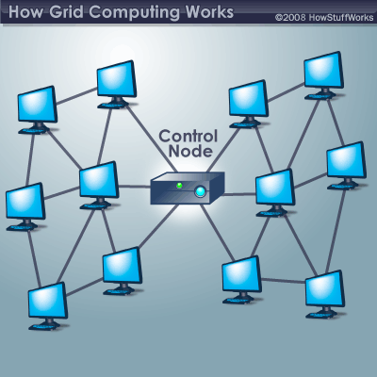
Cloud Basics
What is Cloud Computing?
Virtualization
One computer acting like many
Cloud Computing
A combination of both Virtualization and Grid, but the end user does not have to care about the underlying architecture.
Grid Computing
Many computers acting like one
Utility Computing It is a model in which a service provider makes resources and infrastructure management available as needed, and charges them for specific usage rather than a flat rate.
Collection of computing services (compute, storage, network, applications, etc.)
Accessible on-demand over a network.
Business and technology model for delivering and acquiring IT services in a utility-like fashion.
Notes:
What were the 4 key concepts?

Slide 6
AWS Basics
The 7 best practices for building systems with AWS
AWS
1
2
3
4
5
6
7
Design for failure and nothing fails
Loose coupling sets you free
Implement elasticity
Build security in every layer
Don’t fear constraints
Think parallel
Leverage different storage options
Notes:
1.Design for failure and nothing fails –
Applications should continue to function even if the underlying physical hardware fails or is removed/replaced.
2.Loose coupling sets you free -
The more loosely they’re coupled, the bigger they scale
Load balance clusters
Use a queue to pass messages between components
3.Implement elasticity –
Elasticity is a fundamental property of the cloud
4.Build security in every layer –
Security is a shared responsibility.
You decide how to: Encrypt data in transit and at rest ; Enforce principle of least privilege ;Create distinct, restricted Security Groups for each application role ;Use multi-factor authentication
5.Don’t fear constraints-
Need more RAM?
Consider distributing load across machines or a shared cache
Need better IOPS for database?
Instead, consider multiple read replicas, sharding, or DB clustering
Hardware failed or config got corrupted?
“Rip and replace”—simply toss bad instances and instantiate replacement
6.Think parallel-
Experiment with parallel architectures
1 server working on a job sequentially for 4 hours or
4 servers working on a job in parallel for 4 hours
Same cost (i.e., 4 instance hours), but parallel is 4x faster

Slide 7


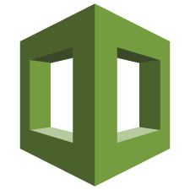
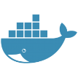

DevOps Architecture that we will build
https://hub.docker.com/
Detailed view
Internet
AWS
AWS cloud
AWS
AWS region EU (Ireland)
AWS Cloud
VPC
Availability Zone
CF template json
Public subnet
Private subnet
Public security group
Tomcat Server
CloudInit
CloudInit
CloudInit
Nginx
Jenkins
Sonar
Nexus
Gerrit
ELK
Open LDAP
Chef Server
AWS CloudFormation
Notes:
Describe each step

Slide 8
Top 4 tool types for DevOps
Broadly we deal with:
Application Lifecycle Management
What do we want to build and how is it going so far
SCM
Where are we going to safely store software, data and media and track and control it?
Orchestration
How are we going to move software, data and media around and configure it (remember infrastructure “is” software as well)
Automated Quality Assurance
How do we know the software does / is doing what it is supposed to. “The continuum of testing and monitoring”
Notes:
Name them

Slide 9
Problem #1: Long cycle time
Value Released
Guessed Well
Guessed Badly
Time
Notes:
Have someone recall the point here

Slide 10
Problem #2: Release risk
Release
Ideas
Values
Notes:
And here

Slide 11
Problem #3: hotfixes, merge, risk, waste
"Release"
"Release"
"Release"
"Release"
"Release"
"Release"
"Release"
Release
"Release"
"Release"
"Release"
"Release"
"Release"
"Release"
"Release"
"Release"
"Release"
"Release"
"Release"
"Release"
"Release"
Ideas
Values
Notes:
And here

Slide 12



Lean – Fast Feedback
Fastest Feedback...
During Development
After Development
Pair programming is an agile software development technique in which two programmers work together at one workstation. One, the driver, writes code while the other, the observer, pointer or navigator, reviews each line of code as it is typed in. The two programmers switch roles frequently.
PRECOMMIT HOOK ALL THE CODE
Peer Review
http://en.wikipedia.org/wiki/Pair_programming
http://lmsgoncalves.files.wordpress.com/2015/09/muppetspairprogramming.jpg
http://johnkpaul.com/blog/2013/10/04/git-precommit-hook-awesomeness/
Notes:
Name some types

Slide 13
Typical CI Workflow using a Pipeline
CI Workflow Pipeline
Building a Delivery Pipeline is a highly effective way of maximizing the visibility and effectiveness of automation.
This slide highlights the desirable characteristics and benefits of a pipeline.
Immediate start after check-in.
One new change per new pipeline
Visible project status
Since environments are created from version control, users can be provided access to perform diagnostics without concerns about corrupting an environment.
All stages e.g. code analysis used as enforceable gates
Easy to drill down to outputs of each stage e.g. details of failure
Infrastructure resources recycled
Compile & Package
Committer: jdoe Story:25
Sonar Code Analysis
Commit ID: 113
Create ST env
Deploy Code
Load Test Data
Run Test Harness
Create clustered env
Deploy Code
Run Perf Test
Run Unit Tests
Tear down ST env
Run Security Test
Tear down ST env
Servers and environments built from version control
Tested build package re-used
Parallel execution
Failed gate (end of pipeline)
Committer notified
Consistently executed automated test harness
Run Ops Test
Notes:
What were the benefits?

Slide 14
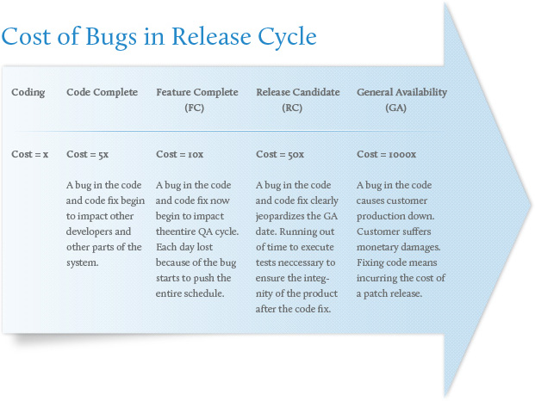
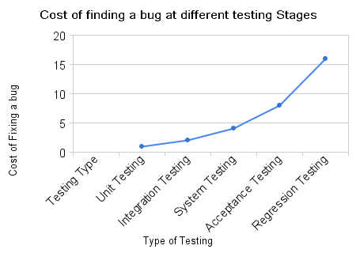
Cost of not Failing (aka Learning) Fast
Note from Module 4 - Keep image for now – I don’t know if we’re keeping or replacing
A lot!
http://www.augmentum.com/what-we-do/our-services/software-qa-test
http://www.theautomatedtester.co.uk/blog/2008.htm
Notes:
Get the class to guess the relative cost at each phase
1x = coding
?x = code complete
Etc.

Slide 15
What about LEAN?
Does drawing it like this make us feel better?
(All “Design” Steps)
Develop Unit Test
Link Test
Assembly Test
Business Process
Test
User Acceptance Test
Compile & Package
Committer: jdoe Story:25
Sonar Code Analysis
Create ST env
Deploy Code
Load Test Data
Run Test Harness
Create clustered env
Deploy Code
Run Perf Test
Commit ID: 113
Run Unit Tests
Tear down ST env
Run Security Test
Prod deploy
Run Ops Test
Value Stream Mapping
Processing time
Waiting time
Notes:
What was the key point here?
That we need to continuously tune our steps and eliminate waste

Slide 16
Quality Gates in the CI Pipeline
Features through out the pipeline
Immediately after code committed to SCM
If the quality is insufficient, we want to fail as fast as possible (in a helpful meaningful way)
Static: Before the deployment
Dynamic: After
Static
Dynamic
Immediate start after check-in. One new change per new pipeline
All stages e.g. code analysis used as enforceable gates
Compile & Package
Deployment
Committer: jdoe Story:25
Sonar Code Analysis
Commit ID: 113
Create ST env
Deploy Code
Load Test Data
Run Test Harness
Create clustered env
Deploy Code
Run Perf Test
Parallel execution
Run Unit Tests
Tear down ST env
Run Security Test
Tear down ST env
Run Ops Test
Copyright © 2016 Accenture All rights reserved.
Notes:
Name the stage types

Slide 17

MODULE 5 Day 2 Overview

Slide 18

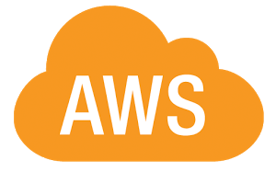
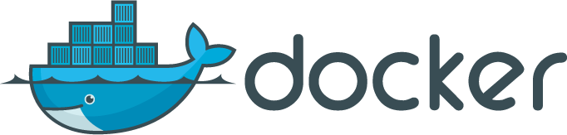
Environments
Implementing environments
Today, we’ll discuss environments in details
“Configuration management” and Convergent Infrastructure using Chef automation tool
Immutable Infrastructure using Docker to create containers
Orchestration in the Cloud using AWS CloudFormation
Elasticity, Auto Scaling groups and Load Configurations
Operations and monitoring in the Cloud

Slide 19
DevOps Architecture that we will build
Day 2 Architecture
VPC
AWS
Academy VPC
Academy Security Group
DevOps Academy Server
Nginx
Jenkins
Sonar
Nexus
Gerrit
ELK
Open LDAP
Academy Security Group
Chef-Server
AWS Cloud
AWS CloudFormation
Academy Security Group
Tomcat server
Notes:
For day 2 we will stand up 4VMs
2 VMs which run two Docker containers each
Chef-Server
Chef-node aka test environment
For module 7 we’ll create a separate VPC and use auto scaling

Slide 20
LET’S TALK ABOUT THE LAB

Slide 21
Lab – Standing up Day 2 environments
Lab exercises
Go here! https://alm.accenture.com/wiki/display/DOT/Day+2+Setup+Lab
Duration: ~30 minutes

Slide 22

DO THE LAB!

Slide 23
OBSERVATION AND DISCUSSION

Slide 24

QUESTIONS

