Slide 1
Module 6: Containers
DevOps Academy

Slide 2
Content
Sections
Immutable vs Convergent Infrastructure
Introduction to Containers
Containers vs Virtual Machines
Best practices of using Docker containers
Docker architecture overview
Using Docker to build an environment
Summary
Lab exercise
Lab Review
Discussion
Recap

Slide 3



Containers
Yes we are going to talk about Docker now…
✗
✓
✗

In this module we are going to explore using Docker as an alternative to Chef
We’ll consider the pro’s and con’s
We’ll talk about options for using Docker and Chef together

Slide 4
What do Containers Solve
Creating the execution architecture and definitely including your application
Hardware management
Basic Infrastructure orchestration
Platform Infrastructure orchestration
Execution architecture
Deployment architecture
Logical environment separation
Security model
Business Applications
Unlike Chef which may just be used for middleware, the application is usually included
Containers run on VMs or dedicated Container PaaS’
Business Applications
Business Application
Business Application
Business Application
Business Application
Business Application
Platform Application
Notes:
Make the points on the slide

Slide 5
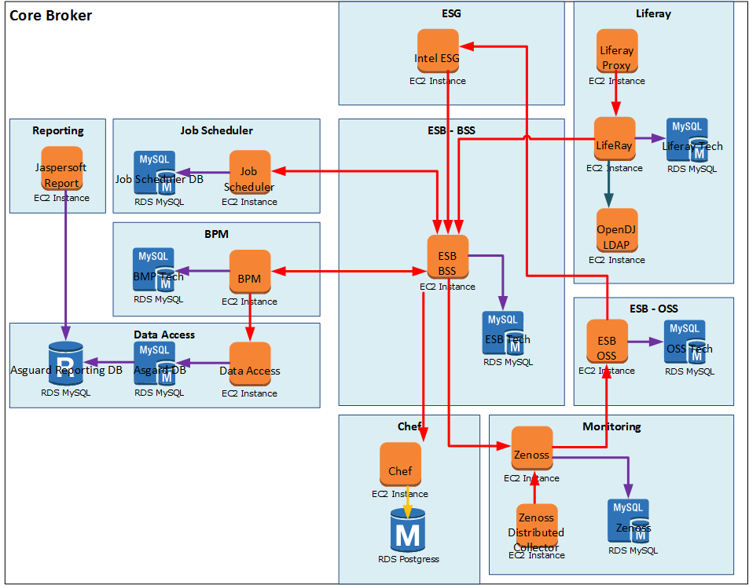
What Problem are we Solving?
Hardware management
Basic Infrastructure orchestration
Platform Infrastructure orchestration
Execution architecture
Deployment architecture
Logical environment separation
Security model
Business Applications
Business Application
Business Application
Business Application
Business Application
Business Application
Platform and basic infra automation >
Just like in the last module, we want to go from this…
319
Virtual Private Cloud
Subnets
Virtual Machines
319
319
319
319
319
319
319
319
Diagram for illustration only

Slide 6















What Problem are we Solving?
…to this!
319
Virtual Private Cloud
Subnets
Virtual Machines
Execution architecture ready for use
319
319
319
319
319
319
319
319
Diagram for illustration only

Slide 7
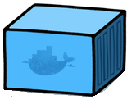
How this time then?
…with Docker containers
319
Virtual Private Cloud
Subnets
Virtual Machines
Execution architecture ready for use
319
319
319
319
319
319
319
319
Diagram for illustration only

Slide 8

And maybe some like this
…multiple Docker containers per VM
319
Virtual Private Cloud
Subnets
Virtual Machines
Execution architecture ready for use
319
319
319
319
319
319
319
319
Diagram for illustration only

Slide 9
Containers
Introduction to containers
What is container?
A Linux kernel container is a virtualization environment without a hypervisor
It is an operating system–level virtualization method
Isolated from other containers but share resources from the host system
Examples of common isolation tools are:
Solaris Zones, OpenVZ, LXC, chroot etc.
“A second piece of the virtualisation pie”
Notes:
Notes:
In an operating system–level virtualization method, kernel of an OS allows running of multiple isolated user space instances on a single host. Such isolated instances are called containers.
In other words a container is a self contained execution environment that shares the kernel of the host system and is isolated from other containers in the system.

Slide 10
How Docker differs from Virtual Machines
The below shows the fundamental difference in Virtual Machines and Docker:
Virtual Machines
Docker
App A
App B
Each virtualized application includes not only the application - which may be only 10s of MB - and the necessary binaries and libraries, but also an entire guest operating system - which may weigh 10s of GB.
App A
App B
The Docker Engine container comprises just the application and its dependencies. It runs as an isolated process in userspace on the host operating system, sharing the kernel with other containers. Thus, it enjoys the resource isolation and allocation benefits of VMs but is much more portable and efficient.
Bins/Libs
Bins/LIbs
Bins/Libs
Bins/LIbs
Guest OS
Guest OS
Docker Engine
Hypervisor
Host OS
Host OS
Server
Server
Some diagrams taken from: https://www.docker.com/whatisdocker

Slide 11
How Docker differs from Virtual Machines
To put it another way:
Virtualization refers to a process of creating a virtual computer, hardware platform, operating system, storage device, or computer network resources.
VIRTUAL MACHINES
Virtualized applications include applications, binaries, libraries and entire (guest) Operation System
A virtual machine emulates a physical computing environment
Requests for CPU, memory, disk, network and other hardware resources to a virtualization layer
VMs provide complete isolation, there is minimal resource sharing
CONTAINERS
Container (should) only contains an application and its dependencies
Runs as an isolated process on the host system, shares the kernel with other containers
It enjoys the resource isolation and allocation benefits of VMs but is more portable and efficient
Less isolated compared to fully virtualised systems
Uses AuFS (Another Union File System) for kernel sharing
3
Notes:
Why is a hypervisor called a hypervisor? - Because operating systems used to be called Supervisors and a Hypervisor manages multiple operating systems i.e. supervisors
Virtualization refers to the act of creating a virtual computer hardware platform, operating system (OS), storage device, or computer network resources.
Types of Virtualization:
Full Virtualization -- Almost complete simulation
Partial Virtualization -- Some but not all of the target environment is simulated
Paravirtualization -- A hardware environment is not simulated; however, the guest programs are executed in their own isolated domains
Each virtualized application includes not only the application - which may be only 10s of MB - and the necessary binaries and libraries, but also an entire guest operating system - which may weigh 10s of GB.
The Docker Engine container comprises just the application and its dependencies. It runs as an isolated process in userspace on the host operating system, sharing the kernel with other containers. Thus, it enjoys the resource isolation and allocation benefits of VMs but is much more portable and efficient.

Slide 12
Immutable Containers
Containers should be treated “like cattle”
Normally we:
Create a container
Run it
Decide we want it to change
Create a new version of the container
Replace the old running container with a new one
The container could technically contain a running Chef agent but this isn’t in the spirit of Docker.
Notes:
Draw the comparisons with Chef

Slide 13
Container PaaS’
No longer have to think about where your containers are
Let a software application your PaaS (sometimes called micro PaaS) work out where to put your containers
Let it create extra VMs or kill them as needed
Flynn vs Deis
Kubernetes
ΚυβερνήΤηϚ: Greek for “pilot” or “helmsman of ship”
The open source cluster manage from Google
This area is exploding with new stuff!
http://www.centurylinklabs.com/flynn-vs-deis-the-tale-of-two-docker-micro-paas-technologies/
Notes:
Mention there are Platform Applications appearing to manage you containers
And that this area is exploding with new things all the time

Slide 14
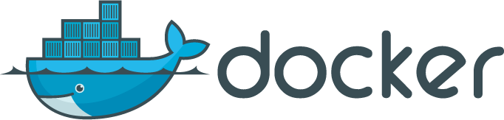
Docker
Docker engine for containers
What is Docker?
An open source OS–level virtualization manager
By default uses LXC (Linux Containers) to create isolated virtual environments
A tool that makes trivially easy to use containers capabilities
Portable and immutable deployment across machines
It is application-centric, allows rapid building, shipping, and running of distributed applications using containers
Consists of Docker Engine, a lightweight runtime and a packaging tool
Docker includes git-like capabilities for tracking successive versions of images and containers
Docker has access to a registry hubs (private and public), this make sharing easy
Any container can be used as an "base image"
Developers can build any app in any language using any tool chain
System administrators use Docker to provide standardised environments for their development, quality assurance, and production teams
Notes:
Notes:
Docker is an open source container platform to build, ship, and run distributed applications. Docker consists of Docker Engine, a lightweight runtime and a packaging tool.
Docker enables apps to be quickly assembled from components and eliminates the friction between development, QA, and production environments.
“Dockerized” apps are completely portable and can run anywhere - colleagues’ OS X and Windows laptops, QA servers running Ubuntu in the cloud, and production data center VMs running Red Hat.

Slide 15
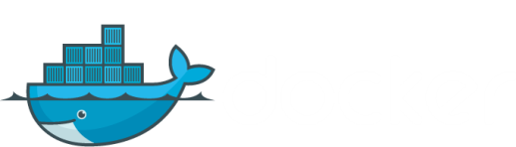
How to use Docker
Docker engine for containers
Docker Container Image Registry
Push
Container A
Source Code Repository
Search
Pull
Run
Dockerfile for A
Build
Container A
Container B
Container C
Docker Engine
Docker Engine
Host 1 OS (Linux)
Host 2 OS 2 (Linux)
http://osv.io/blog/blog/page/3/
Notes:
Explain:
Write a docker file
Create container
Push container to a repo as an image
Pull images
Start container instances

Slide 16
Docker components
We defined
DOCKER IMAGES
Read-only template
Images are frozen files that act as blueprint for containers
DOCKER CONTAINERS
Are spun from images
A Docker container holds everything that is needed for an application to run
Multiple containers can be run from a single image
DOCKER REGISTRIES
Docker registries hold images
Community Docker Hub: https://hub.docker.com/
Docker Accenture Hub: https://docker.accenture.com/

Slide 17
Docker best practices
Using Docker efficiently
Containers should be ephemeral
It can be stopped and destroyed and a new one built and put in place with a minimum of set-up
Use a .dockerignore file
For efficiency during docker build, you should use a .dockerignore file to exclude files or directories
Avoid installing unnecessary packages
Containers are lightweight and should container only an application and its dependencies
Run only one process per container
Decoupling applications into multiple containers makes it easier to scale horizontally & reuse containers
Use container linking for service dependencies
Minimize the number of layers
Layers increase container size
Sort multi-line arguments
Use multiline arguments to improve readability
Build cache
Using no-cache = true/false
Notes:
Build cache
Starting with a base image that is already in the cache, the next instruction is compared against all child images derived from that base image to see if one of them was built using the exact same instruction. If not, the cache is invalidated.
In most cases simply comparing the instruction in the Dockerfile with one of the child images is sufficient. However, certain instructions require a little more examination and explanation.
In the case of the ADD and COPY instructions, the contents of the file(s) being put into the image are examined. Specifically, a checksum is done of the file(s) and then that checksum is used during the cache lookup. If anything has changed in the file(s), including its metadata, then the cache is invalidated.
Aside from the ADD and COPY commands cache checking will not look at the files in the container to determine a cache match. For example, when processing a RUN apt-get -y update command the files updated in the container will not be examined to determine if a cache hit exists. In that case just the command string itself will be used to find a match.

Slide 18
More Docker information
Docker features
File system isolation
Each container run on separate root file system
Resource isolation
CPU, memory can be allocated separately
Network isolation
Runs on its own network namespace, with a virtual interface and IP address of its own
Copy-on-write
Root file systems are created using copy-on-write, which makes deployment extremely fast, memory-cheap and disk-cheap, copy-on-write is provided by AuFS (Another Union File System*)
More on Union File System http://aufs.sourceforge.net/aufs.html
Logging
The standard streams (stdout/stderr/stdin) is logged
Change management
Changes to a container's file system can be committed into a new image
Interactive shell
Docker can allocate a pseudo-tty and attach to the standard input of any container
Docker doesn't provide these features, it merely makes them trivially easy to use

Slide 19
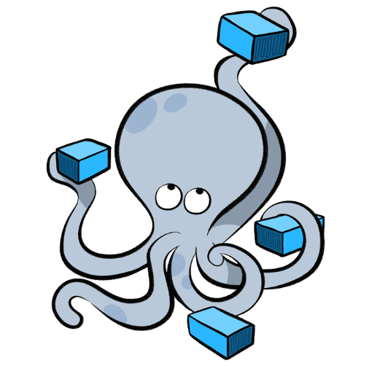
Docker Compose
Using Compose is basically a three-step process:
Compose is a tool for defining and running multi-container docker applications, allowing you to configure and start all your services from a single Compose file
Define your app’s environment with a Dockerfile so it can be reproduced anywhere.
Define the services that make up your app in docker-compose.yml so they can be run together in an isolated environment.
Lastly, run docker-compose up and Compose will start and run your entire app.
For the Accenture DevOps Platform, we have defined custom Dockerfiles for each tool
We have defined all our tools and services in our docker-compose.yml e.g. Jenkins, Sonar, Gerrit etc.
When we spin up a machine, on an AWS EC2 server, we run this docker-compose.yml file and it instantly allows us to bring up our platform

Slide 20
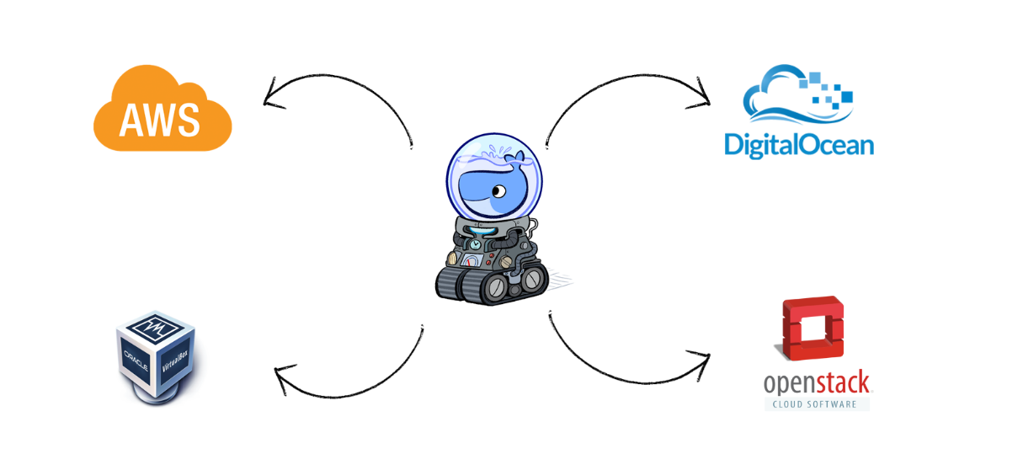
Docker-machine
Docker Machine is a tool that lets you install Docker Engine on virtual hosts, and manage the hosts with docker-machine commands.
You can use Machine to create Docker hosts on your local Mac or Windows box, on your company network, in your data centre, or on cloud providers like AWS or Digital Ocean.
We have spun up our ADOP infrastructure by creating a docker-machine on AWS and then running our docker-compose.yml on top of this docker-machine.

Slide 21
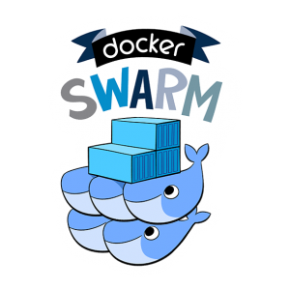
Docker Swarm
Docker Swarm is native clustering for Docker. It turns a pool of Docker hosts into a single, virtual Docker host.
Swarm allows us to have transparent scalability, as well as avoid single points of failure, by having our containers distributed across multiple Docker hosts.
Combined with Docker-compose, it becomes a really powerful tool to automate the containerised deployment of our infrastructure.

Slide 22
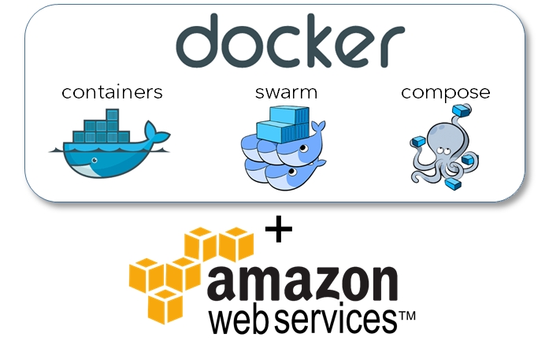
Accenture DevOps Platform on Swarm
ADOP can also be deployed over a Docker Swarm in order to allow a full range of functionality for a real project including scalability
The Swarm is deployed using a CloudFormation template on Amazon Web Services
The template creates public and private subnets – with the intention that the public layer will have the option of including a VPN
The networking makes use of multiple availability zones, creating a contingency for the case where a single availability zone might go out of service
Public traffic is over SSL
Finally, we make use of Elastic Load Balancers to support spanning AZs with consistent endpoints and allow us to leverage auto-scaling groups

Slide 23
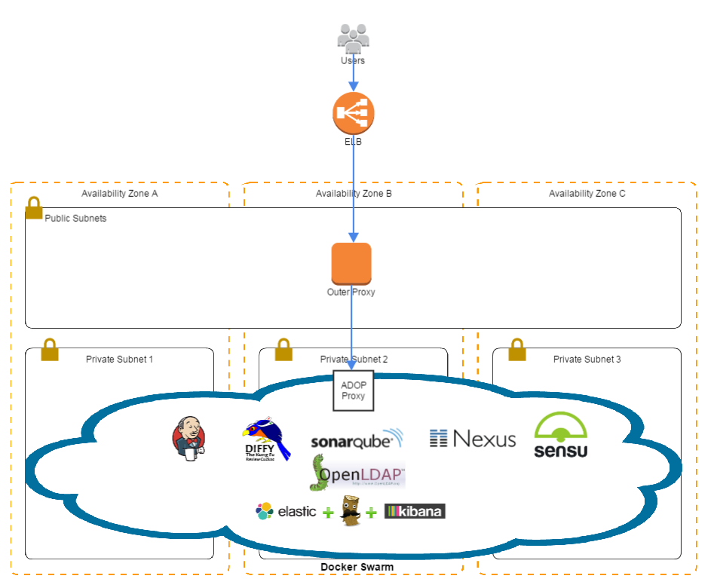
Accenture DevOps Platform on Swarm – Architecture Overview

Slide 24

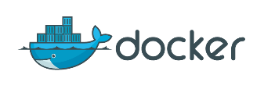

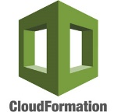

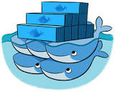

A Brief History of ADOP/B
ADOP has evolved significantly both in functionality and technology as we have embraced technological advances in Docker features.
Generation
1
2
3
4
5
Tools in the Cloud (Monsoon)
DOMO / Single ADOP Platform (DevOps Academy Lab)
Blueprints (nested cloud formation)
Cartridges (cloud-formation + configuration package)
Docker Orchestration
Server Configuration Management
Server Orchestration
Version 2
None.
Single Platform Embedded Tabs
Blueprints (Nested Cloud-Formation)
Cartridges (Data Import + Nested Cloud-Formation)
Cartridges Platform Extensions
Extension Architecture
ACP Blueprint Support
Azure Support
Multi-Tenancy Support Workspaces
Other
Enhancements
Copyright © 2015 Accenture All rights reserved.
24
Notes:
Explain how ADOP has evolved as we embrace Docker as a technology to provision and configure our environment

Slide 25



Case Study: using Docker for Managing Build Servers – pt1
Example: Building Hybris without Docker
The below highlights a Hybris Build Process solution
Process
Something was used to install Hybris on the Build server (one-time only setup) – could be Chef (often manual)
The Hybris build server is used for the compilation of code
When a developer pushes the code to Git, Jenkins will execute on the Hybris build server (if not already in use)
The code is copied onto the Hybris server and the code is compiled
Once compiled Jenkins zips up the content for deployment
Disadvantages
The Hybris build server can only be used for one execution at a time
The build server is restricted to one version of Hybris only
vX.2
Jenkins Server
Build Server

Slide 26



Case Study: using Docker for Managing Build Servers – pt2
Example: Building Hybris with Docker
The below highlights a Hybris Build Process solution
Advantages
Jenkins uses containers as normal slaves, and manages build tool installations if required
Higher throughput of builds resulting into faster feedback to developers
Every build environment is clean and consistent as each is created from the same image
Slaves become available ‘on-demand’ and are destroyed when no longer needed
Scalable, resource and cost efficient
Different image versions are supported
Docker Plugin
API
Isolated build environment
Isolated build environment
Jenkins Server
Build Server

Slide 27



Differences between Chef and Docker
The fundamental difference in Chef and Docker
Chef
Docker
App installed
App
provisioned
Dependencies/ Binaries
App installed
App
provisioned
Chef is used to install applications/manage configuration
It often depends on other cookbooks/dependent repositories (such as yum) to install software
Dependencies resolved at converge (server update) time
Changes can be pushed out to evolve a server
Provisions applications on servers on a separate layer to the operating system
Dependencies resolved at image build time (i.e. before we want to start a container)
Changes must be made by stopping and replacing a container with a new version

Slide 28






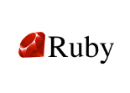
What happens when you are developing Docker?
A lot of layers! Like the movie inception?
Your laptop
Operating system (e.g. Windows)
Terminal (e.g. Git bash)
Docker Machine
Virtual Machine
Linux
Docker (LXE, etc)
Container you want to run
Operating system (e.g. Debian)
Software (e.g. Ruby)
Your code
Hypervisor (e.g. Virtual Box)
Notes:
It can feel a bit overwhelming when you are working with Docker.
This slide describes all the pieces of software when you run Docker locally.
See if it helps people visualise this.

Slide 29
WHAT DOES THIS MEAN FOR PEOPLE?
Notes:
Some suggestions:
Could things really be in the developer domain? – debate. Overall – hope so. We can manage container PaaS’

Slide 30
LET’S TALK ABOUT THE LAB

Slide 31

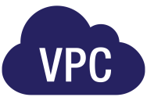
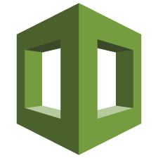

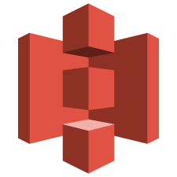
How we are going to use Docker
1. Build a new Dockerfile
3. Pull from registry and run in our environment as a container
2. Test image and push to registry
Docker file
Academy VPC
AWS Cloud
Academy Security Group
AWS CloudFormation
Academy
Server
AMI
https://hub.docker.com/
Amazon S3
Notes:
Using CloudFormation template we will create environments and infrastructure required for this training.
For day 1, we will create a VPC on AWS and then, we will create a single EC2 instance and other related infrastructures.
VPC is Amazon Virtual Private Cloud, it provisions a logically isolated section of Amazon Web Services (AWS) Cloud.
Security Groups allow us to control incoming and outgoing connections form the instances.
Read through step by step and describe. Very important people can visualise what they are about to do.

Slide 32
Lab
Lab exercises
Go here! https://alm.accenture.com/wiki/display/DOT/Module+6+Introduction
Duration: ~30 minutes

Slide 33
DO THE LAB!

Slide 34
Summary
Virtual Machines provide complete isolation at the cost of managing entire Operating System
Containers are self contained execution environment, they are lightweight
Docker recommends running one application per container
Docker model creates immutable containers
Immutable infrastructure does not support change after build. If changes are required, containers should be built from scratch
Convergent infrastructure support changes after deployment
Chef uses convergent model

Slide 35
OBSERVATION AND DISCUSSION

Slide 36

QUESTIONS

