Slide 1
Module 7: Platform Applications
DevOps Academy

Slide 2
Content
Sections
Platform as a Service
Cloud Deployment Model Offerings
Pizza as a Service
The Netflix Pattern
Autoscaling groups
CloudFormation concepts
AWS Machine Images
Elastic Beanstalk
Using AWS for DevOps
Lab - Implement AWS stack with Cloud Formation and observe the Netflix pattern
Review of Lab Exercise
Discussion of Module
Recap

Slide 3
PLATFORM AS A SERVICE

Slide 4
Platform as a Service
Introduction to PaaS
PaaS
A category of cloud computing services that provide computing platform and solution stack
Allows users to create applications using tools supplied by the provider
Infrastructure-as-a-Service is the base layer of Cloud computing
Deals with VMs, storage, servers, network, load balancers etc.
PaaS is a layer on top of Infrastructure-as-a-Service
Provides development environments, databases, web servers etc. as a service.
PaaS delivers application platform as a service
Fastest growing area of cloud computing
Helps DevOps provide services on cloud

Slide 5
Cloud Deployment Model Offerings
Who manages the layers?
Cloud services provide numerous choices to an IT organization. The overhead in managing some of the underlying technology is transferred to the cloud provider
Traditional
Infrastructure
as a Service
Platform
as a Service
Software
as a Service
Application
Application
Application
Application
Application Architecture
Application Architecture
Application Architecture
Application Architecture
System Software
System Software
System Software
System Software
Database
Database
Database
Database
Operating System
Operating System
Operating System
Operating System
Virtualization
Virtualization
Virtualization
Virtualization
Servers
Servers
Servers
Servers
Storage
Storage
Storage
Storage
Network
Network
Network
Network
Consumer Managed
Provider Managed
Notes:
By stack, get people to state what is included (don’t work too hard on the first one)
Then get people to say who manages what

Slide 6
Pizza Illustration
Pizza as a Service
Traditional On-Premises (On Prem)
Infrastructure
as a Service (IaaS)
Platform
as a Service (PaaS)
Software
as a Service (SaaS)
Dining Table
Dining Table
Dining Table
Dining Table
Soda
Soda
Soda
Soda
Electric / Gas
Electric / Gas
Electric / Gas
Electric / Gas
Oven
Oven
Oven
Oven
Fire
Fire
Fire
Fire
Pizza Dough
Pizza Dough
Pizza Dough
Pizza Dough
Tomato Sauce
Tomato Sauce
Tomato Sauce
Tomato Sauce
Toppings
Toppings
Toppings
Toppings
Cheese
Cheese
Cheese
Cheese
Made at Home
Take & Bake
Pizza Delivered
Dined Out
You Manage
Vendor Manages

Slide 7
PaaA: Treat the Platform like an Application
Following the instructions – I left the extra box off the page as it’s the same text as the sub-heading
…the Service Providers do!
Traditional
Infrastructure
as a Service
Platform
as a Service
Software
as a Service
Application
Application
Application
Application
Application Architecture
Application Architecture
Application Architecture
Application Architecture
System Software
System Software
System Software
System Software
Database
Database
Database
Database
Operating System
Operating System
Operating System
Operating System
Virtualization
Virtualization
Virtualization
Virtualization
Servers
Servers
Servers
Servers
Storage
Storage
Storage
Storage
Network
Network
Network
Network
Consumer Managed
Provider Managed
Notes:
We need to think like a PaaS provider

Slide 8
Direct Concerns of the Platform Application
We are interested in all these layers
Hardware management
Basic Infrastructure orchestration
Platform Infrastructure orchestration
Execution architecture
Deployment architecture
Logical environment separation
Security model
Business Applications
Business Applications
Business Application
Business Application
Business Application
Business Application
Business Application
Platform Application
https://blog.accenture.com/mark_rendell/2014/11/04/proposed-reference-architecture-of-a-platform-application-paaa/
Notes:
Talk about them
Basic Infrastructure orchestration
Consists of: Cloud console and API equivalent. See this layer as described in Open Stack here
The owner of this layer can make the call: “I will use these APIs to interact with the Hardware Management layer.”
Abstracts you from: having to manually track usage levels of compute and storage. Monitor the hardware.
Meaning you can: perform operations on compute and storage in bulk using an API
Presents to the next layer: a convenient way to programmatically make bulk updates to what logical infrastructure has been provisioned
Platform Infrastructure orchestration (auto-scaling, resource usage optimisation)
Consists of: effectively a software application built to manage creation of the required infrastructure resources required. Holds the logic required for auto-scaling, auto-recovery and resource usage optimisation
The owner of this later can make the call: “I need this many servers of that size, and this storage, and this network”
Abstracts you from: manually creating the scaling required infrastructure and from changing this over time in response to demand levels
Meaning you can: expect that enough logical infrastructure will always be available for use
Presents to the next layer: the required amount of logical infrastructure resources to meet the requirements of the platform
Execution architecture
Consists of: operating systems, containers, and middleware e.g. Web Application Server, RDBMS
The owner of this later can make the call: “This is how I will provide the runtime dependences that the Business Application needs to operate”
Abstracts you from: the software and configuration required your application to run
Meaning you can: know you have a resource that could receive release packages of code and run them
Presents to the next layer: the ability to create the software resources required to run the Business Applications
Logical environment separation
Consists of: logically separate and isolated instances of environments that can use to host a whole application by providing the required infrastructure resources and runtime dependencies
The owner of this layer can make the call: “This is what an environment consists of in terms of different execution architecture components and this is the required logical infrastructure scale”
Abstracts you from: working out what you need to create fully separate environments
Meaning you can: create environments
Presents to the next layer: logical environments (aka Spaces) where code can be deployed
Deployment architecture
Consists of: the orchestration and automation tools required release new Business Application releases to the Platform Application
The owner of this layer can make the call: “These are the tools I will use to deploy the application and configure it to work in the target logical environment”
Abstracts you from: the details about how to promote new versions of your application, static content, database and data
Meaning you can: release code to environments
Presents to the next layer: a user interface and API for releasing code
Security model
Consists of: a user directory, an authentication mechanism, an authorisation mechanism
The owner of this later can make the call: “These authorised people can do the make the following changes to all layers down to Platform Infrastructure Automation”
Abstracts you from: having to implement controls over platform use.
Meaning you can: empower the right people and be protected from the wrong people
Makes the call: “I want only authenticated and authorised users to be able to use my platform application”

Slide 9
PaaS Value Proposition
Cost Reduction
Lower capital and operational costs for application infrastructure
Pay-per-use of application infrastructure
Economies of scale
Speed to Market
Reduction of time to pilot and test projects
Faster availability to customers
Elasticity / Scalability
Capacity only when you need it
Ability to handle sudden load changes
Achieve high business agility
Agility
Developer Productivity
Deploy faster; Iterate faster
React faster to changing business needs
High Performance Computing
Increased capacity from current physical infrastructure
Avoid provisioning (and paying) for the peak
“Infinite” computing capacity on demand
Notes:
All nice things, but basically whether you use a 3rd party PaaS, host your own instance of a 3rd Party PaaS App, or build you own…
The value prospects are the same – we’re industrialising

Slide 10
PaaS Benefits
Benefit | Development | Testing | Production
Cost | Leverage platform services Reduced IT support Standardization | Less hardware and software to purchase Costs are usage-based | Costs are usage-based OPEX vs CAPEX
Speed | Faster onboarding time Less time installing tools; more focus on development Shortens feedback loop | Testing environments can be provisioned immediately | Reduced or near-zero production down-time Easier to revert to previous application versions
Elasticity | Easier support for larger development environments Extension of developer workstation Promotes scalability | Can be scaled to production size, if needed Testing infrastructure can mirror production | Can scale according to use Platform services preconfigured for scalability and high availability
Agility | Faster onboarding time Less time installing tools; more focus on development Shortens feedback loop | Testing environments can be provisioned immediately | Reduced or near-zero production down-time Easier to revert to previous application versions
High Performance | More projects can be delivered | No environment reconfiguration Concurrent testing | Infinite capacity

Slide 11

The Netflix Pattern
How Netflix deploys code?
Netflix deploys hundreds times per day
Doesn’t use tools like Chef and Puppet, quality assurance or release engineers
Heavily invested on DevOps
Developed unique in-house-PaaS
Developers build, deploy and operate their own server clusters and are accountable when things go wrong
This in-house-PaaS allowed each team to deploy their own infrastructure whenever they want, however many times they require
Deployment at Netflix is fully automated
http://www.infoq.com/news/2013/06/netflix

Slide 12
The Netflix Pattern
Option 1
How Netflix deploys code?
The developer first pushes the code to a source code repository
The code push is picked up by Jenkins, which performs a build producing a package
Then, a fresh VM image (AMI) is produced based on a base image and software that all Netflix servers run, including a JVM and Tomcat, possibly further customized
On top of this base install, the application package is installed. From this, an AMI is produced and registered with the system
To deploy the VM images to its infrastructure, Netflix build Asgard
If everything runs OK, the old cluster is destroyed. If something goes wrong, the load balancer is switched back to the old cluster.
When the new version is booted and has registered itself with the Netflix services registry called Eureka, the load balancer flips a switch directing all traffic to the new cluster
When deploying, the cluster running the previous version is kept running while the new version is instantiated
Using Asgard, VM images can be instantiated to create new EC2 clusters. Every cluster consists of at least three EC2 instances, spread over multiple availability zones
Asgard is web interface for application deployments and cloud management in AWS

Slide 13
The Netflix Pattern
Option 2
How Netflix deploys code?
The developer first pushes the code to a source code repository
The code push is picked up by Jenkins, which performs a build producing a package
Then, a fresh VM image (AMI) is produced based on a base image and software that all Netflix servers run, including a JVM and Tomcat, possibly further customized
On top of this base install, the application package is installed. From this, an AMI is produced and registered with the system
To deploy the VM images to its infrastructure, Netflix build Asgard
If everything runs OK, the old cluster is destroyed. If something goes wrong, the load balancer is switched back to the old cluster.
When the new version is booted and has registered itself with the Netflix services registry called Eureka, the load balancer flips a switch directing all traffic to the new cluster
When deploying, the cluster running the previous version is kept running while the new version is instantiated
Using Asgard, VM images can be instantiated to create new EC2 clusters. Every cluster consists of at least three EC2 instances, spread over multiple availability zones
Asgard is web interface for application deployments and cloud management in AWS

Slide 14

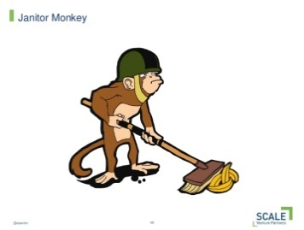
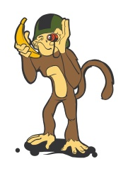
Netflix Released Monkeys
This option uses the logo’s found on Google
Janitor, Conformity and Chaos Monkey
Chaos Monkey
A service which identifies groups of systems and randomly terminates one of the systems in a group
Failures happen, and they inevitably happen when least desired
Even if you are confident that your architecture can tolerate a system failure, are you sure it will still be able run to next week, or next month?
Perhaps an engineer "quick patched" a live system last week and forgot to commit the changes to your source repository
Chaos Monkey service operates at a controlled time and interval, randomly terminates one of the systems, failure is introduced rather than waiting to happen as least desired time
Application are designed to continue working when a peer goes offline
Engineers are around to resolve and learn from any problems
Janitor Monkey
A service which runs in the Amazon Web Services looking for unused resources to clean up
Conformity Monkey
A service which runs in the AWS cloud looking for instances that are not conforming to predefined rules for the best practices
http://techblog.netflix.com/2012/07/chaos-monkey-released-into-wild.html
Notes:
We can’t talk about Netflix without talking about chaos
Anti fragile

Slide 15
Netflix Released Monkeys
This is option is without the logo’s in case you shouldn’t use them
Janitor, Conformity and Chaos Monkey
Chaos Monkey
A service which identifies groups of systems and randomly terminates one of the systems in a group
Failures happen, and they inevitably happen when least desired
Even if you are confident that your architecture can tolerate a system failure, are you sure it will still be able run to next week, or next month?
Perhaps an engineer "quick patched" a live system last week and forgot to commit the changes to your source repository
Chaos Monkey service operates at a controlled time and interval, randomly terminates one of the systems, failure is introduced rather than waiting to happen as least desired time
Application are designed to continue working when a peer goes offline
Engineers are around to resolve and learn from any problems
Janitor Monkey
A service which runs in the Amazon Web Services looking for unused resources to clean up
Conformity Monkey
A service which runs in the AWS cloud looking for instances that are not conforming to predefined rules for the best practices
http://techblog.netflix.com/2012/07/chaos-monkey-released-into-wild.html
Notes:
We can’t talk about Netflix without talking about chaos
Anti fragile

Slide 16
WHAT DOES THIS MEAN FOR PEOPLE?
Notes:
Some suggestions:
Could things really be in the developer domain? – debate. Overall – hope so. We can manage container PaaS’

Slide 17
AWS PLATFORM TOOLS: CLOUDFORMATION

Slide 18

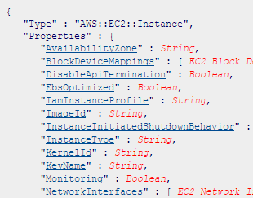
CloudFormation concepts
Option 1
Orchestration using CloudFormation
Provides an easy way to create and manage a collection of related AWS resources
Simplifies provisioning and management of a wide range of AWS resources, from EC2 and VPC to DynamoDB
Architecture can be created/updated in an orderly and predictable fashion
Can describe the AWS resources, dependencies, runtime parameters etc
CloudFormation handles the order of creating resources for users
Templates are simple JSON-formatted text files
AWS provides bunch of sample templates to help get started with: http://aws.amazon.com/cloudformation/aws-cloudformation-templates/
OpenStack equivalent is called Heat

Slide 19
CloudFormation concepts
Option 2
Orchestration using CloudFormation
Provides an easy way to create and manage a collection of related AWS resources
Simplifies provisioning and management of a wide range of AWS resources, from EC2 and VPC to DynamoDB
Architecture can be created/updated in an orderly and predictable fashion
Can describe the AWS resources, dependencies, runtime parameters etc
CloudFormation handles the order of creating resources for users
Templates are simple JSON-formatted text files
AWS provides bunch of sample templates to help get started with: http://aws.amazon.com/cloudformation/aws-cloudformation-templates/
OpenStack equivalent is called Heat

Slide 20
Step 1, Basic IaaS Provisioning
Like we did at the start of the day, CloudFormation creates IaaS components from scratch
Hardware management
Basic Infrastructure orchestration
Platform Infrastructure orchestration
Execution architecture
Deployment architecture
Logical environment separation
Security model
Business Applications
Business Applications
Business Application
Business Application
Business Application
Business Application
Business Application
Platform Application

Slide 21
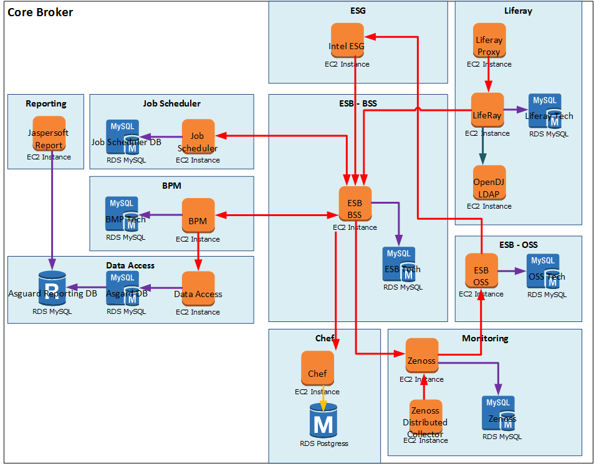
Cloud Formation in Action
Hardware management
Basic Infrastructure orchestration
Platform Infrastructure orchestration
Execution architecture
Deployment architecture
Logical environment separation
Security model
Business Applications
Business Application
Business Application
Business Application
Business Application
Business Application
Platform and basic infra automation >
Build IaaS components from nothing
319
Virtual Private Cloud
Subnets
Virtual Machines
319
319
319
319
319
319
319
319
Diagram for illustration only

Slide 22















Cloud Formation in Action
Hardware management
Basic Infrastructure orchestration
Platform Infrastructure orchestration
Execution architecture
Deployment architecture
Logical environment separation
Security model
Business Applications
Business Application
Business Application
Business Application
Business Application
Business Application
Full platform ready to work >
Build IaaS components from nothing with pre-baking
Virtual Private Cloud
Subnets
Virtual Machines
Execution architecture ready for use
319
319
319
319
319
319
319
319
Diagram for illustration only
Notes:
If you pre-bake ready to work AMIs with your middleware and app, you can do everything

Slide 23
CloudFormation concepts
Desired Architecture
Resource List
SNS Topic
Template
CloudFormation
SQS Queue
Elastic Load Balancer
SNS Topic
Auto Scaling Group
EC2 Instance
DB Instance
EC2 Instance
EC2 Instance
Simple DB Domain
EBS
DB Storage
Notes:
Explain the diagram:
When we have a model of a desired architecture, a JSON template is created
The AWS CloudFormation service executes the template to create a complete architecture.
Such architectures can be update in controlled and orderly fashion.
Briefly describe what each services do: Elastic Load Balancer, AutoScaling Group, EC2 Instance, SimpleDB Domain, SNS Topic, EBS etc.

Slide 24
AWS PLATFORM TOOLS: AUTO SCALING

Slide 25
Autoscaling Groups
Scalability and availability of instances and applications
Helps maintain 100% availability of applications and instances
Is capable of delivering resources almost flawlessly with zero downtime
User-defined policies, schedules and alarms perform automatic scaling and alerting
Automatically scales up of instances to meet requirements during burst-peak times
Also used to scale down resources during quiet periods to keep the cost down
Can detect impaired instances, unhealthy applications and automatically bring up new instances
Helps maintain required compute capacity of the infrastructure
May define min/max number of instances, architecture of instances, ports, regions to be available at etc.

Slide 26
Reference Architecture of a Platform Application
Logic driven, dynamic provisioning of resources
Hardware management
Basic Infrastructure orchestration
Platform Infrastructure orchestration
Execution architecture
Deployment architecture
Logical environment separation
Security model
Business Applications
Business Applications
Business Application
Business Application
Business Application
Business Application
Business Application
Platform Application

Slide 27
Configuring auto scaling groups
Launch Configurations
Launch configurations is at the core of auto scaling groups
Any Auto Scaling group requires a launch configuration
It is a template that applies to EC2 instances launched into a auto scaling group
Launch configuration defines characteristics like the AMI to be used, instance type, security groups, configuration scripts etc
Compliments auto scaling group
Auto Scaling adjusting capacity as needed
Unused capacity
Over capacity
Available Capacity

Slide 28
AWS PLATFORM TOOLS: ELASTIC BEANSTALK

Slide 29
Amazon’s PaaS: Elastic BeanStalk
Easy to begin, Impossible to outgrow
AWS service for deploying and scaling web applications
For services developed with Java, .NET, PHP, Node.js, Python, Ruby, and Docker
On familiar servers such as Apache, Nginx, Passenger, and IIS
Allows users to select a platform, upload application code
Deploying and running is handled by Elastic Beanstalk for users
Elastic Beanstalk automatically handles the deployment, capacity provisioning, load balancing, auto-scaling and health monitoring
Users retain full control over the AWS resources
Select a Platform
Upload an Application or Use a Sample
Run it!
http://aws.amazon.com/elasticbeanstalk/

Slide 30
WHAT DOES THIS MEAN FOR PEOPLE?
Notes:
Some suggestions:
This uber powerful, we need to harness it

Slide 31
LET’S TALK ABOUT THE LAB

Slide 32
Lab – Autoscaling
Lab exercises
Go here: https://alm.accenture.com/wiki/display/DOT/Module+7+Introduction
Duration: ~30 minutes

Slide 33
DO THE LAB!

Slide 34
Summary
Key points
Platform as a Service is a category of cloud computing services that provide computing platform and solution stack
PaaS is a layer on top of Infrastructure-as-a-Service
We discussed how Netflix deploys code
We discussed what Chaos, Janitor and Conformity monkey are and how they can be used to build Phoenix like infrastructure
How DevOps can benefit from Amazon cloud services
We also briefly looked at:
Auto Scaling Group
Launch Configuration
Elastic Beanstalk
Lab exercise on Auto Scaling

Slide 35
OBSERVATION AND DISCUSSION

Slide 36

QUESTIONS

