Slide 1
Module 9: Closing
DevOps Academy

Slide 2
What’s next?
Some options
Case Studies https://go.accenture.com/devopscasestudies
Certification https://go.accenture.com/devopscertification
Offering Public page http://accenture.com/devops
Hackathon video https://www.youtube.com/watch?v=c01BaogQCxA
Copyright © 2016 Accenture All rights reserved.
Notes:
Presenter Notes:
Expand on the different types of quality gates
Mention they correspond to boxes on the right of the V-model and the traditional test phases we’ve covered

Slide 3
Everything is all about this
Value Stream
Idea
Value
Notes:
But most importantly it about doing things different and fighting the cause

Slide 4
This is the way
Value Released
Value Stream
Rapid Feedback
Value Stream
Idea
Value
Idea
Value
Time

Slide 5
This is this…
Value Released
Rapid Feedback
Value Stream
Idea
Value
Value Stream
Idea
Value
Time

Slide 6
This could be the future
Development and Operations Team
Development and Operations Team
CMS
DB
Development and Operations Team
Development and Operations Team
Development and Operations Team
Site
PIM
Tools
Platform

Slide 7
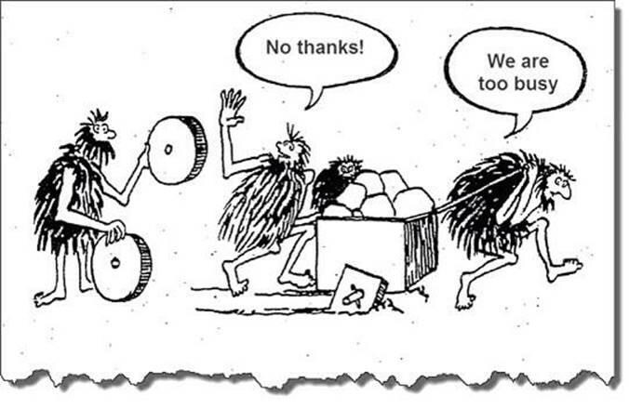
Notes:
Go back to your day jobs, is it going to be like this?

Slide 8
Go Back and Preach
What are the biggest “leap of faith” assumptions (about value) on your account and how could you test them (ASAP)?
Notes:
So if you are going to go back to your clients and take just one thing from this talk (to preach about)

Slide 9
Go Back and Preach – other ideas
Who does what and why – can hand-offs be reduced to optimise more widely and improve throughput
Who do we ideally want to trust more and how can we do that – can the development organisation be accountable for quality?
How fast do developers get feedback – could Continuous Integration or Continuous Delivery be trialled (with a Hypothesis of course)?
Is there an opportunity to create a new “field” – could you start small with a new product in the cloud with end to end teams (perhaps using the DevOps Platform)?
Yammer about what you are doing and work with us (crowdsource)
Show people: https://mediaexchange.accenture.com/media/t/1_kz34icui
Notes:
If you fancy trying a number of things, try these.

Slide 10
Further Reading
https://alm.accenture.com/wiki/display/DOT/DevOps+Agile+New+IT+Reading+List
Notes:
If it seems hard, there is help out there

