Slide 1
Module 5: Introduction to Infrastructure as Code “Configuration Management”

Slide 2
Content
Sections
Introduction to Automating Infrastructure
Benefits of using Infrastructure as Code
How Infrastructure as code fits into DevOps
Introduction to Convergent Configuration Management tools (pros and cons)
The most popular tools and a comparison of them
Introduction to Chef
Chef Architecture
Key concepts in Chef
Convergent infrastructure in practice (bootstrapping and rolling out changes)
Lab - Implement Chef pipeline to deploy an application
Review of Lab Exercise
Discussion and Observation
Review

Slide 3
Infrastructure as code

Slide 4
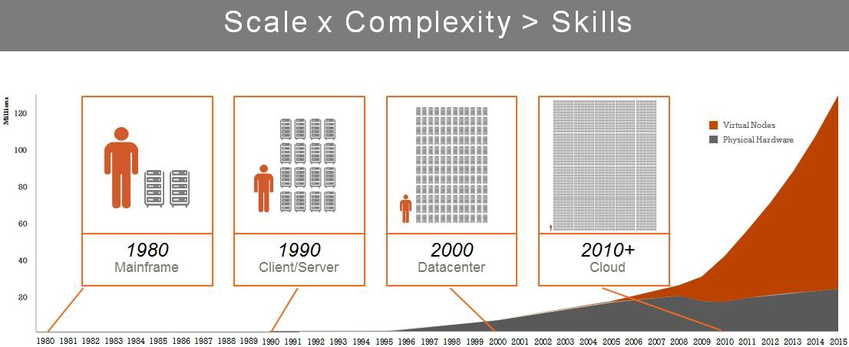
IT Infrastructure Evolution
Doing things manually is no longer an option
http://regmedia.co.uk/2012/03/26/opscode_server_complexity.jpg
Notes:
Exponential Increase In Configuration Changes
Thousands of infrastructure dependencies and configurations needed for each change
❑ Huge amounts of Time required to incorporate changes if done manually
❑ Increased Cost of Correction of Manual Errors
Huge Need for Talent
Risk of Critical Skills Shortage
Server counts are on the rise, and apps span physical boxes and virtual machines scattered on both sides of the corporate firewall
Infrastructure changes all the time. Especially in “the Cloud”:-Different operating systems different hardware from different vendors, different applications in the stack
Quick provisioning of new geographies, business continuity

Slide 5

Philosophical Significance
What would this man think?
“I think; therefore I am.” Rene Descartes
Dualism – separation of body and mind, parallels with Physical and Logical
“I am indeed amazed when I consider how weak my mind is and how prone to error.” Rene Descartes
“The first precept was never to accept a thing as true until I knew it as such without a single doubt.” Rene Descartes
http://upload.wikimedia.org/wikipedia/commons/7/73/Frans_Hals_-_Portret_van_Ren%C3%A9_Descartes.jpg
Notes:
Guess who it is?
What did he say?
What could relate to DevOps?
The idea (from Maartens Laurens from DCSC/Open Credo) is that Descartes’ ideas about dualism – the separation from the body and the mind
A bit like the transition from infra being physical to it now also being logical
We can treat infra differently now
Other quotes are quite nice – with infra as code, we are dealing with complexity (first quote) and uncertainty, second.

Slide 6

Infrastructure as Code
What does Infrastructure Automation do?
Abstracts us from the physical systems (body) so that we can deal with logical systems (mind):
Compute
Storage
Network
Allows to use APIs to programmatically provision the infrastructure that we need (IaaS)
Allows platform applications / services to abstract us even higher and no longer have to be concerned with Compute and Storage (PaaS)
Allows us to represent everything with something that we can put into version control, test, and release
http://upload.wikimedia.org/wikipedia/commons/3/3a/Sipping_Bird.jpg
Notes:
So if we have another logical (not spiritual) dimension to treat infra automation, what does it actually do?
Read through the points and discuss with examples
We typically don’t work too much below the API layer
If we wanted to, we’d use Open Stack

Slide 7
The Hierarchy of Abstraction
Modelling a Platform Application in generic layers
Hardware management
Basic Infrastructure orchestration
Platform Infrastructure orchestration
Execution architecture
Deployment architecture
Security model
Logical environment separation
Business Applications
Business Application
Business Application
Business Application
Business Application
Business Application
Business
Applications
Platform
Application
Copyright © 2015 Accenture All rights reserved.
https://blog.accenture.com/mark_rendell/2014/11/04/proposed-reference-architecture-of-a-platform-application-paaa/
Notes:
This is a possible reference architecture for platform product
This re-enforced the point that we usually work above the level of hardware management
But there is still a lot remaining for us to think about

Slide 8
How Infrastructure as code fits into Continuous Delivery
Fundamental to success
Predictability is essential
No time for manual processes
Compile & Package
Committer: jdoe Story:25
Sonar Code Analysis
Create ST env
Deploy Code
Load Test Data
Run Test Harness
Create clustered env
Deploy Code
Run Perf Test
Commit ID: 113
Run Unit Tests
Tear down ST env
Run Security Test
Prod deploy
Run Ops Test
Absolute consistency presumed!
Notes:
Make the point that if different environments in the pipeline don’t behave the same, how are we going to have the confidence to continuously release?

Slide 9


Inspiration from Developers: Everything in Version Control
Compile
Committer: jdoe Story:25
Sonar Code Analysis
Package
Deploy Code
Load Test Data
Run Test Harness
Deploy Code
Run Test Harness
Run Perf Test
Commit ID: 113
Run Unit Tests
Run Security Test
Prod deploy
Run Ops Test

Slide 10

Inspiration from Developers: Continuous Integration
Compile
Committer: jdoe Story:25
Sonar Code Analysis
Package
Deploy Code
Load Test Data
Run Test Harness
Deploy Code
Run Test Harness
Run Perf Test
Commit ID: 113
Run Unit Tests
Run Security Test
Prod deploy
Run Ops Test

Slide 11

Inspiration from Developers: Static Code Analysis & Unit Tests
Compile
Committer: jdoe Story:25
Sonar Code Analysis
Package
Deploy Code
Load Test Data
Run Test Harness
Deploy Code
Run Test Harness
Run Perf Test
Commit ID: 113
Run Unit Tests
Run Security Test
Prod deploy
Run Ops Test

Slide 12
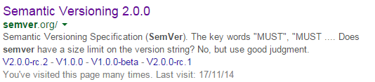
Inspiration from Developers: Label and Release
Compile
Committer: jdoe Story:25
Sonar Code Analysis
Package
Deploy Code
Load Test Data
Run Test Harness
Deploy Code
Run Test Harness
Run Perf Test
Commit ID: 113
Run Unit Tests
Run Security Test
Prod deploy
Run Ops Test

Slide 13
Semantic Versioning for Infrastructure Code Updates
Aka Semver
System for version numbers meaningful to the consumer
Example version: 3.41.24
Given a version number MAJOR.MINOR.PATCH, increment the:
MAJOR version when you make incompatible API changes,
MINOR version when you add functionality in a backwards-compatible manner, and
PATCH version when you make backwards-compatible bug fixes.
Additional labels for pre-release and build metadata are available as extensions to the MAJOR.MINOR.PATCH format.
http://semver.org/
Highly applicable to infrastructure code, but not widely adopted… yet!
Notes:
Semver is a standard that makes version numbers meaningful to the consumer
Explain from the perspective of a consumer
Mention wildcarding version consumption, e.g. I’ll take 3.41.*
Mention it is used in Chef
Highly applicable to infrastructure code, but not widely adopted… yet!
Normally:
No-one knows what version the infra is on
Changes considered by Ops as “safe” e.g. yum update –all may be almost invisible to developers until they cause a problem
Live incident
Failed release due to inconsistent views across environments

Slide 14

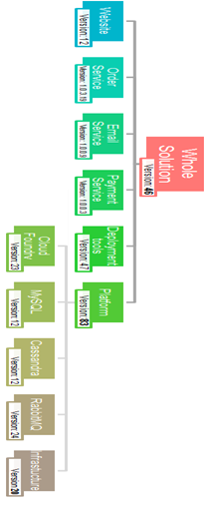

Managing Flow of Infrastructure Updates
Non prod data centre
Prod data centre
Check
in
Compile
and package
Static Code Analysis
Unit Tests
CT env
deploy
Run Functional Tests
Run Security Tests
PT env deploy
Run Tech Tests
Production deploy
Check
in
Compile
and package
Static Code Analysis
Unit Tests
CT env
deploy
Run Functional Tests
Run Security Tests
PT env deploy
Run Tech Tests
Production deploy
Check
in
Compile
and package
Static Code Analysis
Unit Tests
CT env
deploy
Run Functional Tests
Run Security Tests
PT env deploy
Run Tech Tests
Production deploy
Check
in
Compile
and package
Static Code Analysis
Unit Tests
CT env
deploy
Run Functional Tests
Run Security Tests
PT env deploy
Run Tech Tests
Production deploy
Platform data centre
Platform
Check
in
Compile
and package
Unit Tests
Platform env deploy
Monitoring tests
Check
in
Compile
and package
Unit Tests
Platform env deploy
Monitoring tests
Check
in
Compile
and package
Unit Tests
Platform env deploy
Monitoring tests
Check
in
Compile
and package
Unit Tests
Platform env deploy
Monitoring tests
Check
in
Compile
and package
Unit Tests
Platform env deploy
Monitoring tests
Notes:
And we need to plumb together where we have multiple integrations

Slide 15


Inspiration from Developers: Automatically Runtime Test
Compile
Committer: jdoe Story:25
Sonar Code Analysis
Package
Deploy Code
Load Test Data
Run Test Harness
Deploy Code
Run Test Harness
Run Perf Test
Commit ID: 113
Run Unit Tests
Run Security Test
Prod deploy
Run Ops Test

Slide 16
How Infrastructure as code fits into DevOps
Infrastructure automation in DevOps
Development
Operations
Bridges the inconsistency between development team and operations team
Developers benefit from having consistent environments for deployment
Operations benefit from having tested deployments on production like environments
Assures product quality of environments and hence of products deployed
Supports use of Agile and other modern development processes and methodologies
Facilitates the increased rate to demand for releases from application and business unit stakeholders
Supplements utility computing i.e. wide availability of virtualized and cloud infrastructure from internal and external providers
Overlaps increased usage of data centre automation and configuration management tools

Slide 17
What does this mean for people?
Notes:
Some suggestions:
Need to up our game!

Slide 18
Automation tools

Slide 19

Concepts of Infrastructure Automation: Snowflakes
What we are trying to create
Predictability
Consistency
Flexibly
The opposite of “snowflakes”
Avoid configuration drift (like snow drift…)
http://martinfowler.com/bliki/SnowflakeServer.html
Notes:
Everyone knows that every snow flake is different
Martin Fowler made the cute comparison that servers are usually like snowflakes when we want them to be homogenous
Snowflake infrastructure are tweaked and hacked to make it work but difficult to reproduce
The metaphor can be further abused when you picture snowflakes drifting like a snow drift
When over time servers become less and consistent – even if you started off well

Slide 20
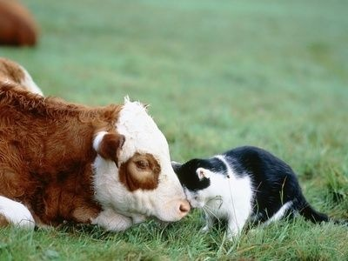
Concepts of Infrastructure Automation: Cattle and pets
A callous attitude to servers
A farmer gives animals numbers rather than names
When an animal in a herd falls sick, it is separated from the others, killed and replaced
A pet owner gives their pets names
When a pet falls sick, it gets taken to a vet with a view to bringing it back to health (at any expense)
Servers should be treated like cattle. Don’t cuddle them.

Slide 21

Concepts of Infrastructure Automation: Phoenixes
What we should be able to do
“One day I had this fantasy of starting a certification service for operations. The certification assessment would consist of a colleague and I turning up at the corporate data center and setting about critical production servers with a baseball bat, a chainsaw, and a water pistol. The assessment would be based on how long it would take for the operations team to get all the applications up and running again.” http://www.sahashock.com/index.cgi/en/20/http/sysadvent.blogspot.com
The ultimate test of re-creation
A new verb “to phoenix” – to destroy and recreate
Notes:
Phoenixes - infrastructure should be like a phoenix, regularly rising from the ashes. Theoretically, it should be possible to virtually burn down servers at regular intervals and bring them back. Puppet and Chef have facilities to do this, automatically re-applying their defined configuration

Slide 22
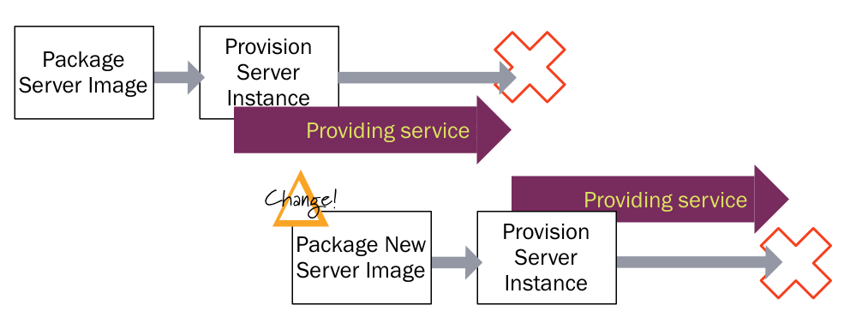
Concepts of Infrastructure Automation: Immutable
To evolve or to re-create?
An Immutable Server is the logical conclusion of this approach, a server that once deployed, is never modified, merely replaced with a new updated instance.
Also sometimes called “the Netflix pattern”
http://martinfowler.com/bliki/ImmutableServer.html
Notes:
There is discussion about whether to evolve servers or re-create
Certainly we have to think about state and persistence (“systems of record”)
The Netflix pattern means that new whole servers are build instead of RPMs or .exes or WARs (since they use Amazon the format is AMI)
The deploy these.

Slide 23
What does this mean for people?
Notes:
Some suggestions:
Less attachment to servers
Much safer from disaster

Slide 24
Illustration of Infra as Code

Slide 25
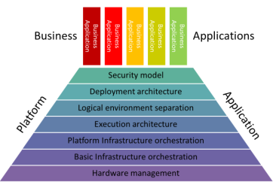
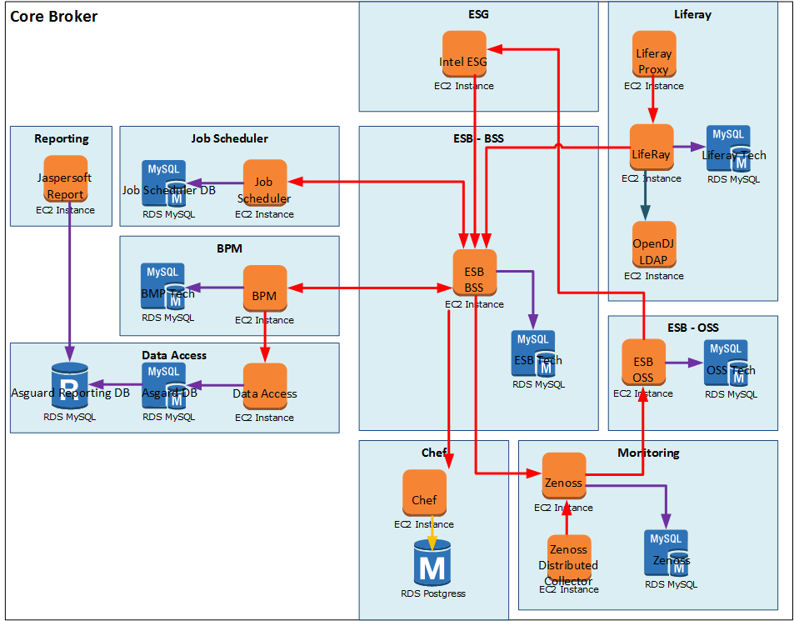
Illustration of Phoenix-ing: IaaS
Build IaaS components from nothing
319
Platform and basic infra automation >
319
319
319
319
319
Virtual Private Cloud
Subnets
319
Virtual Machines
319
319
Diagram for illustration only

Slide 26















Illustration of Phoenix-ing: Environment
Add the execution time dependencies
319
Execution architecture >
319
319
319
319
319
Virtual Private Cloud
Subnets
319
Virtual Machines
Software Installs
319
319
Diagram for illustration only

Slide 27



Illustration of Phoenix-ing: Code and Config
319
Deploy the code
319
Tools in the Cloud (Monsoon)
Deployment architecture >
Reporting
Scheduler
319
BPM
ESG
319
DAL
319
319
Proxy
BSS ESB
319
Portal
Chef
Virtual Private Cloud
LDAP
Subnets
319
OSS BSS
Virtual Machines
Monitoring
Software Installs
Jenkins Deploy
319
319

Slide 28
Active “Configuration Management” tools

Slide 29
Introduction
Haven’t we already covered Configuration Management?
“Configuration Management” have a new popular meaning
Tools that actively manage the configuration of infrastructure, tools and environments
Notes:
Make the points from the slide

Slide 30

Where CM Tools Generally Operate
Configuring the execution architecture
Can be used to deploy your applications as well (treat all software the same)
Can also extend to the platform infrastructure orchestration e.g. Chef Metal
Notes:
However, they’ve mostly extended downwards as well, e.g. Chef Metal handles infra orchestration
We will be using Chef and using it in the execution arch layer

Slide 31
What CM Tools Generally Do
Take you from this…
319
Platform and basic infra automation >
319
319
319
319
319
Virtual Private Cloud
Subnets
319
Virtual Machines
319
319
Diagram for illustration only

Slide 32
How We Currently Deliver The Platform
…to this!
319
319
319
319
319
319
Virtual Private Cloud
Subnets
319
Virtual Machines
Execution architecture ready for use
319
319
Diagram for illustration only

Slide 33

Active “Configuration Management” Tools
So how do Active Configuration Management Automation tools do it?
Treat servers “Pets”
Can evolve and heal them aka “Converge“ them
Updates are typically instigated as a “Pull” from the VM
Should be idempotent
The state of the infrastructure was known the last time Chef ran
Should be the only way servers get change
"ssh creates a smell”
Notes:
Explain the points
idempotent (re-runnable and the same outcome irrespective of start state)
Ssh creates a smell – from a famous blog talking about not doing things properly (in a repeatable, recreateable, non-snowflake way)

Slide 34




Active “Configuration Management” Tools
Popular tools
Some of the popular configuration management tools are:
Chef
Puppet
SaltStack
Ansible
Uses a convergent model of configuration
Periodically run a VM (aka node's) “recipes” (or manifests) so that the node incorporates the latest configuration information from master configuration server
Agents only make configuration changes when the node is out of spec, so it's safe to run them repeatedly
SaltStack and Ansible support Push as well as Pull
Notes:
Explain these tools:
Chef
Chef is a configuration management tool written in Ruby and Erlang.
It uses a pure-Ruby, domain-specific language (DSL) for writing system configuration recipes
Used to streamline the task of configuring & maintaining a servers, and can integrate with cloud-based platforms
Puppet
an open source configuration management utility
produced by Puppet Labs, founded by Luke Kanies in 2005.
It is written in Ruby and released as free software under Apache 2.0 licence
SaltStack
Another open-source tool for configuration management, infrastructure automation and cloud orchestration.
Python-based, initially released in March 2011
Ansible
Similar tool
Modules work over JSON and standard output
Can be written in any programming language.
Uses YAML to express reusable descriptions of systems
CloudFormation
“we use CloudFormation to describe the infrastructure as code. The CloudFormation language is declarative JSON that is organized into files called templates. The templates can be deployed on AWS and then managed as stacks. The CloudFormation service handles creating, updating, and deleting AWS resources in the stacks. All we have to do is record what we want in the template and CloudFormation determines the dependencies and steps to create or change the infrastructure to be like what the template describes”

Slide 35
Introduction to Chef
What is Chef
Chef is a powerful automation tool that transforms complex infrastructure into code
Chef makes it easy to deploy servers and applications to any physical, virtual, or cloud location, no matter the size of the infrastructure
Chef is built to address the hardest infrastructure challenges by modelling IT infrastructure and application delivery as code
Your infrastructure becomes as versionable, testable, and repeatable as application code
Chef is a configuration management tool written in Ruby and Erlang
It uses a pure-Ruby, domain-specific language for writing system configuration ‘recipes’
Supports all major platforms
RHEL/CentOS, Ubuntu, Debian, Fedora, Mac OS X, Windows 7, and Windows Server
By convention, it’s our tool of choice (we’re not keen on holy wars).
Notes:
Explain these tools:
Chef
Chef is a configuration management tool written in Ruby and Erlang.
It uses a pure-Ruby, domain-specific language (DSL) for writing system configuration recipes
Used to streamline the task of configuring & maintaining a servers, and can integrate with cloud-based platforms
Puppet
an open source configuration management utility
produced by Puppet Labs, founded by Luke Kanies in 2005.
It is written in Ruby and released as free software under Apache 2.0 licence
SaltStack
Another open-source tool for configuration management, infrastructure automation and cloud orchestration.
Python-based, initially released in March 2011
Ansible
Similar tool
Modules work over JSON and standard output
Can be written in any programming language.
Uses YAML to express reusable descriptions of systems
CloudFormation
“we use CloudFormation to describe the infrastructure as code. The CloudFormation language is declarative JSON that is organized into files called templates. The templates can be deployed on AWS and then managed as stacks. The CloudFormation service handles creating, updating, and deleting AWS resources in the stacks. All we have to do is record what we want in the template and CloudFormation determines the dependencies and steps to create or change the infrastructure to be like what the template describes”

Slide 36
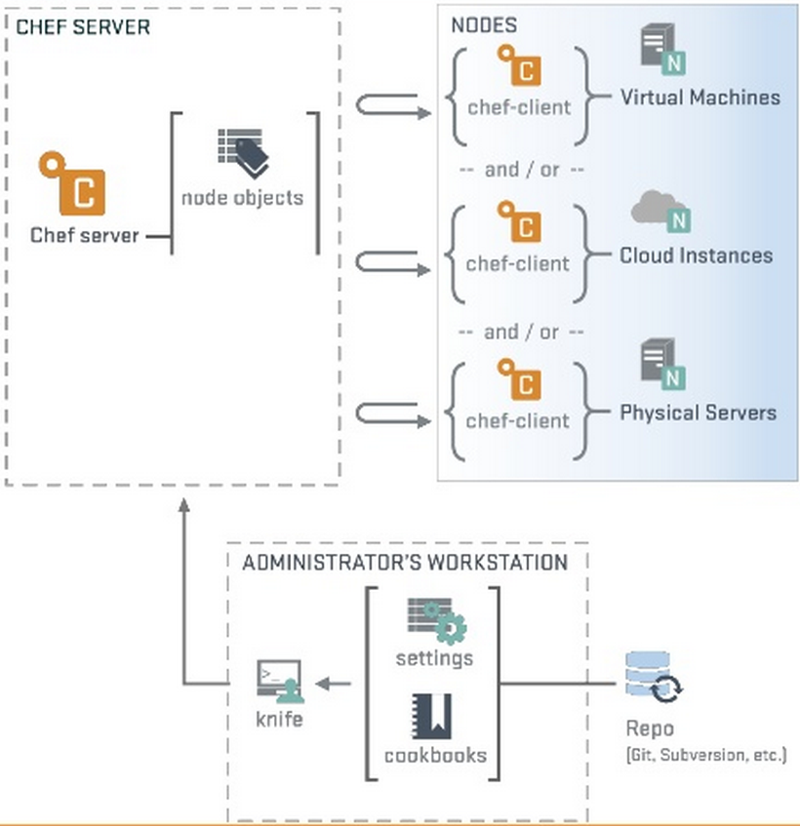
Chef architecture
Notes:
Chef Server: The Chef server stores your recipes as well as other configuration data. The Chef server acts as a hub that is available to every node in the organization to make use of recipes and configuration data.
Node: A node can be a physical server, a virtual server or a container instance. The nodes are connected to a Chef Server through a process called bootstrapping. Once the node is connected to a Chef server it periodically polls the Chef server using a tool called Chef client for the latest recipes and checks to see if the node is in compliance with the policy defined by these recipes. If the node is out of date, the Chef client runs them on the node to bring it up to date. The Chef client is installed on each node in your network.
Work station: The workstation usually a laptop, is the location from which recipes and other chef configuration files are authored, synchronized with a git repository known as Chef-Repo that stores the files, and from where recipes and other files are uploaded to the Chef Server. The work station is also used to bootstrap nodes to the Chef Server.

Slide 37
Convergent infrastructure in practice
Convergent model
Chef uses a convergent model of configuration
Recipes only make configuration changes when the node is out of spec
So it's safe to run them repeatedly
For example, a recipe that installs a particular service on a node will only do this if the service doesn't already exist or if it's out of date
Recipes either do nothing or bring the environment closer to the desired configuration state
As changes propagate through the nodes, the network as a whole converges to the desired configuration state
By default, the Chef client pulls configuration updates from the Chef server every 30 minutes
Chef makes network-wide configuration searchable and makes search results available to the recipes
Combining search with periodic configuration updates is very powerful
Notes:
Talk people through this

Slide 38
How Chef Provisions the Execution Architecture
319
First individual VMs (aka nodes) are “bootstrapped” to the Chef Server
319
Tools in the Cloud (Monsoon)
319
319
319
319
319
Virtual Private Cloud
Subnets
319
Virtual Machines
Bootstrap to Chef
319
319
Diagram for illustration only
Notes:
Describe what happens

Slide 39
How Chef Provisions the Execution Architecture
319
The “recipe” is downloaded and used by the local Chef agents to do the installations and configuration
319
Tools in the Cloud (Monsoon)
319
319
319
319
319
Virtual Private Cloud
Subnets
319
Virtual Machines
Bootstrap to Chef
Chef Convergence (Hardening)
319
Chef Convergence (Product Install)
319
Diagram for illustration only
Notes:
Describe what happens

Slide 40
Key concepts in Chef
Chef terms
Knife
knife is a command-line tool
provides an interface between a workstation, local chef-repo and the chef server
help manage nodes, cookbooks-recipes, roles, environments, cloud resources
Bootstrap
Installation of the chef-client on a target node so that it can function as a chef-client and communicate with its Chef server
Cookbook
fundamental unit of configuration and policy distribution
defines a scenario, such as everything needed to install and configure an application, and then definition of all of the components that are required to support that scenario
Roles
a way to define certain patterns and processes that exist across nodes in an organization as belonging to a single job function
Databag
data bag is a global variable that is stored as JSON data and is accessible from a server
is indexed for searching and can be loaded by a recipe or accessed during a search

Slide 41
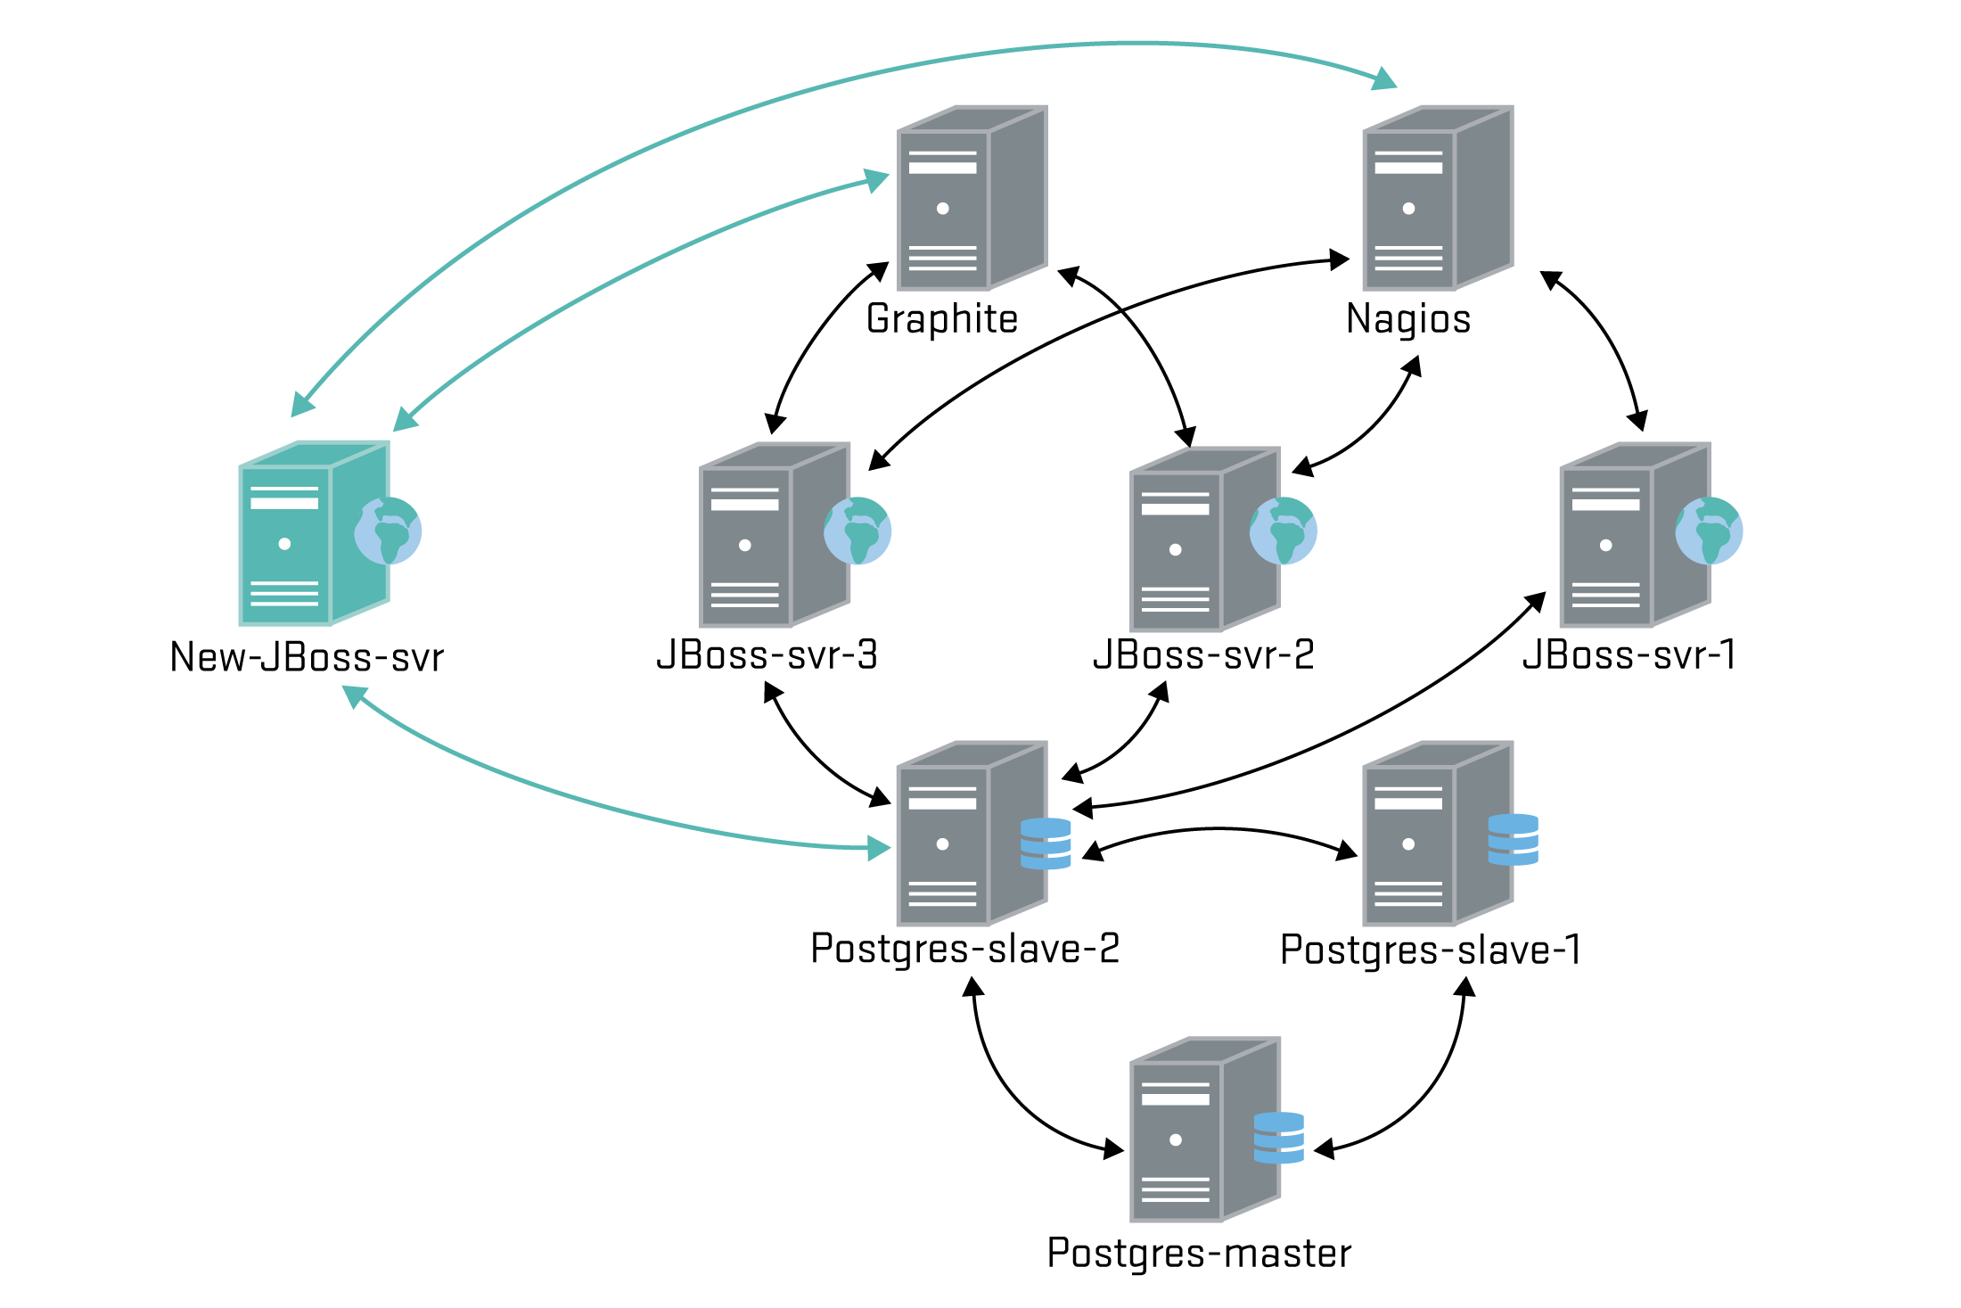
Searchable Configuration
Chef Server is part of your CMDB
Notes:
To support system integration, Chef makes network-wide configuration searchable and makes search results available to the recipes. Combining search with periodic configuration updates is very powerful. For example, since configuration recipes run periodically, load balancers will automatically notice new web servers and begin to route requests to them. Here's an example.
A new JBoss app server has just come online. The next time the Chef client runs on the other nodes, the recipes notice that a new app server node has been added and update their lists of IP addresses. The new server becomes integrated into the environment.
Mention ITIL and CMDB

Slide 42
What does this mean for people?
Notes:
Some suggestions:
Need to figure out who can make Chef updates! “Git hub pull model is best”, i.e. don’t create silos

Slide 43
Let’s talk about the lab

Slide 44
Lab
Lab exercises
Go here! https://alm.accenture.com/wiki/display/DOT/Module+5+Introduction
Duration: ~30 minutes

Slide 45
Do the lab!

Slide 46
Summary
Key Points
We looked at Infrastructure Automation
Benefits of Infrastructure of as code
Discussed Convergent Configuration Management tools
Cows, Pets, Snowflakes, Phoenixes – metaphors to describe infrastructures
The most popular tools and a comparison of them
Why Chef
Chef Architecture
Key concepts in Chef
We also discussed convergent model in Chef
Searchable configuration can discover nodes and apply recopies automatically

Slide 47
Observation and Discussion
Discussion

Slide 48
References
Useful References
https://www.linkedin.com/today/post/article/20140408140732-2129380-devops-is-not-only-infrastructure-automation
http://blog.controlgroup.com/2013/09/30/aws-cloudformation-and-infrastructure-as-code/
https://www.getchef.com/solutions/configuration-management/

Slide 49

Questions
?

