Slide 1
Module 6: Containers

Slide 2
Content
Sections
Immutable vs Convergent Infrastructure
Introduction to Containers
Containers vs Virtual Machines
Best practices of using Docker containers
Docker architecture overview
Using Docker to build an environment
Summary
Lab exercise
Lab Review
Discussion
Recap

Slide 3
Containers
Yes we are going to talk about Docker now….
In this module we are going to explore using Docker as an alternative to Chef
We’ll consider the pro’s and con’s
We’ll talk about options for using Docker and Chef together

Slide 4
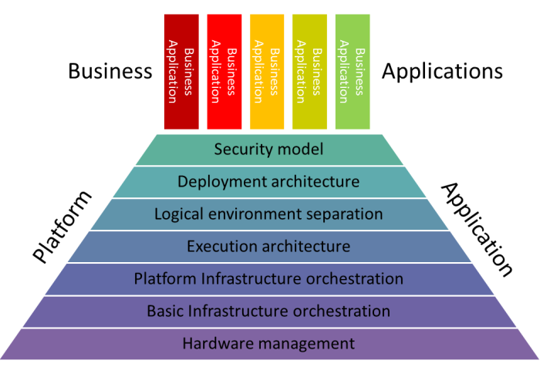
What Do Containers Solve
Creating the execution architecture and definitely including your application
Unlike Chef which may just be used for middleware, the application is usually included
Containers run on VMs or dedicated Container PaaS’
Notes:
Make the points on the slide

Slide 5

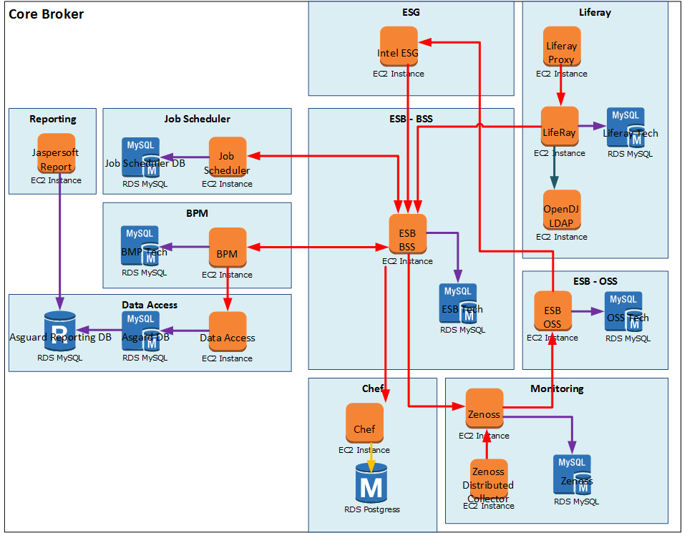
What Problem are we Solving?
Just like in the last module, we want to go from this…
319
Platform and basic infra automation >
319
319
319
319
319
Virtual Private Cloud
Subnets
319
Virtual Machines
319
319
Diagram for illustration only

Slide 6















What Problem are we Solving?
…to this!
319
319
319
319
319
319
Virtual Private Cloud
Subnets
319
Virtual Machines
Execution architecture ready for use
319
319
Diagram for illustration only

Slide 7
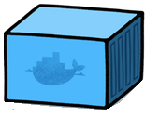
How This Time Then?
…with Docker containers
319
319
319
319
319
319
Virtual Private Cloud
Subnets
319
Virtual Machines
Execution architecture ready for use
319
319
Diagram for illustration only

Slide 8

And Maybe Some Like This
…multiple Docker containers per VM
319
319
319
319
319
319
Virtual Private Cloud
Subnets
319
Virtual Machines
Execution architecture ready for use
319
319
Diagram for illustration only

Slide 9
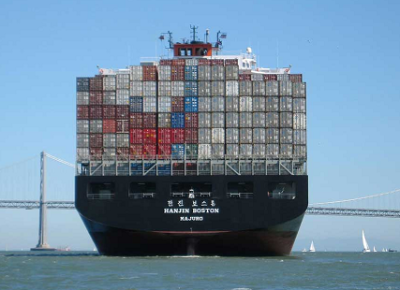
Containers
Introduction to containers
What is container?
A Linux kernel container is a virtualization environment without a hypervisor
It is an operating system–level virtualization method
Isolated from other containers but share resources from the host system
Examples of common isolation tools are:
Solaris Zones, OpenVZ, LXC, chroot etc.
“A second piece of the virtualisation pie”
Notes:
Notes:
In an operating system–level virtualization method, kernel of an OS allows running of multiple isolated user space instances on a single host. Such isolated instances are called containers.
In other words a container is a self contained execution environment that shares the kernel of the host system and is isolated from other containers in the system.

Slide 10
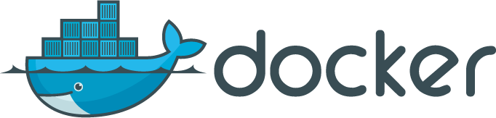
Docker
Docker engine for containers
What is Docker?
An open source OS–level virtualization manager
By default uses LXC (Linux Containers) to create isolated virtual environments
A tool that makes trivially easy to use containers capabilities
Portable and immutable deployment across machines
It is application-centric, allows rapid building, shipping, and running of distributed applications using containers
Consists of Docker Engine, a lightweight runtime and a packaging tool
Docker includes git-like capabilities for tracking successive versions of images and containers
Any container can be used as an "base image"
Docker has access to a registry hubs (private and public), this make sharing easy
Developers can build any app in any language using any tool chain.
System administrators use Docker to provide standardised environments for their development, quality assurance, and production teams.
Notes:
Notes:
Docker is an open source container platform to build, ship, and run distributed applications. Docker consists of Docker Engine, a lightweight runtime and a packaging tool.
Docker enables apps to be quickly assembled from components and eliminates the friction between development, QA, and production environments.
“Dockerized” apps are completely portable and can run anywhere - colleagues’ OS X and Windows laptops, QA servers running Ubuntu in the cloud, and production data center VMs running Red Hat.

Slide 11
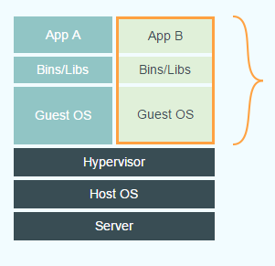
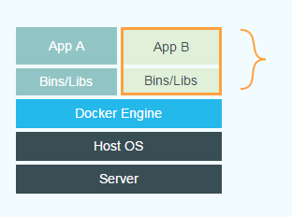
How Docker differs from Virtual Machines
The below shows the fundamental difference in Virtual Machines and Docker:
Virtual Machines
Docker
Each virtualized application includes not only the application - which may be only 10s of MB - and the necessary binaries and libraries, but also an entire guest operating system - which may weigh 10s of GB.
The Docker Engine container comprises just the application and its dependencies. It runs as an isolated process in userspace on the host operating system, sharing the kernel with other containers. Thus, it enjoys the resource isolation and allocation benefits of VMs but is much more portable and efficient.
3
Some diagrams taken from: https://www.docker.com/whatisdocker

Slide 12
How Docker differs from Virtual Machines
To put it another way:
Virtualization refers to a process of creating a virtual computer, hardware platform, operating system, storage device, or computer network resources.
Virtual Machines
Virtualized applications include applications, binaries, libraries and entire (guest) Operation System
A virtual machine emulates a physical computing environment
Requests for CPU, memory, disk, network and other hardware resources to a virtualization layer
VMs provide complete isolation, there is minimal resource sharing
Containers
Container (should) only contains an application and its dependencies
Runs as an isolated process on the host system, shares the kernel with other containers
It enjoys the resource isolation and allocation benefits of VMs but is more portable and efficient
Less isolated compared to fully virtualised systems
Uses AuFS (Another Union File System) for kernel sharing
Notes:
Why is a hypervisor called a hypervisor? - Because operating systems used to be called Supervisors and a Hypervisor manages multiple operating systems i.e. supervisors
Virtualization refers to the act of creating a virtual computer hardware platform, operating system (OS), storage device, or computer network resources.
Types of Virtualization:
Full Virtualization -- Almost complete simulation
Partial Virtualization -- Some but not all of the target environment is simulated
Paravirtualization -- A hardware environment is not simulated; however, the guest programs are executed in their own isolated domains
Each virtualized application includes not only the application - which may be only 10s of MB - and the necessary binaries and libraries, but also an entire guest operating system - which may weigh 10s of GB.
The Docker Engine container comprises just the application and its dependencies. It runs as an isolated process in userspace on the host operating system, sharing the kernel with other containers. Thus, it enjoys the resource isolation and allocation benefits of VMs but is much more portable and efficient.

Slide 13
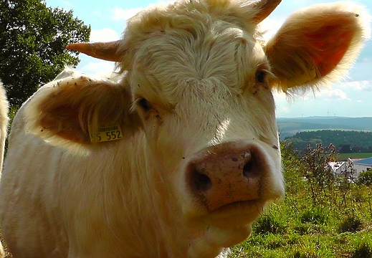
Immutable Containers
Containers should be treated “like cattle”
Normally we:
Create a container
Run it
Decide we want it to change
Create a new version of the container
Replace the old running container with a new one
The container could contain a Chef agent
Notes:
Draw the comparisons with Chef

Slide 14
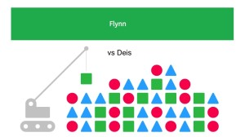
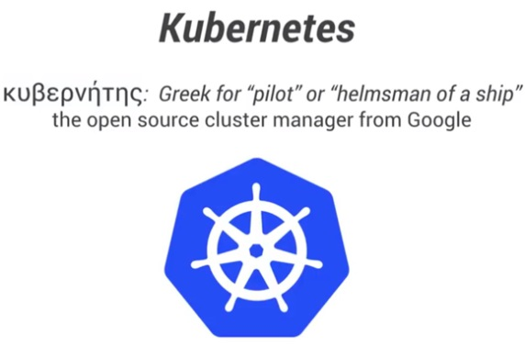
Container PaaS’
No longer have to think about where your containers are
Let a software application your PaaS (sometimes called micro PaaS) work out where to put your containers
Let it create extra VMs or kill them as needed
This area is exploding with new stuff!
http://www.centurylinklabs.com/flynn-vs-deis-the-tale-of-two-docker-micro-paas-technologies/
Notes:
Mention the there are Platform Applications appearing to manage you containers
And that this area is exploding with new things all the time

Slide 15
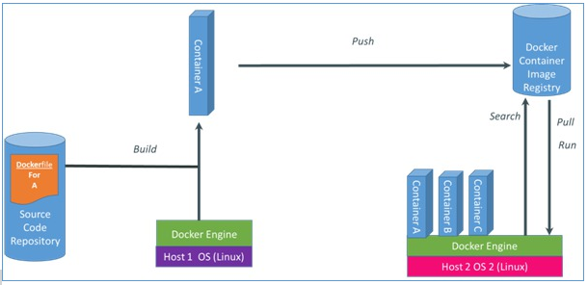
How to use Docker
Docker engine for containers
http://osv.io/blog/blog/page/3/
Notes:
Explain:
Write a docker file
Create container
Push container to a repo as an image
Pull images
Start container instances

Slide 16
Docker Components
We defined
Docker images
Read-only template
Images are frozen files that act as blueprint for containers
Docker containers
Are spun from images
A Docker container holds everything that is needed for an application to run
Multiple containers can be run from a single image
Docker registries
Docker registries hold images
Community Docker Hub: https://hub.docker.com/
Docker Accenture Hub: https://docker.accenture.com/

Slide 17
Docker Best Practices
Using Docker efficiently
Containers should be ephemeral
it can be stopped and destroyed and a new one built and put in place with a minimum of set-up
Use a .dockerignore file
For efficiency during docker build, you should use a .dockerignore file to exclude files or directories
Avoid installing unnecessary packages
Containers are lightweight and should container only an application and its dependencies
Run only one process per container
Decoupling applications into multiple containers makes it easier to scale horizontally & reuse containers
Use container linking for service dependencies
Minimize the number of layers
Layers increase container size
Sort multi-line arguments
Use multiline arguments to improve readability
Build cache
Using --no-cache=true/false
Notes:
Build cache
Starting with a base image that is already in the cache, the next instruction is compared against all child images derived from that base image to see if one of them was built using the exact same instruction. If not, the cache is invalidated.
In most cases simply comparing the instruction in the Dockerfile with one of the child images is sufficient. However, certain instructions require a little more examination and explanation.
In the case of the ADD and COPY instructions, the contents of the file(s) being put into the image are examined. Specifically, a checksum is done of the file(s) and then that checksum is used during the cache lookup. If anything has changed in the file(s), including its metadata, then the cache is invalidated.
Aside from the ADD and COPY commands cache checking will not look at the files in the container to determine a cache match. For example, when processing a RUN apt-get -y update command the files updated in the container will not be examined to determine if a cache hit exists. In that case just the command string itself will be used to find a match.

Slide 18
More Docker Information
Docker features
File system isolation - Each container run on separate root file system
Resource isolation - CPU, memory can be allocated separately
Network isolation - Runs on its own network namespace, with a virtual interface and IP address of its own.
Copy-on-write - Root file systems are created using copy-on-write, which makes deployment extremely fast, memory-cheap and disk-cheap, copy-on-write is provided by AuFS (Another Union File System)
More on Union File System http://aufs.sourceforge.net/aufs.html
Logging - The standard streams (stdout/stderr/stdin) is logged
Change management - Changes to a container's file system can be committed into a new image
Interactive shell - Docker can allocate a pseudo-tty and attach to the standard input of any container
Docker doesn't provide these features, it merely makes them trivially easy to use

Slide 19



Case Study: Using Docker for Managing Build Servers – pt1
Example: Building Hybris without Docker
The below highlights a Hybris Build Process solution
Process:
Something was used to install Hybris on the Build server (one-time only setup) – could be Chef (often manual)
The Hybris build server is used for the compilation of code
When a developer pushes the code to Git, Jenkins will execute on the Hybris build server (if not already in use)
The code is copied onto the Hybris server and the code is compiled
Once compiled Jenkins zips up the content for deployment
Disadvantages:
The Hybris build server can only be used for one execution at a time
The build server is restricted to one version of Hybris only
vX.2
Jenkins Server
Build Server

Slide 20



Case Study: Using Docker for Managing Build Servers – pt2
Example: Building Hybris with Docker
The below highlights a Hybris Build Process solution
Docker Plugin
Advantages:
Jenkins uses containers as normal slaves, and manages build tool installations if required
Higher throughput of builds resulting into faster feedback to developers
Every build environment is clean and consistent as each is created from the same image
Slaves become available ‘on-demand’ and are destroyed when no longer needed
Scalable, resource and cost efficient
Different image versions are supported
API
Isolated build Environment
Isolated build Environment
Jenkins Server
Build Server

Slide 21



Differences between Chef and Docker
The fundamental difference in Chef and Docker
App installed
App
provisioned
Dependencies/Binaries
App installed
App
provisioned
Chef:
Chef is used to install applications/manage configuration
It often depends on other cookbooks/dependent repositories (such as yum) to install software
Dependencies resolved at converge (server update) time
Changes can be pushed out to evolve a server
Docker:
Provisions applications on servers on a separate layer to the operating system
Dependencies resolved at image build time (i.e. before we want to start a container)
Changes must be made by stopping and replacing a container with a new version

Slide 22
What happens when you are developing Docker?
A lot of layers! Like the movie inception?
Your laptop
Operating system (e.g. Windows)
Terminal (e.g. Git bash)
Docker-Machine
Virtual Machine
Linux
Docker (LXE, etc.)
container you want to run
OS e.g. Debian
Software e.g. Ruby
Your code
Hypervisor (e.g. Virtual Box)
Notes:
It can feel a bit overwhelming when you are working with Docker.
This slide describes all the pieces of software when you run Docker locally.
See if it helps people visualise this.

Slide 23
What does this mean for people?
Notes:
Some suggestions:
Could things really be in the developer domain? – debate. Overall – hope so. We can manage container PaaS’

Slide 24
Let’s talk about the lab

Slide 25
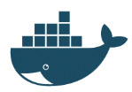

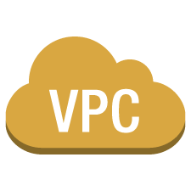


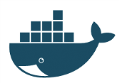

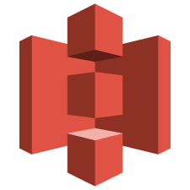
How We Are Going To Use Docker
2. Push to registry
https://docker.accenture.com/
3. Pull from registry and run in our environment
1. Build a new container
Docker file
AWS Cloud
Academy VPC
Academy Security Group
Academy Security Group
AWS CloudFormation
Sonar-Jenkins-Server
“Test Environment” Server
Academy Security Group
AMI
OpenLDAP-Gerrit-Server
Amazon S3
Notes:
Using CloudFormation template we will create environments and infrastructure required for this training.
Day 1 architecture is different that day 2 architecture.
For day 1, we will create a VPC on AWS and then, we will create two EC2 instances and other related infrastructures.
VPC is Amazon Virtual Private Cloud, it provisions a logically isolated section of Amazon Web Services (AWS) Cloud.
Security Groups allow us to control incoming and outgoing connections form the instances.
Read through step by step and describe. Very important people can visualise what they are about to do.

Slide 26
Lab
Lab exercises
Go here! https://alm.accenture.com/wiki/display/DOT/Module+6+Introduction
Duration: ~30 minutes

Slide 27
Do the lab!

Slide 28
Summary
Virtual Machines provide complete isolation at the cost of managing entire Operating System
Containers are self contained execution environment, they are lightweight
Docker recommends running one application per container
Docker model creates immutable containers
Immutable infrastructure does not support change after build. If changes are required, containers should be built from scratch
Convergent infrastructure support changes after deployment
Chef uses convergent model

Slide 29
Observation and Discussion
Discussion

Slide 30

Questions
?

