Slide 1
Module 8 Operations

Slide 2
Content
Sections
Operations in the cloud
Security
Patching
High Availability
Monitoring tools anatomy
Different tools out there for Monitoring
Applying Monitoring tools to DevOps
Backup strategies within DevOps and the Cloud
Implementing Backup and Monitoring solutions
Intro to lab
Discussion
Summary
References

Slide 3
Cloud Operations

Slide 4

Security
Keeping secure in the Cloud
Information security is of paramount importance to Cloud customers
Your cloud provider may take responsibility but not necessarily accountability
Security is a core functional requirement that protects mission-critical information from accidental or deliberate theft, leakage, integrity compromise, and deletion
Cloud Security advantages over traditional IT infrastructure:
Expenditure reduced on:
Network security devices
security software licences
staffing of an information security organization
information security regulatory compliance
physical security requirements
smart cards for access control

Slide 5
Security
Cloud Shared Responsibility
Shared Responsibility based on the AWS Model
AWS and Customer to share responsibility for Security
Security should be implemented in every layer of the cloud application architecture
Physical security is typically handled by service provider which is an additional benefit of using the cloud
Customers responsible for secure operating systems, platforms, and data
AWS provides different types of shared responsibility services:
Infrastructure Services
Container Services
Abstracted Services
Notes:
Presenter Notes:
- Briefly introduce each type of the services

Slide 6
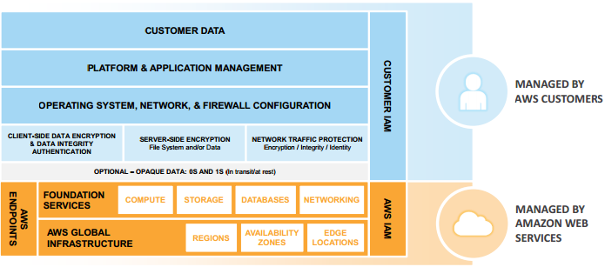
Security
Infrastructure Services
AWS looks after Facilities, Physical security of hardware, Network infrastructure, Virtualization infrastructure
This category includes compute services, such as Amazon EC2, and related services, such as Amazon Elastic Block Store (Amazon EBS), Auto Scaling, and Amazon Virtual Private Cloud (Amazon VPC).
With these services, you can architect and build a cloud infrastructure using technologies similar to and largely compatible with on-premises solutions.
You control the operating system, and you configure and operate any identity management system that provides access to the user layer of the virtualization stack.

Slide 7
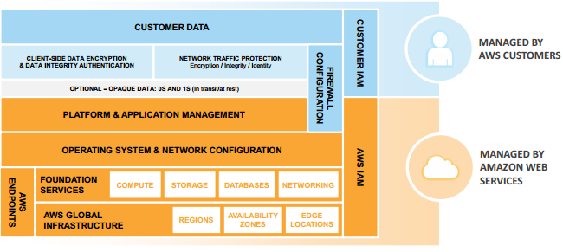
Security
Container Services
Services in this category typically run on separate Amazon EC2 or other infrastructure instances, but sometimes you don’t manage the operating system or the platform layer.
AWS provides a managed service for these application “containers”.
You are responsible for setting up and managing network controls, such as firewall rules, and for managing platform-level identity and access management separately from IAM.
Examples of container services include Amazon Relational Database Services (Amazon RDS), Amazon Elastic Map Reduce (Amazon EMR) and AWS Elastic Beanstalk

Slide 8
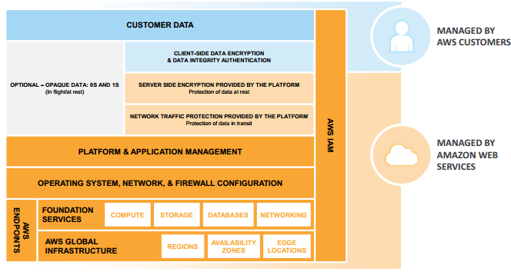
Security
Abstracted Services
This category includes high-level storage, database, and messaging services.
These services abstract the platform or management layer on which you can build and operate cloud applications.
You access the endpoints of these Abstracted services using AWS APIs.
AWS manages the underlying service components or the operating system on which they reside.
You share the underlying infrastructure, and abstracted services provide a multi-tenant platform which isolates your data in a secure fashion and provides for powerful integration with IAM.
Notes:
Presenter Notes:
Examples of first bullet point:
such as Amazon Simple Storage Service (Amazon S3), Amazon Glacier, Amazon DynamoDB, Amazon Simple Queuing Service (Amazon SQS), and Amazon Simple Email Service (Amazon SES).

Slide 9
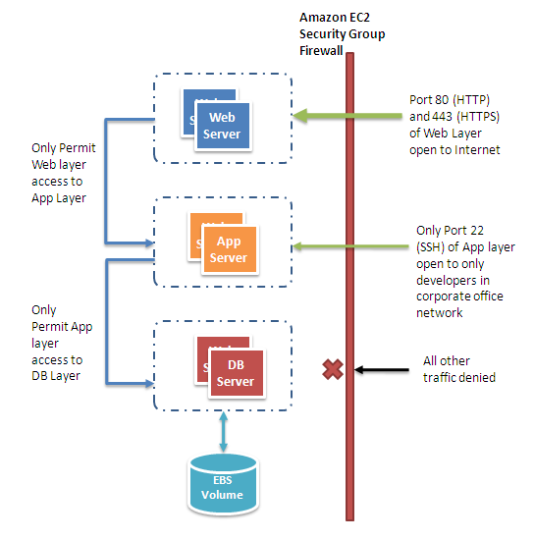
Security
Cloud Security Best Practices
Tools, features and guidelines on how to secure your cloud application in the Cloud
Protect your data in Transit
Protect your data at rest
Protect your Cloud credentials
Manage multiple Users and their permissions with Identity and Access Management
Secure your Application
Use Security groups to protect your instances
Security groups give you basic firewall-like protection for running instances
Notes:
Presenter Notes:
Protect data in transit using SSL connections
Protect data at rest by encrypting data before uploading to cloud
Protect Cloud Credentials, including Keys and Certificates
Talk them through the diagram on securing application

Slide 10
What does this mean for people?
Notes:
Some suggestions:
We now have a lot of power – use it wisely!

Slide 11
Patching

Slide 12
Patching
Basics
Operating systems, middleware, and applications need to be regularly patched to guard against newly found vulnerabilities or to provide additional functionality.
In the non-enterprise space, updates are typically handled by turning on the auto-update feature of the operating system or middleware.
Software patches
Security: Fix vulnerabilities
Functional: Add features, improve existing functions, change software behaviours
Impacted systems: Hypervisor, OS, middleware, applications
Vendor Tools: Windows Server Update Services, Redhat Network, etc.
Only handles Windows/Redhat systems
Standalone tool with no integration with other management tools, e.g., change management
3rd Party Tools: IBM TEM, VMware vSphere update manager
TEM: Hypervisor, guests, middlewares, apps. vSphere: hypervisor & guests
Scheduling & deployment made easy but largely rely on human involvement, no tool integration
Amazon EC2, Microsoft Azure, many private Clouds
User manages patching. VMs can be potentially vulnerable when first provisioned

Slide 13

Patching
Patch management in enterprise
Patch management challenges in traditional enterprise
Lack of standardization in software/hardware/services
Human intervention in every step (notification, approval, scheduling, deployment, post-deployment)
Every customer wants a different patch management policy to suit their needs
Patch management solution provided to one customer can be completely different from another
Little or no solution reuse
Labour intensive and cost ineffective

Slide 14


Patching
Patch management in Cloud
Cloud opportunities
Highly standardized software/hardware stacks
Aggressively increase the level of services automation in many processes of IT delivery,
including patch management
A clean slate to offer customers with more standardized solutions and services at a lower cost
Lower provider’s operational costs get passed to customers so they are likely willing to accept standardized services such as patch management
Cloud challenges
Extremely large, multi-tenancy, deeper vertical stack due to virtualization

Slide 15
High Availability

Slide 16
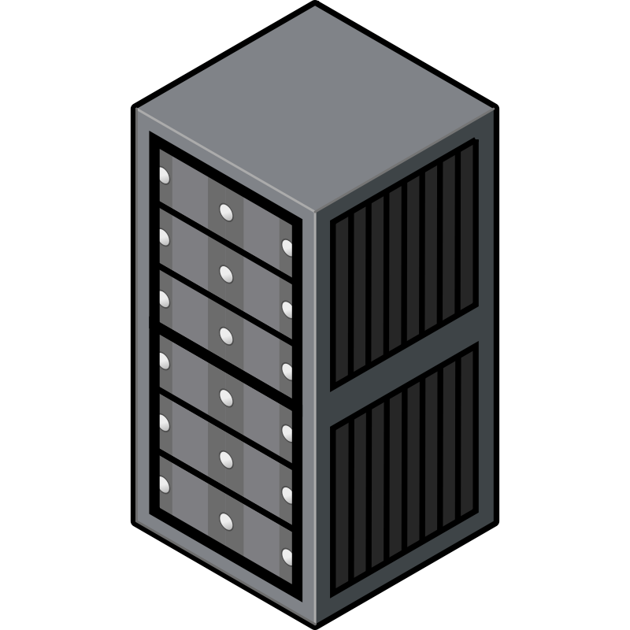
High Availability
High Availability in the Cloud
Design for Failure and Nothing will Fail
Be a pessimist when designing architectures in the cloud; assume things will fail.
In other words, always design, implement and deploy for automated recovery from failure.
By being a pessimist, you end up thinking about recovery strategies during design time, which helps in designing an overall system better.
Antifragile
Make your Cloud resilient to changes and chaos
Chaos Monkey
Introduce chaos into your Cloud
Learn from problems introduced
Become Antifragile
Notes:
Presenter Notes:
-Introducing the topic of high Availability:
The cloud is all about redundancy and fault-tolerance. Since no single component can guarantee 100% uptime (and even the most expensive hardware eventually fails), we have to design a cloud architecture where individual components can fail without affecting the availability of the entire system.
- Explain the main principles that leads to High Availability in the cloud
- Explain Fragile, sturdy and Antifragile

Slide 17

High Availability
General HA Cloud Best Practices
Avoid single points of failure
Always place (at least) one of each component (load balancers, app servers, databases) in at least two Availability Zones
Maintain sufficient capacity to absorb AZ / cloud failures
Reserved Instances – guarantee capacity is available in a separate region/cloud
Replicate data across AZs and backup or replicate across
clouds/regions for failover
Setup monitoring, alerts and operations to identify and automate problem resolution or failover process
Design stateless applications for resilience to reboot / re-launch

Slide 18
What does this mean for people?
Notes:
Some suggestions:
These tools are available to use consistently throughout the lifecycle

Slide 19
Monitoring

Slide 20
Monitoring
Definition
Telemetry is the highly automated communications process by which measurements are made and other data collected at remote or inaccessible points and transmitted to receiving equipment for monitoring. The word is derived from Greek roots: tele = remote, and metron = measure.
Wikipedia, the free encyclopaedia
Application Performance Management (APM) is the monitoring and management of performance and availability of software applications. APM strives to detect and diagnose application performance problems to maintain an expected level of service. APM is "the translation of IT metrics into business meaning ([i.e.] value)."^{[1]}
Wikipedia, the free encyclopaedia
Business intelligence (BI) is the set of techniques and tools for the transformation of raw data into meaningful and useful information for business analysis purposes.
Wikipedia, the free encyclopaedia
Notes:
Describe how monitoring is using telemtry (remote measurement) to look at application performance
And ultimately business intelligence is what matters

Slide 21

Monitoring
Monitoring Anatomy
What we need
Core
Holds configuration about hosts/services
Distributed across number of masters
Check execution (poke)
Result queue (poke response)
Agent
Installed on the hosts to be monitored
Passes information to the Core
Graphing
Anomaly detection
Check/thresholds against metrics collected
Alerting
UI
http://www.slideshare.net/superdupersheep/stop-using-nagios-so-it-can-die-peacefully

Slide 22





Monitoring
Monitoring Tools
Monitoring
Sensu
Nagios
Graphing
Graphite
Collectd
Graphana
Logging
ELK
Rsyslogd
Alerting
Sensu

Slide 23
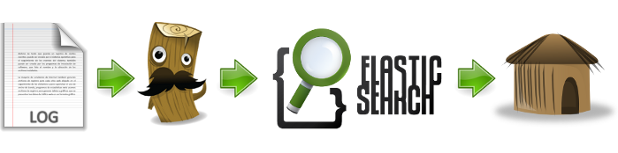
Monitoring
Elasticsearch, Logstash, Kibana (ELK) Stack
Image Source: http://blog.xebia.fr/2013/12/05/logstash-elasticsearch-kibana-s01e00-analyse-de-vos-donnees-en-temps-reel-cloud-ready/
Notes:
Logs get pushed into logstash via a shipper or datasource:
rsyslogd (TCP/UDP)
Lumberjack
RabbitMQ
2. Logstash takes the logs and other time-based information and stores it for processing and transformations. Logstash parses all data sources, based on Grok patterns and outputs a JSON object for each log entry.
Grok patterns are regular expressions for breaking down log entries into their constituent parts.
Elasticsearch is a search and analytics engine.
Queries are based on the Apache Lucene language
Kibana is elasticssearch’s data visualizations engine allowing you to view all your data through custom dashboards.

Slide 24
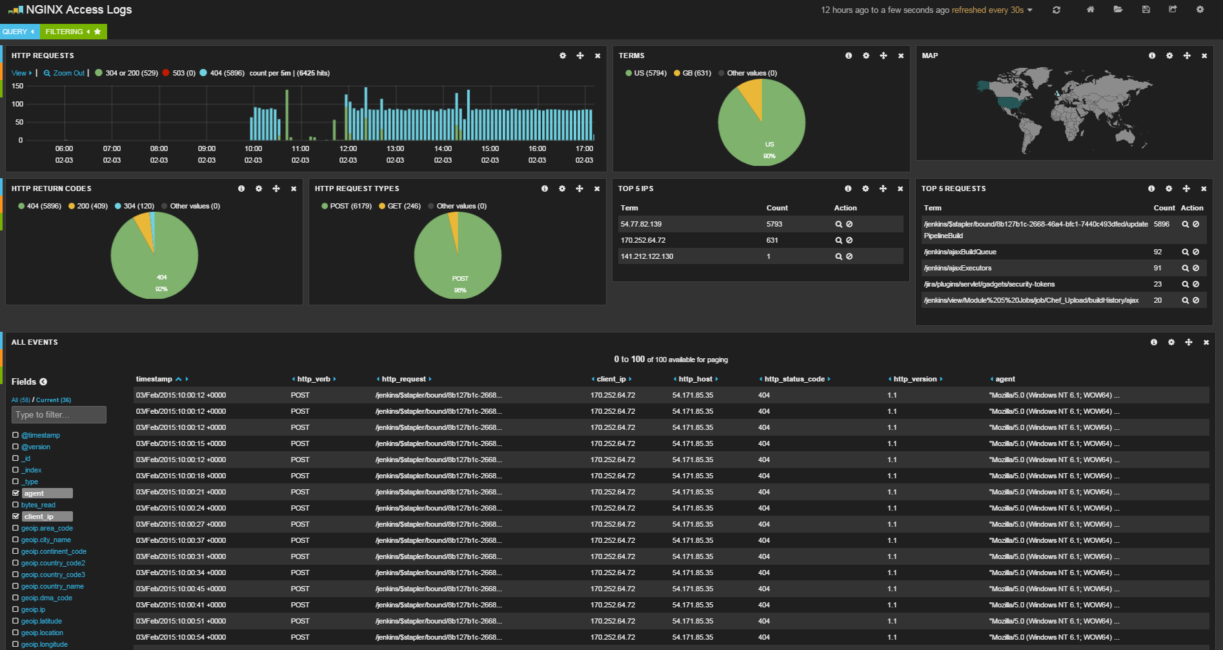
Monitoring
Kibana Visualisation – Example NGINX Access Logs
Source: DevOps Office Model
Notes:
Kibana provides rich interactions and UI elements for visualising data.
We can:
Produce Pie charts, tables, histograms, maps.
Filter through logs based on filters.
Complex search queries based on Apache Lucene language.

Slide 25
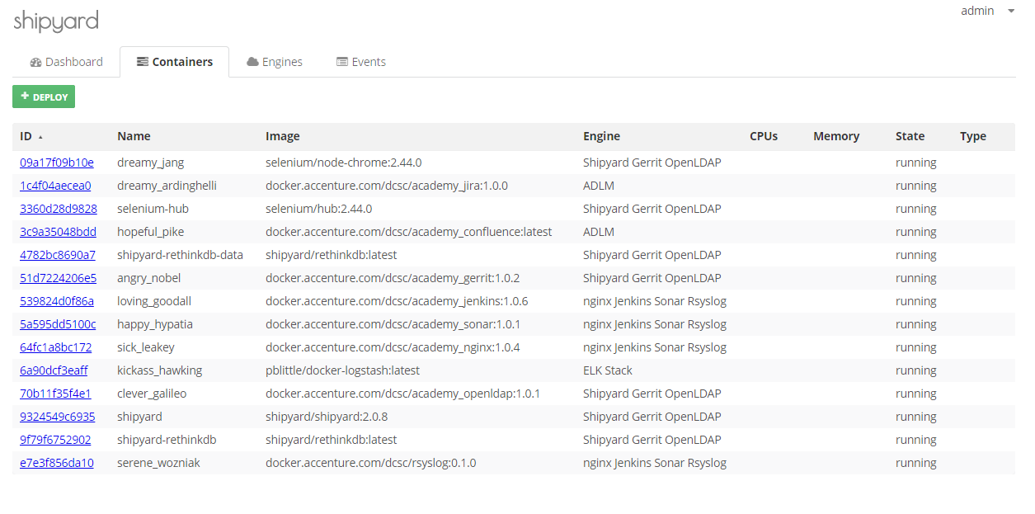
Monitoring
Shipyard – Managing/Monitoring Docker Containers
Source: DevOps Office Model
Notes:
Explain Shipyard.
Manage Docker daemons on separate hosts.
View Container logs
Deploy, Destroy, Scale and restart containers
View running containers
Monitor Container CPU/Memory Usage
Downsides:
Security - Docker daemon needs to be listening on 0.0.0.0:2375 opposed to a local web socket.

Slide 26
What does this mean for people?
Notes:
Some suggestions:
Talk about who does what. This is to powerful for a 3rd party to do for us!

Slide 27
Back Up

Slide 28
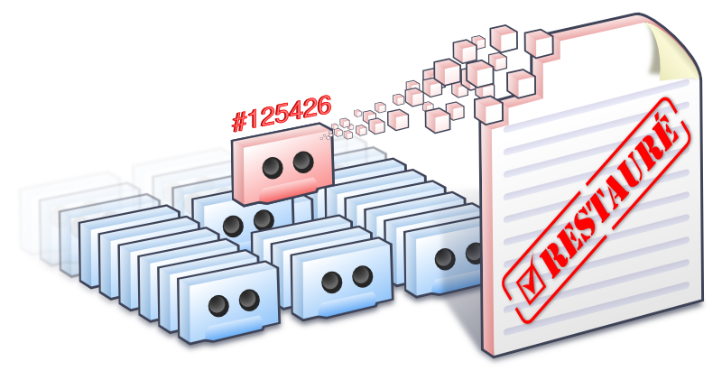
Backup
Backup Strategies
Images:
Take backups of the Machine state as images
Great for spinning up base images to be consistently re-used
Disadvantageous when:
Changes have been made on top of the base image which makes it redundant
Snapshotting an entire disk will capture far more data than is actually needed for a backup
Snapshots do not stop processes that may be writing to the file system (i.e. your database)
File-level restore is very difficult if not impossible with a snapshot
Rebuild from scratch using Configuration Management:
Quick as deployment is automated
Consistent
Can be flexible
What about user/business created data?

Slide 29
Backup
Backup Strategies in the Cloud
Backup and Recovery of Configuration Files
Code Repository
Customers use a variety of version management approaches for configuration files
Store different versions of configuration files in designated locations and securely control them like any other code
Back up these code repositories using the appropriate backup cycle (e.g., daily, weekly, monthly) and snapshots to protected locations
Shared storage
Use Amazon S3 to store your configuration files, taking advantage of the durability of the service
In addition to backing up the files to an alternate location on a regular basis.

Slide 30
Backup
Backup Strategies in the Cloud
Protecting Configurations Rather Than Servers
Cloud service enables the backup and recovery of a standard server, such as a web server or application server, so that you can focus on protecting configuration and stateful data—rather than the server itself.
This set of data is much smaller than the aggregate set of server data, which typically includes various application files, operating system files, temporary files, and so on.
This change of approach means that regular nightly incremental or weekly full backups can take far less time and consume less storage space.

Slide 31
Let’s talk about the lab

Slide 32
Introduction to Lab
Monitoring in the Cloud
Go here: https://alm.accenture.com/wiki/display/DOT/Module+8%3A+Introduction
Duration: ~30 minutes

Slide 33
Do the lab!

Slide 34
Delete your stuff in Amazon!

Slide 35
Summary
Key Points
Key Operations in the cloud
Security
Patching
High Availability
Anti-fragile
Plan to fail
chaos monkey
What we need to monitor
Different tools out there for Monitoring
Applying Monitoring tools to DevOps
Backup strategies within DevOps
Backup strategies in the Cloud
Implementing Backup and Monitoring solutions

Slide 36
Observation and Discussion
Discussion

Slide 37

Questions

Slide 38
References
Useful References
Patch Management Automation for Enterprise Cloud, Hai Huang, Salman Baset, Chunqiang Tang (IBM TJ Watson Research Center) http://www1.cs.columbia.edu/~salman/publications/patch-noms-2012.pdf
http://aws.amazon.com/security/
http://media.amazonwebservices.com/AWS_Security_Best_Practices.pdf
http://media.amazonwebservices.com/pdf/AWS_Security_Whitepaper.pdf
http://techblog.netflix.com/2011/07/netflix-simian-army.html
http://www.slideshare.net/rightscale/rightscale-webinar-high-availability-in-the-cloud-architectural-best-practices
http://www.slideshare.net/superdupersheep/stop-using-nagios-so-it-can-die-peacefully
http://media.amazonwebservices.com/AWS_Backup_Recovery.pdf

