Slide 1
Closing

Slide 2
What’s next?
Some options
Case Studies https://go.accenture.com/devopscasestudies
Certification https://go.accenture.com/devopscertification
Offering Public page http://accenture.com/devops
Hackathon video https://www.youtube.com/watch?v=c01BaogQCxA
Notes:
Mention these things that can be done

Slide 3


Everything is all about this
Value Stream
Idea
Value
Notes:
But most importantly it about doing things different and fighting the cause

Slide 4
This is the way
Value Released
Value Stream
Rapid Feedback
Idea
Value
Time

Slide 5

This is this…
Rapid Feedback
Value Released
Rapid Feedback
Rapid Feedback
Time

Slide 6
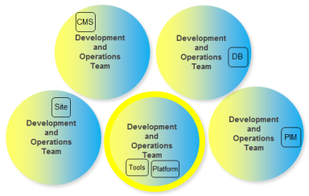
Everything is all about this
This could be the future

Slide 7
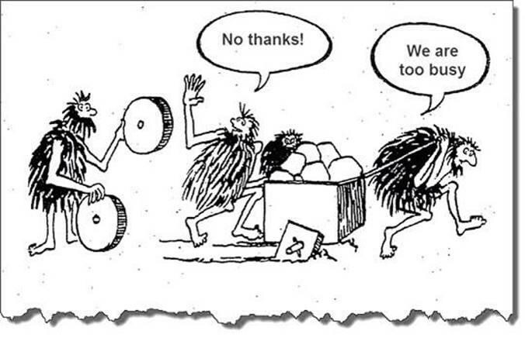
Notes:
Go back to your day jobs, is it going to be like this?

Slide 8
Go Back and Preach
What are the biggest
“leap of faith” assumptions (about value)
on your account
and how could you test them (ASAP)?
Notes:
So if you are going to go back to your clients and take just one thing from this talk (to preach about)

Slide 9
Go Back and Preach – other ideas
Who does what and why – can hand-offs be reduced to optimise more widely and improve throughput
Who do we ideally want to trust more and how can we do that – can the development organisation be accountable for quality?
How fast do developers get feedback – could Continuous Integration or Continuous Delivery be trialled (with a Hypothesis of course)?
Is there an opportunity to create a new “field” – could you start small with a new product in the cloud with end to end teams (perhaps using the DevOps Platform)?
Yammer about what you are doing and work with us (crowdsource)
Show people : https://mediaexchange.accenture.com/media/t/1_kz34icui
Notes:
If you fancy trying a number of things, try these.

Slide 10

Fearless change
https://vimeo.com/channels/pipelineconf/123616200
Notes:
If it seems hard, there is help out there

