Slide 1
True Intent Studies
Arjun Upadhyay

Slide 2
True Intent Study
A type of “online user experience assessment” for website
Measures users’ initial intent, brand affinity, shows behavior, site usage, measures “success”
First case study published at UPA (Usability Professional Association) 2003 by Jeff Schueler and Scog Kincaid of Usability Sciences Corporation (USC)
Now offered by online user experience consulting firms, including USC and Keynote

Slide 3
True Intent Study vs Usability Testing
Usability testing is oriented more for collecting specific data on the ease of use on particular tasks conducted on your site. A True Intent Study, on the other hand, is aimed at collecting “true” data on participants doing what they came to the site to do.
Usability testing is done to measure website performance (such as task success or abandonment, or time on task) and gather users comments while trying to complete tasks (using think-aloud), true intent studies will help you measure purpose or reasons why visitors come to your site, satisfaction (NPS), and profile.
Usability testing is often used during the design stage, with low or high fidelity prototypes. True intent studies are done once a product is live.
The combination of both studies (usability and true intent) can help you measure the online experience throughout the whole product development life cycle.

Slide 4
Here’s how it works…
Users go to a website on their computer with a pretty clear idea of what they intend to do. They navigate to a site and, once there, they have a goal in mind.
Visitors are invited to participate in a short survey as they arrive to the site’s homepage (or any target page you choose)…
…but before they actually participate and fill out the survey, they are told to continue surfing and do what they came to do as they normally would on the site.
They spend as little or as long as they wish on the site accomplishing their goal. Only when they are done, they can choose to start the questionnaire.

Slide 5
Here’s how it works…
During the survey they are asked a series of questions related to their experience, such as:
What did you come to do?
Can you tell us a bit about yourself? (basic demographic data)
Did you accomplish your goal?
Were you happy with your experience?
How likely are you to recommend the site to others?
How can we make our site better?
These are all important pieces of data that could not be otherwise captured in an observational study.

Slide 6
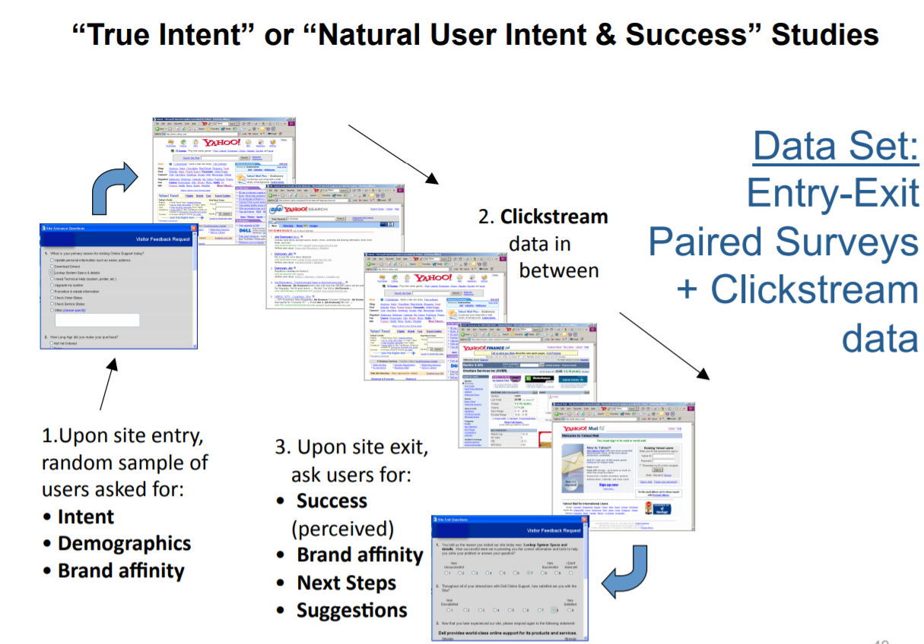

Slide 7
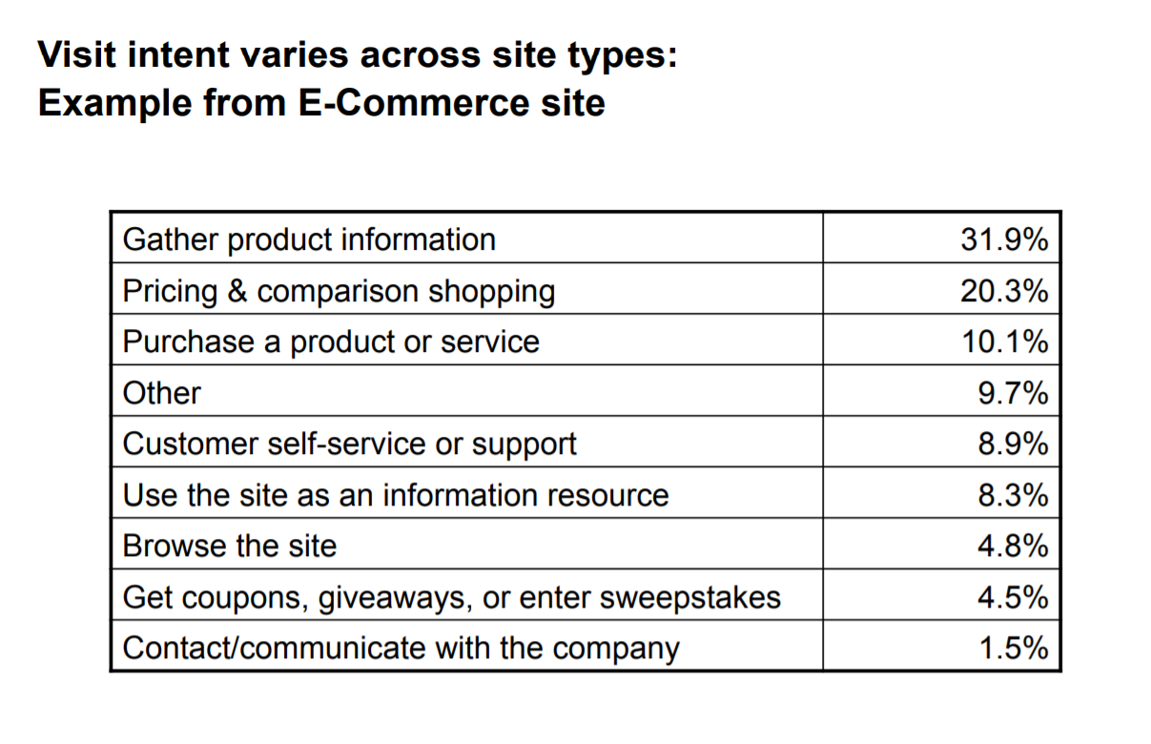

Slide 8
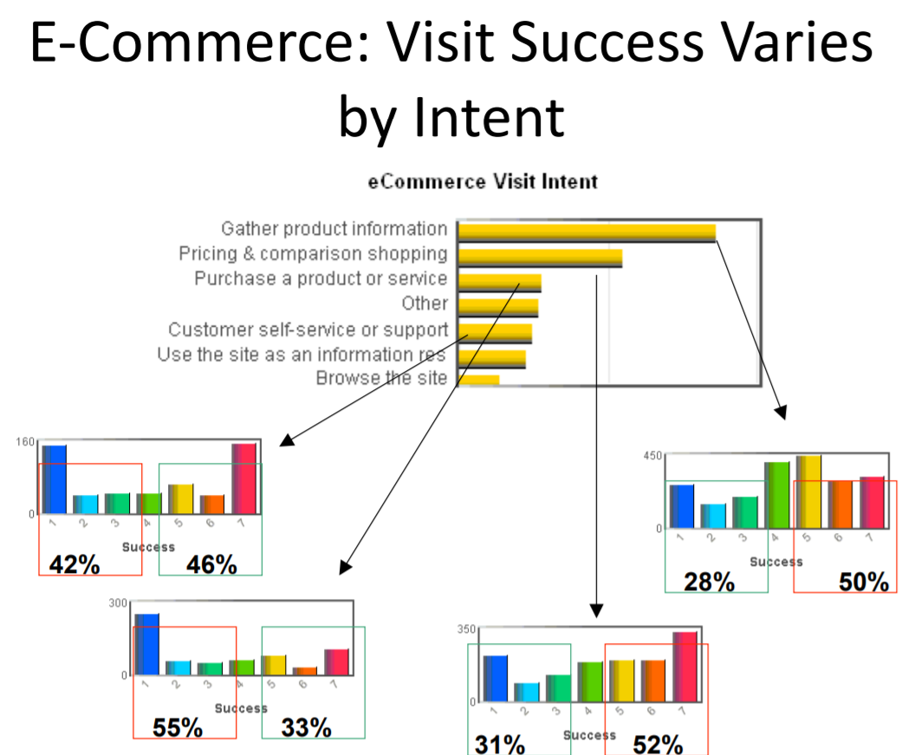

Slide 9
True Intent Studies in Practice
Can be tricky to do well
Sampling should be random
Recruitment difficult because downloads (to capture data) great affect drop-off rates
Larger websites have bigger barriers
Lots of bureaucracy
Security and Code efficiency concerns
High traffic can bring down consultant’s site
Need and executive champion or it won’t happen
Great when ask, “ why do people come to the site? ”

