Slide 1
Enterprise Data Architecture & Reconciliation Data Analytics Internship Project
Submitted by:
Meenal Upadhyay

Slide 2
Project Problem Statement
A FinTech organization stores its business data across multiple disconnected systems, making it difficult to generate accurate financial reports and audit-ready insights.
Challenges
User records contain multiple historical entries, making it difficult to identify currently active users.
Transaction data is stored as unstructured server logs that require extraction and cleaning.
Daily exchange rate data contains missing values for weekends.
Data from different sources must be integrated into a single, reliable dataset.
Business stakeholders require an interactive dashboard to monitor revenue trends and customer performance.
Project Objective
To build an automated data analytics pipeline that extracts, cleans, reconciles, and integrates data from multiple sources, then creates an interactive Power BI dashboard for financial analysis and decision-making.

Slide 3
Project Solution
To solve the business problem, an end-to-end data analytics pipeline was developed using Python and Power BI. The solution involved extracting, cleaning, transforming, merging, and visualizing data from multiple sources.
Project Workflow
Phase 1: SQL Extraction
Connected to the SQLite database.
Retrieved the latest records for each user.
Filtered only active users using SQL queries.
Phase 2: Data Cleaning & Regex Extraction
Loaded server log data.
Removed invalid (ERROR) records.
Extracted Date, User ID, Product ID, and Euro Value using Regular Expressions.

Slide 4
Phase 3: Financial Reconciliation
Loaded daily exchange rate data.
Filled missing weekend exchange rates using forward fill.
Merged all datasets.
Calculated USD Revenue from Euro values.
Phase 4: Dashboard Creation
Exported the final cleaned dataset.
Built an interactive Power BI dashboard to visualize financial performance and customer insights.

Slide 5
Tools & Technologies Used
Tool | Purpose
Python | Data extraction, transformation, and automation
Pandas | Data cleaning, manipulation, and merging
SQLite | Extracting active user data using SQL queries
Regular Expressions (Regex) | Parsing unstructured server log data
Matplotlib | Data visualization during analysis
Power BI | Interactive dashboard creation and business reporting

Slide 6
Key Techniques Applied
SQL Queries for Data Extraction
Regular Expressions (Regex)
Data Cleaning & Preprocessing
Data Integration & Merging
Missing Value Handling (Forward Fill)
Revenue Calculation
Interactive Dashboard Design

Slide 7
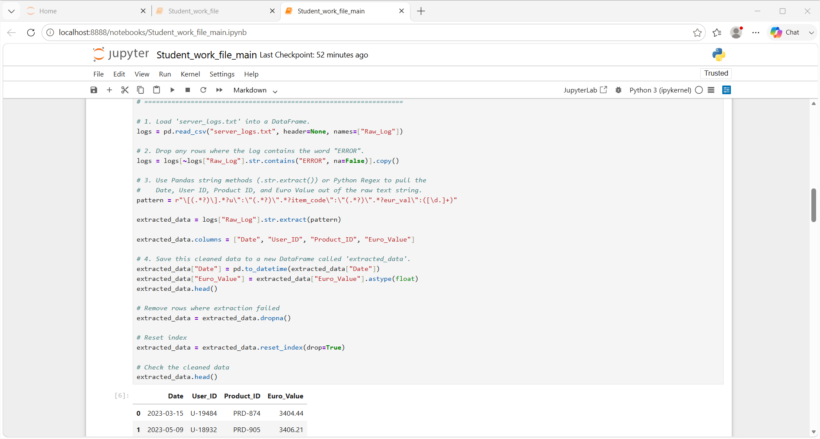
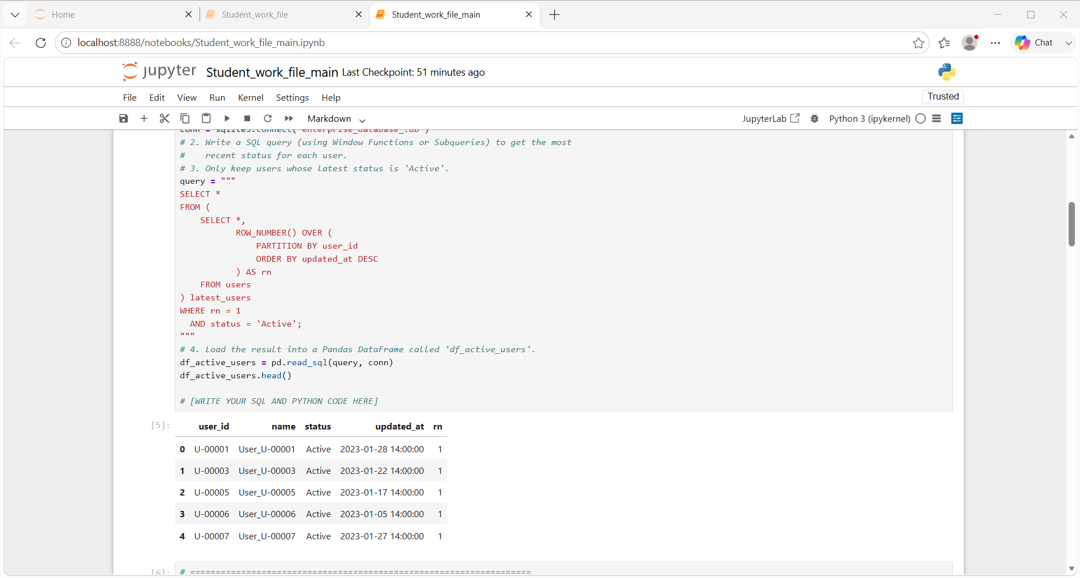
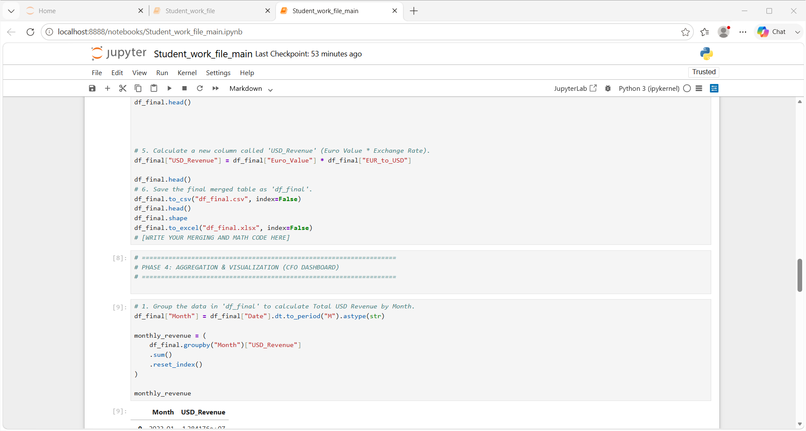
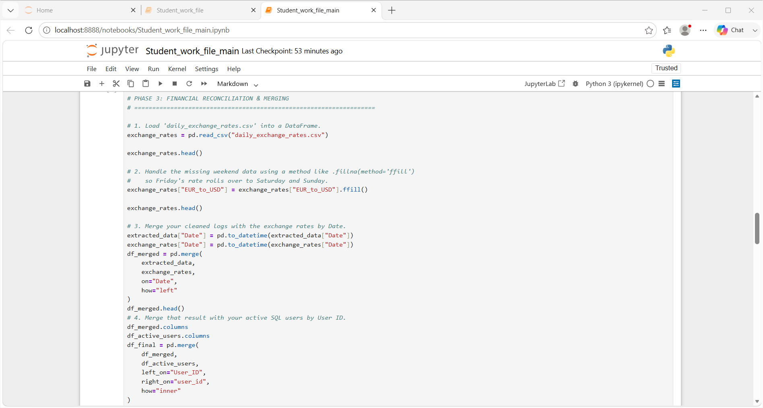
Project Dashboard & Results
Jupyter Notebook

Slide 8
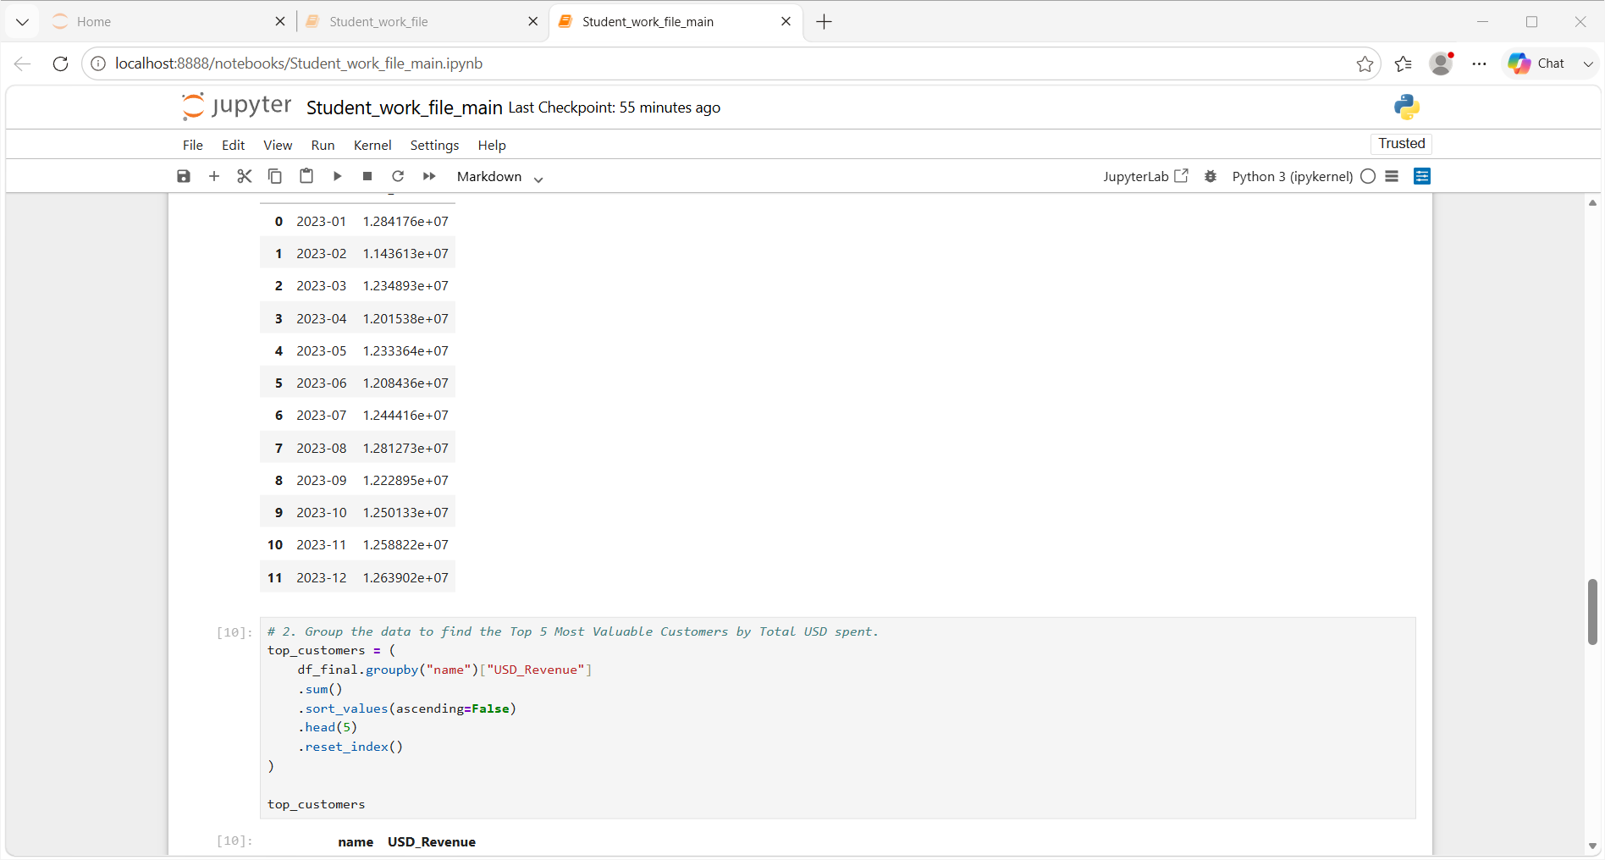
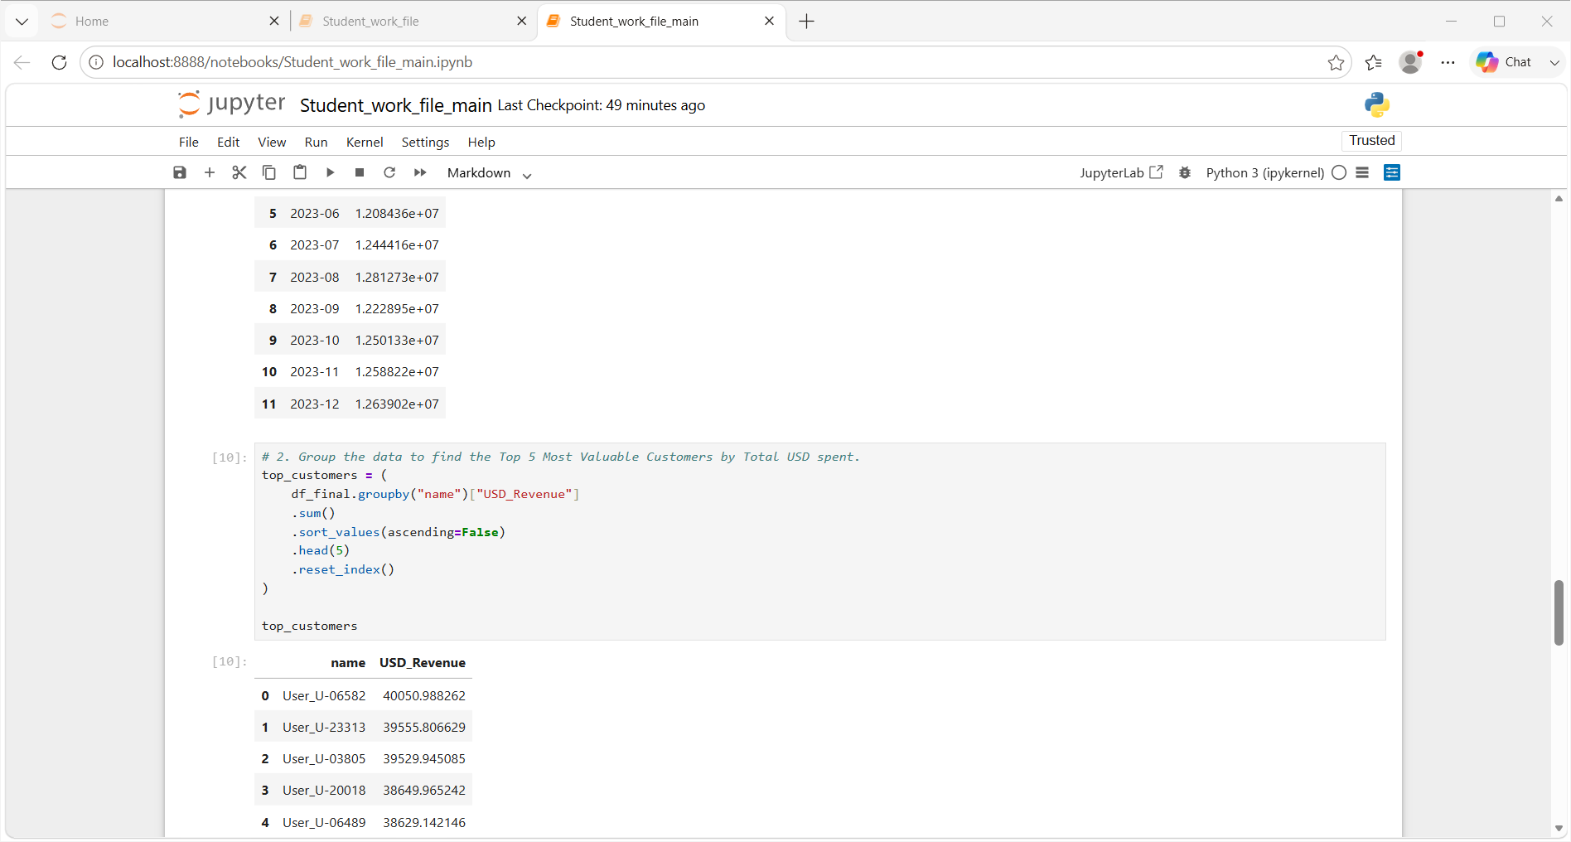
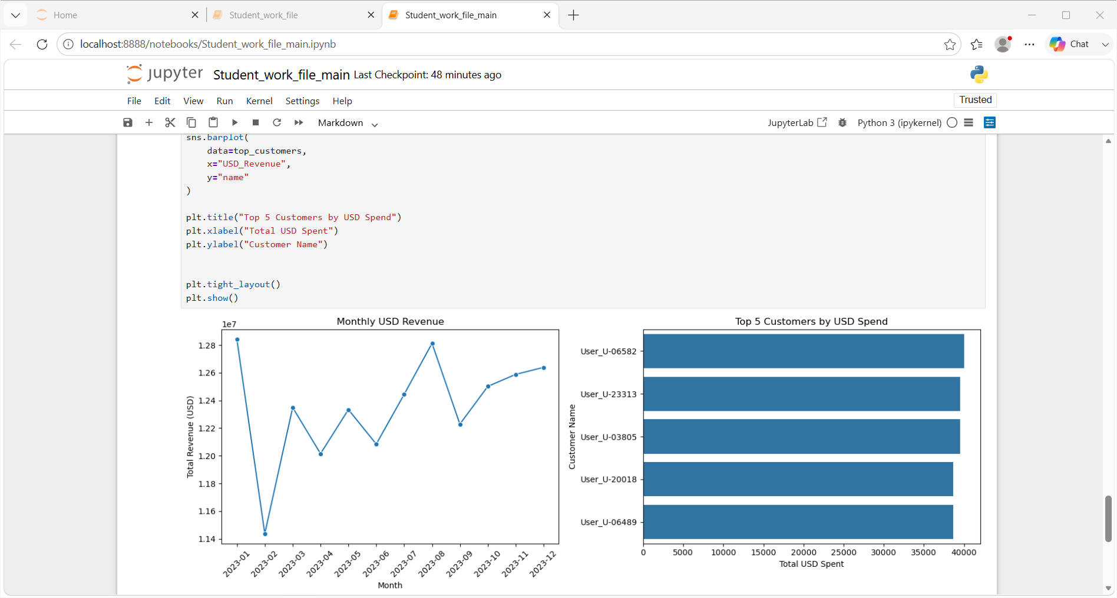
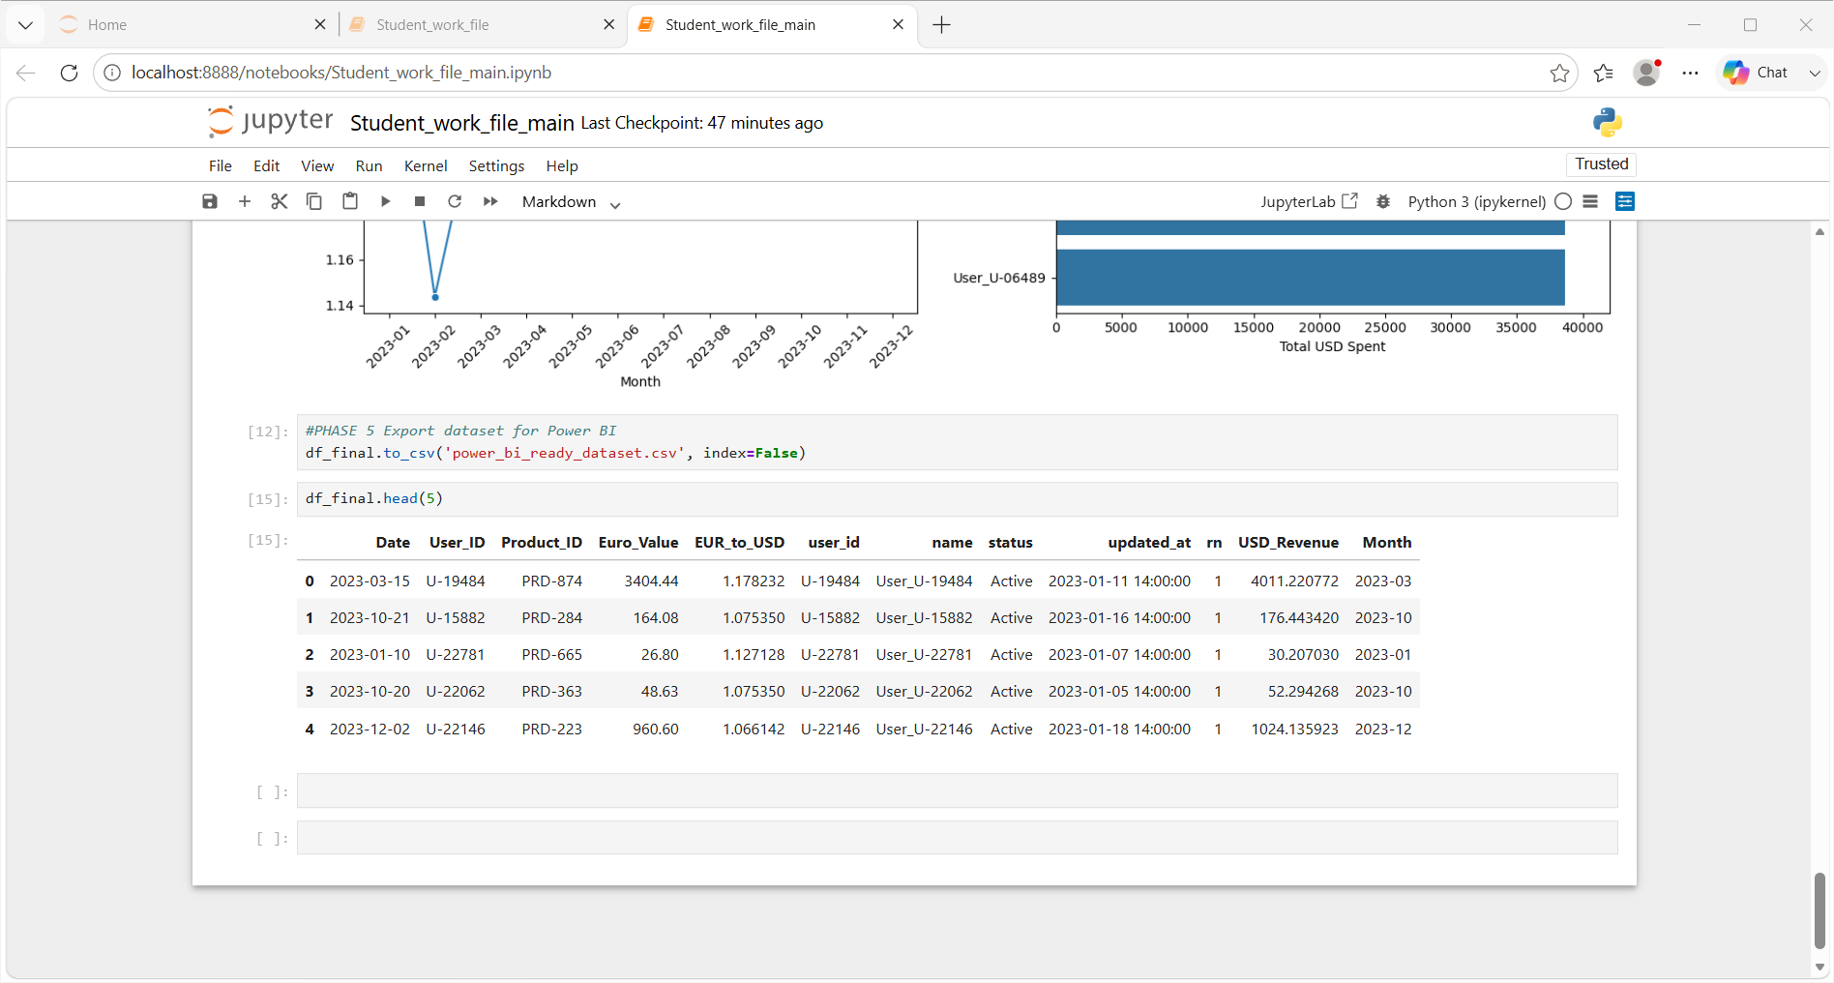

Slide 9
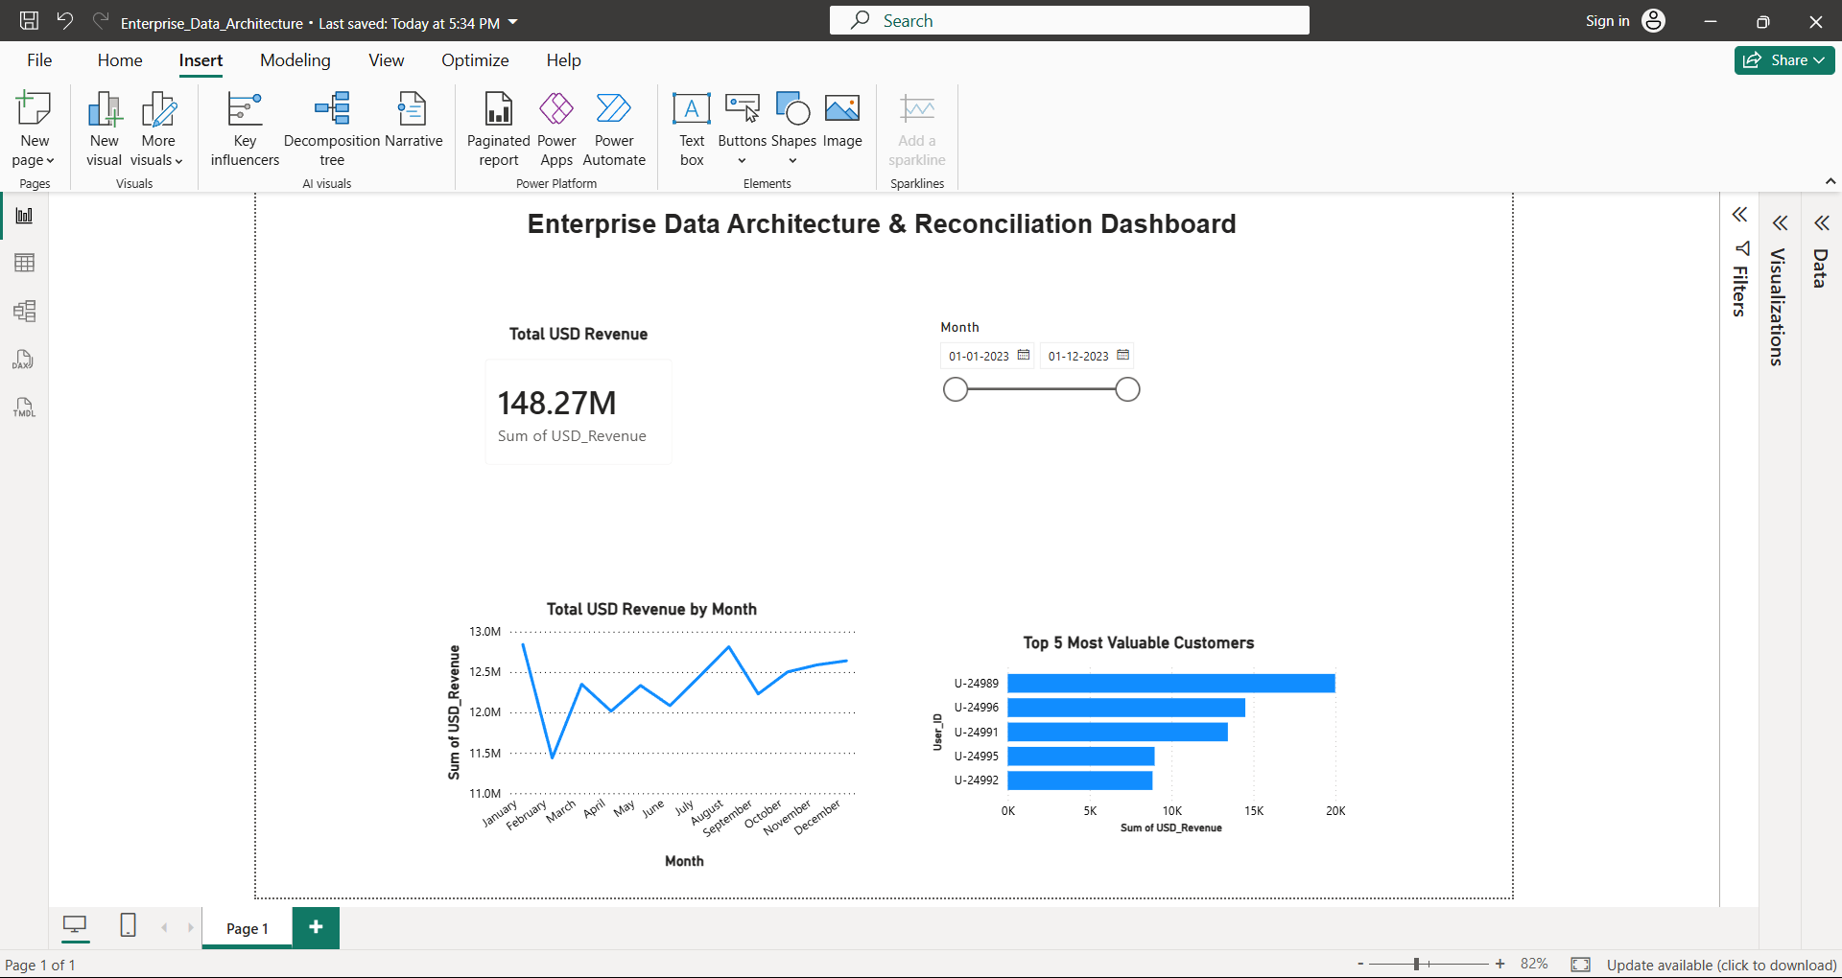
Power BI Dashboard

Slide 10
Project Report
This project focused on integrating and analyzing financial data from multiple enterprise data sources. The workflow involved extracting active user records from a SQL database, processing unstructured server logs using Regular Expressions (Regex), handling missing exchange rate values, and merging all datasets into a single, analysis-ready dataset. The final dataset was then used to build an interactive Power BI dashboard that provides meaningful financial insights for decision-making.
Key Results
Successfully extracted the latest active user records from the SQL database.
Processed and cleaned server log data using Regex.
Handled missing weekend exchange rates using forward fill.
Merged multiple datasets into a unified dataset.
Calculated USD Revenue from Euro transaction values.
Built an interactive Power BI dashboard to visualize:
Total USD Revenue
Monthly Revenue Trend
Top 5 Most Valuable Customers

Slide 11
Conclusion
This project successfully demonstrated the complete data analytics workflow, from data extraction and cleaning to financial reconciliation and dashboard creation. By integrating data from multiple enterprise sources, the project produced an accurate and analysis-ready dataset. The interactive Power BI dashboard enables users to monitor revenue trends, identify top customers, and support data-driven business decisions.
Key Learning Outcomes
SQL Data Extraction
Data Cleaning & Preprocessing
Regular Expressions (Regex)
Data Integration & Merging
Financial Data Analysis
Power BI Dashboard Development
Data Visualization & Business Reporting

