Slide 1

WORKFORCE ATTRITION INTELLIGENCE : HR Analytics Dashboard
Optimizing Employee Satisfaction, Retention, and Recruitment Efficiency
Prepared By : Sakshi Upadhyay

Slide 2
Table of Contents
Business Problem & Objective
Dataset Understanding
Tools & Tech Stack
Step-by-Step Methodology
KPI Summary
Individual Insight Narratives
Final Recommendation Strategy
Conclusion
Future Scope
APPENDIX 1 – Power BI Visual Snapshots
APPENDIX 2 – SQL Queries & Outputs

Slide 3
🧾 Business Problem & Objective
Business Problem :
High attrition in Sales & Operations affecting productivity and revenue
Delayed recruitment process increasing vacancy duration
Limited visibility into employee satisfaction and retention
Identify top attrition drivers + quantify financial impact
Objective :
Analyze employee attrition trends and satisfaction scores
Identify high-risk employees & departments
Provide actionable insights to improve retention and recruitment efficiency
turn HR data into financially meaningful retention strategy.

Slide 4
Dataset Overview/ Understanding
Dataset Overview :
Total Employees: 1470
Attrition Count: 237 → 16.12% attrition rate
Average Monthly Income: ₹6.5K
Avg replacement cost per employee ≈ ₹28.7K
Dataset Understanding :
Demographics (Age, Marital Status, Gender, Education)
Job Info (Job Role, Department, Salary Band, OverTime status)
Experience (YearsAtCompany, YearsInCurrentRole, YearsSinceLastPromotion)
Satisfaction Levels (Environment, Relationship, Work-Life Balance)

Slide 5
Tools & Tech Stack
Stage | Tool Used | Why
Cleaning | Excel | Remove noise, unwanted rows, ensure schema consistency
KPI + Aggregation | MySQL (SQL Queries) | Business slicing, grouping, root-driver numeric validation
Visualization + Storytelling | Power BI | Interactive visuals, DAX KPIs, business story alignment

Slide 6
🔄 Step-by-Step Methodology
Imported raw HR dataset into Excel → cleaned formatting + removed
unnecessary records
Loaded prepared data into MySQL → derived role-wise KPI, salary bands
& segmentation using SQL
Built Power BI model → measures (DAX) → designed dashboard in multiple
pages with impact visuals
Applied business interpretation lens → converted patterns into retention strategy

Slide 7
KPI Summary
📊
Metric | Value | Meaning
Attrition Rate | 16.12% | Workforce leakage health measure
Attrition Count | 237 employees | Represents actual exit volume
Average Monthly Income | ₹6,500 | Salary dissatisfaction risk indicator
Total Employees | 1470 | Total no. of Employees in the dataset
Attrition Cost | ₹ 6.81 M | Estimated annual replacement loss due to employee exits. Reducing attrition by 10% saves ~₹681k yearly.

Slide 8
Individual Insight Narratives
Job Role Impact -
Sales Representatives show 39.76% attrition — the highest in the entire workforce.
This means almost 4 out of every 10 Sales hires exit — a massive productivity leakage role.
Tenure Pattern -
Attrition is front-loaded: 36.36% exit <1 year, 34.50% at 1 year.
This means the problem is not employee loyalty — it is employee onboarding failure.
Salary Sensitivity -
Attrition in Low Salary Band (<₹5K) = 21.76% — nearly double of high salary band (8.9%).
Money dissatisfaction → direct churn driver.
Demographics -
Under 25 years = 39.18% attrition → this age group lacks stability and guidance.
Distance 15–20 KM group attrition = 25.64% → commute friction is real.
Department Focus -
R&D = 56.12% attrition → the most expensive loss because this is specialized talent.

Slide 9
💡Final Recommendation Strategy
Driver | Strategic Action
Salary Band Leakage | Targeted 8–12% uplift for low band roles
Sales Role Drain | Role-Specific Development, Commission Structure Review
Early Tenure Drop | Structured onboarding + mentoring program for 0–1 year
High Overtime Churn | Reduce workload + shift balancing
R&D Talent Loss | Retention premium + cross project mobility

Slide 10
✔️ Conclusion
This analysis proves that employee attrition is not random — it is pattern driven, financially significant and behaviorally explainable. By identifying high-risk segments such as Sales roles (39.76%), low salary bands (21.76%), early tenure exits (36.36% < 1 year), and age under 25 (39.18%), the company can act precisely instead of reacting broadly. Retention, when driven by data, becomes a targeted investment — not a cost center. If the organization only focuses on these top priority segments and optimizes compensation, onboarding experience, commute friction and workload balancing, it can reduce attrition by at least 8-12% — unlocking ₹6.8M+ annual savings, strengthening capability continuity, and accelerating sustainable workforce stability.

Slide 11
Future Scope
This project can be extended to build a predictive model that can identify which employees are most likely to leave next based on patterns like salary, distance, age, role, tenure, etc.
HR can use these insights to create personalized retention programs for high-risk groups instead of one-size-fits-all HR policies.
Scenario simulation can be added (example: “What if we increase salary by 8% for low band?”) to measure how much attrition can drop before implementing changes in real world.

Slide 12
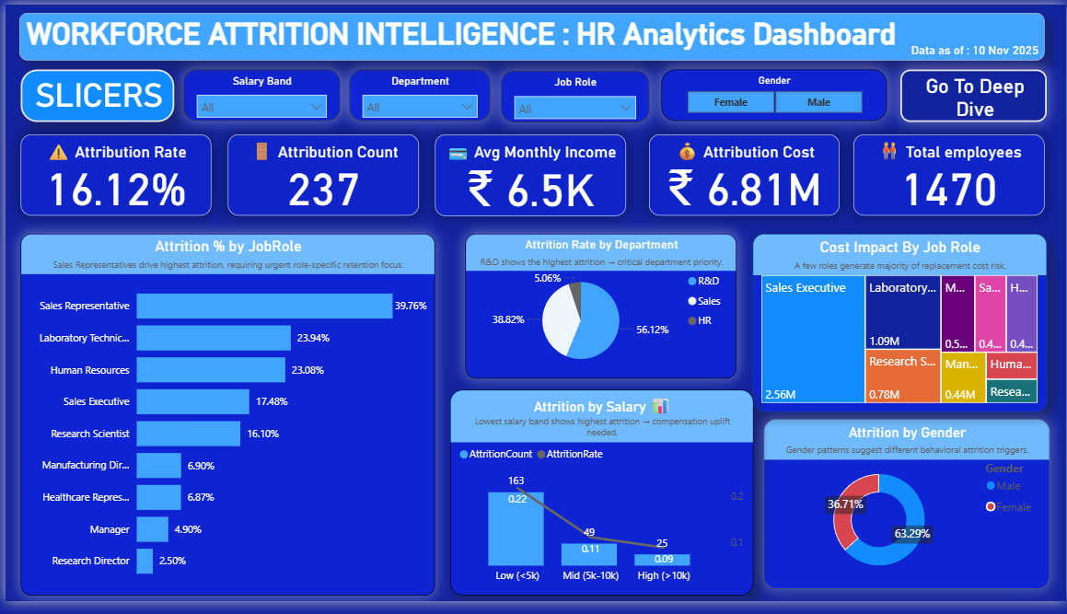
APPENDIX 1 – Power BI Visual Snapshots : (page 1)

Slide 13
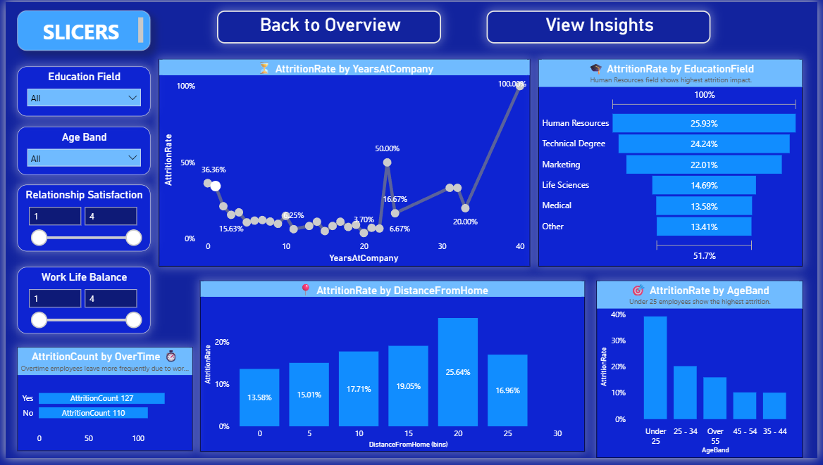
Page 2

Slide 14
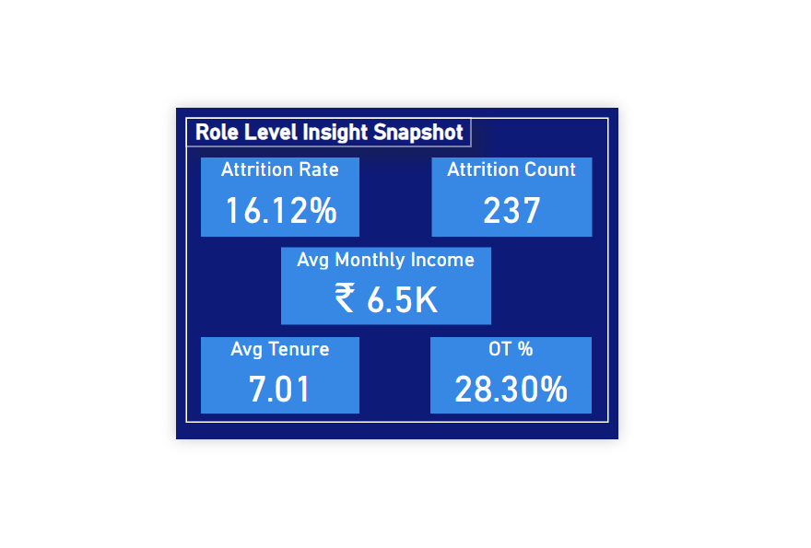
Tooltip

Slide 15
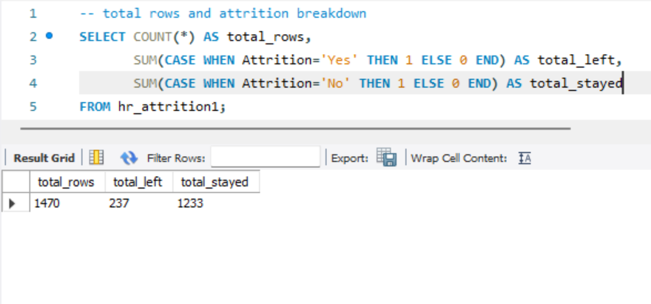
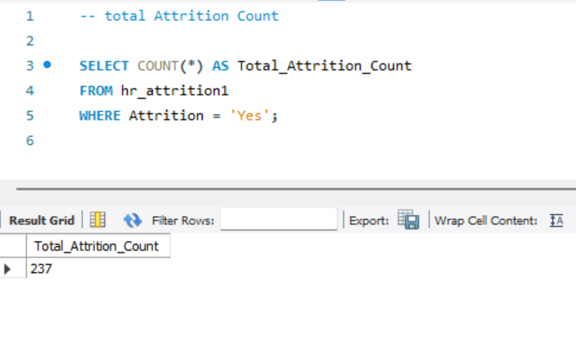
APPENDIX 2 – SQL Queries & Outputs
Attrition Breakdown
Total Attrition Count

Slide 16
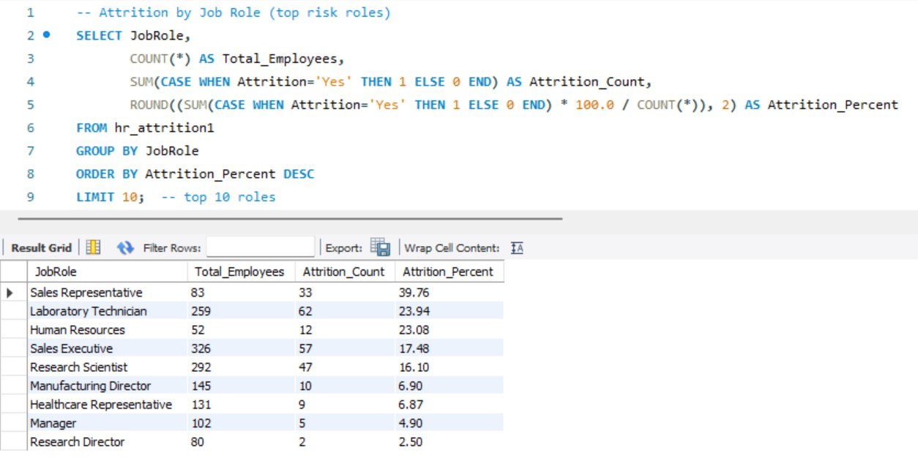
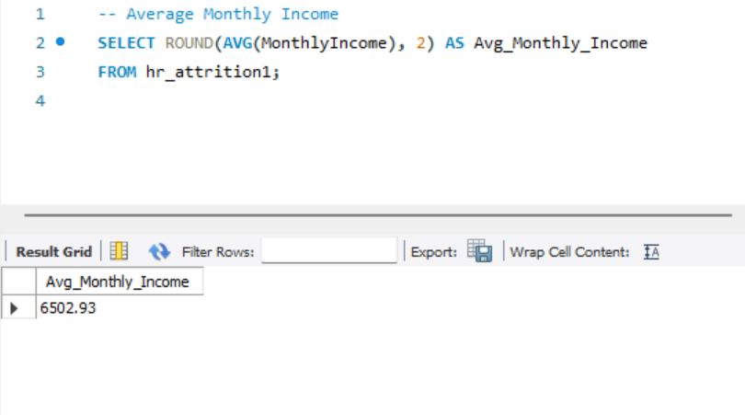
Attrition By Job Role(top 10)
Average Monthly Income

Slide 17
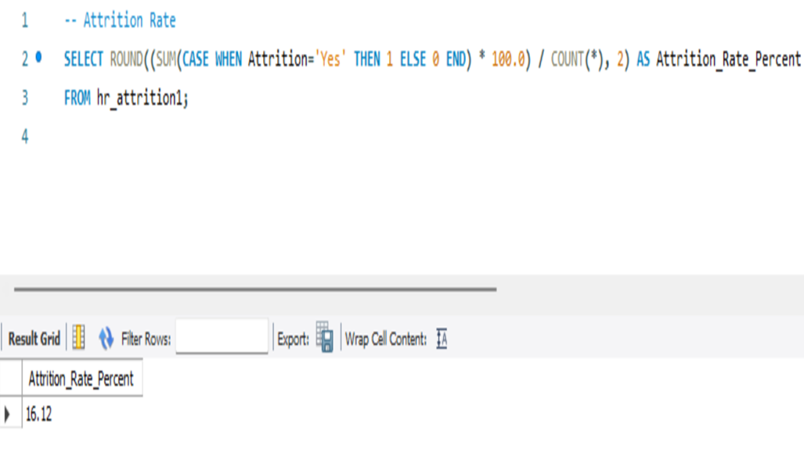
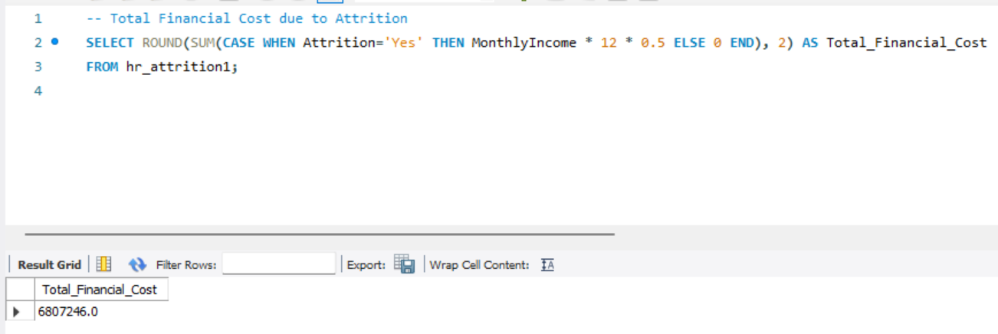
Attrition Rate
Attrition Cost

Slide 18
Contact & Portfolio
❑ mail ID : upadhyaysakshi93@gmail.com
❑ LinkedIn: https://www.linkedin.com/in/sakshiupadhyayofficial/
❑ GitHub : https://github.com/upadhyaysakshi93-jpg

