Slide 1
CS 332: Algorithms
Dynamic Programming
Greedy Algorithms

Slide 2
Administrivia
Hand back midterm
Go over problem values

Slide 3
Review: Amortized Analysis
To illustrate amortized analysis we examined dynamic tables
  1. Init table size m = 1
  2. Insert elements until number n > m
  3. Generate new table of size 2m
  4. Reinsert old elements into new table
  5. (back to step 2)
What is the worst-case cost of an insert?
What is the amortized cost of an insert?

Slide 4
Review:
Analysis Of Dynamic Tables
Let c_{i} = cost of ith insert
c_{i} = i if i-1 is exact power of 2, 1 otherwise
Example:
  Operation Table Size Cost
1
2
3
4
5
6
7
Insert(1)
1
1
1
8
Insert(2)
2
1 + 1
2
9
Insert(3)
4
1 + 2
Insert(4)
4
1
Insert(5)
8
1 + 4
Insert(6)
8
1
Insert(7)
8
1
Insert(8)
8
1
Insert(9)
16
1 + 8

Slide 5
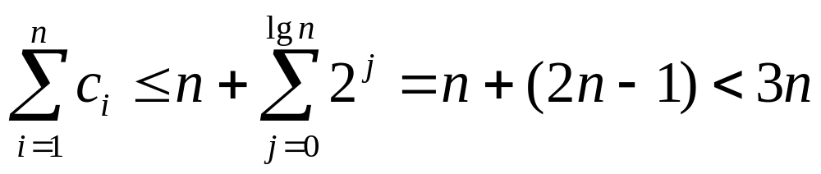
Review: Aggregate Analysis
n Insert() operations cost
Average cost of operation
= (total cost)/(# operations) < 3
Asymptotically, then, a dynamic table costs the same as a fixed-size table
  Both O(1) per Insert operation

Slide 6
Review: Accounting Analysis
Charge each operation $3 amortized cost
  Use $1 to perform immediate Insert()
  Store $2
When table doubles
  $1 reinserts old item, $1 reinserts another old item
  We’ve paid these costs up front with the last n/2 Insert()s
Upshot: O(1) amortized cost per operation

Slide 7
Review: Accounting Analysis
Suppose must support insert & delete, table should contract as well as expand
  Table overflows ⇒ double it (as before)
  Table < 1/4 full ⇒ halve it
  Charge $3 for Insert (as before)
  Charge $2 for Delete
    Store extra $1 in emptied slot
    Use later to pay to copy remaining items to new table when shrinking table
What if we halve size when table < 1/8 full?

Slide 8
Review:
Longest Common Subsequence
Longest common subsequence (LCS) problem:
  Given two sequences x[1..m] and y[1..n], find the longest subsequence which occurs in both
  Ex: x = {A B C B D A B }, y = {B D C A B A}
  {B C} and {A A} are both subsequences of both
    What is the LCS?
  Brute-force algorithm: For every subsequence of x, check if it’s a subsequence of y
    What will be the running time of the brute-force alg?

Slide 9
LCS Algorithm
Brute-force algorithm: 2^{m} subsequences of x to check against n elements of y: O(n 2^{m})
But LCS problem has optimal substructure
  Subproblems: pairs of prefixes of x and y
Simplify: just worry about LCS length for now
  Define c[i,j] = length of LCS of x[1..i], y[1..j]
  So c[m,n] = length of LCS of x and y

Slide 10
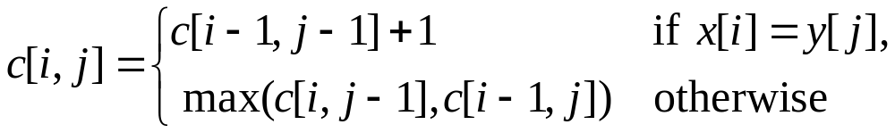
Finding LCS Length
Define c[i,j] = length of LCS of x[1..i], y[1..j]
Theorem:
What is this really saying?

Slide 11
Optimal Substructure of LCS
Observation 1: Optimal substructure
  A simple recursive algorithm will suffice
  Draw sample recursion tree from c[3,4]
  What will be the depth of the tree?
Observation 2: Overlapping subproblems
  Find some places where we solve the same subproblem more than once

Slide 12
Structure of Subproblems
For the LCS problem:
  There are few subproblems in total
  And many recurring instances of each
    (unlike divide & conquer, where subproblems unique)
How many distinct problems exist for the LCS of x[1..m] and y[1..n]?
A: mn

Slide 13
Memoization
Memoization is one way to deal with overlapping subproblems
  After computing the solution to a subproblem, store in a table
  Subsequent calls just do a table lookup
Can modify recursive alg to use memoziation:
  There are mn subproblems
  How many times is each subproblem wanted?
  What will be the running time for this algorithm? The running space?

Slide 14
Dynamic Programming
Dynamic programming: build table bottom-up
  Same table as memoization, but instead of starting at (m,n) and recursing down, start at (1,1)
  Draw LCS-length table for i=0..7, j=0..6:
    X (vert) = {A B C B D A B}, Y (horiz) = {B D C A B A}
    Initialize top row/left column to 0, march across rows
    What values does a given cell depend on?
  What is the final length of the LCS? the LCS itself?
  What is the running time? space?
Can actually reduce space to O(min(m,n))

Slide 15
Dynamic Programming
Summary of the basic idea:
  Optimal substructure: optimal solution to problem consists of optimal solutions to subproblems
  Overlapping subproblems: few subproblems in total, many recurring instances of each
  Solve bottom-up, building a table of solved subproblems that are used to solve larger ones
Variations:
  “Table” could be 3-dimensional, triangular, a tree, etc.

Slide 16
Greedy Algorithms
A greedy algorithm always makes the choice that looks best at the moment
  The hope: a locally optimal choice will lead to a globally optimal solution
  For some problems, it works
  My example: walking to the Corner
Dynamic programming can be overkill; greedy algorithms tend to be easier to code

Slide 17
Activity-Selection Problem
Problem: get your money’s worth out of a carnival
  Buy a wristband that lets you onto any ride
  Lots of rides, each starting and ending at different times
  Your goal: ride as many rides as possible
    Another, alternative goal that we don’t solve here: maximize time spent on rides
Welcome to the activity selection problem

Slide 18
Activity-Selection
Formally:
  Given a set S of n activities
  s_{i} = start time of activity i
  f_{i} = finish time of activity i
  Find max-size subset A of compatible activities
3
4
6
2
1
5
  Assume (wlog) that f₁ ≤ f₂ ≤ … ≤ f_{n}

Slide 19
Activity Selection:
Optimal Substructure
Let k be the minimum activity in A (i.e., the one with the earliest finish time). Then A - {k} is an optimal solution to S’ = {i ∈ S: s_{i} ≥ f_{k}}
  In words: once activity #1 is selected, the problem reduces to finding an optimal solution for activity-selection over activities in S compatible with #1
  Proof: if we could find optimal solution B’ to S’ with |B| > |A - {k}|,
    Then B  {k} is compatible
    And |B  {k}| > |A|

Slide 20
Activity Selection:
Repeated Subproblems
Consider a recursive algorithm that tries all possible compatible subsets to find a maximal set, and notice repeated subproblems:
S
1∈A?
yes
no
S’
2∈A?
S-{1}
2∈A?
yes
no
yes
no
S’’
S’-{2}
S’’
S-{1,2}

Slide 21
Greedy Choice Property
Dynamic programming? Memoize? Yes, but…
Activity selection problem also exhibits the greedy choice property:
  Locally optimal choice ⇒ globally optimal sol’n
  Them 17.1: if S is an activity selection problem sorted by finish time, then ∃ optimal solution
  A ⊆ S such that {1} ∈ A
    Sketch of proof: if ∃ optimal solution B that does not contain {1}, can always replace first activity in B with {1} (Why?). Same number of activities, thus optimal.

Slide 22
Activity Selection:
A Greedy Algorithm
So actual algorithm is simple:
  Sort the activities by finish time
  Schedule the first activity
  Then schedule the next activity in sorted list which starts after previous activity finishes
  Repeat until no more activities
Intuition is even more simple:
  Always pick the shortest ride available at the time

Slide 23
The End

