Slide 2

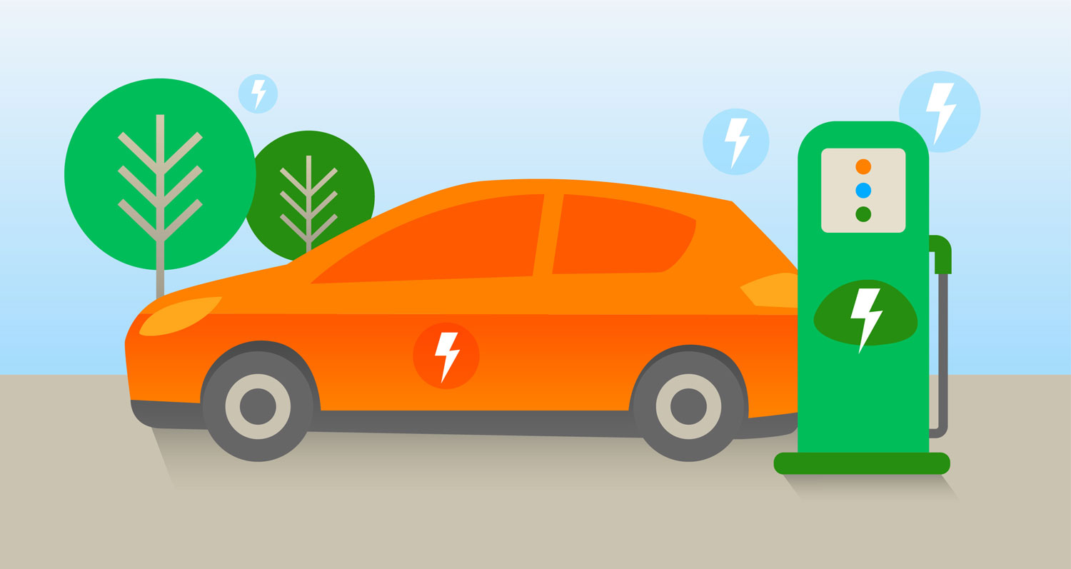
EV – Pulse Analytics
Smart EV Charging Station Performance & Revenue Intelligence
Power BI Project Presentation
Presented by : Upagna N
Institution : upGrad
Batch: PBI Batch-5 Date : 14-August-2026

Slide 3

Problem Statement
Electric Vehicle (EV) charging station operators generate large volumes of data from
charging sessions, station locations, pricing plans, weather conditions, and
calendar-based demand patterns.
However, this data is often stored across multiple sources and is not effectively
utilized for decision-making.
The key business challenges are:
⚡ Identifying peak charging hours and high-demand locations.
🔋 Monitoring station utilization and charger performance.
⏱️ Reducing customer waiting time and congestion.
💰 Understanding the impact of pricing and weather on revenue and
energy consumption.
📊 Providing management with a single, interactive view
of operational performance.

Slide 4
Business Impact :
📈 Improve revenue visibility and pricing decisions
⏳ Reduce waiting time and charging congestion
🔌 Optimize charger and station utilization
📍 Identify high-performing and underperforming locations
📊 Enable faster data-driven management decisions

Slide 5

Innovation ⚡ Unified Analytics Platform – Combined charging sessions, station details, pricing,
weather, and calendar data into a single Power BI model.
📊 Interactive Decision-Making – Designed dynamic dashboards with slicers, filters,
and drill-down analysis for management-friendly exploration.
📍Location Intelligence – Enabled area-wise and station-wise performance
comparison to identify revenue hotspots and underutilized stations.
⏱️ Operational Insight – Analyzed waiting time, session completion, and charger
utilization to improve customer experience and efficiency.
💡 Business-Focused Visualization – Converted raw operational data into actionable
KPIs and visual insights for faster strategic decisions.

Slide 6
Architecture Diagram
Charging
Sessions
Stations
Pricing
Weather
Calendar
Power BI Data Model
Interactive Dashboard

Slide 7
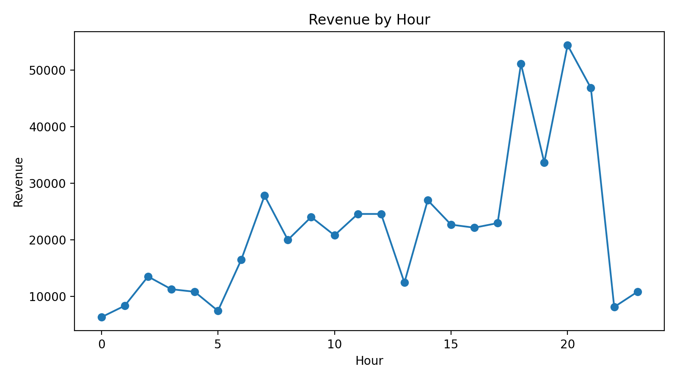
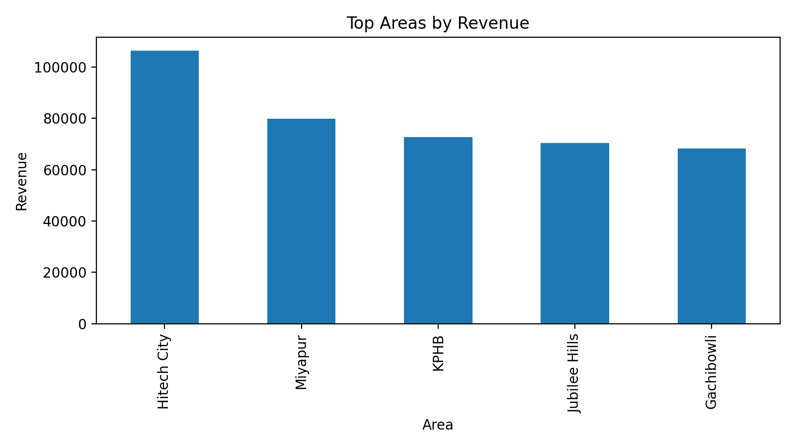
Power BI Dashboard – KPIs
500
Total Sessions
₹528,030
Total Revenue
28,305 kWh
Energy Delivered
10.6 min
Avg Wait Time
85.2%
Completion Rate

Slide 8
Key Insights(green)
📌 Peak revenue: 8 PM
📍 Highest revenue area: Hitech City
🔌 Most profitable charger : DC Fast
📈 Strong and consistent charging demand
⏱️ Congestion increases during peak hours
✅ High session completion rate
🔋 Higher utilization = higher revenue

Slide 9
Recommendations: 🔌 Expand DC Fast Charging
Add DC Fast chargers in Hitech City, Gachibowli, Madhapur to reduce congestion
💰 Dynamic Pricing
Offer off-peak discounts to balance demand and improve utilization
⏱️Reduce Wait Times
Use real-time monitoring and smart queue management during peak hours
📍Improve Operations
Optimize underperforming stations + Implement predictive maintenance
📊 Enable Real-Time Monitoring
Use Power BI dashboard for continuous tracking of revenue and utilization

Slide 10
Conclusion: 📊 Converted raw EV data into actionable insights
⚡ Unified operational and revenue analysis in Power BI
📈 Identified peak demand and high-performing locations
🔌 Highlighted opportunities for infrastructure optimization
⏱️ Enabled real-time KPI monitoring and faster decisions
🚀 Supports scalable and sustainable EV charging growth
💡 EV Pulse Analytics demonstrates that data-driven monitoring and visualization can enhance operational efficiency, improve customer satisfaction, and drive strategic growth in modern EV charging networks.

