Slide 1

Vehicle Loan Digital Marketing
Q4 Proposal
by XXXX

Slide 2
Heading
Story

Slide 3
Heading
Data in depth

Slide 4
Heading
Problem statement

Slide 5
Heading
What did you do?

Slide 6
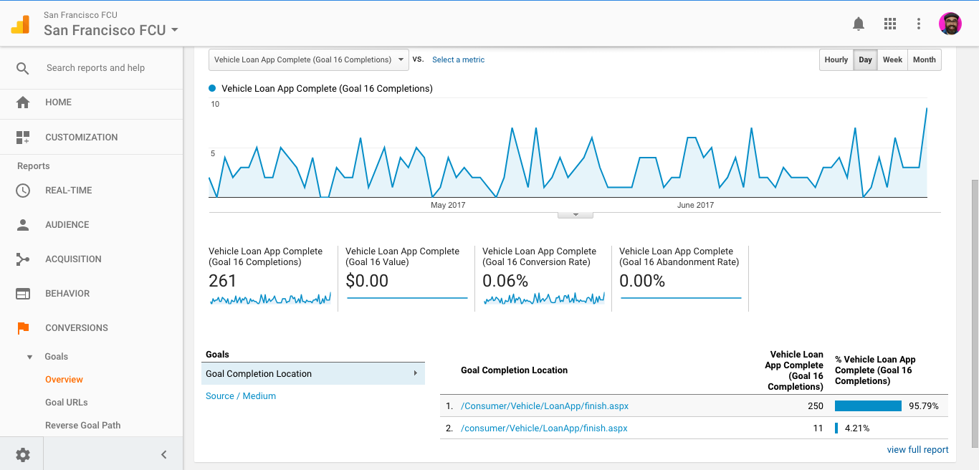
Objectives & Graphs
Tracked in Google Analytics

Slide 7
Objectives & Graphs
Tracked in Google Analytics

Slide 8
Objectives & Graphs
Tracked in Google Analytics

Slide 9
Objectives & Graphs
Tracked in Google Analytics

Slide 10
Conclusion
What did you achieve or learn from this exercise

