Slide 1
ENCMAIL
Prepared by :
Sudip Tripathi
Swatantra Dhakal
Upakar Paudel

Slide 2
Introduction
Major focus is on encryption technique
Encrypts the mail before sending it
Uses RSA

Slide 3
Working
During signup, unique public key and private key is generated for every user
When user sends mail, unique session key is created to encrypt and decrypt the mail
RSA uses public key to encrypt session key so that receiver can decrypt it using their private key. And then system decrypts mail using the session key

Slide 4
RSA algorithm
Select two prime numbers p and q
Calculate n = pq
Calculate f(n) = (p-1) * (q-1)
Select e such that e is relatively prime to f(n) and less than n
Determine n such that d = e⁻¹ mod f(n) and d less than f(n)
Resulting public key is PU = {e,n} and private key is PR={d,n}
If M is the message(plain text) then it can be converted to cipher text as C = Me (mod n)
The cipher text can be converted to plain text as M = C^{d} (mod n)

Slide 5
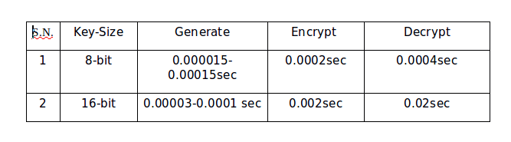
Time taken for computing

Slide 6
Conclusion
RSA’s performance decreases as it’s bit size gradually decreases
RSA Decryption is slower than RS A Encryption
Newer encryption technique Elgamal is proposed that have decryption time better than that of encryption with the security strength of RSA

Slide 7
Thank You

