Slide 1
ANTICIPATING HEPATIC DISORDER THROUGH MACHINE LEARNING CLASSIFICATION TECHNIQUES
TEAM MEMBERS:
G SAI LAKSHMI 20091A05D2
M GOWTHAMI 20091A0547
U VENU GOPAL 21095A0516
P VIGNESH 21095A0518
UNDER THE GUIDANCE OF
Mrs . S. RUBIA PARVEEN M.Tech.
Assistant Professor, Department of CSE

Slide 2

Key Insights
Abstract
Introduction
Literature survey
Problem statement
Methodology
Algorithm description
Revival of proposal
References

Slide 3
ABSTRACT
Liver Disease is the leading cause of global death that impacts the massive quantity of humans around the world. This disease diagnosis is very costly and complicated. Machine learning is a process designed to discover patterns in large datasets to enable decision making. It can perform supervised , unsupervised , and reinforcement learning. It focuses on using data The Indian Liver Patient Dataset (ILPD) is used here. We use it to review previously health records. The machine learning algorithms we use are Logistic Regression, K Nearest Neighbors, Support Vector Machine, Random Forest. The aim of this project is to use these machine learning techniques to achieve maximum accuracy in predicting liver disease. The final result is determined using the most accurate machine learning algorithm and a interface is created using Flask where the users can check whether they have liver disease or not.

Slide 4
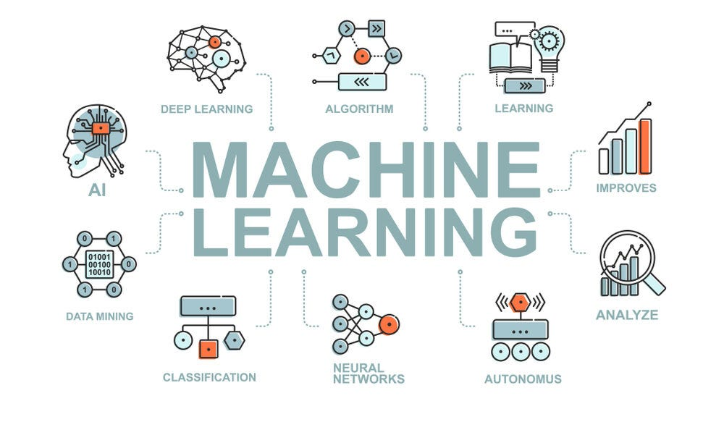
INTRODUCTION TO DOMAIN:
Machine learning, a subset of AI, enables computers to learn from data patterns without explicit programming. Algorithms analyze large datasets, allowing machines to make predictions and solve complex tasks. With supervised, unsupervised, and reinforcement learning, it finds applications in fields like healthcare and autonomous vehicles. This technology’s adaptability and efficiency make
it pivotal in driving innovation across diverse industries.

Slide 5
Types of Machine Learning Algorithms:
1. Supervised Learning Algorithms: In supervised learning, the algorithm learns from labeled training data to make predictions or classify new, unseen data. It involves mapping input variables to output variables based on example input-output pairs.
2. Unsupervised Learning Algorithms: Unsupervised learning algorithms are used when the training data is unlabeled. The algorithm learns patterns and relationships in the data without any predefined output labels.
3. Reinforcement Learning algorithm: Reinforcement learning involves an agent learning to interact with an environment and maximize a reward signal. The agent learns through trial and error, receiving feedback in the form of rewards

Slide 6
LITERATURE SURVEY
Name of the paper | Year & month | Author Name | Algorithm/ Techniques Used | Advantages | Limitations
Liver Disease Prediction using Machine Learning Classification Techniques | 2022, April | Ketan Gupta, Nasmin Jiwani, Neda Afreen & Divyarani | Light GB | By use of Light GB algorithm we get the appropriate result and accuracy was 63%. | Disadvantage of Light GB method is it is narrow user based.
Liver Disease Prediction Using Machine Learning Classification | 2021, February | Jayakumar Sadhasivam, J.Senthil, R.M.Ganesh, N.Chellapan | Support Vector Machine. | Best accuracy obtained by the support vector machine algorithm was 68% | Further developments in the preprocessing were to be made.

Slide 7
LITERATURE SURVEY
Name of the paper | Year & month | Author Name | Algorithm/ Techniques Used | Advantages | Limitations
“Prediction of Liver Disease using Classification Algorithms | 2018, December | Thirunavukkarasu K, Ajay S. Singh, Md Irfan, Abhishek Chowdhury | Logistic Regression and K-Nearest Neighbor | Logistic Regression and K-Nearest Neighbor have the highest accuracy but logistic regression have the highest sensitivity. | Though K-Nearest Neighbor has highest accuracy its sensitivity is less than Logistic Regression.

Slide 8
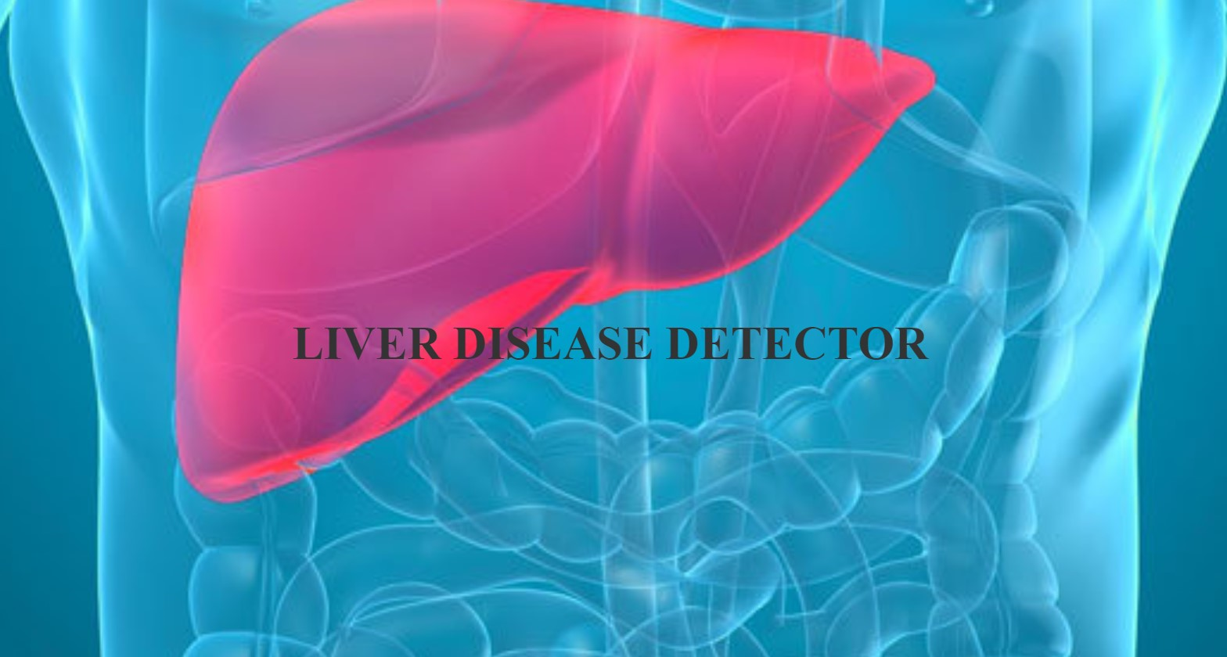
PROBLEM STATEMENT
We are building a model to predict the liver disease using supervised learning algorithm and deploying this model as a web page.

Slide 9
DISADVANTAGES OF SYSTEM
Drawbacks of Existing Model:
Light GB method is it is narrow user based.
In CNN testing accuracy was less than training accuracy.
K-Nearest Neighbor sensitivity is less than Logistic Regression.
Support Vector Machine is unsuitable to large datasets.

Slide 10
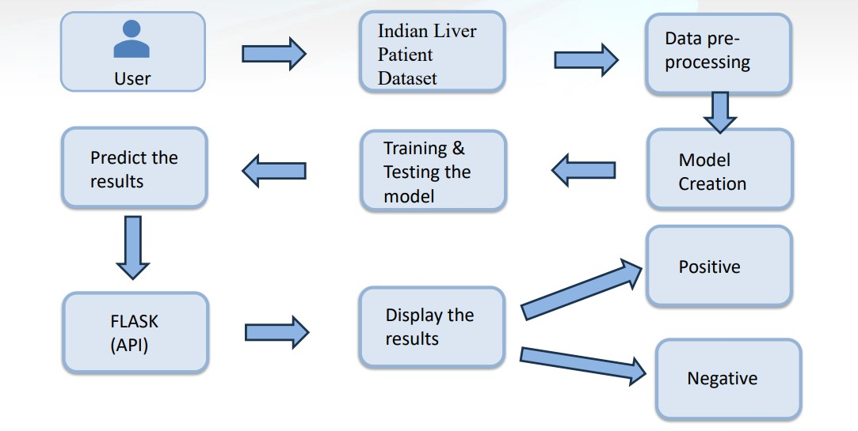
PROPOSED METHODOLOGY

Slide 11
PROPOSED METHOD
The suggested system was created with the goal of creating an interface using flask that can predict whether a individual has liver disease or not. The suggested approach includes collecting data from the user. Pre-processing the data is the next stage once data collection is complete. Data Preprocessing is the process of cleaning the data such as changing text to lowercase, and eliminating null values. Then, using the preprocessed data, we train multiple models. We may assess the trained models using measures such as accuracy, precision, recall, and F1-score. We can look at the model with the best classification results. In order to determine if a user's health report is "Positive" or "Negative," the proposed method's final step is to build a user interface using Flask.

Slide 12
ALGORITHM DESCRIPTION
Logistic Regression (LR): It is a supervised learning algorithm used for binary classification problems. It models the relationship between the dependent variable and one or more independent variables by estimating the probabilities using a logistic function. The algorithm aims to find the best-fit line that separates the two classes.
K Nearest Neighbour (KNN): It is a non-parametric algorithm used for both classification and regression tasks. It works by finding the K nearest data points in the training set to a given test point and classifying the test point based on the majority class of its neighbors. KNN does not make any assumptions about the underlying data distribution.

Slide 13
ALGORITHM DESCRIPTION
Support Vector Machine(SVM): It is a supervised learning algorithm used for both classification and regression tasks. It aims to find the best hyper plane that separates the data points of different classes with the maximum margin. SVM can handle both linearly separable and non-linearly separable data by using different kernel functions.
Random Forest Classifier: It is an ensemble learning algorithm that combines multiple decision trees to make predictions. It works by creating a set of decision trees on different subsets of the training data and then averaging their predictions. Random Forest can handle both classification and regression tasks and is known for its ability to handle high-dimensional data and avoid overfitting.

Slide 14
HARDWARE & SOFTWARE REQUIREMENTS
HARDWARE REQUIREMENTS:
Processor : Intel Core
Hard Disk : 40 GB.
RAM : 8.00 GB
SOFTWARE REQUIREMENTS:
Operating System: Windows 10,11..etc
Coding Language: Python 3.0 and HTML.
Web Application Interface: Flask.

Slide 15
MODULE SPLIT-UP
User: The user will register and login into the web application, enter his or her health records according to the attributes asked, and receive the predicted result of whether the user is positive for liver disease or not.
Web application: The web application will check whether the user who signed in to the page is an existing user or not. If not, it will redirect to the registration page. After registration, it will ask for user details and send them to the system. Later, when the system sends the prediction results, it will display them to the user.
System: Collects the user data from the web application, predicts the results, and sends them to the web application, where the data is displayed to the user.

Slide 16
REVIVAL OF PROPOSAL
Liver disease refers to an abnormality in the liver’s function, resulting in illness . The liver is responsible for many vital functions within the body, and if it becomes damaged or infected, the loss of these functions can have a significant impact on overall health. Hepatic disorder is another term used to describe liver disease . This umbrella term encompasses a range of possible complications that prevent the liver from performing its assigned roles. Even if only a quarter of the liver is still functioning and the rest is damaged, this organ’s efficiency will be greatly reduced. The liver is the biggest hard structure in the human build and is well thought-out as a gland because, amid its many roles, it creates and secretes bile. The liver is stood at the upright part of the abdomen and the rib cage shelters it. It has two core lobes that are thru with small lobules. The liver cells have two dissimilar bases of a blood source.

Slide 17
CONCLUSION
We conclude that through this project efficiency of the prediction is increased and accuracy of the prediction algorithms where we have used different algorithms to predict the accuracy of the disease is determined. Finally we created a web application through flask interface where the users can check whether they have liver disease or not.

Slide 18
REFERENCES
Ketan Gupta, Nasmin Jiwani, Neda Afreen & Divyarani D “Liver Disease Prediction using Machine learning Classification Techniques” in 11th IEEE International Conference on Communication Systems and Network Technologies.
Jayakumar Sadhasivam, J.Senthil, R.M.Ganesh, N.Chellapan “Liver Disease Prediction Using Machine Learning Classification” in https://www.webology.org/datacms/articles/20211222042439pmWEB18293.pdf.
Thirunavukkarasu K, Ajay S. Singh, Md Irfan, Abhishek Chowdhury “Prediction of Liver Disease using Classification Algorithms” in 2018 4th International Conference on Computing Communication and Automation (ICCCA).

Slide 19
ANY QUERIES?

Slide 20
THANK YOU

