Slide 1
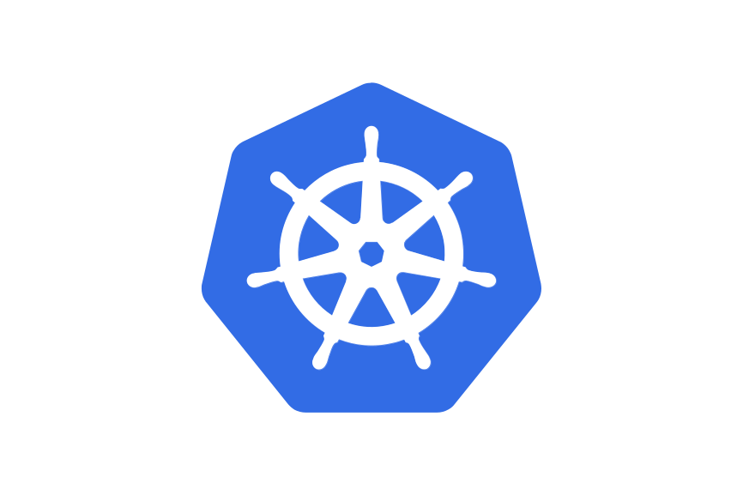

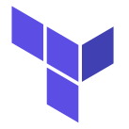
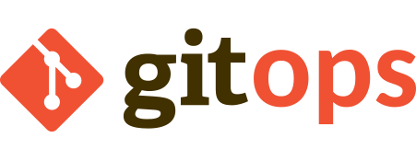
CabinOps:
A Crash Course in Kubernetes

Slide 2
About the Presenter
Who cares

Slide 3
General Vocabulary
Shell
CLI
Git, Repo, GitHub
Database
Environment (Variable)
Containerization, Container Image
Docker
Orchestration
YAML

Slide 4
Part 1: Kubernetes (K8s)
Control Plane
K8s is a cloud-native tool for container orchestration
  Built with scalability, availability at center
  Automatic deployment, management
Apps run on one or more Nodes ≈ Computer
Smallest unit: Pod ≈ Container
  Pod runs on a single Node
  Apps can consist of multiple & different Pods (Deployments)
Controllers try to match the state we declare via Manifests (YAML files)
Node-1
Node-2
...
Pod-App-1-1
Pod-
App-
2
...
Pod-
App-
1-2
...

Slide 5
Object Creation
Kubectl CLI
Control Plane
example-pod.yaml
Node-1
Node-2
apiVersion: v1
kind: Pod
metadata:
name: example-pod
namespace: default
spec:
containers:
- name: example
image: nginx
ports:
- containerPort: 80
kubectl apply -f example-pod.yaml
...
For this operation, use API version 1.
Create this Resource: a Pod in the Namespace ‘default’, named ‘example-pod’. It consists of a single container: The image ‘nginx’, with open port ‘80’ (basic HTTP).
Pod-App-1-1
Pod-
App-
2
Pod-
App-
1-2
...
...

Slide 6
Namespaces
Control Plane
Namespaces create separate sections
  Pods can only interact within same Namespace!
  Namespaces can span across multiple Nodes
Each App has own Namespace
  Own Database,…
Node-1
Node-2
...
Pod-App-1-1
Pod-
App-
2
...
Pod-
App-
1-2
...
Namespace app-1
Namespace app-2
example-ns.yaml
apiVersion: v1
kind: Namespace
metadata:
name: app-1
kubectl apply -f example-ns.yaml

Slide 7
Services
app-1-svc
Control Plane
Pods are disposable; they can die/be killed at any time
  IP address can change
Services handle communication between Apps
Also used for load balancing etc.
Node-1
Node-2
...
Pod-App-1-1
Pod-
App-
2
...
Pod-
App-
1-2
...
Namespace app-1
example-svc.yaml
Namespace app-2
apiVersion: v1
kind: Service
metadata:
name: app-1-svc
spec:
selector:
app.kubernetes.io/name: app-1
ports:
- name: http
protocol: TCP
port: 80
targetPort: 9376
kubectl apply -f example-svc.yaml

Slide 8
Recap: Apps in K8s
Recap:
App is created as Deployments
  Each Deployment: One or more exact copies of a Pod (ReplicaSet)
In-cluster access via Services pointing to Pods
Next steps:
Pods are disposable: maintain state of App?
Outside-cluster access?

Slide 9
Exercise 1
Clone the Repo at https://github.com/upart/cabinops
Setup: (WSL), Devbox together
Follow the Instructions and play around!

Slide 10
Volumes
app-1-svc
Control Plane
Since Pods are disposable, a restarting Pod loses its state
Intra- and Inter-Pod sharing of Files via Volumes
  type ‘EmptyDir’: similar to Volumes in Docker
  Persistent Volumes (PVs) and Persistent Volume Claims (PVCs): allows provisioning Volumes for developers without knowing how exactly the volume is created (separation of concern)
Can also use Database or Artifact Stores etc. for storage
Node-1
Node-2
...
Pod-App-1-1
Pod-
App-
2
...
Pod-
App-
1-2
...
Namespace app-1
Namespace app-2

Slide 11
Ingress*
app-1-svc
Control Plane
An Ingress allows accessing Services from outside the Cluster
HTTP(S) traffic is routed according to rules set by Ingress
Ingress is handled by an Ingress Controller, most commonly nginx
Node-1
Node-2
...
Pod-App-1-1
Pod-
App-
2
...
Pod-
App-
1-2
...
Namespace app-1
Namespace app-2
*Frozen: In real cases, use Gateway API instead!

Slide 12
It Never Stops
app-1-svc
Control Plane
ConfigMaps, Secrets
Liveness, Readiness, Startup Probes
ServiceAccounts for RBAC
CRDs
Node-1
Node-2
...
Pod-App-1-1
Pod-
App-
2
...
Pod-
App-
1-2
...
Namespace app-1
Namespace app-2

Slide 13
Recap: Apps in K8s
Recap:
App is created as Deployments
  Each Deployment: One or more exact copies of a Pod (ReplicaSet)
In-cluster access via Services pointing to Pods
To maintain the state of a Pod, we use Persistent Volumes or Databases
Services can be accessed from outside the cluster using Ingresses/Gateway API
Also:
Define Custom Resource Definitions (CRDs) for Controller

Slide 14
Part 2: Helm
Deploying Apps in K8s
  Create Namespace
  Install CRDs
  Install Deployments
  Tweak settings
  Install Deployments
  Tweak settings
  ...
helm install repo-name/chart-name
Helm is the primary way to install someone else’s applications in K8s

Slide 15
Helm Charts
Helm installs Helm Charts
  Saved in repositories with a fixed structure:
    Chart.yaml
      Metadata: name, version,...
    values.yaml
      Variables for tuning of Chart(s)
      Quality of Helm Chart depends strongly on values.yaml!
    charts/
      Dependency Helm Charts
    templates/
      YAML-Files with {{ govaluate.style.templating }}

Slide 16
Installing Helm Charts
Add a repo to Helm
  helm repo add bitnami https://charts.bitnami.com/bitnami
Install a Helm Chart
  (helm repo update) to ensure newest version
  helm install bitnami/mysql
Can install same Helm Chart multiple times, with different settings
  helm show values bitnami/mysql
  helm install bitnami/mysql –-set param1=value1,param2=value2
  or
  helm install -f values.yaml bitnami/mysql

Slide 17
Recap: Helm and Helm Charts
Helm is the primary way to install someone else’s applications in K8s
Helm Charts are saved in repos

Slide 18
Exercise 2
Follow the instructions and play around!

Slide 19
Part 3: GitOps and Terraform
If not careful, settings can end up all over the place:
  values.yaml in repo
  Installation with helm --set
  Hyperscaler (GCP, AWS, Azure)
    Machines
    Services
GitOps: The (desired) state of our cluster is described in a Git repo and changes are always tracked

Slide 20
Terraform
Terraform is a tool for Infrastructure-as-Code (IaC)
  Which hyperscaler, how many nodes, which DNS settings,… is written in some file
  State of infrastructure can be recreated using just that file!
Uses Providers to create infrastructure, circumventing using GUIs or learning specific APIs

Slide 21
Terraform
Terraform scans directory for `.tf`-files
Creates state-files to keep track of the current state
`terraform init`
  Install providers mentioned in `.tf`-files
`terraform apply`
  Calculate difference and apply only those changes. Shuts down old Nodes, starts new ones, changes settings, installs Helm Charts, applies Manifests,...

Slide 22
Recap: GitOps and Terraform
GitOps requires:
  The (desired) state of our cluster is described in a Git repo
  Changes to the state are always tracked
Terraform is a tool for Infrastructure-as-Code (IaC)
  Uses Providers to perform GitOps on Nodes, DNS, Helm Charts, Manifests,...

Slide 23
Exercise 3
Follow the instructions and play around!

