Slide 1
Preliminary results on magnet challenge

Slide 2
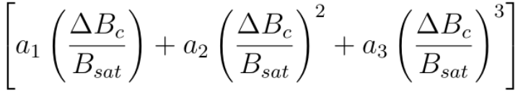
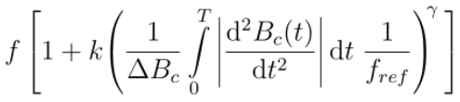

Features based on Stenglein approach
Fit values
Quasistatic part
Frequency dependent part
Features
.
delta_b / B_sat is extended up to power of 6
Frequency depend part: tailor row to express as a linear feature
Frequency dependent part also includes the slew rate due to 2nd derivation

Slide 3
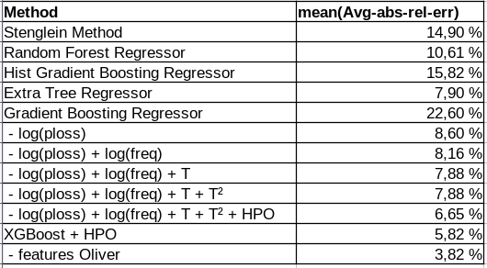
Try out different regressors

Slide 4
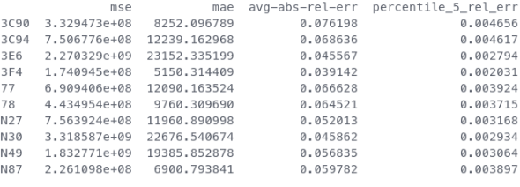
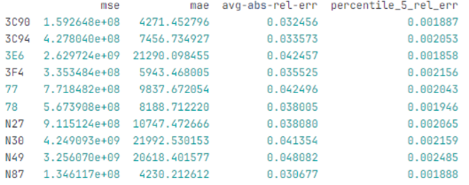
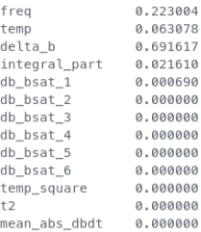
XGBoost different features
Feature set Nikolas
Feature set Oliver
Feature importances

Slide 5
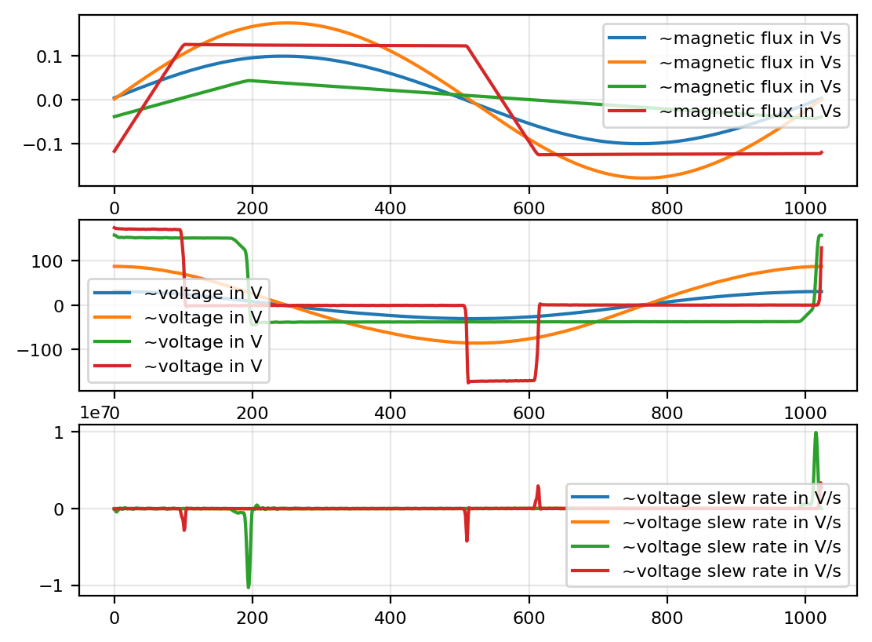
Adding new features according to Till
Second derivative gives information where the GaN MOSFETs are switching and how fast they switch (slew rate)
effects spikes/(oscillations) in h-curve

