Slide 1
Magnet Challenge – Update 2023-06-29

Slide 2
Implementing Stenglein approach

Slide 3

Implementing Stenglein model
Part 1: quasistatic hyst. Losses
Part 2: effective frequency depending on slopes

Slide 4
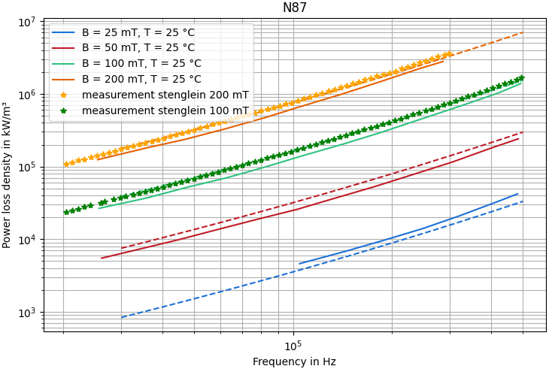
Using stenglein model without own measurements
Stenglein model fits its own measurements
But not the datasheet measurements
Datasheet values are lower than in stenglein measurement
For accurate results, measurement on every batch necessary
Solid: Datasheet
Dashed: Stenglein-Model
Stars: Stenglein measurements

Slide 5
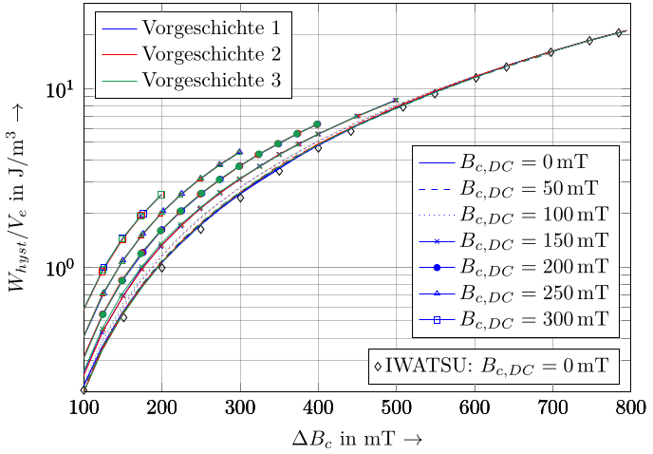
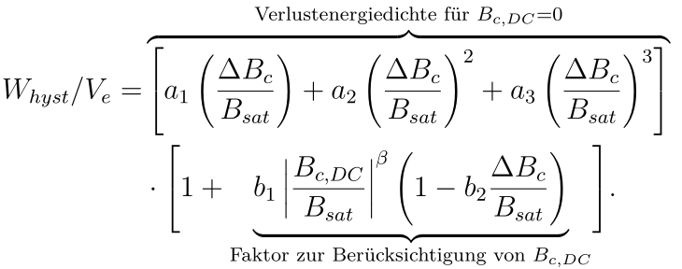
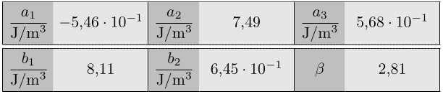
Part 1: Getting quasistatic hysteresis factors
DC-part
Magnet loss data
DC-part

Slide 6

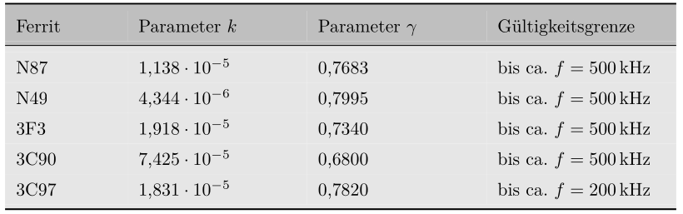
Part 2: Rate dependent data

Slide 7
Drawbacks
Model only valid for a single temperature. Curve fitting for several temperatures can be done
The quasistatic hysteresis loss needs measurments < 1 kHz. Stenglein uses 100 Hz for measurements
Model requires own measurements, the datasheet does not contain enough data

Slide 8
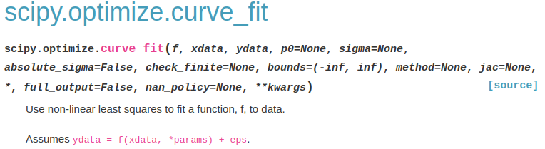
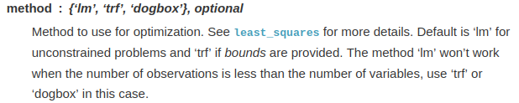
Changing the fit parameters
Lm: levenberg-Marquardt method with no bounds
Trf: Trust Region Method, bounds needed
dogbox

Slide 9
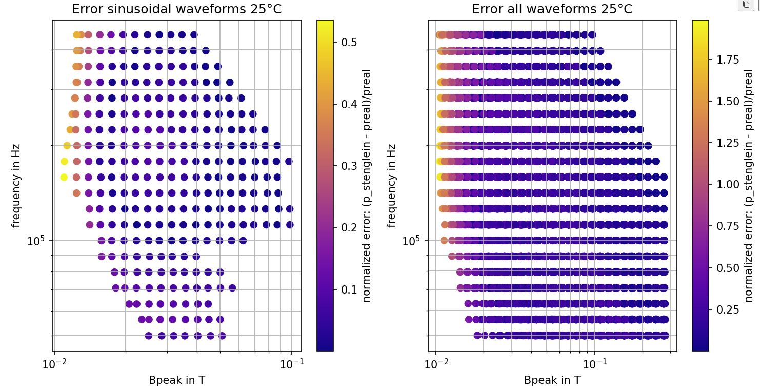
3 fit parameters

Slide 10
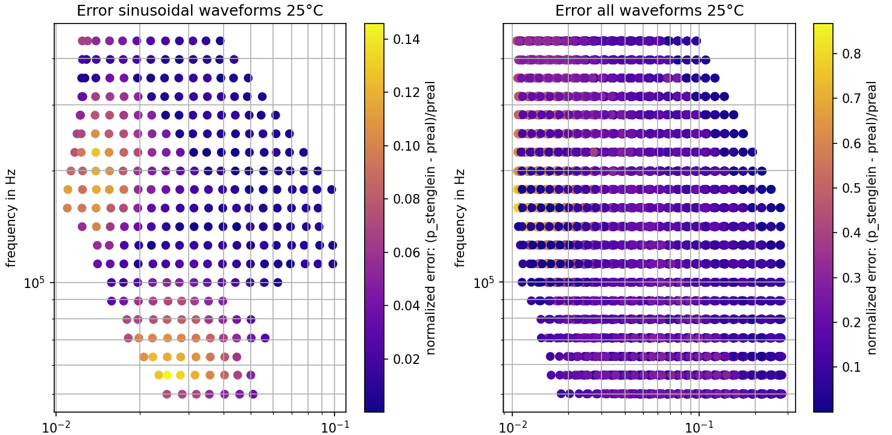
6 fit parameters

Slide 11
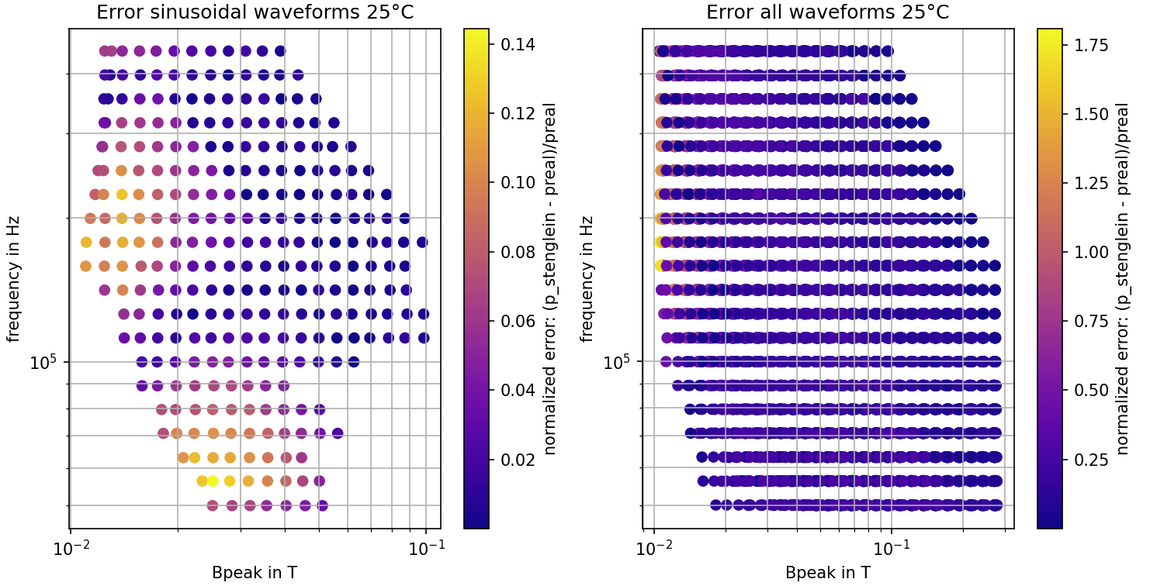
9 fit parameters

Slide 12
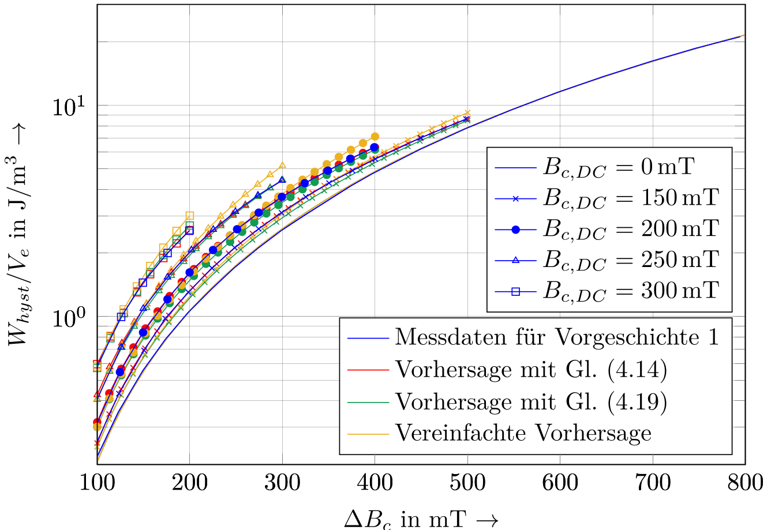
Difference in the results

Slide 13
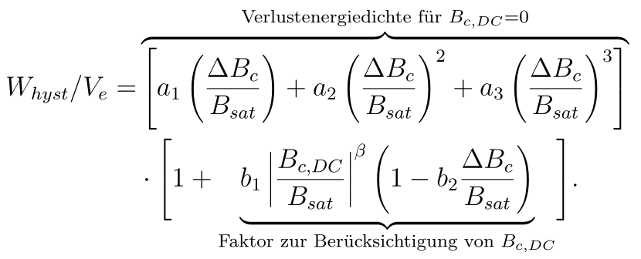
May add fitting a DC-part, even it does not exist

Slide 14
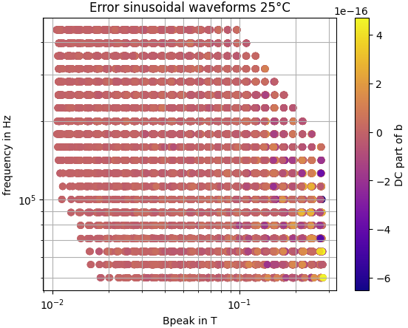
Looking at the DC-part of B-field

Slide 15
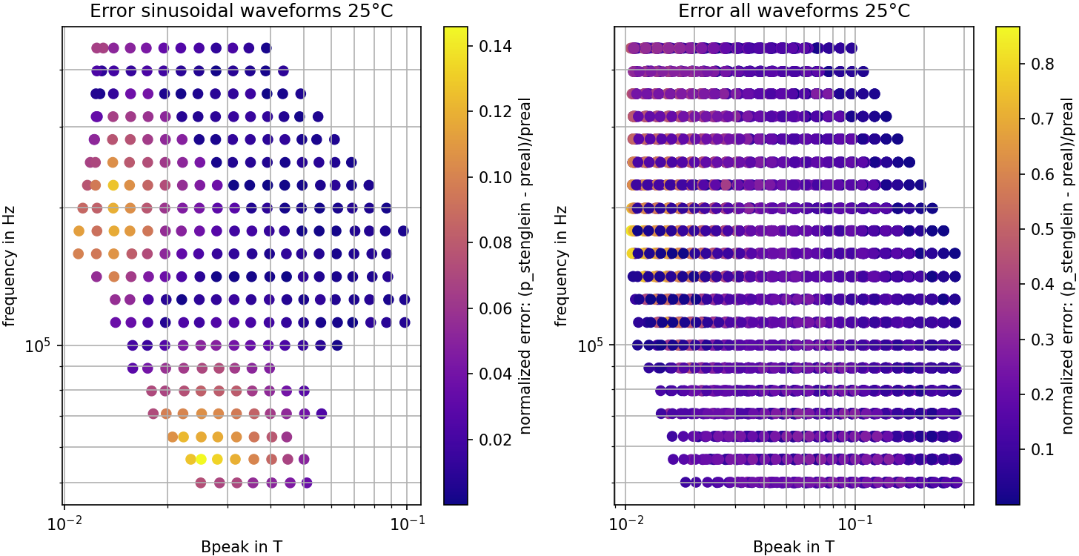
Dogbox fit method using 6 fit-parameters

