Slide 1
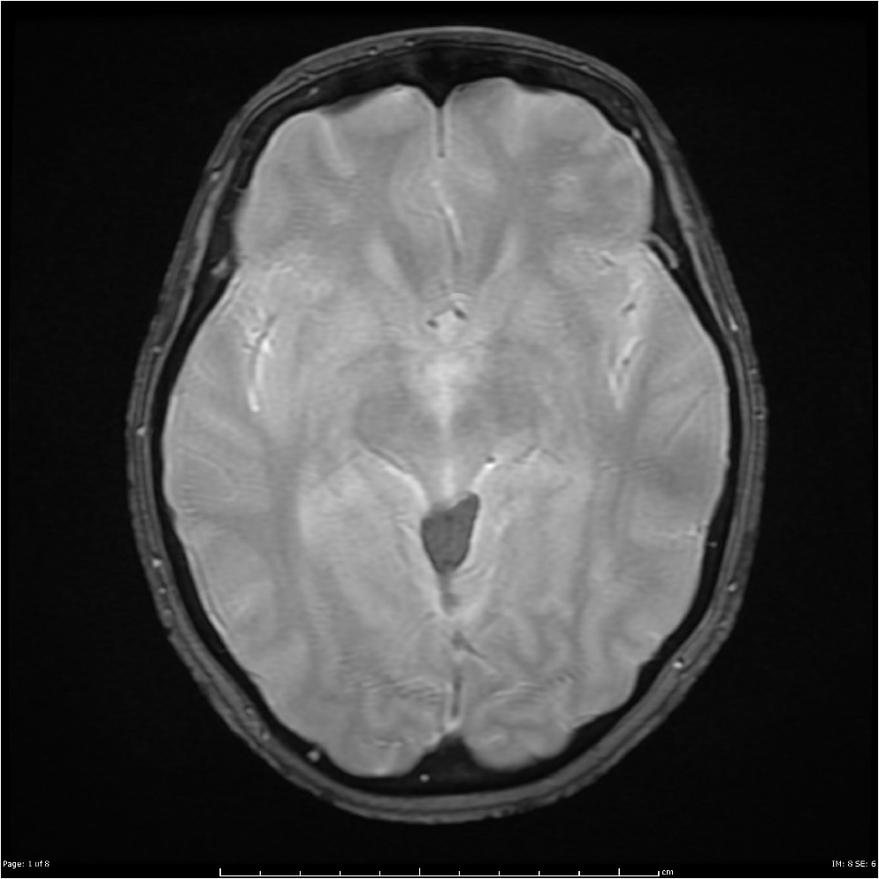
BrainScan’19
David García, Aitor Jara, Eduard Mainou and Núria Sánchez
Advisor: Santi Puch
Artificial Intelligence with Deep Learning
UPC School
July 2019

Slide 2
Contents
Motivation
Description
Database
Model
Implementation
Dataset
Code structure
Issues
Demo

Slide 3
Motivation
Bla bla bla we wanted to learn bla bla bla, our tutor was in this field bla bla bla

Slide 4
Description
Explanation of the database, and how the data is contained( volums and stuff)
Short explanation of the Unet.

Slide 5
Implementation
Basically how we used and created the dataset using the database
How we implemented the model (loss, layers….)

Slide 6
Issues
List and brief explanation of all the issues and problems we have faced.

Slide 7
Demo
Github
Tensorboard

Slide 8
Q&A

