Slide 1
Interannual variability of the marine heat waves in the Western North Pacific Ocean and its marginal seas
Topic 1
Topic 2
Decadal SST Variability in the East Asian Marginal Seas over Recent Decades: Warming, Hiatus, and Reacceleration
Hyung-Ju Park and Hanna Na

Slide 2




Decadal SST Variability in the East Asian Marginal Seas over Recent Decades: Warming, Hiatus, and Reacceleration
Hyung-Ju Park and Hanna Na
Normalized SSTa
P1: Warming (82–98)
P2: Hiatus (98–11)
P3: Reacceleration (11–22)
$$a_{3}=0.83℃ dec^{−1}$$
$$a_{2}=−0.29℃ dec^{−1}$$
Interannual
$$a=0.26℃ {dec}^{−1}$$
Decadal
$$a_{1}=0.44℃ dec^{−1}$$
SST anomaly
Decadal ( > 6 year)
Interannual (2-6 year)
Park et al. (submitted, JC)

Slide 3
Western Boundary Currents Warm Faster than Global Mean in 20th century
East Asia
warming!
0.13℃ dec⁻¹
Wu et al. (2012)

Slide 4
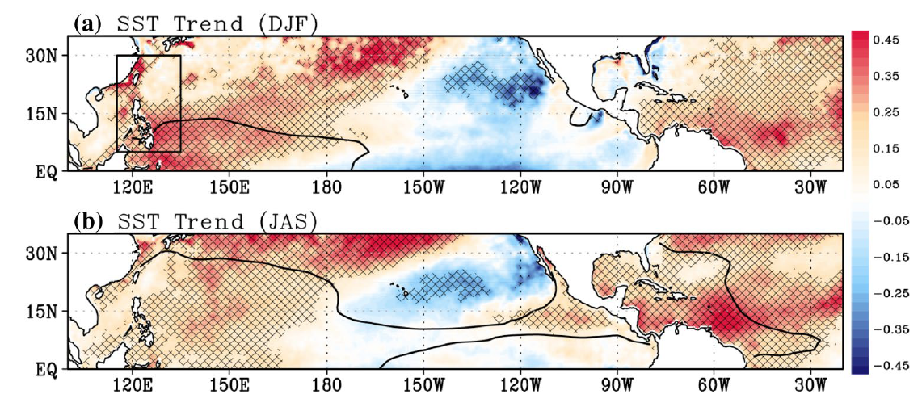
Significant SST warming in the East Asian Marginal Seas
Lee and Park (2019)
East Sea
MHW frequency
Lee et al. (2023)
1982-2014
Park et al. (2019)

Slide 5
Seas around China:
Rapid SST Acceleration Since 1950
SST trend
Since 1950:
Since 1982:
0.10–0.14
0.14–0.16
+0.45
-0.27
+0.31
Wang et al. (2023)

Slide 6
From previous studies (warming – hiatus period)
Kim et al. (2018)
Tang et al. (2020)
Lee et al. (2023)
20

Slide 7
From previous studies (warming – hiatus period)
Physical mechanism:
The anomalous downward (upward) surface heat flux accompanied by the negative (positive) winter wind speed anomaly are related to the warming (hiatus) period
Significant correlation with EAWM during hiatus period
4.1. Atmospheric components: wind and heat flux
Kim et al. (2018)
Cai et al. (2017)
21
No significant correlation with KVT and Changjiang river discharge

Slide 8
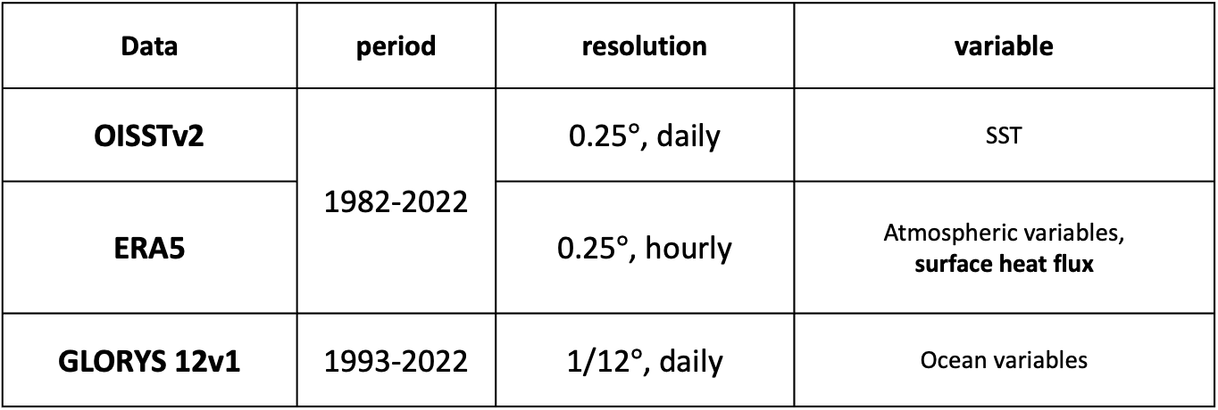
Data and Method
Data | period | resolution | variable
OISSTv2 | 1982-2022 | 0.25$°$, daily | SST
ERA5 |  | 0.25$°$, hourly | Atmospheric variables, surface heat flux
GLORYS 12v1 | 1993-2022 | 1/12$°$, daily | Ocean variables
ERA5 surface heat flux is interpolated to the grid points of GLORYS12v1
24
Notes:
Now i will introduce the data and methods used in this study.
For sea surface temperature data, Optimum Interpolation Sea Surface Temperature (OISST) version 2 is used
The atmospheric field is based on the ERA5
For precipitation data, Global Precipitation Climatology Project (GPCP) is used
and the ocean data is based on Simple Ocean Data Assimilation (SODA) 3.4.2
The research period was set from 1982, when OISST data became available, to 2022.
The MHW events were defined by applying the method of Hobday et al. (2016) to the OISST data.
For an event to be defined as an MHW,
the temperature must be higher than the 90 percentile for each calendar day.
it should last at least five days
and if the gaps between those events are less than two days , it will be considered as the same event
The baseline period for calculating the anomaly and threshold was set to the entire period, data is available.

Slide 9

OISST trend
$$[℃ {dec}^{−1}]$$
EJS
ECS
WNP
Overall SST trend (1982–2022): positive, but weaker than in each sub‑period
Warming (1982–1998): significant warming in the East China Sea
Hiatus (1998–2011 ): slight cooling overall; marginal significance only in Yellow & East China Seas
Reacceleration (2011–2022): very strong warming in the northwestern East/Japan Sea, East China Sea, and western North Pacific
23

Slide 10





P1: Warming (82–98)
P2: Hiatus (98–11)
P3: Reacceleration (11–22)
$$[℃ {dec}^{−1}]$$
$$a_{3}=0.83℃ dec^{−1}$$
$$a_{2}=−0.29℃ dec^{−1}$$
$$a=0.26℃ {dec}^{−1}$$
$$a_{1}=0.44℃ dec^{−1}$$
SST anomaly
Decadal ( > 6 year)
Interannual (2-6 year)
Research on the interannual component was submitted
(Park and Na, Submitted)
The spectral analysis of the SST time series reveals a clear distinction between interannual and decadal components.
Based on the sign of trend, warming, hiatus, and reacceleration periods are separated.
Interannual
Decadal
22

Slide 11

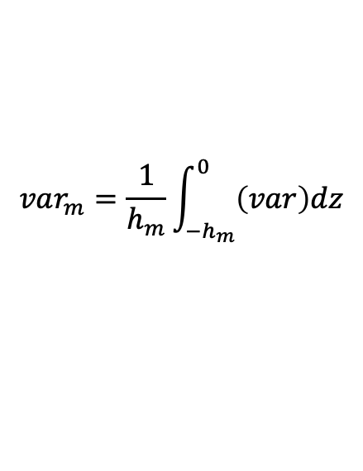


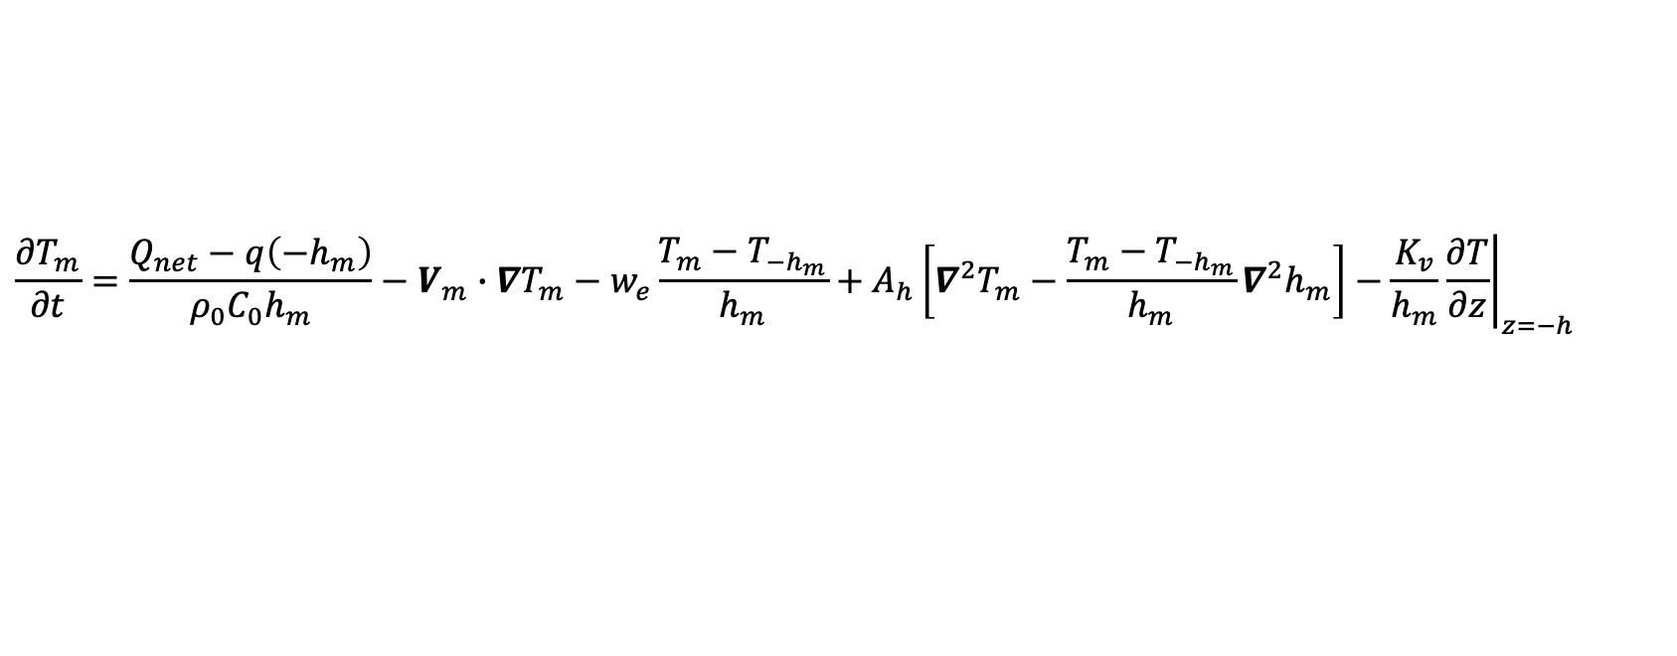




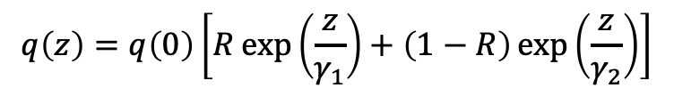

Mixed Layer Heat budget equation
Tendency
Diabatic
Advection
Entrainment
Horizontal diffusion
Vertical Diffusion
$$\frac{∂T_{m}}{∂t}=\frac{Q_{net}−q\left({−h}_{m}\right)}{ρ_{0}C_{0}h_{m}}−V_{m}∙∇T_{m}−w_{e}\frac{T_{m}−T_{−h_{m}}}{h_{m}}+A_{h}\left[∇^{2}T_{m}−\frac{T_{m}−T_{−h_{m}}}{h_{m}}∇^{2}h_{m}\right]−\frac{K_{v}}{h_{m}}{\left.\frac{∂T}{∂z}\right|}_{z=−h}$$
$$var_{m}=\frac{1}{h_{m}}\int_{−h_{m}}^{0}{\left(var\right)dz}$$
$h_{m}$ = mixed layer depth
Qiu and Kelly (1993)
In Diabatic term,
$$q\left(z\right)=q\left(0\right)\left[R\exp\left(\frac{z}{γ_{1}}\right)+\left(1−R\right)\exp\left(\frac{z}{γ_{2}}\right)\right]$$
$$R=0.77, γ_{1}=1.5 m,γ_{2}=14 m$$
Water type II (western Pacific; Jerlov 1968)
$$q\left(0\right)=SW$$
In entrainment term,
$\frac{∆h_{m}}{∆t}$, if $∆h_{m}>0$
$$w_{e}=$$
$0$, if $∆h_{m}≤0$
Eddy diffusivity
$$A_{h}={10}^{2} m^{2} s^{−1}$$
$$K_{v}={10}^{−4} m^{2} s^{−1}$$
25

Slide 12

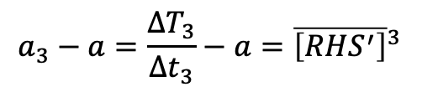
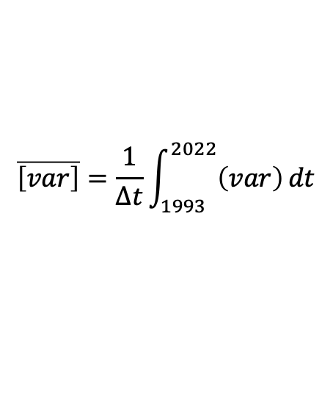

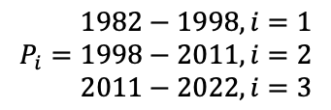


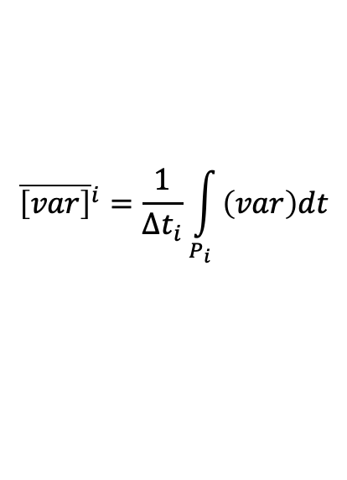
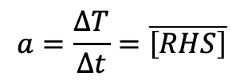
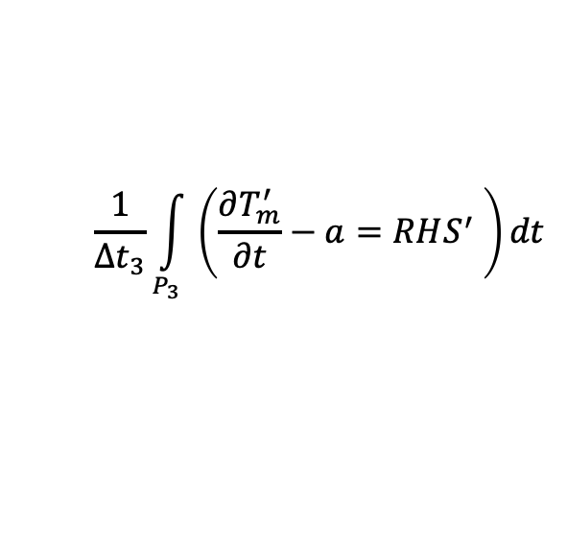
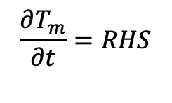
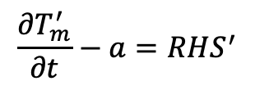
$$\frac{∂T_{m}}{∂t}=\frac{Q_{net}−q\left(h_{m}\right)}{ρC_{0}h_{m}}−V_{m}∙∇T_{m}−w_{e}\frac{T_{m}−T_{−h_{m}}}{h_{m}}+A_{h}\left[∇^{2}T_{m}−\frac{T_{m}−T_{−h_{m}}}{h_{m}}∇^{2}h_{m}\right]−\frac{K_{h}}{h_{m}}{\left.\frac{∂T}{∂z}\right|}_{z=−h}$$
$${\overline{\left[var\right]}}^{i}=\frac{1}{∆t_{i}}\int_{P_{i}}{\left(var\right)dt}$$
$$\overline{\left[var\right]}=\frac{1}{∆t}\int_{1993}^{2022}{\left(var\right)}dt$$
$$P_{i}=\begin{matrix}1982−1998, i=1 \\ 1998−2011, i=2 \\ 2011−2022, i=3\end{matrix}$$
→ Warming
→ Hiatus
→ Reacceleration
$$∆t=2022−1993=30 years$$
$$\frac{∂T_{m}}{∂t}=RHS$$
$$\frac{1}{∆t_{3}}\int_{P_{3}}{\left(\frac{∂T_{m}^{′}}{∂t}−a=RHS^{′} \right)dt}$$
(1)
$$a=\frac{∆T}{∆t}=\overline{\left[RHS\right]}$$
“a” is trend for entire period
$$a_{3}−a=\frac{∆T_{3}}{∆t_{3}}−a={\overline{\left[RHS^{′}\right]}}^{3}$$
(2)
$$T_{m}={\overline{T}}_{m}+T_{m}^{′}$$
As the integration period becomes longer,
The terms in RHS balanced each other, a₃-a becomes smaller
$$RHS=\overline{RHS}+RHS^{′}$$
$$\frac{∂T_{m}^{′}}{∂t}−a=RHS^{′}$$
(1)-(2)
Monthly average is applied
26

Slide 13
Monthly
Low!!
Numerical scheme?
Resolution?
R²(ten, *)
Dia
Adv
Ent
H. Diff
MLD seas
Lim et al. (2012)
Low
(<10 %)
V. Diff
RHS
High
(>90 %)
Medium
(70-80 %)
27

Slide 14








During reacceleration period…
[$℃ {yr}^{−1}$]
$${\overline{\left[var′\right]}}^{3}$$
28
Dia
Oceanic
a₃ - a
[$℃ {yr}^{−1}$]
EJS
Adv
Ent
ECS
WNP
H. Diff
V. Diff
Not reliable…
$$a_{3}−a={\overline{\left[RHS^{′}\right]}}^{3}$$
ECS
P1: Warming (82–98)
P2: Hiatus (98–11)
P3: Reacceleration (11–22)
R²
$$a_{1}−a$$
$$a_{2}−a$$
$$a_{3}−a$$
Advection?
Shading: 5m T Trend $[℃ {dec}^{−1}]$
Contour: $heating′$ [W m⁻² ; CI: 4W m⁻²]

Slide 15

$${\overline{\left[var′\right]}}^{3}$$
Advection
[$℃ {yr}^{−1}$]
U_{m}, V_{m}
ES
YECS
WNP
29

Slide 16


YECS
$${\overline{\left[var′\right]}}^{3}$$
Advection [$℃$/ year]
GLORYS - SSH [cm]
AAC
AAC
AC
AC
AAC
a₃ - a
30

Slide 17

EJS
31
Advection [$℃$/ year]
GLORYS - SSH [cm]
AAC
a₃ - a

Slide 18

GLORYS - SSHa [cm]
Physical mechanism for the warm advection?
32
g’=0.026 m s⁻²
Wind Stress Curl anomaly [x10⁻⁸ N m⁻³]
+ Prop.
AAC
Year 0 (2011-2022)
-10⁻⁷ N m⁻³ ~ 1.84 cm month⁻¹
WSC
SSH increase
0.4 x -10⁻⁸ N m⁻³ for 4-year
~3.5cm SSH increase
AC
AAC
$${\overline{\left[var′\right]}}^{3}$$
Year -1 (2010-2021)
Year -2 (2009-2020)
When Kuroshio
intrusion is strong…
AAC
Year -3 (2008-2019)
Year -4 (2007-2018)
Kang and Na (2022)

Slide 19
33
WNP???
NLM
LM
Reacceleration period!
JAN 2023
SST diff (18-22) – (12-16)
This coastal warming was caused by the approach of the Kuroshio near the coast, which is related to the S-shaped LM explained in Sect. 2 (see Figs. 3 and 4e) and the westward bifurcation of the Kuroshio
Advection
SSH

Slide 20
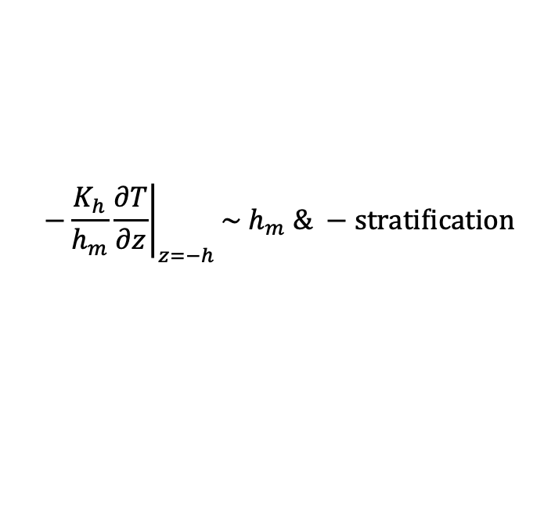
YECS − Diffusion
$${\overline{\left[var′\right]}}^{3}$$
$$−\frac{K_{h}}{h_{m}}{\left.\frac{∂T}{∂z}\right|}_{z=−h}\sim h_{m} \& −stratification$$
31
V. Diff
MLD [m]
Weaker
Stratification
and / or
Deeper MLD
a₃ - a
Weaker vertical diffusion?
Weaker stratification?

Slide 21
Summary
34
During the reacceleration period (2011–2022), the area-averaged SST in the EAMS increased at 0.83 °C per decade, about three times the rate over 1982–2022.
The warming was particularly pronounced in the ECS, the northwestern EJS, and south of Japan.
Mixed layer heat budget analysis
Common: Horizontal warm advection supported the SST-warming pattern across the three regions.
ECS: Kuroshio intrusion and a northward current anomaly along the Chinese coast → warm advection; vertical-diffusion anomalies also supported warming with magnitudes comparable to advection.
EJS: A northward alongshore current anomaly east of the Korean Peninsula → warm advection; the vertical-diffusion term appeared larger than advection but is interpreted cautiously due to strong budget uncertainty.
ECS & EJS: WSC-forced changes in geostrophic currents contributed to the warm advection.
South of Japan: A Kuroshio path shift from NLM (2012–2016) to LM (2018–2022) explains the reacceleration-period SST trend via associated temperature advection.
Unlike earlier warming and hiatus periods that were often explained by heat input from the atmosphere, during reacceleration the ocean variability drove the SST warming, while the excess heat was released to the atmosphere.

Slide 22
Discussion
Regressed SST & SLP
35
P1 (1982−2006; 25-year)
P1
82–06
82-02
89-95
92-99
85-06
PDO
NPGO
IOBM
EAWM
P2
02–22
P2 (2002−2022 ; 21-year)
Kim et al. (2018)
Correlation with NPGO & PDO reversed in late 2000s (compared to the correlation prior to regime shift)
Both mechanism and drivers are changed during recent decades!
Thank You!

Slide 23
Monthly
Low!!
No seasonal cycle
Numerical scheme?
Resolution?
R²(ten, *)
Dia
Adv
Ent
H. Diff
MLD seas
Lim et al. (2012)
Low
(<10 %)
V. Diff
RHS
High
(>90 %)
Medium
(70-80 %)
27

Slide 24
Large-Scale MHW drivers: Basin-wide mode of Lee et al. (2020)
Warm anomaly in winter
Basin-wide ocean warming starts to emerge from the previous winter
Warm
Warm-to-cold SST anomaly transitions in the Tropical Pacific
Q1. How is the ENSO transition related to the large-scale MHWs in the Western North Pacific Ocean and the East Asian marginal seas?
Cold
7
Notes:
I would like to introduce in more detail the basin-wide mode of Lee et al. (2020), which motivated my research,
and want to suggest several scientific questions arising from it.
This figure shows the distribution of SST before large-scale warming is occurred in the summer.
(click)
The basin-wide warm anomaly in East Asia already existed from the previous winter, and its intensity slightly increased in the summer.
(click)
The equatorial Pacific was transitioning from warm SST anomaly in winter to cold SST in summer.
(click)
My first question is to answer how is the ENSO transition related to the large-scale MHWs in the western north pacific ocean and east asian marginal seas.
, which is not handled in this paper.

Slide 25
Large-Scale East Asia MHW drivers: Basin-wide mode of Lee et al. (2020)
CGT Pattern
Ding and Wang (2005)
Circum-global teleconnection (CGT) pattern:
Dominant upper-level circulation pattern over the midlatitude
The CGT is accompanied by significant
surface air temperature anomalies in east Asia
(Ding and Wang, 2005; Yeo et al., 2019)
Son et al. (2021)
Indian Summer Monsoon (ISM)
The upward direction of surface heat flux make the role of CGT unclear
Q2. What is the role of the CGT pattern for the large-scale MHWs?
8
Notes:
My second question is related to the upper atmosphere.
They also showed that when the basin-wide MHW occurred in summer,
there was wavenumber-5 pattern encircling the mid-latitudes of the Northern Hemisphere,
(click)
which is known as the Circumglobal Teleconnection (CGT) pattern by Ding and Wang 2005.
over East Asia, there was an Anticyclonic circulation.
This anticyclonic circulation may be related with the occurrence of the MHWs
(Click)
However, they showed that the direction of the surface heat flux is upward.
therefore, the role of CGT pattern still remains unclear
here comes my second question, :
what is the role of the CGT pattern for the large-scale MHWs?
And I will also suggest the potential source region for the wave pattern.

Slide 26



Interannual component: ELT Year – Heat flux driven (ONDJ)
[hPa]
Shading: Sea surface temperature [$℃$]
Contour: Turbulent heat flux [$W m^{−2}$]
Target Domain
KAC: Kuroshio Anticyclone
PSAC: Philippine Sea Anticyclone
Shading: 2m temperature [$℃$]
Contour: Sensible heat flux [$W m^{−2}$]
Shading: 1000hPa specific humidity [$g {kg}^{−1}$]
Contour: latent heat flux [$W m^{−2}$]
Positive SST anomaly in the WNP Ocean and East Asian marginal seas
Downward sensible and latent heat flux anomaly accompanied with the warm and moist air
The southerly wind over the East Asia related to the anticyclonic circulations over the Kuroshio Extension and Philippine Sea
KAC
PSAC
Notes:
The figure shows the map of SST anomalies during the El Niño mature phase.
You can see that positive SST anomalies are present over a wide area, including the target domain.
(click)
These positive SST anomalies coincide with regions of downward sensible and latent heat flux anomalies, caused by the warm and moist air masses.
This suggests that the marine heatwaves are driven by heat flux from the atmosphere to the ocean.
(click)
Examining the lower atmospheric circulation, we find that southerly winds are transporting warm, moist air from low latitudes to East Asia.
These southerly winds are associated with two distinct anticyclones: one located over the Kuroshio Extension and the other over the Philippine Sea.
Therefore, we can conclude that these two anticyclones played a key role for the large-scale MHWs.
In fact, the relationship between these two anticyclones and El Niño is well-documented.

Slide 27
Interannual component: ELT Year – Heat flux driven (ONDJ)
Relationship with El Niño?
Kuroshio Anticyclone (KAC)
(Related to the PSAC)
PRCP
PRCP
CP forcing
WNP forcing
Kim et al. (2018)
Response of the competing forcings from precipitation anomaly in CP and WNP
First appears in November
Mature in December
Kim and Kug (2018)
Rapidly decays in January
[mm day⁻¹]
GPH850
Response
GPH850
Response
[m]
[m]
Philippine Sea Anticyclone (PSAC)
Wind-Evaporation-SST feedback
Wang et al. (2000)
Thermodynamic coupling of the low-level atmospheric Rossby waves and the oceanic mixed layer
Wu et al. (2017)
From late fall to following spring
KAC (Son et al., 2014):
Kuroshio Anticyclone
PSAC (Wang et al., 2000):
Philippine Sea Anticyclone
PSAC
Matsuno-Gill type response
Notes:
The Philippine Sea Anticyclone (PSAC) and the Kuroshio Anticyclone (KAC), which developed during El Niño period, were identified by Wang et al. (2000) and Son et al. (2014), respectively.
They are known to arise from different mechanisms.
(click)
First, the PSAC is understood to develop through the thermodynamic coupling of lower atmospheric Rossby waves —forced by warm SSTs in the equatorial eastern Pacific—with the ocean's mixed layer.
(click)
In contrast, the KAC is known to occur due to the competing forcing between enhanced convective activity in the central Pacific associated with El Niño and suppressed convective activity related to the PSAC.
The difference in their mechanisms result in difference in their life cycles
The PSAC occurs in late fall and can persist until spring, whereas the KAC appears in November, matures in December, and rapidly decays in January.
These life cycles can influence the temporal evolution of the marine heatwave.
엘니뇨와 함께 발달하는 Philippine Sea Anticyclone과 Kuroshio Anticyclone은 각각 Wang et al. 2000, 과 Son et al. 2014에서 발견한 현상으로 각각 다른 기작에 의해 발생하는 것으로 알려져 있습니다.
먼저 Philippine Sea Anticyclone의 경우 적도 동태평양의 warm SST가 강제하는 대기 하층 로스비파가 해양 혼합층과 열역학적으로 coupling 되어 발달하는 것으로 알려져 있습니다.
반면, Kuroshio Anticyclone은
엘니뇨와 관련된 Central Pacific의 대류활동 증가와 Philippine Sea Anticyclone과 관련된 대류 활동 억제가
서로 competing하는 강제력으로 작용하여 발생하는 것으로 알려져 있습니다.
이러한 기작의 차이는 life cycle의 차이를 만듭니다.
PSAC의 경우에는 늦가을에 형성되어 봄까지도 존재하는 반면,
KAC의 경우에는 11월에 나타나 12월에 mature하고, 1월달에 빠르게 사라집니다.
이러한 life cycle은 해양 열파의 시간 변화에도 영향을 주게 됩니다.

Slide 28
Interannual component: ELT Year – Heat flux driven (ONDJ)
(Shading and Contour)
Kuroshio Anticyclone: Nov – Jan (Kim et al., 2018)
Philippine Sea Anticyclone: late fall – spring (Wu et al., 2017)
Oct.
PSAC
Nov.
KAC
Dec.
PSAC
KAC
Jan.
Feb.
Heat Flux-Driven
Ocean-Driven?
The distinct evolution of the KAC and PSAC contribute to the time variation of SSTa in WNP Ocean and East Asian marginal seas!
Mar.
18
Notes:
As shown in the left panel, the PSAC persists from October to March, accompanied by southerly winds and downward heat flux.
In contrast, the KAC existed for a shorter period,
especially for the December, it accompanies strong downward heat flux
The evolving pattern of the positive SST anomaly matches with the downward heat flux.
Untill now, we have examined that the formation of positive SST anomalies during El Niño phase is related to the two anticyclones.
(Click)
Now, we will evaluate the oceanic processes that occurred during the La Niña developing phase
왼쪽 패널에서 볼 수 있는 것처럼, PSAC는 10월부터 3월까지 계속 존재하며, 지속적으로 southerly wind와 downward heat flux를 동반하는 것을 볼 수 있습니다.
그에 반해 KAC는 더 짧은 기간 동안만 존재했는데,
특히 12월에 매우 강한 downward heat flux를 동반 하는 것으로 나타났습니다.
이전에 보여줬던 시계열 뿐만 아니라 positive SST anomaly의 evolving pattern 또한 downward heat flux와 일치하는 것을 확인 할 수 있었습니다.
(click)
지금까지 El Niño 동안 양의 SST anomaly가 형성되는 것이 두 anticyclone과 관련된 것임을 살펴 보았다면,
이제 La Niña가 발달할 때에는 어떤 과정이 있었는지 살펴보고자 한다.

Slide 29
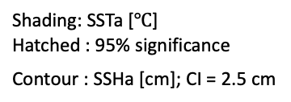
Interannual component: ELT Year – Ocean Driven
Shading: SSTa [$℃$]
Hatched : 95% significance
Contour : SSHa [cm]; CI = 2.5 cm
[W m⁻²]
Ocean-driven
Jan
Jul
Heat flux-driven
Feb
Aug
Ocean-Driven
Mar
Sep
Apr
Source of the positive SSHa:
propagation from the remote ocean or local forcing?
Physical relationship between SSHa and SSTa?
Oct
May
Nov
JAS
OND
Jun
Dec
Notes:
Now, I aim to understand the oceanic processes that led to the occurrence of the heatwave during the developing phase of La Niña.
The SST anomaly from January to December of the ELT Year is shown by shading
The hatched areas represent 95% significance level.
The positive SST anomalies that appears during the El Niño mature phase gradually weakened and became insignificant by June.
However, from July to October, significant signals reappeared, which then disappeared in November and December along with strong upward heat flux.
To examine how the ocean process contributed to the SST anomaly during this period, we also displayed SSH anomaly.
There is SSHa signals that propagating westward.
As it entered the black box, the magnitude gradually intensified and accompanies the warm SST anomalies.
that, some part of the SSHa passes through the Luzon Strait, and others enter into the East China Sea
The SSHa still accompanies the warm SST anomaly even after entering the ECS.
In this section, we first aim to identify the source of the SSHa.
It can be propagated from remote ocean or could be affected by the local forcing.
After that, the physical relationship between the SSHa and SST anomalies will be discussed
이제 어떤 해양 과정에 의해서 La Niña developing phase에 열파가 발생 했는지 이해하고자 한다.
ELT Year 1월부터 12월까지 SSTa를 shading으로 나타내었다.
이 때, 열파가 주로 발생한 영역으로 확대하여 나타 내었다.
hatched area는 95% 유의 수준을 넘는 것을 표현한다.
El Nino mature phase때 heat flux에 의해 형성된 양의 SST anomaly는 그 크기가
점차 줄어들어 6월에는 유의하지 않게 나타났다.
그러나 7월부터 10월까지 다시 유의한 시그널이 나타나는데,
이는 11, 12월에 강한 upward heat flux와 함께 사라진다.
파란색으로 표현한 기간 동안, 유의한 SSTa signal를 만드는데 ocean이 어떻게 기여했는지 살펴보기 위하여 SSHa를 같이 표현 하였다.
이때 동에서 서로 전파되는 SSHa 시그널이 있었는데,
그것이 black box에 들어올 때, 점차 강해지고, SST anomaly도 동반하는 것으로 나타났다.
그 후에 SSHa의 일부는 Luzon strait로 빠져나가고, 일부는 동중국해로 유입 되는데,
유입된 후에도 positive SST anomaly를 동반하는 것으로 나타났다.
이 파트에서 저는 먼저 SSHa의 source를 밝히고자 합니다.
remote ocean에서부터 전파될 수도 있고, local forcing에 의해서 강화될 수도 있을 것입니다.
그 후에 SST와 물리적으로 어떤 상관이 있는지 토의하고자 합니다.

Slide 30
Interannual component: ELT Year – Ocean Driven
Source of the SSHa: propagation from the remote ocean or local forcing?
Qiu and Chen (2010)
RMS SSHa
Shading: SSHa [cm]
STCC
124.5E
NEC
STCC
127.25E
Shading: U_{g}
Contour: T
128.75E
133E
138E
143.5E
Westward propagating
first mode baroclinic Rossby wave
13.0 cm/s
NEC: North Equatorial Current
STCC: Subtropical Counter Current
18.5-21N
1
Notes:
First, Hovmöller diagram for the latitude band marked by the black box is presented.
This diagram reveals the presence of SSH anomaly that propagating from the east.
(Click)
The boxed area corresponds to the region where the Subtropical Countercurrent (STCC) exists.
The eastward current is related to the meridional temperature gradient in the upper ocean
According to Qiu and Chen, the strong baroclinicity in the STCC could leads to the baroclinic instability, resulting in the intense eddy activity.
In this context, westward propagating Rossby wave signal may be the source of the SSHa.
먼저, 앞서 box 친 위도대에서 Hovmoller diagram을 나타내 보았습니다.
동쪽에서부터 전달되는 SSHa가 존재하는 것을 확인할 수 있습니다.
(Click)
Box친 영역은 Subtropical counter current가 존재하는 해역으로,
Qiu and Chen에 따르면 STCC 상층 해양의 meridional temperature gradient에 의해 동으로 향하는 표층 mean current 가 형성되고,
강한 연직 시어와 관련하여 서쪽 전파하는 로스비파가 발달하는 곳입니다.
이러한 맥락에서 baroclinic instability로 인해 발달한 로스비파가 SSHa의 source일 수도 있습니다.

Slide 31
Interannual component: ELT Year – Ocean Driven
Source of the SSHa: propagation from the remote ocean or local forcing?
Qiu and Chen (2010)
RMS SSHa
Shading: SSHa [cm]
Blue: Negative
Red : Positive
Contour : WSCa
CI = 2 x 10⁻⁸ N m⁻³
[10⁻⁸ N m⁻³]
STCC
(MJJAS averaged)
124.5E
NEC
STCC
127.25E
Shading: U_{g}
Contour: T
1.5 Layer reduced gravity model
(Qiu et al., 2002)
128.75E
133E
+ Prop.
g’=0.026 m s⁻²
138E
-10⁻⁷ N m⁻³ ~ 1.84 cm month⁻¹
143.5E
WSC
SSH increase
WSCa explains 68% of SSHa increase during MJJAS!
Westward propagating
first mode baroclinic Rossby wave
13.0 cm/s
Both westward propagating Rossby wave and negative WSC contribute to the positive SSHa
NEC: North Equatorial Current
STCC: Subtropical Counter Current
18.5-21N
Notes:
However, another factor that can force the SSHa is the wind stress curl
The increase of the SSHa seems also related with the negative WSC anomaly
, which existed over a wide area including STCC region
Based on a 1.5-layer reduced gravity model, the contribution of WSC is estimated.
According to this model, 68% of the increase in SSHa from May to September in the boxed region can be explained by the WSCa.
(click)
Therefore, both the westward-propagating Rossby waves and the negative wind stress curl anomaly contribute to the formation of positive SSHa.
그러나, SSHa를 강제할 수 있는 다른 요인에는 wind stress curl anomaly가 있습니다.
box친 영역에 SSHa가 강화되는 동안 지속적인 음의 WSCa가 존재 하였습니다.
이 기간동안 넓은 영역에 음의 WSCa가 존재하는 것을 확인할 수 있습니다.
음의 WSC은 Ekman transport를 통해 SSHa 증가에 기여할 수 있는데요.
1.5 layer reduced gravity model을 이용하면 그 크기를 짐작할 수 있습니다.
해당 식에 따르면, May부터 September까지 Box친 영역에서 SSHa 증가량의 68%는 WSCa로 설명할 수 있었습니다.
따라서 서쪽으로 전파되는 로스비파와 음의 WSC모두 양의 SSHa를 형성하는데 기여한다고 할 수 있겠습니다.

Slide 32
Chelton et al. (2011)
7.2 cm/s @ 20N

Slide 33
Interannual component: ELT Year – Ocean Driven
Physical relationship between SSHa and SSTa?
Shading : Ta
Black Contour : T
Shading: SSHa [cm]
Dashed line:
Mixed layer depth
Gray line: 30m
Sep 124.5E
Contour : WSCa
CI = 2 x 10⁻⁸ N m⁻³
Jun 133E
Jul
124.5E
May 138E
Aug 127E
NEC
STCC
127.25E
Aug
128.75E
Sep
133E
138E
143.5E
Apr 143.5E
Shading: U_{g}
Contour: T
Jul 129E
Latitude
Latitude
Notes:
Now, I would like to discuss the physical relationship between SSHa and SST anomaly.
(Click)
To this end, yz cross-sections intersecting the SSHa core for each month is evaluated.
The x-axis represents latitude, and the y-axis represents depth.
In May and June, significant temperature anomalies is located within the thermocline for some reason.
The black dashed line indicates the mixed layer depth, and we can see that the significant signals exists only in the upper thermocline.
(Click)
However, from July to September, as the mixed layer deepens, significant temperature anomalies are also observed within the mixed layer.
This suggests the that the positive temperature anomaly could be entrained from the thermocline into the mixed layer, and the emerges in the SSTa.
이제 이러한 SSHa와 SSTa 사이의 물리적 상관성에 대하여 논의하고 싶습니다.
(click)
이를 위하여 각 달마다 SSHa core를 가로지르는 yz cross section을 나타내었습니다.
x축은 위도를 y축은 depth를 나타냅니다.
5월과 6월에 유의한 온도 아노말리가 thermocline에 존재하는 것을 확인할 수 있습니다.
검정색 파선으로 표현한 것이 Mixed layer depth인데, 유의한 signal이 mixed layer 내부에는 없고, upper thermocline에만 존재하는 것을 확인할 수 있습니다.
(click)
그러나, 7월부터 9월까지 더 깊어진 Mixed layer와 함께 유의한 온도 아노말리가 Mixed layer 내부에도 존재하는 것을 확인할 수 있습니다.
이는 entrainment에 의해 양의 온도 아노말리가 thermocline에서 mixed layer 내부로 섭입 되었을 가능성을 의미 합니다.

Slide 34

Interannual component: ELT Year – Ocean Driven
Physical relationship between SSHa and SSTa?
Shading : Ta
Black Contour : T
Shading: SSHa [cm]
Dashed line:
Mixed layer depth
Gray line: 30m
Sep 124.5E
Contour : WSCa
CI = 2 x 10⁻⁸ N m⁻³
Jun 133E
Ekman Downwelling?
Green contour : $\frac{∂U}{∂z}$
124.5E
May 138E
Aug 127E
NEC
STCC
127.25E
128.75E
133E
138E
143.5E
Apr 143.5E
Shading: U_{g}
Contour: T
Jul 129E
Latitude
Latitude
Notes:
Then, how can we understand the temperature anomaly in the thermocline?
If baroclinic instability is the cause, it would appear along the strong vertical shear.
To confirm this, the vertical gradient of the zonal current is plotted.
It is evident that areas with strong vertical shear align with the temperature anomalies indicating role of the baroclinic instability
However, Ekman downwelling associated with negative wind stress curl anomalies can also generate positive temperature anomalies within the thermocline.

Slide 35

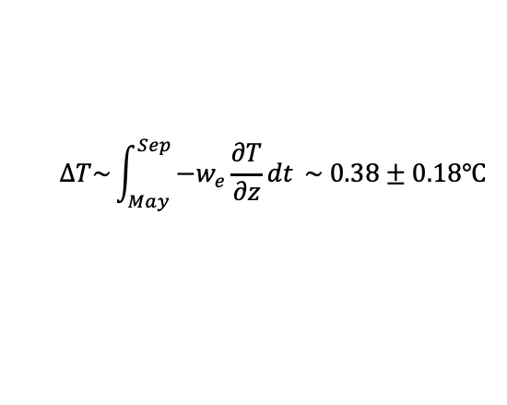


Interannual component: ELT Year – Ocean Driven
MJJAS Averaged
Shading : Ta
Contour : T
[10⁻⁸ N m⁻³]
Black Line:
Mixed layer depth (MLD)
Dashed line:
Climatological MLD
Ekman downwelling
$$w_{e}= \frac{1}{ρf}∇×\overset{⃑}{τ }\text{= −}\text{5.8 }±\text{ 2.8} × \text{10}\text{−7}\text{m} \text{s}\text{−1}$$
Temperature increase
$$∆T\sim \int_{May}^{Sep}{{−w}_{e}\frac{∂T}{∂z}dt }\sim 0.38±0.18℃$$
$$\left(\frac{∂T}{∂z}\sim \frac{10℃}{200m}\right)$$
Month
$58±28\%$ @ 100m
Negative WSCa and Rossby wave propagation lead to the positive SSH and temperature anomaly
Deepening of mixed layer contributes to the emergence of temperature anomaly from subsurface to the surface
Notes:
이를 정량화 하기 위해 박스 안에서 ekman downwelling과, 그로 인한 온도 변화를 estimate해 보았다.
May부터 September까지 Nagative WSCa는 평균적으로 10의 -8승 m/s 정도의 order로 매우 작은

Slide 36
Interannual component: ELT Year – Ocean Driven
Heat flux driven
Ocean driven
SSTa
Ta @ Mixed Layer bottom
Core T – Mixed Layer T
JAS
Jun
OND
Potential condition for the entrainment
Shading : Ta
Contour : T
1. Core temperature anomaly in the thermocline (MLD < T core depth < MLD+100m)
2. Mixed layer deepening
3. Temperature anomaly in the subsurface emerges to the surface
Black Line:
Mixed layer depth (MLD)
Dashed line:
Climatological MLD
The region that satisfies all three conditions is represented as a dotted area in (b) and (e)

Slide 37
Interannual component: ELT Year – Ocean Driven
Source of the negative WSCa?
Relationship with El Niño to La Niña transition?
WNPSH: Western North Pacific Subtropical High
WNPAC: Western North Pacific Anticyclone
MJJAS
5880m of 500hPa GPH: boundary of WNPSH
May
Chen et al. (2016)
Jun
Enhance trade wind ->Evaporation ->cold SST ->
depress convection->high pressure anomaly->wave propagation
Jul
[m]
Warm IO -> activate Kelvin wave ->
Ekman divergence
Westward extension of the WNPSH in ELT Year!
Aug
Sep
Boundary of the WNPSH (5880m)
The WNPSH is stronger, more prolonged, and extends further west in the ELT year than in a normal year.
The WNPSH is maintained by the combined effect of Indian Ocean warming and Eastern Pacific cooling via Kelvin and Rossby wave responses (Chen et al., 2016).
The relationship between ENSO transition and oceanic Rossby wave propagation needs to be further studied.

Slide 38
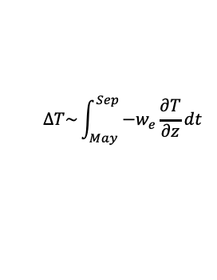

Interannual component: ELT Year
Mature Phase of El Niño (ONDJ)
Developing Phase of La Niña (MJJAS)
Shading: SAT [℃]
Contour: SLP [hPa]
Vector: UV10
Shading: SSHa [cm]
Contour : WSCa
CI = 2 x 10⁻⁸ N m⁻³
124.5E
127.25E
Kuroshio Anticyclone
(Son et al., 2014)
128.75E
133E
Ekman downwelling
$$w_{e}= \frac{1}{ρf}∇×\overset{⃑}{τ }$$
138E
Philippine Sea Anticyclone
(Wang et al., 2000)
143.5E
Temperature increase
$$∆T\sim \int_{May}^{Sep}{{−w}_{e}\frac{∂T}{∂z}dt }$$
The Kuroshio and Philippine Sea Anticyclone supplies the warm and moist southerly winds to East Asia
Negative WSCa and Rossby wave propagation
→ positive SSH and temperature anomaly
Deepening of mixed layer
→ emergence of the subsurface temperature to the surface
Distinct pathways of the ENSO teleconnection!
Notes:
During the El Niño mature phase, there is an anticyclonic circulation to the east of Japan,
which supplies the warm and moist air to the East Asia
This anticyclone is named the 'Kuroshio anticyclone’ by the Son et al. 2014
can be explained by atmospheric teleconnection related to the tropical convective activity.
And, during the La Nina developing phase, there is a positive SSHa over the WNP Ocean.
related to this anomaly, the intensity of the Kuroshio Current was also stronger than normal year, as shown by this red line.
This relationship with ENSO is consistent with previous studies.
This two periods illustrate the distinct pathways of the ENSO teleconnection,
Atmospheric Bridge and Oceanic Tunnel

