Slide 1
Decadal SST Variability in the East Asian Marginal Seas
Warming, Hiatus, and Reacceleration
Hyoung-Ju Park, Yong-Sun Kim, Hanna Na
2025-09-25

Slide 2
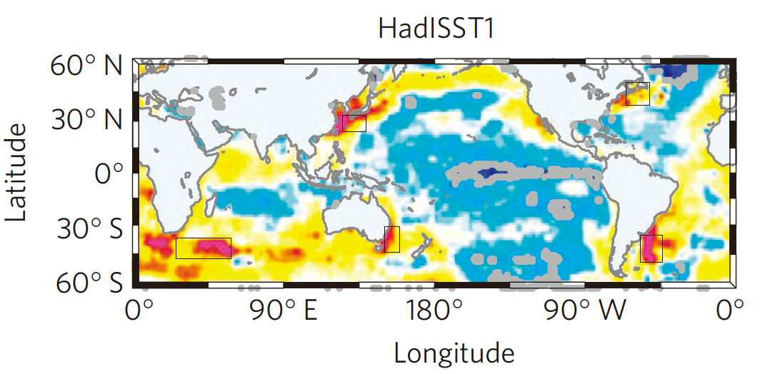
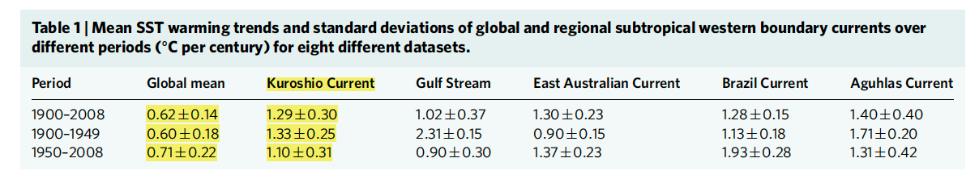
Western Boundary Currents warm faster than global mean (Wu et al., 2012)
1900–2008 HadISST1: WBC regions warm ~2× global mean
Kuroshio region ≈ 1.3 °C/century vs global 0.62 ± 0.14 °C/century
Key takeaway: East Asia lies in a WBC warming hotspot

Slide 3
East Asian marginal seas: rapid acceleration since 1950 (Wang et al., 2023)
Since 1950: 0.10–0.14 °C/decade (SST trend)
Since 1982: 0.14–0.16 °C/decade (SST trend)
Decadal breakdown: 1979–1998 +0.31; 1998–2011 −0.27; 2011–2019 +0.45 °C/decade

Slide 4
Decadal variability and drivers
Interplay of EAWM, WNPSH, PDO/IPO/NPGO, and Kuroshio heat transport
PDO interpretation depends on dataset/EOF choice (Wen et al., 2014)
Hiatus: tropical Pacific cooling dominates; extremes still intensify (Li 2019/2021; Wang 2019/2020)

Slide 5
Research Question
What mechanisms drove the rapid SST increase during the reacceleration (2011–2022)?
Approach: separate interannual vs decadal; conduct mixed-layer heat-budget; evaluate closure (R²)

Slide 6
Data and Methods
OISSTv2 (0.25°, daily, 1982–2022): SST
ERA5 (0.25°, hourly→monthly, 1982–2022): atmosphere & surface heat flux
GLORYS12v1 (1/12°, daily, 1993–2022): ocean currents/SSH/MLD
Mixed-layer heat budget: Ṫm = Diabatic − Advection − Entrainment + Hori.Diff + Vert.Diff
Validation: budget closure via R²(Ṫm, RHS) and term-by-term contributions

